Slide 1
Lecture 4: Tourism and Events
We are just looking at this for one week, a more detailed coverage is in the subject THS2HME Hallmark Events

Slide 2
Who is a tourist?
Warwick buys a ticket to the World Cup Final at the MCG and walks there from his house.
Doris is staying at her beach house at Venus Bay. She attends the Venus Bay Crayfish Festival.
Boris is an international student at La Trobe. With a group of friends from Menzies College he goes into town for the Moomba Festival.
Vic visits the Collingwood Farmers Market and buys an organic ham which he takes with him for Christmas with his family in the country.

Slide 3
Who is a tourist?
Harry catches an early plane to Sydney for a business meeting. He returns home that night. In contrast, Ron participates via video-conferencing.
Warwick buys a ticket to the World Cup for his cousin, who is visiting from England.
Geoffrey celebrates his anniversary with a package of a 5 star hotel, dinner and performance of Mama Mia.
Michelle travels to Las Vegas to compete in the U14 skateboarding championship. Her parents also go to support her.

Slide 4
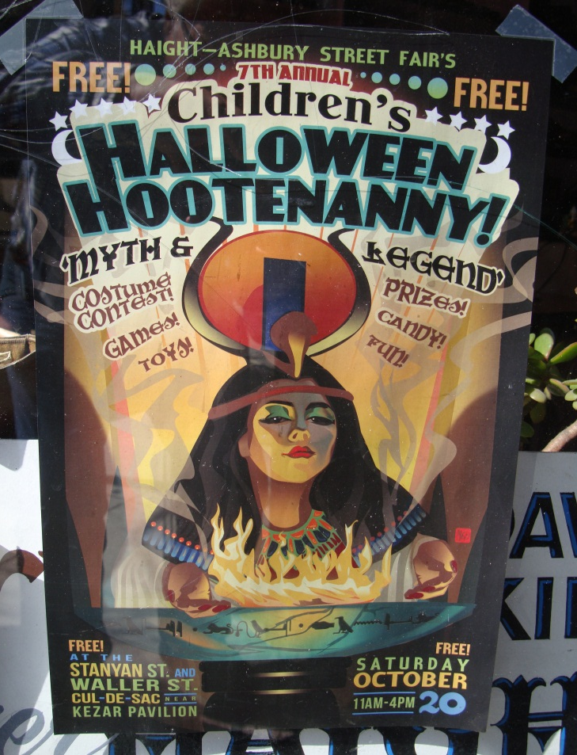
Complexity
Not all events are aimed at tourists
How do we define and measure tourists?
Numbers or impacts?
Dollar value?
Incidental tourism?

Slide 5
Why is Tourism Important 1?
Event Organisers seek tourists as part of their marketing mix.
Just one segment, a way to increase attendees/ sales
Still get locals
http://www.youtube.com/watch?v=Dek9F2lkMQA
http://www.youtube.com/watch?v=ZH-4d0KNMZ4
http://www.youtube.com/watch?v=Kpa_wE3gYfk

Slide 6
Why is Tourism Important 2?
Justifies support from governments, marketing organisations etc
May be funding
Or marketing
PUBLIC FUNDING, so needs to be an economic benefit to the community
Note difference between profitability (for organiser) and economic impact (for society)

Slide 7
Recap from Week 1
MEGA EVENT
HALLMARK EVENT
Competitive bid
Owned by central body
Staged at different places
Eg Olympics
Large scale, one-off expenditure
High risk?
Place develops and owns the event
Repeated, eg annual
May be part of a calendar or portfolio
Brands the place, not the event
Spreads risk?

Slide 8
http://www.youtube.com/watch?v=xeeAbZhos8Y
http://www.youtube.com/watch?v=tLK0dnwnYUE

Slide 9

Longer Term – Tourism Legacy
Event is the opportunity to promote tourism AFTER the event
Create an image
Raise awareness

Slide 10
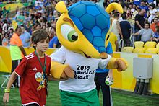
https://www.youtube.com/watch?v=F2h6jDoabLE

