Slide 1
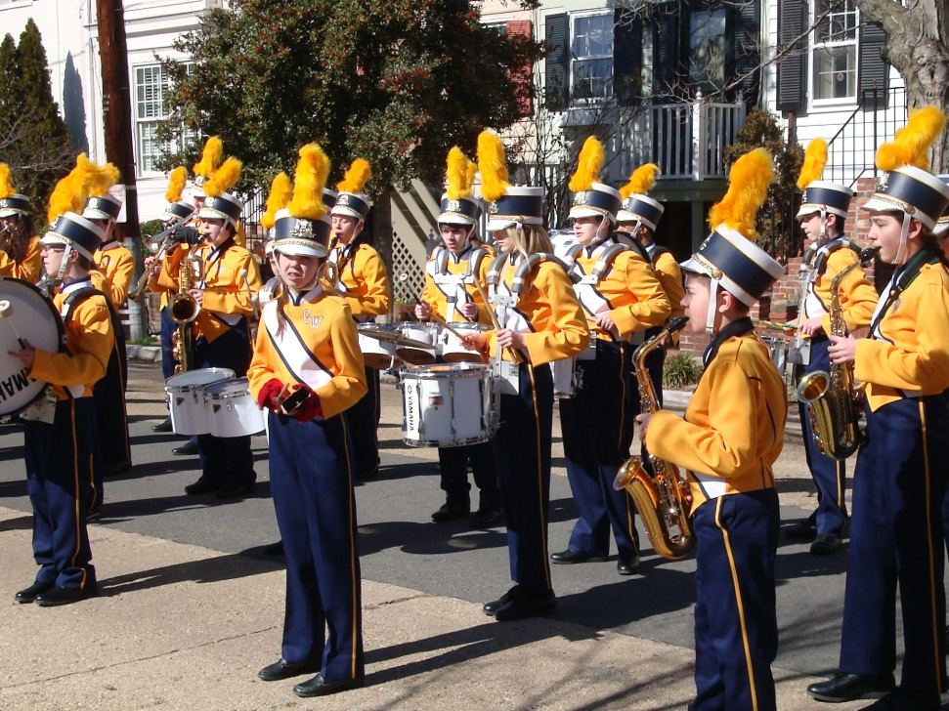
THS1FEM Lecture 3
The Event Experience - Meanings
Organisers last week
Audience & Participants this week

Slide 2
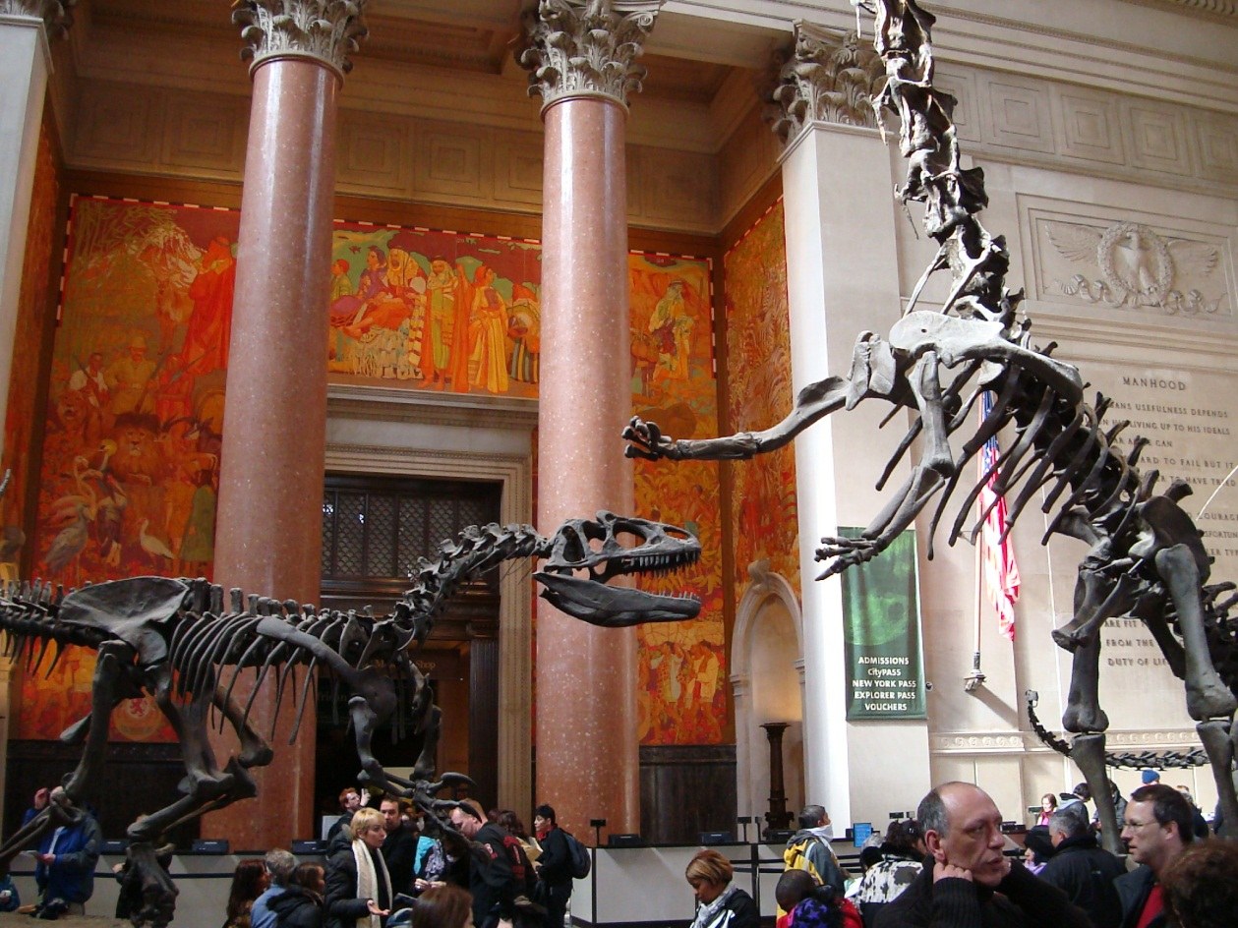
Organisers want to achieve OBJECTIVES
Audience, participants and other stakeholders find MEANING

Slide 3
Politics and events
http://www.youtube.com/watch?v=qck5arjMGBg

Slide 4
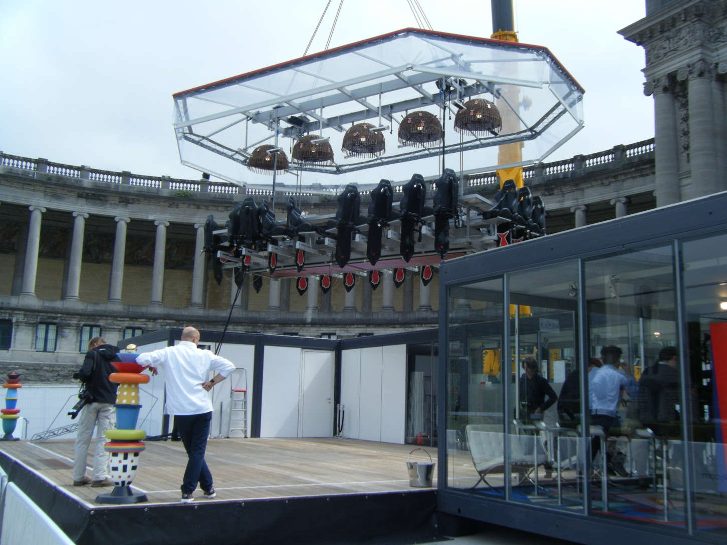
Event Experience/ Fandom

Slide 5
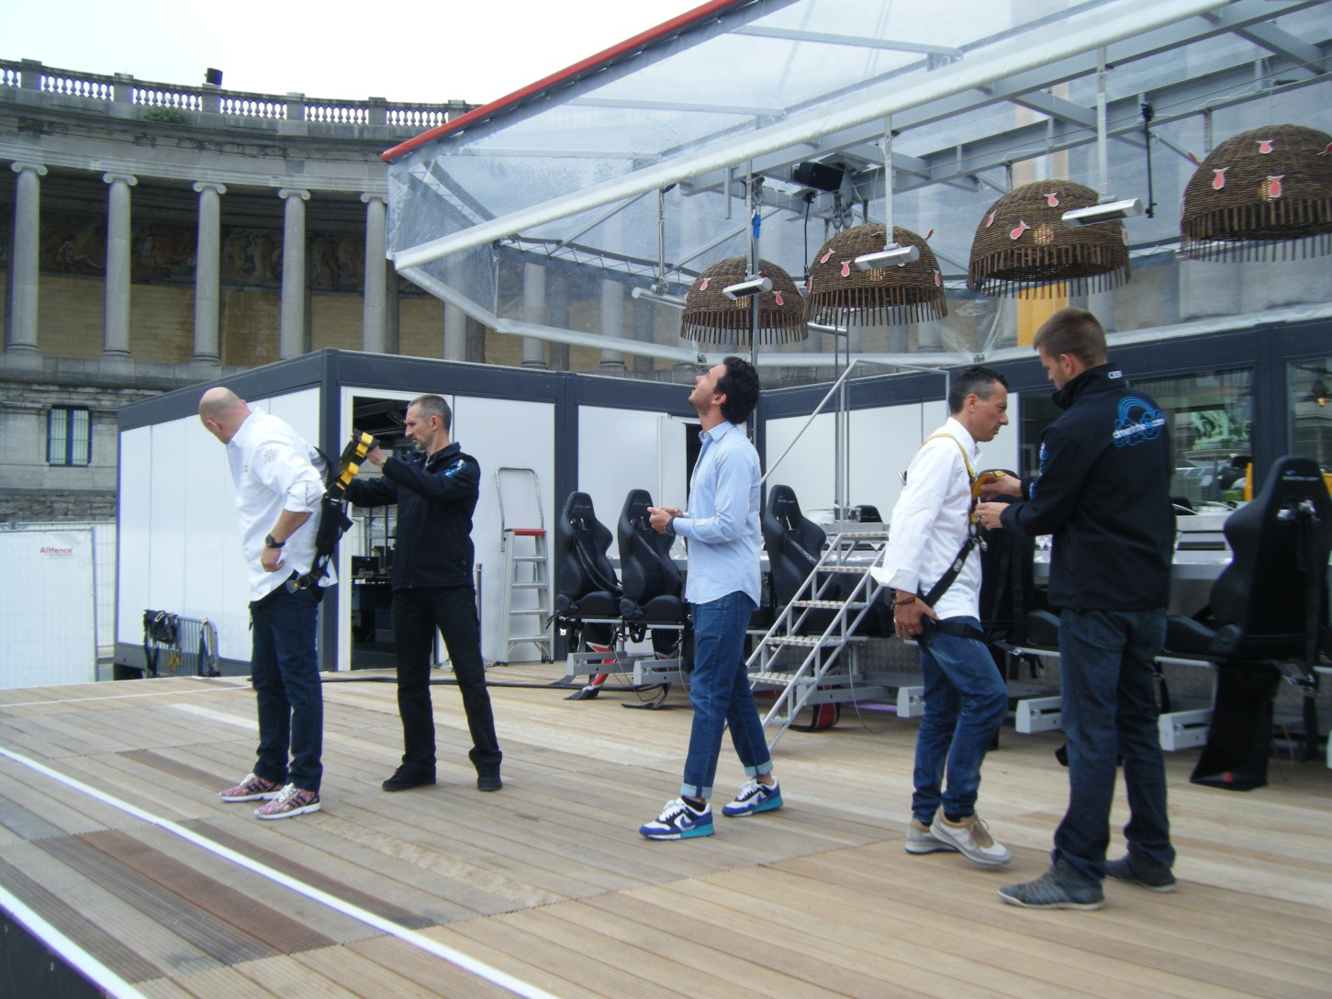
Dinner in the Sky -Brussels

Slide 6
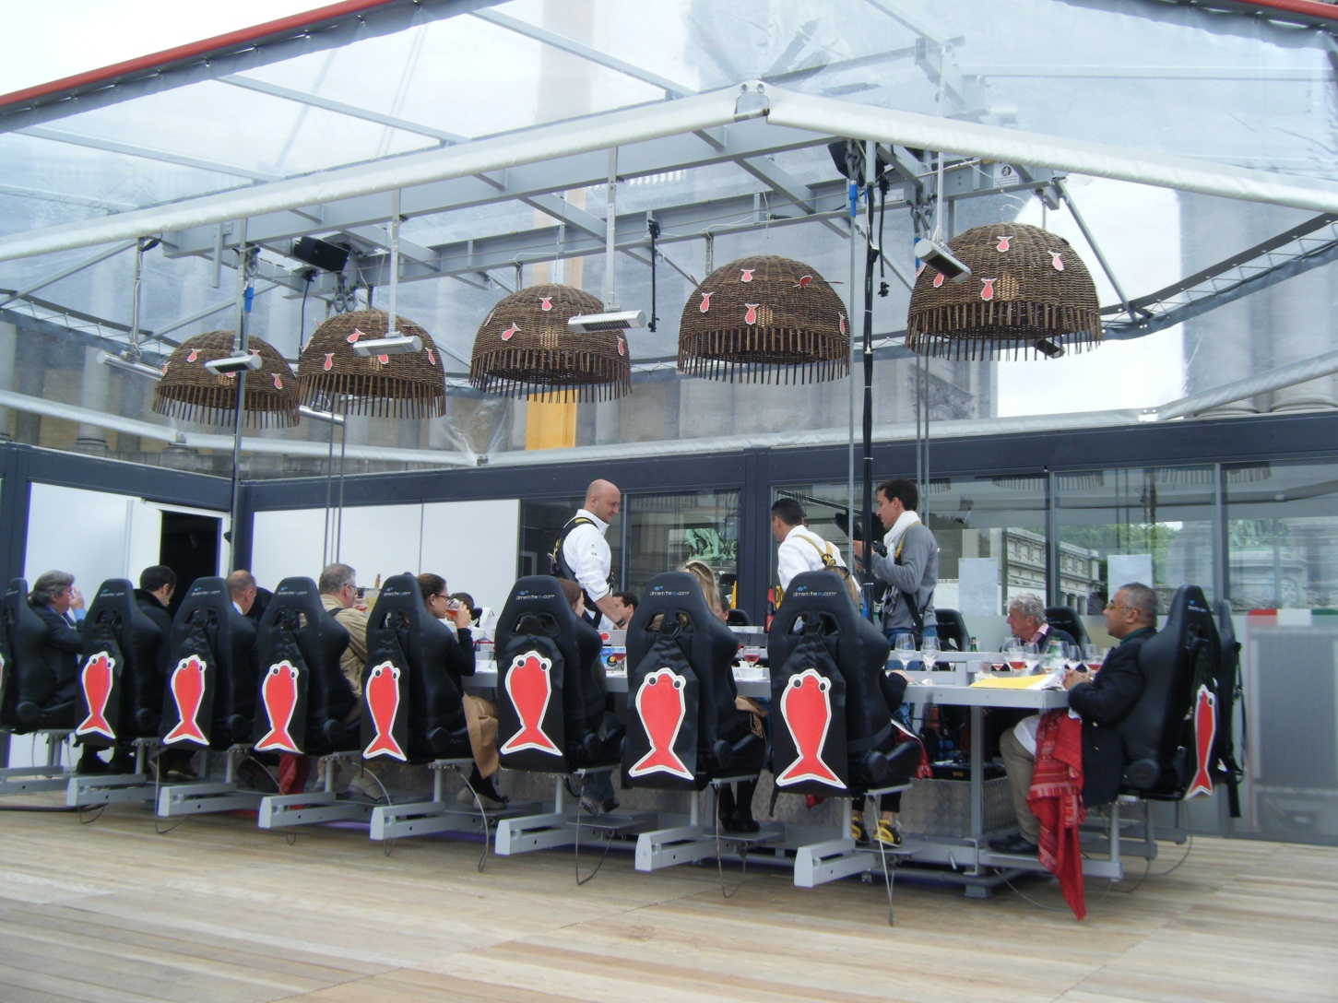
A ‘famil’ event

Slide 7
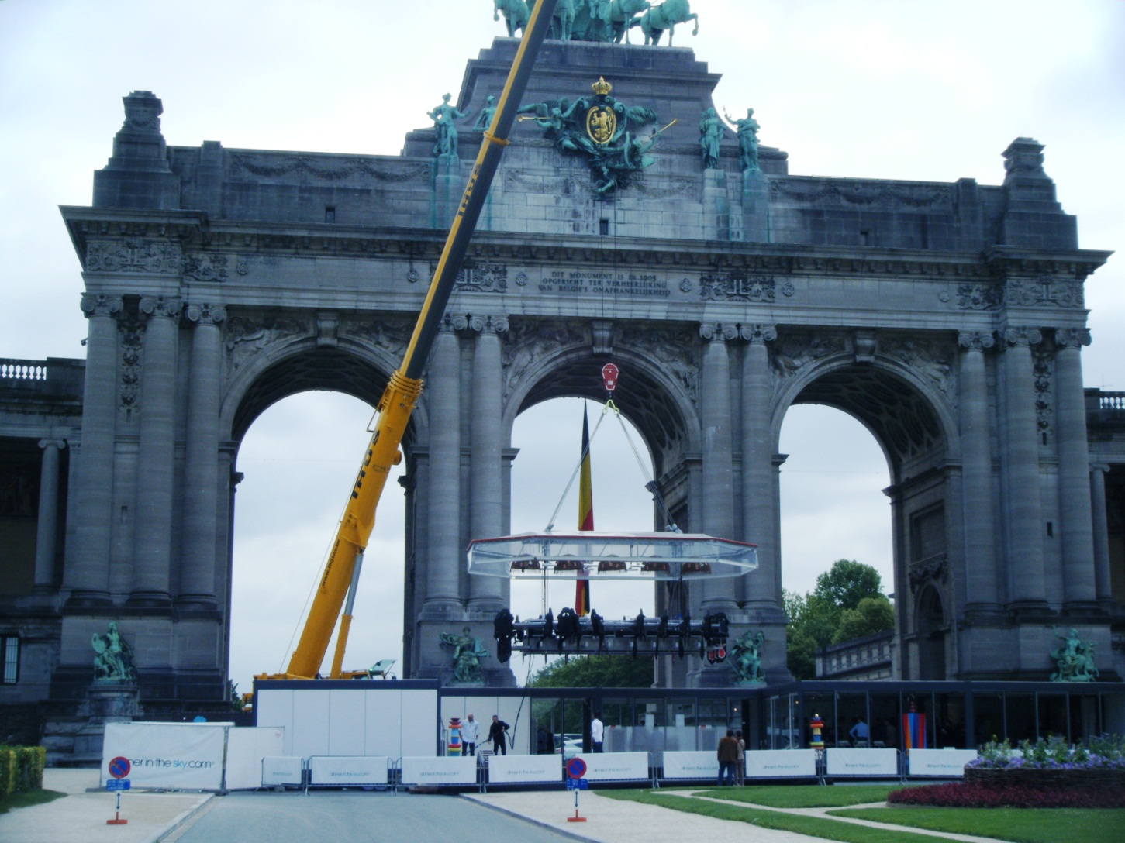
http://www.dinnerinthesky.com/dits_dinner/index.php

Slide 8
Rituals and Inversion/ Reversal
In the annual Feast of Fools at Christmas, every rite and article of the Church no matter how sacred was celebrated in mockery. A lord of the revels, was elected from the inferior clergy … whose day it was to turn everything topsy-turvy.
They installed their lord as Pope or Bishop or Abbot of Fools in a ceremony of head-shaving accompanied by bawdy talk and lewd acts; dressed him in vestments turned inside out; played dice on the altar and ate black puddings and sausages while mass was celebrated in nonsensical gibberish …
wearing beast masks and dressed as women or minstrels … [then] all rush violently from the church to parade through the town, drawing the dominus in a cart from which he issues mock indulgences while his followers hiss, cackle, jeer, and gesticulate … Naked men haul carts of manure which they throw at the populace. Drinking bouts and dances accompany the procession (Tuchman 1978: 32-33).

Slide 9
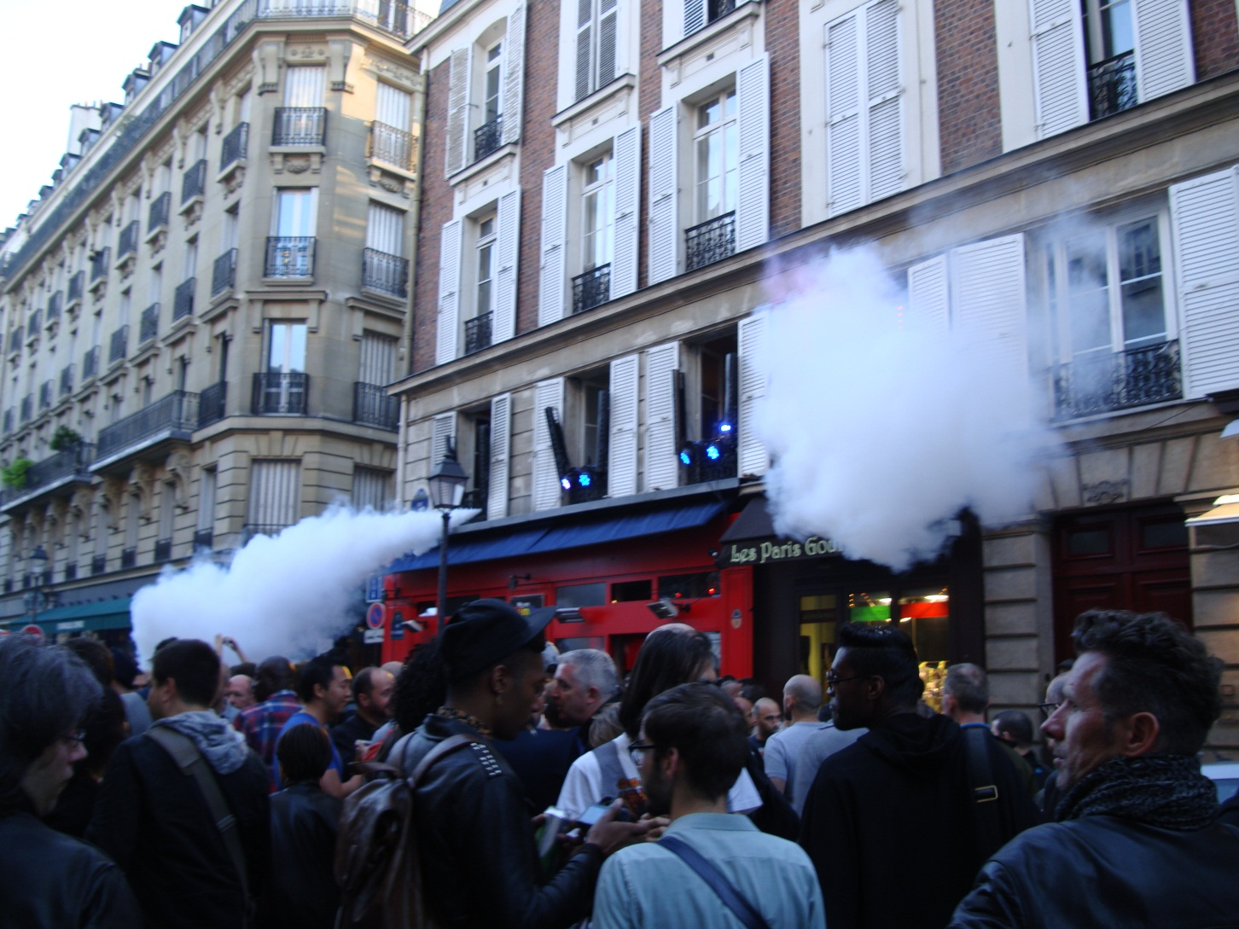
CARNIVALESQUE

Slide 10
RITUAL STRUCTURE (Falassi, 1987):
Common rites or components of events
1. Valorisation. Time and space are claimed for the event through an opening ceremony. The event is now marked as symbolically different from normal time and space.
2. Purification. There are ceremonies to cleanse and safeguard the festival and its participants.
3. Passage. Rituals which mark transition from one stage of life to another, particularly for young people.
4. Reversal. Normal behaviours and roles are reversed. The illicit may be respectable. A common form is the coronation of a 'fool' as the king of the festival.
5. Conspicuous Display. The most valued objects are displayed, for example, religious relics are paraded.
6. Conspicuous Consumption. Abundant, even wasteful, consumption, particularly of food and drink.
7. Dramas. Treasured stories are told through dramatic or musical performances.
8.Exchange. Symbolic exchanges of money, valuables or tokens. The wealthy might distribute gifts and money to the poor.
9. Competition. Typically games and sporting contests, often between rival groups. Such games may be a substitute for armed conflict.
10. Devalorisation. A closing ceremony marks the return to normal time and space, perhaps with a promise of a future repeat of the festival.

Slide 11
Key Concepts
LIMINALITY – Transition of Participant occurring within the event (SOCIOLOGY)
EXISTENTIAL AUTHENTICITY – Experience feels real and makes participant feel better/ more real (TOURISM)
CO-CREATION – Participants are actively engaged and ‘make’ the experience (MARKETING)
SERIOUS LEISURE – a ‘career’ in a pastime – building skills and experience (LEISURE)

Slide 12
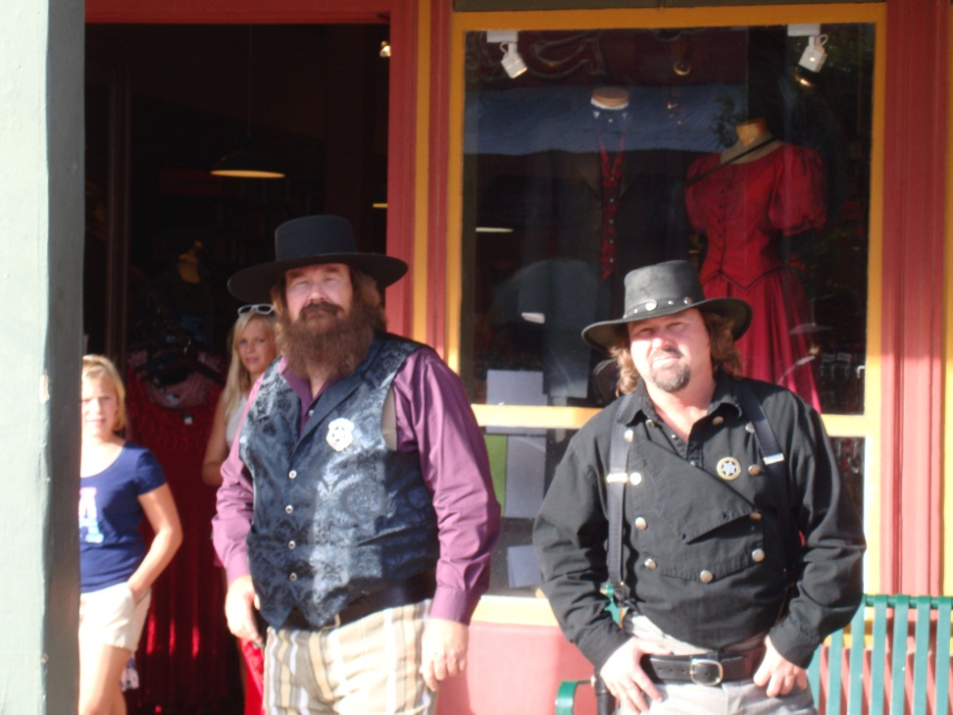
Helldorado Days, Tombstone
Held annually, weekend event
Started in 1929, as 50th anniversary of town
Focus on Gunfight at the OK Corral (1881) & Wyatt Earp
Imagery influenced by film Tombstone (1991)
http://www.youtube.com/watch?v=XTWYKf5hXIg
Carnivalesque/ Costuming/ Masking

Slide 13
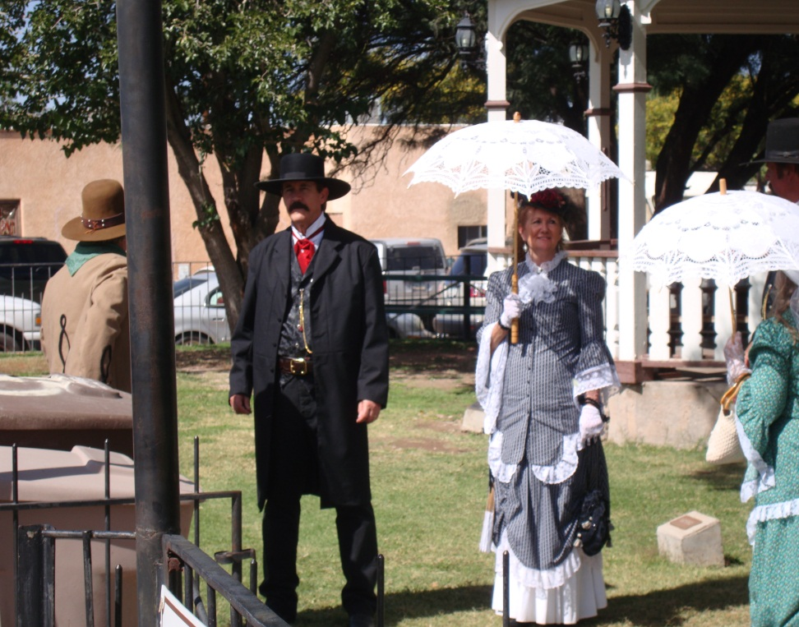
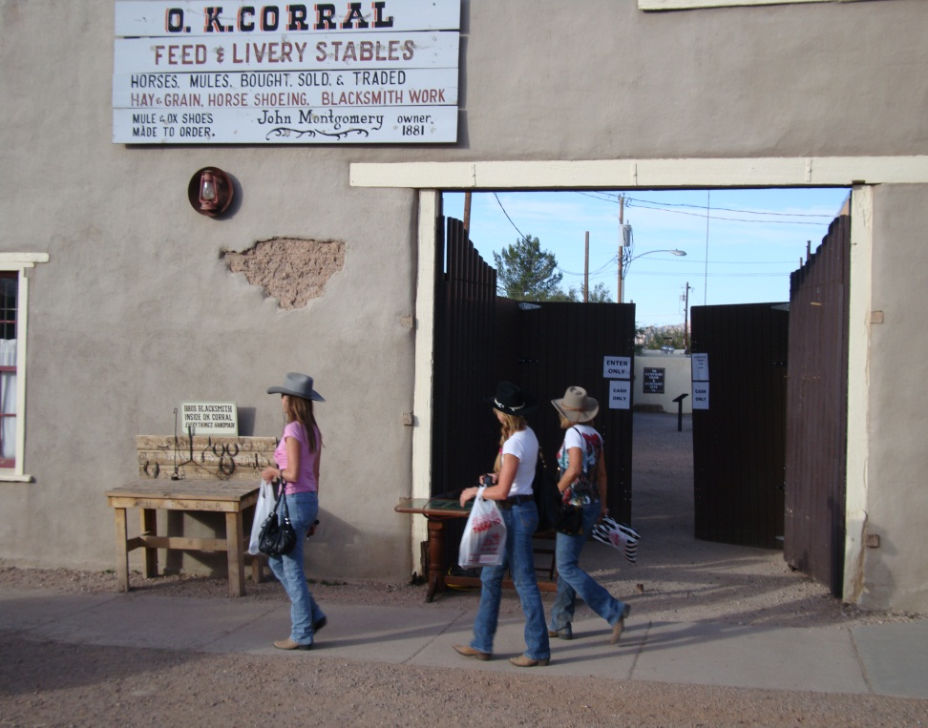

Slide 14
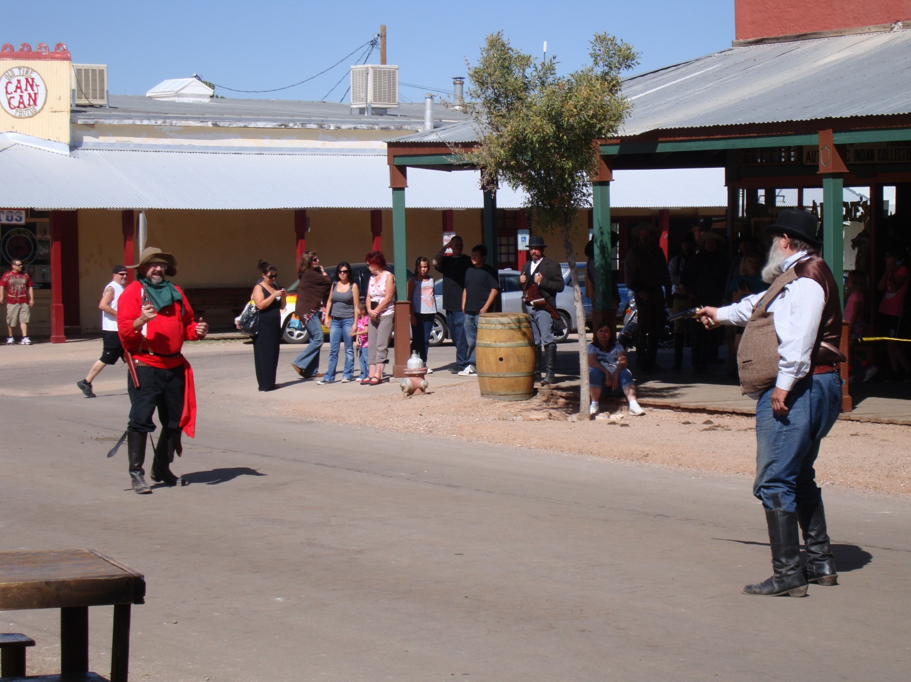
Skits – short performances on Main St

Slide 15
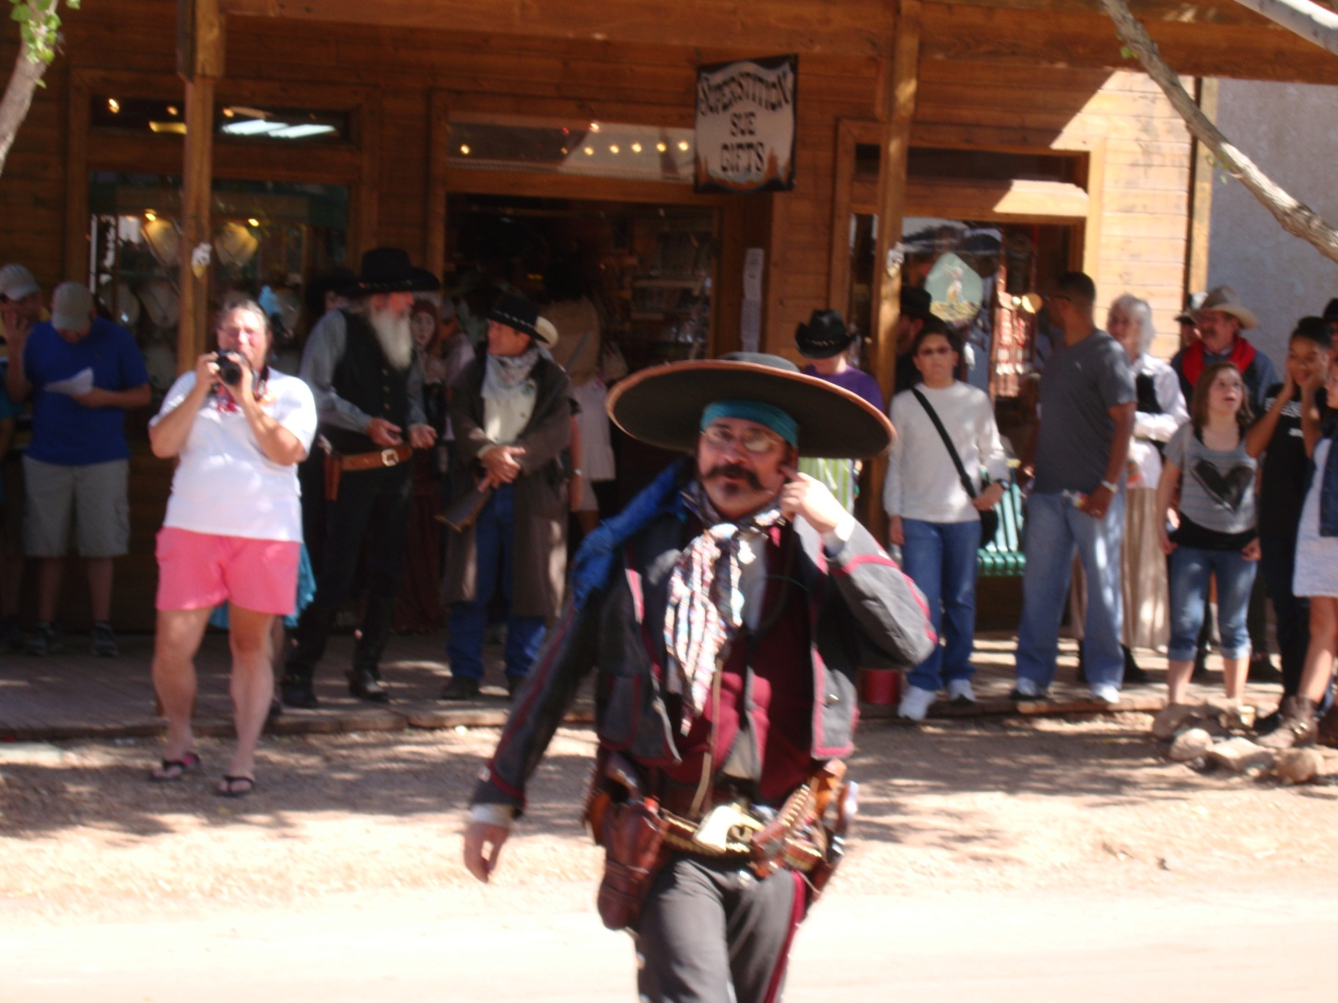
Role Play

Slide 16
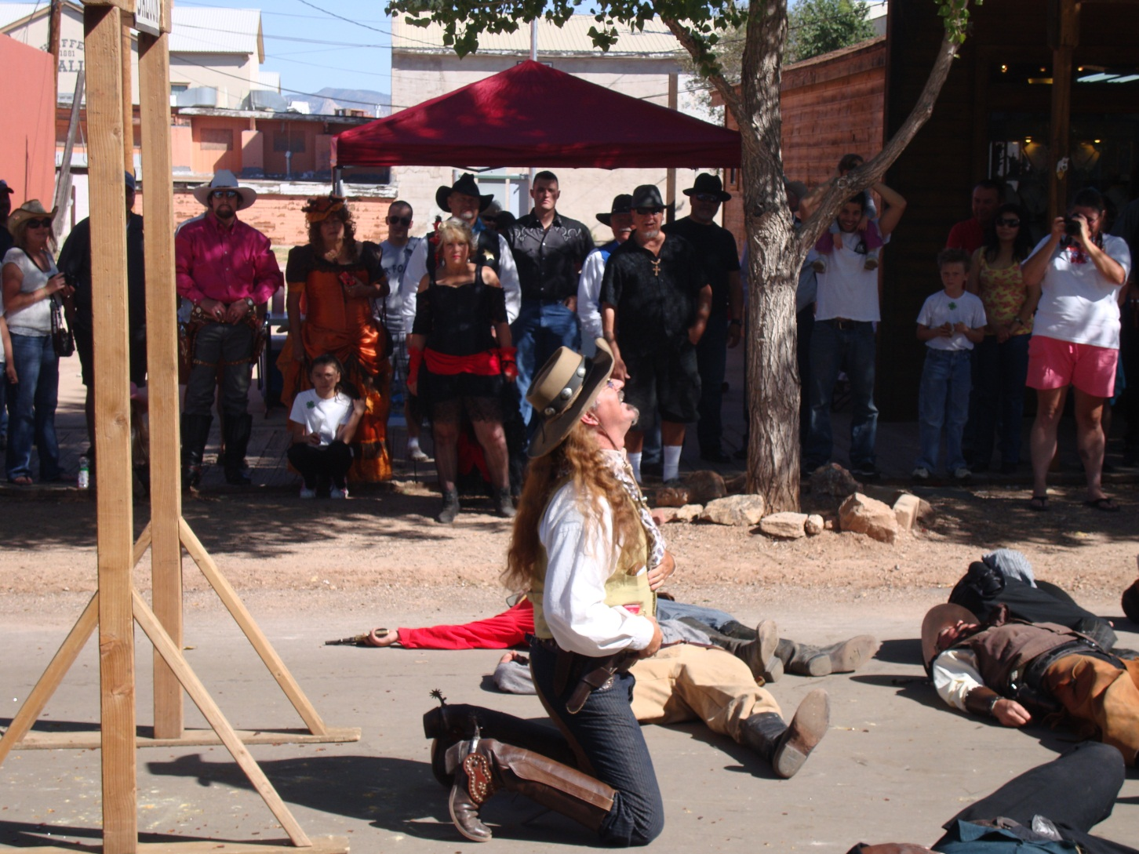

Slide 17
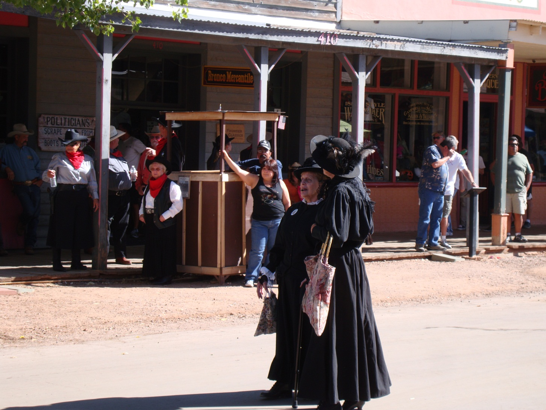
Feminine – The Widows

Slide 18
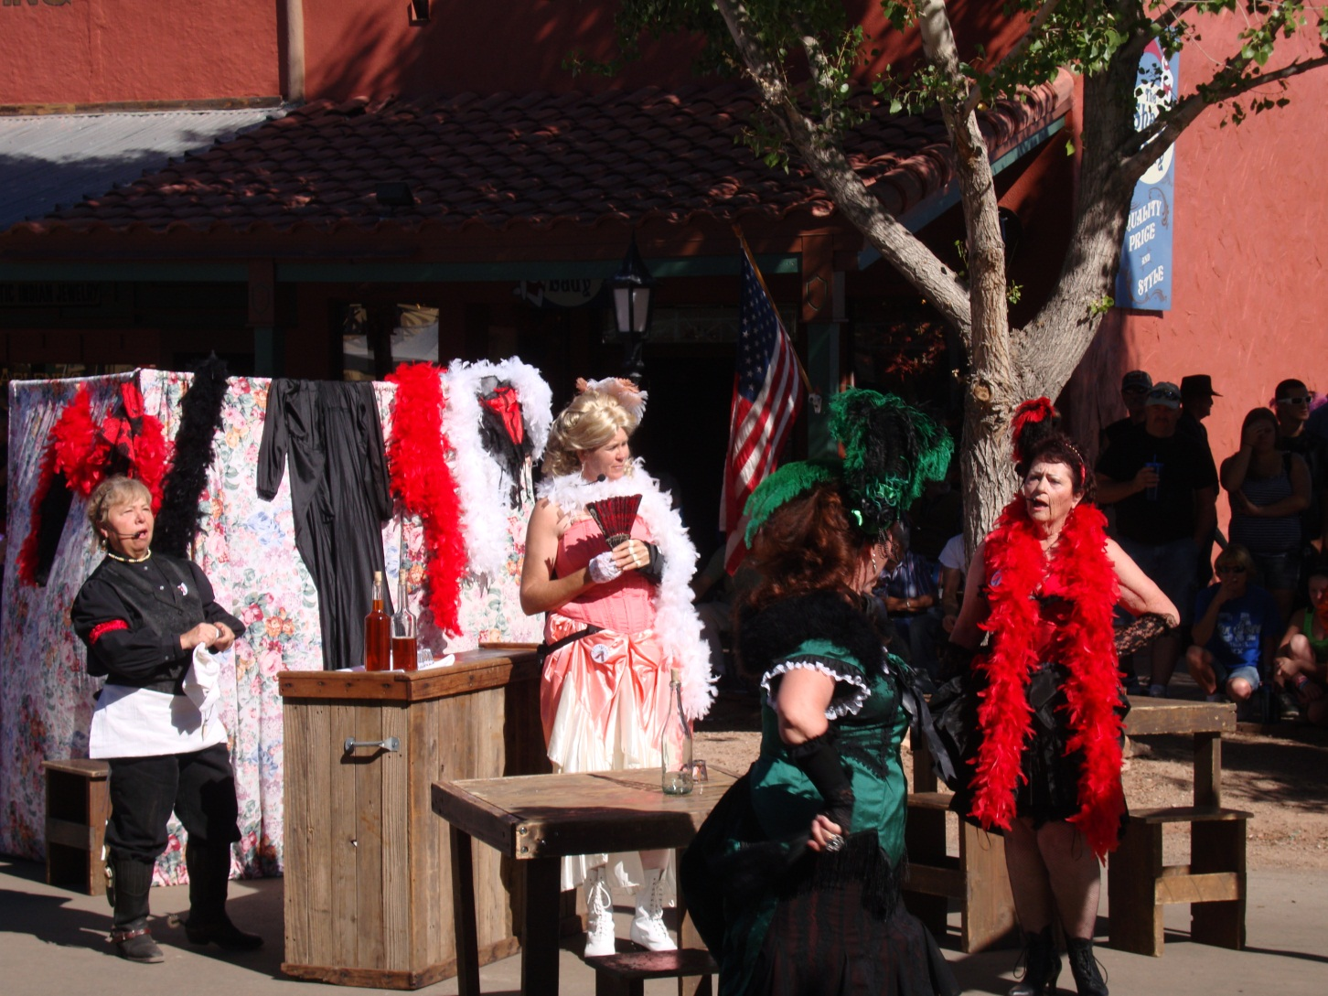
Transformation to Saloon Girls

Slide 19
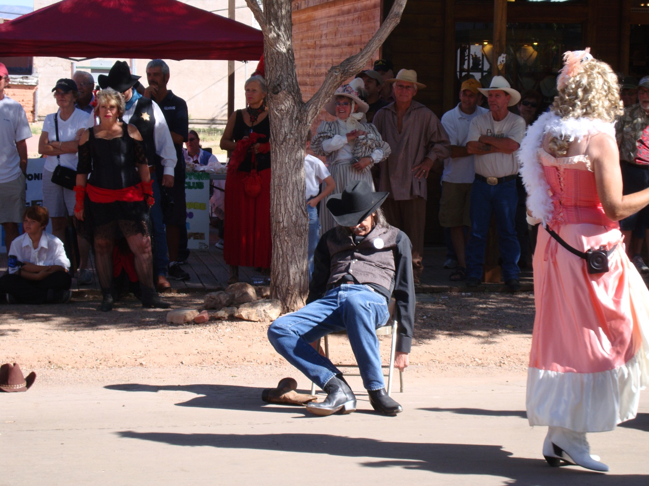
Changing Relationships

Slide 20
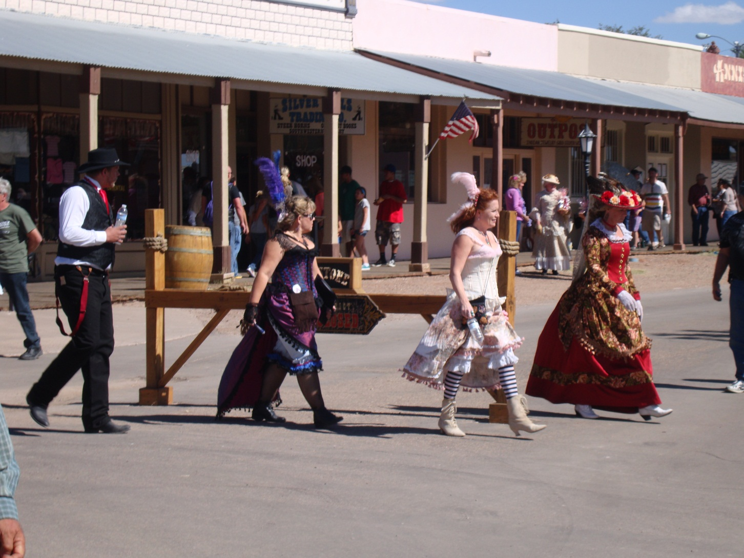
La Passeggiata

Slide 21
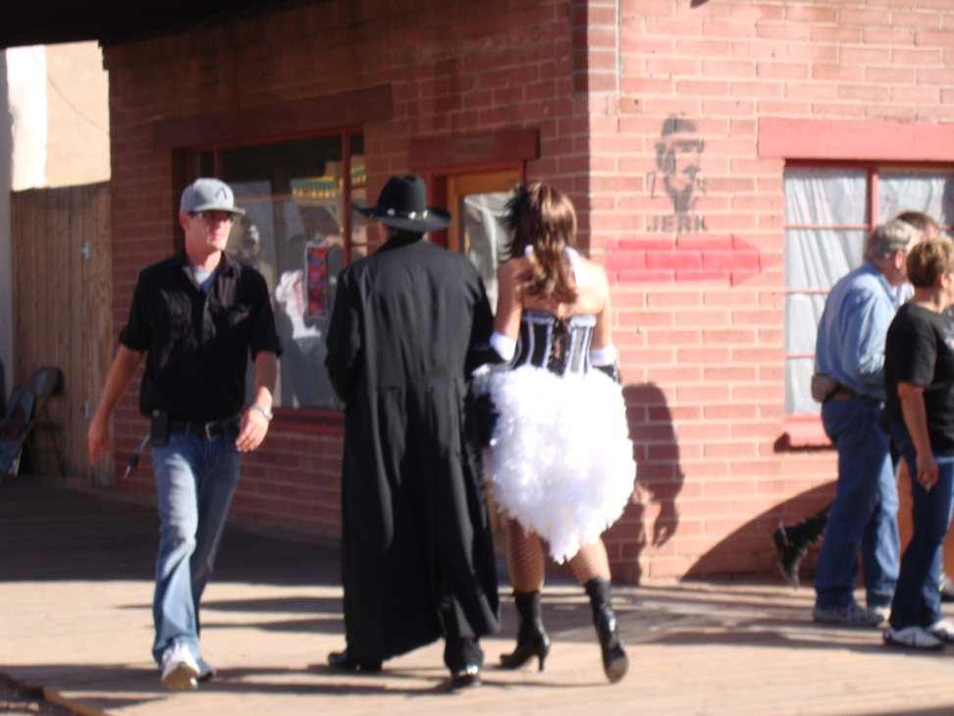
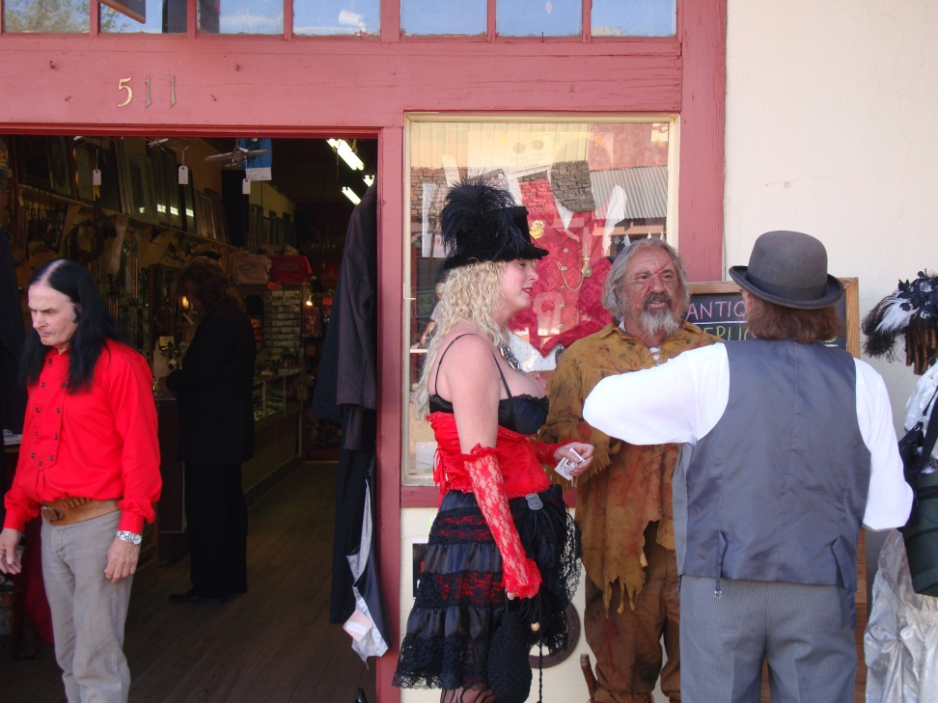

Slide 22
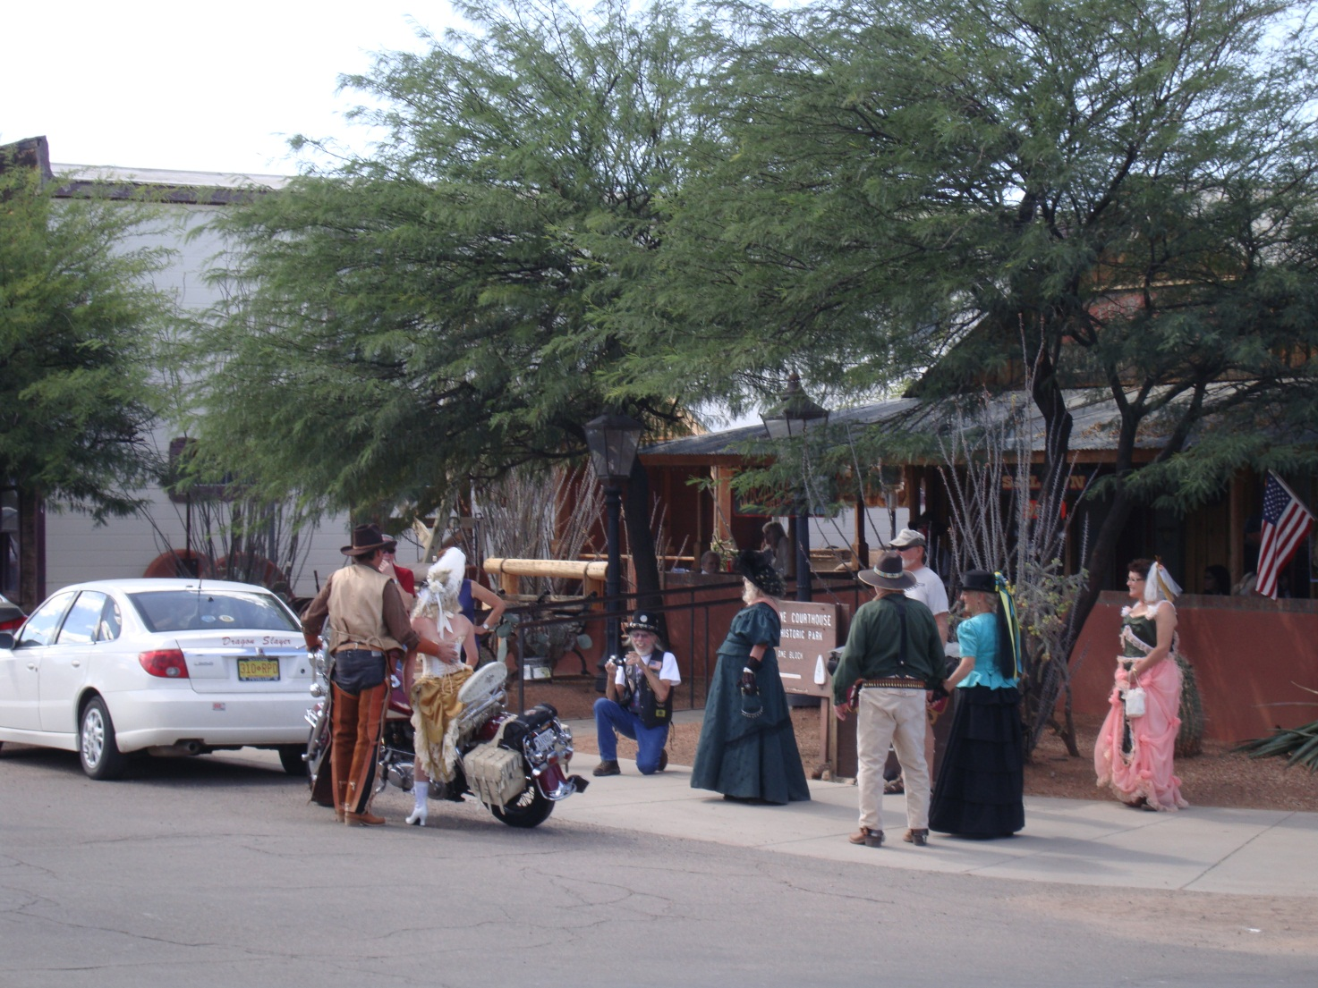

Slide 23
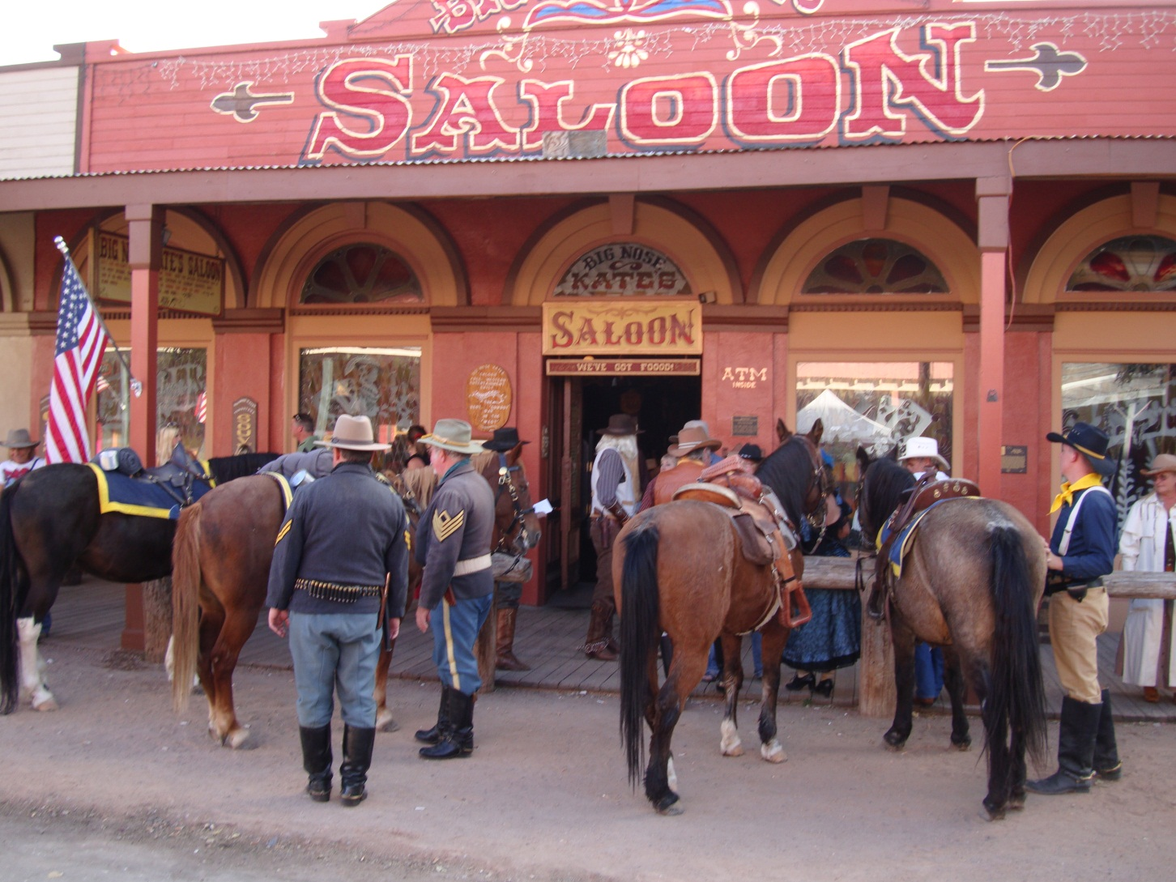
Concept of Serious Leisure for Participants

