Slide 1
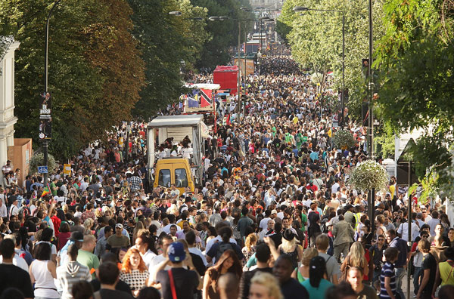
Lecture 2: The Event Concept

Slide 2
Let’s start with National Days
https://www.youtube.com/watch?v=qzQyE7MlAx0

Slide 3
Opening Ceremonies
http://www.youtube.com/watch?v=JyhXIxkXUhg

Slide 4
KEY TOPICS TODAY
What is an Event Concept?
Why is it Important?
Distinguish between roles/ importance of:
  Event Organising Committee
  Event Organiser/ Director
  Stakeholders
  External Service Providers (eg Venue)

Slide 5
EVENT CONCEPT
Basic or core idea for the event
Underpins creation and all strategy flows from this
Intersection of:
The Theme. WHAT the event is about
The Structure. HOW the event is run
The Objectives. WHY the event is being staged

Slide 6
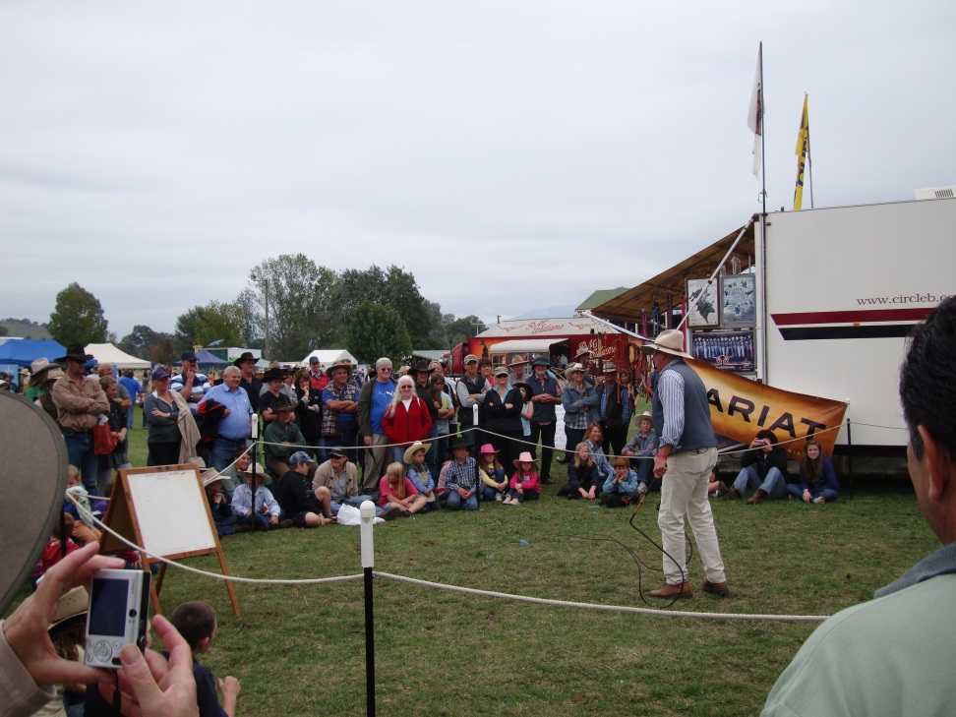
SOME COMMON OBJECTIVES
Attract tourists
Entertain local people
Get the community together
Launch a new product
Engage with customers
Impart some key health messages
Promote a special interest

Slide 7
Some Examples
https://www.youtube.com/watch?v=rK03SUGVDXA
https://www.youtube.com/watch?v=C0DMzx5i7Q0

Slide 8
Organising Structure
Event Organising Committee – local people/ businesses/ council
Event Director – paid employee
Venues – main street, council parks, private property
Stakeholders – many groups, societies and individuals

Slide 9
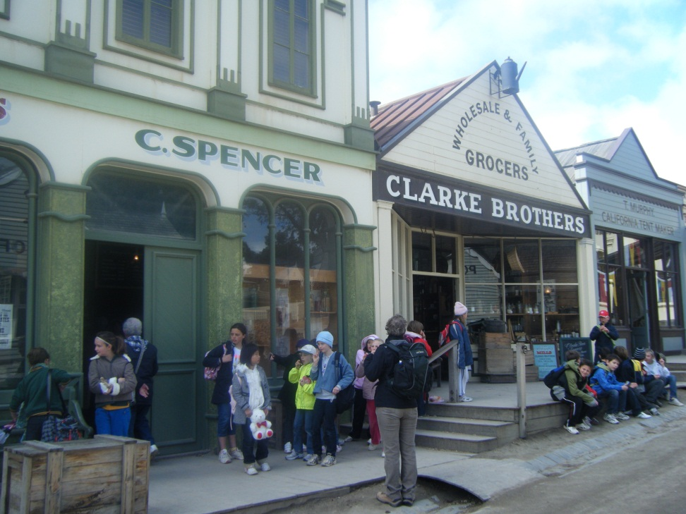
Roundtable Model
Case study of 150th Anniversary of the Victorian Gold Rushes (2001)
Community Engagement
Committee & Paid Organiser
Won Tourism Victoria Award

Slide 10
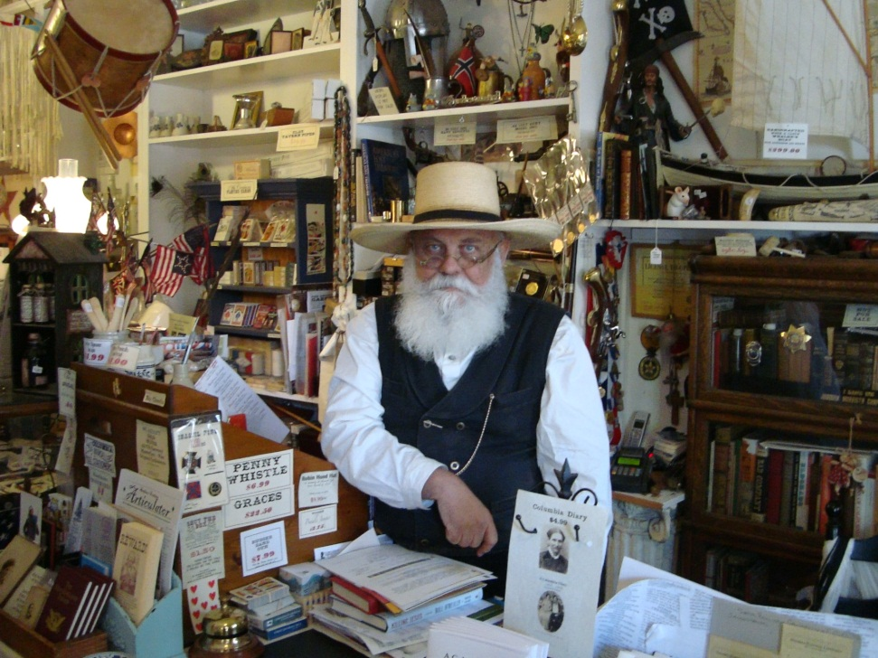
150th Anniversary of Gold
52 stakeholder groups
13 councils
7 government departments
Fight over where Gold found first
Change of government during planning
Seeding funding of $1.7m

