Slide 1
MGT 811 Contemporary Management Capabilities
Week Eight, Critical Thinking
Stephen Rodwell srodwell@icms.edu.au

Slide 2
Outline for today
What is critical thinking
Benefits of critical thinking
Exploring critical thinking
Blooms Taxonomy
Becoming a critical thinker
Green and Red thinking
Activity

Slide 3
Critical thinking begins when you question beyond what is obvious
You want to know more:
How something happens,
Why it happens, and further
what will happen if something changes.
Critical thinking therefore requires a conscious level of processing, analysis, creation and evaluation of possible outcomes, and reflection.

Slide 4
If you’re a critical thinker, you think.
….No surprise….
You are willing to examine your beliefs, assumptions, and opinions and weigh them against facts. You are willing to evaluate the generalizations and stereotypes you have created and are open to change, if necessary.

Slide 5
Critical thinkers listen carefully.
If you’re a critical thinker, you listen carefully to what others are saying and are able to give feedback. You are able to suspend judgment until all the facts have been gathered and considered.

Slide 6
Critical thinkers look for evidence….
If you’re a critical thinker, you look for evidence to support your assumptions and beliefs. You examine problems closely and are able to reject information that is incorrect or irrelevant.

Slide 7
Therefore…through experience, as a critical thinker, you will:
Identify information that is being put forth as an argument and break it down to its basic components for evaluation.
Construct alternative interpretations
Be willing to explore diverse perspectives
Be willing to change personal assumptions when presented with valid information
Be willing to ask difficult questions and the ability to receptive to opposing viewpoints.

Slide 8
Critical thinkers are curious
They are interested in knowing all there is about a topic. They look for new and better ways to do everything. They are not the person who will settle for “…because that is the way we have always done it.”

Slide 9
Definitions
Critical thinking is . . .
Thinking “outside” the box
Divergent thinking
Forming logical inferences
Limitless thinking
Higher level thinking involving.
Epistemology: https://youtu.be/r_Y3utIeTPg

Slide 10
Definitions
In accordance with…
Evaluating
Analyzing
Synthesizing
Forming opinions
Assessing
Rating
Making inferences
Drawing conclusions
Critiquing

Slide 11
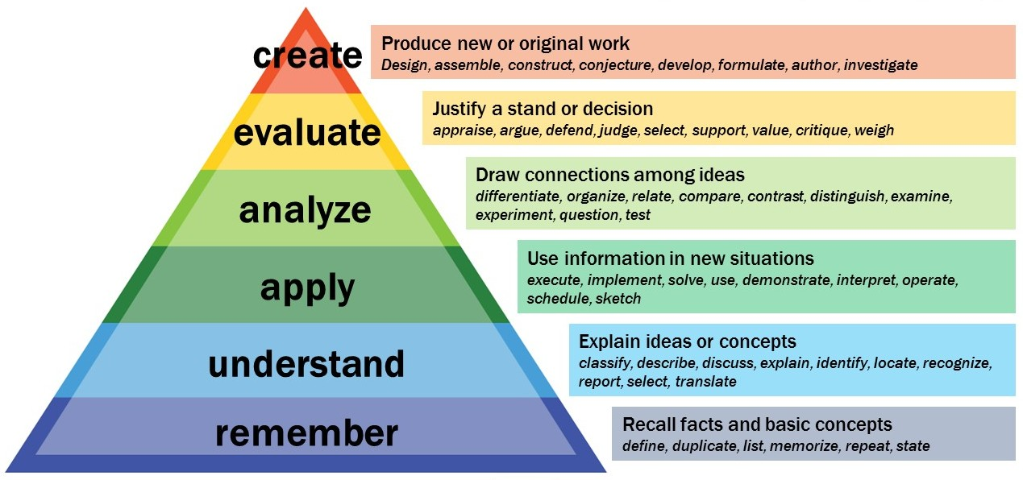
Blooms Taxonomy

Slide 12
Understanding Bloom’s Taxonomy
A hierarchy is a sequential organization
It progresses upward from simple to complex
Each level builds upon the preceding level(s)
An appropriate concept map of Bloom’s Taxonomy is pyramidal in shape, beginning at the base with knowledge and progressing upward
At the highest levels there is no 1 “right” answer
Examples:
What is your opinion of . . .?
What conclusions can you draw from . . .?
How would you rate the movie . . .?

Slide 13
Critical Thinking Application
. . .
. . .
. . .
How can the definition of critical thinking help you solve this problem? Connect the 9 dots using 4 straight lines. Once you start drawing the lines, do not stop until all 9 dots have been connected.
HINT: Lines may be vertical, horizontal and/or diagonal.

Slide 14
Solution — Critical Thinking Exercise
. . .
. . .
. . .

Slide 15
Why Is Critical Thinking Important?
It . . .
underlies reading, writing, listening and speaking—basic elements of communication
plays an important part in social change. . .
institutions in any society—courts, governments, schools, businesses—are the products of critical thinking
plays a major role in technological advances
blazes a path to freedom from half-truths and deceptions

Slide 16
How Can One Become a Critical Thinker? (part 1)
By asking pertinent questions (of self as well as others);
By assessing statements and arguments;
By developing a sense of observation and curiosity;
By becoming interested in finding new solutions;
By examining beliefs, assumptions, and opinions and weighing them against truth.
By developing a “thinker’s vocabulary”

Slide 17
How Can One Become a Critical Thinker? (part 2)
By listening carefully to others, thinking about what they say, and giving feedback;
By observing with an open mind;
By making assertions based on sound logic and solid evidence;
By sharing ideas with others;
By becoming an open-minded listener and reader;
By engaging in active reading and active listening!

Slide 18
Activity 1: What is Critical Thinking?
To be clear in writing:
State
Elaborate (in other words…)
Exemplify and/or illustrate
Write out the most important thing you know about critical thinking, in this form:
Critical thinking is …..
In other words…
For example of…

Slide 19
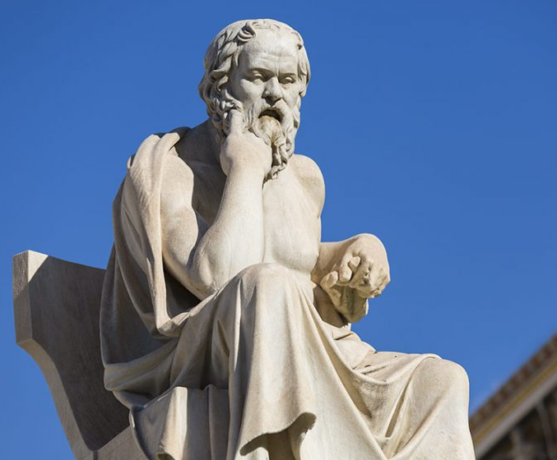
Thinking tells us:
What there is
What is happening
What our problems are
What our options are
What threatens us
What is important
What is unimportant
Who our friends are
Who our enemies are
What our “history” is
Who we are
Who loves us
Thinking fast and slow: https://youtu.be/uqXVAo7dVRU

Slide 20
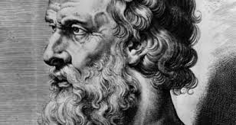
Thinking determines:
What we learn
How we learn
What we think is important to learn
What effort we should expend
What we think is true
What we think is false
How things should be viewed
Whether our learning is of high or low quality
Whether our learning is deep or superficial

Slide 21
Green & Red Thinking
Red Thinking
Higher order executive functioning
Thinking that analyses, assesses and improves Green Thinking
Green Thinking
Instinctive, automatic, spontaneous thinking
Unconsciously guided

Slide 22
Green Thinking
Unconscious Mixture Of High Quality
And Low Quality Thinking
Spontaneous Subconscious Uncontrolled
Impulsive Self protecting Unanalyzed
Reflexive Self validating
Includes ideas that are valid, as well as nonsense, confusion, stereotypes, prejudices. The key is that we cannot distinguish the difference between high and low quality thought in green thinking mode.
Green thinking goes without assessing itself.

Slide 23
Red Thinking
Red Thinking stops and assesses itself before going forward.
Disciplined Seeks the truth Self assessing
Critical Thinking Self correcting Probing
In red thinking mode, we actively work to eliminate prejudices, biases, dysfunctional thinking from our thinking. We actively work on our thinking.
We rigorously apply intellectual standards to our thinking.

Slide 24
Summary
Critical thinking is “higher level” thinking
It often requires us to think “outside the box”
Many occupations/careers require critical thinking
The things we enjoy in everyday society are the result of critical thinking
By adopting certain habits and behaviors we can learn to think critically.

Slide 25
Any Questions?

Slide 26
Activity 2. Beginning to Think about Your Thinking
To begin to think about your thinking, make a list of any problems you believe currently exist with your thinking. Try to be as explicit (clear) as possible. The more problems you identify the better. For each problem you identify, complete the following statements:
One problem with my thinking is…
This is a problem because…
If I adequately addressed this problem, the quality of my life would improve in the following ways…

Slide 27
THANK YOU
Stephen Rodwell srodwell@icms.edu.au

