Slide 1
MGT 811 Contemporary Management Capabilities
Week Twelve, Communication
Stephen Rodwell srodwell@icms.edu.au

Slide 2
Outline for today
How does the communication process work?
What is the communication process?
Communication and Leaders
Consequences of poor communication
Inspirational and powerful communication
Listening as a leadership skill
The leader’s role in resolving conflict

Slide 3
How does the communication process work?
Communication in organisations is crucial:
It may be deliberate in terms of a verbal instruction, an email or a written report
It may be more casual in terms of a chat at lunch
It may be unintentional in terms of body language observed at a meeting
In order to get a message across accurately the following must be considered:
The message
The audience or receiver
How the message is likely to be received

Slide 4
The Communications Process
CONTEXT
PERCEPTUAL
FILTERS
PERCEPTUAL
FILTERS
CODING OF MESSAGE
CHANNEL
Verbal, non-verbal, electronic
DECODING OF MESSAGE
1.
SENDER
MESSAGE
2.
RECEIVER
NOISE
FEEDBACK
CONTEXT

Slide 5
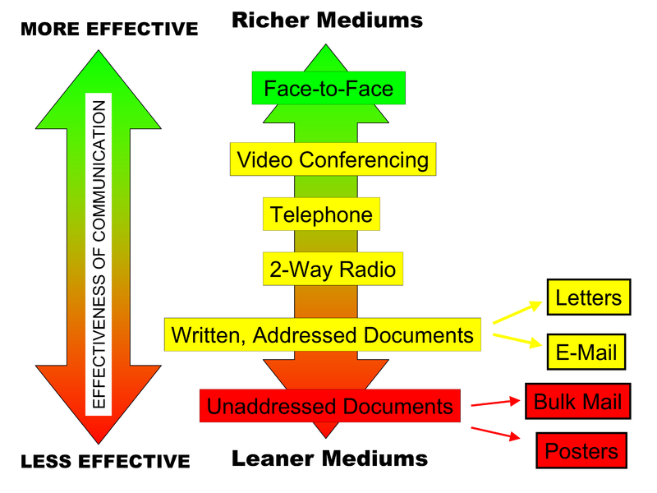
Communications Richness

Slide 6
Communication and Leaders
“I know that you believe you understand what you think I said, but I am not sure you realize that what you heard is not what I meant.”
Robert McCloskey US State Department

Slide 7
Communication and Leaders
No one ever became a great leader without first becoming a great communicator.
It has never been easier for humans to communicate – we have come a long way from the stone age, the classical age, medieval times, through the Renaissance until today
And yet the inability to communicate well is well known in business, studies, politics, society and life.

Slide 8
Communication and Leaders
Communication is about different things depending on context – information, explanation, an idea…
Who said?
“We hold these truths to be self-evident: that all men are created equal; that they are endowed by their Creator with certain unalienable rights; that among these are life, liberty, and the pursuit of happiness.”

Slide 9
Communication and Leaders
Who said?
“Four score and seven years ago our fathers brought forth on this continent, a new nation, conceived in Liberty, and dedicated to the proposition that all men are created equal.”

Slide 10
Communication and Leaders
Who said?
“I still have a dream, a dream deeply rooted in the American dream – one day this nation will rise up and live up to its creed, "We hold these truths to be self evident: that all men are created equal." I have a dream...”

Slide 11
Some Consequences of poor Communication
Lower efficiency
Lower employee morale
Decreased innovation
Business failure
Others…?

Slide 12
Two forms of communication
To change your interlocutor’s mind:
https://youtu.be/Lvz5fcuw9j0
To change the audience’s mind:
https://youtu.be/5CAj3p2F9FQ

Slide 13
Inspirational and Powerful Communication
How do you make your speaking, written and nonverbal communication inspiring and powerful?
Speaking and Writing
Be Credible If the speaker is perceived as highly credible, the attempt at persuasive communication is more likely to be successful.
Gear Your Message to the Learner A message must be adapted to the interests and motivations of the listener.
Sell Group Members on the Benefits of Your Suggestions Leaders are constrained by the willingness of group members to take actions on their suggestions and initiatives.
Use Heavy-Impact and Emotion-Provoking Words Certain words used in the proper context give power and force to your speech. Examples of emotion-provoking and powerful words include “outclassing the competition,” “bonding with customers,” and “capturing customer loyalty.”
Use Anecdotes to Communicate Meaning A carefully chosen anecdote is useful in persuading group members about the importance of organizational values.

Slide 14
Inspirational and Powerful Communication (cont.)
Speaking and Writing
Back Up Conclusions with Data Persuasiveness increases when spoken and written presentations are supported with solid data.
Minimize Language Errors, Junk Words, & Vocalized Pauses If you minimize common language errors you increase persuasiveness and appear more articulate and informed.
Write Crisp and Clear Memos, Letters, & Reports that Include a Front-Loaded Message Business leaders characteristically write easy-to-read, well-organized messages both in e-mail and more formal reports. A persuasive speaker or writer places key ideas at the beginning of a conversation, memo, paragraph, or sentence.
Use Business Jargon in Appropriate Doses Sprinkling business talk with jargon helps establish rapport and adds to a person’s popularity
Use a Power-Oriented Linguistic Style (a) downplay uncertainty, (b) use the pronoun I frequently, (c) apologize infrequently, (d) know exactly what you want, and (e) frame your comments in a way that increases your listener’s receptivity.

Slide 15
Inspirational and Powerful Communication
Six Basic Principles of Persuasion
Liking: People like those who like them –a leader has a better chance of persuading and influencing group members who like them
Reciprocity: People repay in kind the leader should be a model of desired behavior. Managers can often influence group members to behave in a particular way by displaying that behaviour first
Social Proof: People follow the lead of similar others – as a leader – persuade a key individual and others will follow
Consistency: People align with their clear commitments as a leader persuade people to commit in writing to what you want them to do – they will consistently follow
Authority: People defer to experts make constituents aware of your expertise.
Scarcity: People want more of what they can have less of people are more likely to act if they believe that the resource at issue is shrinking rapidly.

Slide 16
Inspirational and Powerful Communication
Nonverbal Communication
Use Perfect Posture
Use Positive Head and Hand Gestures
If Standing, Stand Up Straight with Feet Outward
Speak at a Moderate Pace with Confident Voice
Smile Frequently and Naturally
Maintain Eye Contact
Gesture in a Natural, Friendly Way
Have a Big Desk or Chair – Take up Space

Slide 17
Listening as a Leadership Skill
Listening is a fundamental management and leadership skill. For encouraging subordinates, establishing good exchanges, and identifying problems.
Strategies Towards Enhancing Your Listening Skills:
Show Respect A foundation tactic for a leader to become an effective leader is to show respect for others. Showing respect leads to careful listening.
Making the Rounds
Getting out of your office to have conversations with group members, employees, etc.
Also referred to as “Management by Walking Around”
Allows the leader to stay alert to potential problems.

Slide 18
The Leader’s Role in Resolving Conflict
Leaders and managers spend about 20 percent of their time resolving conflicts and negotiating.
A leader’s personality influences how much conflict he or she has to resolve. An accepting, warm, and understanding leader will have much less conflict to resolve than a rejecting, cold, and non-compassionate leader.
What, according to the text are the 5 Conflict Management Styles?
What, according to the text, is the key to resolving conflict?

Slide 19
The Leader’s Role in Resolving Conflict
Conflict Management Styles
Competitive Style – Desire to achieve one’s own goals at the expense of the other party, or to dominate. (win-lose)
Accommodative Style – Favors appeasement, or satisfying the other’s concerns without taking care of one’s own.
Sharing Style – Prefers moderate but incomplete satisfaction for both parties, resulting in a compromise.
Collaborative Style – reflects a desire to fully satisfy the desires of both parties. It is based on an underlying philosophy of win-win approach to conflict resolution, the belief that after conflict has been resolved, both sides should gain something of value. When collaborative approaches to resolving conflict are used, the relationships among the parties are improved.
Avoidant Style – combines lack of cooperation and unassertiveness He or she is indifferent to the concerns of either party.

Slide 20
The Leader’s Role in Resolving Conflict
People engaged in conflict resolution typically combine several of the five resolution styles to accomplish their purpose.
For example, a generally effective approach to resolving conflict is to be competitive with regard to a cost that is important for oneself but unimportant to the opponent. At the same time, the person uses accommodation for a cost that is unimportant to oneself but important to the opponent.
The most useful approach to resolving conflict between two people is to get the parties involved to engage in confrontation and problem solving. The manager sits down with the two sides, and encourages them to talk to each other about the problem, not talk directly to him or her.

Slide 21
The Leader’s Role in Resolving Conflict
Negotiating and bargaining is a basic leadership role. The approaches to negotiation here emphasize a strategy of integration or collaboration, with a philosophy of win-win.
Listen First to Investigate What the Other Side Wants - Whoever talks the most during negotiation loses. Being the first to list helps establish trust. Listening also involves paying attention to what the other side is saying.
Begin with a Plausible Demand or Offer - A plausible demand or offer is better than a grossly inflated one because it shows that you are bargaining in good faith. Also, if a third party has to resolve the conflict, a plausible demand or offer will receive more sympathy than an implausible one.

Slide 22
The Leader’s Role in Resolving Conflict
Focus on Interests, Not Positions - Rather than clinging to specific negotia­tion points, keep your overall interests in mind and try to satisfy them. The true object of nego­tiation is to satisfy the underlying interests of both sides.
Be Sensitive to International Differences in Negotiating Style - Americans often have a no-nonsense approach to negotiation, such as frankness and impatience. This may be interpreted as rudeness by people from non-American cultures, and it can lead to failed negotiations.
Allow for Face Saving - While negotiating, recognize that you might want to make another deal with the other party, so conduct yourself in a dignified manner. Do not attempt to maximize gain for yourself and minimize gain for the other side.

Slide 23
Summary
Today we have explored the following topics:
Effective leaders are effective communicators.
Leaders may develop inspirational and powerful speaking and writing by following a set of suggestions.
A power-oriented linguistic style is one way to communicate with inspiration and power.
Leaders can improve their communication by following principles of persuasion.
Leaders can also develop their use of nonverbal communication, which is especially helpful for videoconferencing and telepresence.
Overcoming cross-cultural communication barriers is another leadership challenge.
Leaders must also be skilled in conflict management and negotiations.

Slide 24
Any Questions?

Slide 25
Tutorial Activity
Discuss and answer the following questions
Who are the great communicators in history? Why?
Who are the great current communicators? Why?
Why is it important for leaders to be effective communicators?
What are the consequences of poor business communication?
How do you make your speaking, written and nonverbal communication inspiring and powerful?
Why is listening important for leaders?
How can you enhance your listening skills?
What is the best method for resolving conflict between two parties?
What are the keys to negotiation?

Slide 26
THANK YOU
Stephen Rodwell srodwell@icms.edu.au

