Slide 2
Value Chain Management MGT804
Week 7
Sustainability and CSR in the value chain

Slide 3
Sustainability: ‘People, Planet, Profit’
Sustainability - Corporate Social Responsibility
Finding solutions without harming the needs of future generations
Focus from shareholder to stakeholders:
  People: Labor circumstances
  Planet: Usage of natural resources
  Profit: Financial development
Weigh decisions based on these three criteria

Slide 4
Towards a sustainable environment
Sustainability has different aspects.
Most of the time it is referred to as corporate social responsibility (CSR).
Sustainable purchasing is about buying for a better future world.
The traditional shareholder focus has made way for a stakeholder focus.
Sustainable profitability can be achieved if the company is able to balance the interests of customers, employees, society, the environment and its shareholders.

Slide 5
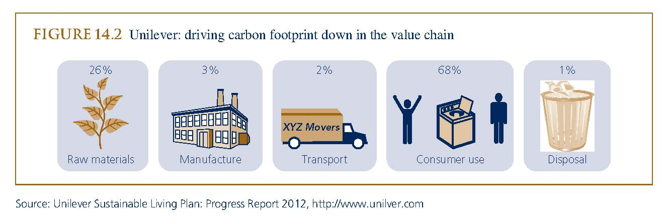
Unilever’s sustainable living plan

Slide 6
Sustainable Purchasing
Suppliers form an important source of competitive ability
Suppliers also form risks considering sustainability
Companies like Philips are busy considering these issues
  Developing a standard
  Self-assessment and audit
  Plan of action with corrective measures
  Suppliers are willing to cooperate
Continuing this approach from first tier to second tier suppliers is still a long way to go

Slide 7
How to drive CSR in supply chain relationships
Most major companies today have CSR integrated in their mission statement and business strategies.
Companies that operate downstream in their value chains, i.e. consumer goods manufacturers and retailers seem to emphasise product safety and environmental friendliness in their stakeholder relationships.
First and second tier suppliers, which operate more upstream in their value chains, seem to.

Slide 8
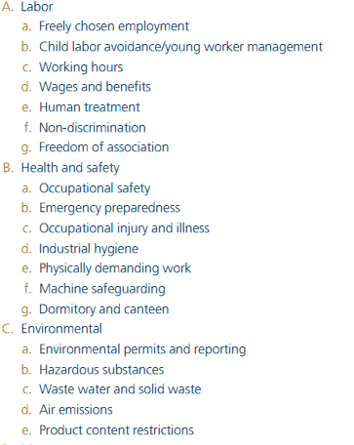
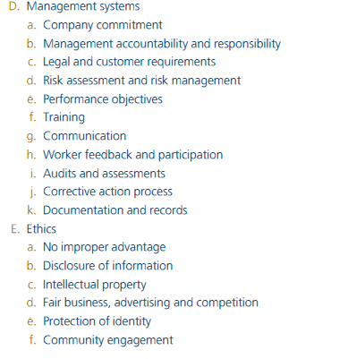
Figure 14.3 Philips’ supplier sustainability audit

Slide 9
Six steps to responsible buying
1 Establish good relationships with suppliers to ensure long-term, stable, risk-sharing connections.
2 Make sure your communications are clear and timely, so suppliers know
the terms of the trade, have information about expectations and are able to
give feedback.
3 Establish sustainable pricing so the supplier, buyer and those further down
the chain benefit from the relationship.
4 Give clear lead times and payments.
5 Show respect for human rights in the supply chain. Buyers should give
preference to suppliers who demonstrate they are improving social and
environmental conditions.
6 Offer continued support for small-scale producers and home workers. Buyers should find out who their suppliers are and if they include smallholders, home workers and those in disadvantaged areas, they should be careful not to change that.

Slide 10
Mini case study – Tesco and CSR
Tesco monitors and assesses overall company performance towards CSR with the following range of KPIs:
Economic – local sourcing: 7,000 local products
Environment
Energy efficiency – year-on-year percentage reduction of usage
Water consumption
Vehicle efficiency
Recycling
Social – ‘computer for schools’: increase value of computers donated
Charitable donations – 1%
Employee retention and training
Supply chain labour standards – training staff and suppliers (including SA8000)
Source: Tesco website (2004)

Slide 11
Mini case study – TR fastenings
TR Fastenings invests a lot of time in investigating and visiting existing and potential suppliers.
Whether they are in the UK, Europe or Asia, the same criteria are applied:
Do they provide fair conditions for workers?
Do they protect the environment?
Do they exhibit reasonable, ethical corporate behaviour?
TR has a regulatory framework which is easy to understand and which conveys the standards which the company requires.
In several instances where the above have not been adequate but the companies are interested in improving, TR has agreed a contract at a
price slightly higher than the norm in order to allow the companies to fund the necessary improvements. In this way, TR sees that it can meet its CSR obligations and remain competitive, and it gets a committed supplier that will work well with TR and look after its employees.

Slide 12
Social accountability 8000 (SA8000)
Purpose and scope
This international standard specifies requirements for social accountability to enable a company to:
Develop, maintain and enforce policies and procedures in order to manage those issues which it can control or influence.
Demonstrate to interested parties that policies, procedures and practices are in conformity with the requirements of this standard.
The requirements of this standard shall apply universally with regard to geographic location, industry sector and company size.
The company shall also respect the principles of the following international instruments such as:
Universal Declaration of Human Rights.
The United Nations Convention on the Rights of the Child.

Slide 13
The ethical trading initiative (ETI)
The Ethical Trading Initiative (ETI) is an alliance of companies, trade unions, development and campaigning groups that works to improve the lives of workers in global supply chains.
The ETI base code includes:
Employment is freely chosen
Freedom to join unions
Safe clear conditions
No child labour
Living wages to be paid
Fair working hours
No discrimination
No harsh or inhumane treatment.

Slide 14
The International Labour Organization (ILO)
The International Labour Organisation (ILO) has three major tasks, the first of which is the adoption of international labour standards, called Conventions and Recommendations, for implementation by member states. The Conventions and Recommendations contain guidelines on child labour, protection of women workers, hours of work, rest and holidays with pay, labour inspection, vocational guidance and training, social security protection, workers’ housing, occupational health and safety, conditions of work at sea and protection of migrant workers.
They also cover questions of basic human rights; among them are freedom of association, collective bargaining, the abolition of forced labour, the elimination of discrimination in employment and the promotion of full employment.

Slide 15
Fairtrade
Fairtrade is a system monitored and operated by the Fairtrade Labelling Organisation, which sets working and social standards that must be complied with before companies are awarded a Fairtrade mark. It aims to change the way we trade, creating fairer working conditions, greater opportunities in the marketplace and social development for producer partners.
Sourcing principles from Fair Trade are:
Engage with stakeholders
Understand the supplier country context
Transparent communication
Price to cover cost of labour and capital employed
Develop partnering relationships
Integrate social objectives with other buying functions.

Slide 16
Best practice: what buyers can do to improve labour conditions
Avoid putting undue pressure on suppliers that might impact on workers.
For example, changing an order at the last minute or shortening lead times could mean that workers are forced to do overtime.
Think about the effect of the prices you set – insist that suppliers comply with the ETI base code.

Slide 17
Best practice: what buyers can do to improve labour conditions (Continued)
Give reasonable time scales for suppliers to address areas of non-compliance and provide support to help them improve, such as education and training.
Help your major suppliers to share good practice by developing benchmarking groups where they can get together to exchange ideas about how to overcome speciﬁc issues in their region or industry.

Slide 18
Video
Sustainable Procurement Education - Training

Slide 19
Green SCM integrates environmental and supply chain management.
Green Supply Chain Management
Supply Chain
Management
Environmental
Management
Green Supply Chain Management
Green SCM recognizes the disproportionate environmental impact of supply chain processes in an organization.
Notes:
Currently, there is no tool for performing Green Supply Chain analysis in conjunction with standard supply chain analysis.

Slide 20
Green SCM leverages the role of the environment in SC value creation.
Environmental Value Drivers
Tangible Outcomes
Green Supply Chain Programs
Profitability
Asset Utilization
Supply Chain Value
Service Level
Employee Satisfaction
Customer
Stakeholder Interests
Environmental Sustainability
Reputation
Continuity
Community Quality of Life
Alliances
Technology
Intangible Value Drivers
Source: Forging New Links, GEMI, 2004
Notes:
ES&H Management results in tangible supply chain improvements:
Profitability – by reducing the cost of compliance and potentially finding markets for process waste, the organization can improve both revenue and costs, resulting in an increase in profits.
Asset utilization – by designing processes with an eye for minimizing waste, assets are used more efficiently.
Service levels – Part of ES&H management is the recognition of the impacts on customer operations; by mitigating these impacts, you can improve customer satisfaction and the level of service you provide.
ES&H also drives intangible improvements
Customer and stakeholder relationships – many customers will prefer to source from an environmentally friendly source; in addition, proper ES&H management can lead to reduces costs and better value delivered to the customer.
Brand equity and reputation – a reputation for strong environmental management can lead to an improved reputation with both customers and stakeholders.
Business continuity – Mitigating environmental and safety risks will improve the continuity of operations by minimizing the risk of disruption due to non-compliance issues.
Alliances – ES&H management usually involves forming alliances with outside organizations, which can translate into future business opportunities.
Technology – Improving ES&H management can lead to a better understanding of processes and improve the organizations knowledge and use of management technology.

Slide 21
Historically, GSC management focused on the upstream supply chain.
Typical Green Supply Chain Analysis
Manufacturer encourages suppliers to adopt green practices, environmental management systems, etc.
Focus is on the material content and environmental practices of suppliers.
Supplier
Supplier
Manufacturer
Supplier

Slide 22
Now, GSC programs are moving from compliance to value creation.
Environmental, Safety, and Health Business Contributions
Assure Compliance
Raise Productivity
Minimize Risk
Enhance Relations
Maintain Health
Support Innovation
Protect the Environment
Enable Growth
Traditional Cost Avoidance
Emerging Value Creation
Source: Forging New Links, GEMI, 2004

Slide 23
Companies are starting to view GSC as a strategic analysis tool.
Pollution Prevention Hierarchy
Long
Term
Source Reduction
Strategic
Recycle/Reuse
Control Technology
The Pollution Prevention Hierarchy gauges the value of environmental programs.
Disposal
Short
Term
Tactical
Source: U.S. Environmental Protection Agency

Slide 24
Drivers of Going Green
Legislations, regulations and standards for going Green
Ethical obligations and social responsibility
Financial incentives

Slide 25
Impediments to Going Green
Lowers economic profits
Imposes unequal costs among competitors
Costs of going green will eventually be shifted to the stakeholders
Social issues are best solved by government. “Business of business is business”.

Slide 26
Green supply chain management is a driver for process improvements.
In general, pollution and waste represent incomplete, ineffective, or inefficient use of raw material.
Green supply chain analysis provides an opportunity to review processes, materials, and operational concepts.
As with continuous improvement programs, green supply chain analysis targets:
  Wasted material
  Wasted energy or effort
  Under-utilized resources
Green Process Improvement Approach
Identify the waste streams
Measure or identify the opportunity cost of the waste
Create innovation vs. treatment bias toward waste reduction
Source: Green and Competitive, Proter and van der Linfde, HBR, Sept.-Oct. 1995
Environmental Supply Chain Management, Carter and Narasimhan, CAPS Research, 1998

Slide 27
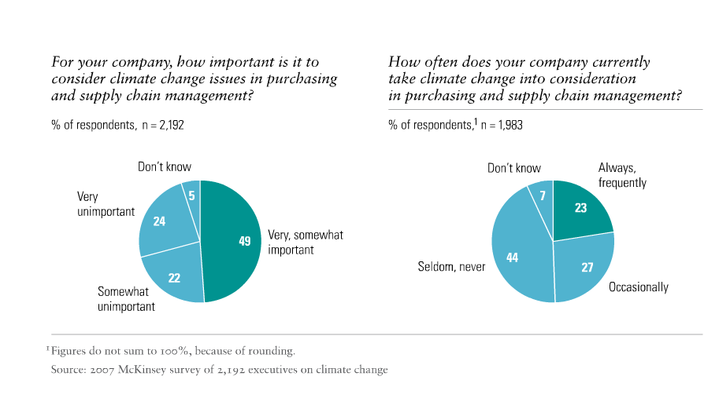
Gap Between Knowledge and Action

Slide 28

Why Supply Chain?
Profitability: It has the potential to create value (profit) for the business.
Criticality: Firms cannot be sustainable unless their supply chains become sustainable first.
Is this a Green car?

Slide 29
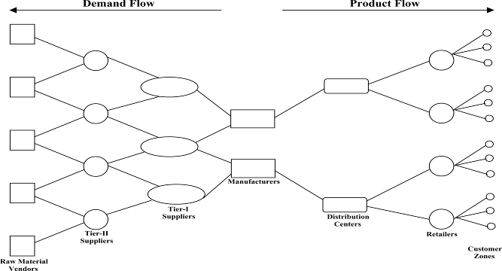
Why Supply Chain? (Cont.)
Synergic nature: “Networked” vs. Individual effort

Slide 30
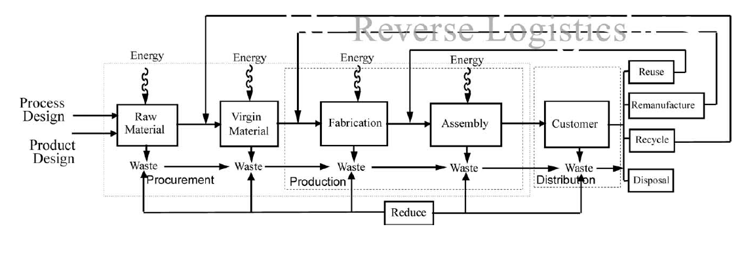
What is a Sustainable Supply Chain?
“Management of raw materials and services from suppliers to manufacturer/service provider to customer and back with improvement of the social and environmental impacts explicitly considered”.
Adapted from Sarkis [1]

Slide 31
Green Sourcing Principles & Values
Best efforts to mitigate all kinds of pollution:
  Air, water, land, noise, etc.
Avoid creating waste whenever possible:
  Packaging – inbound and outbound
  Environmentally friendly chemicals
Reduced disposal costs:
  Recycling waste
  Reusable packaging
Lower operational costs
  Energy conservation
  High density lighting

Slide 32
Corporate Practices for Green Sourcing
Make Green part of the RFI/RFP process and filter out non-green suppliers
    – What % of their waste stream is recycled?
    – What % of their raw materials are from recycling?
    – What $’s have they invested in Green initiatives?
Require or encourage suppliers to undertake independent environmental certification , e.g. ISO 14000
Build environmental criteria into supplier contract conditions
Supply base environmental performance management
Conduct life cycle analysis in cooperation with suppliers
Coordinate minimization of environmental impact in the extended supply chain

Slide 33
Corporate Practices for Green Sourcing (Cont.)
Cooperate with suppliers to deal with end-of-pipe environmental issues:
  Reduce packaging waste at the customer/supplier interface
  Reuse/recycle materials in cooperation with the supplier
  Launch reuse initiatives (including buy backs and leasing)
Reverse logistics:
  Give supplier an incentive to reduce the customer’s environmental load
  Waste by-products reused by the raw material suppliers
  Material ‘Life Cycle Management’

Slide 34
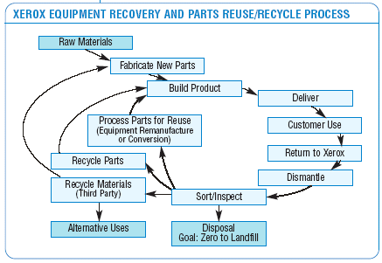
Xerox implemented a take-back program redefined customer’s expectations.
Xerox Copier Take-back Program
70-90% (by weight) of machines reused
144 million pounds diverted from landfills (2003)
In early 1990s Xerox launched a new initiative to take back used copiers as a source of material for new machines.
Customers like the program because they no longer worry about machine disposal.
Xerox estimates “several hundred million” dollar savings annually.
Source: Bringing the Environment Down to Earth, Reinhardt, HBR, July-August 1999
Environment, Health, and Safety Progress Report: 2004, Xerox Corporation

Slide 35
Conclusion
Supply Chain is the most important issue that a green business should address in its environmental efforts.
Greening the supply chain can potentially reduce costs and provide profit opportunities.
Bringing sustainable practices into supply chain is a certain trend in the future. Thus, those who start from now gain a competitive advantage.

Slide 36
Tutorial
Practical activity:
Study Walmart’s supplier sustainability assessment (http://sustaindane.org/uploads/2011/Walmart%20Supplier%20Assessment(1).pdf) and discuss which types of question can be used to measure the sustainability performance in different areas including:
Energy and climate
Material efficiency
Nature and resources
People and community
Find Walmart’s practices to cover each area and how the sustainability performance in each area will be calculated.

