Slide 2
Value Chain Management MGT804 Week 4
Warehousing, storage
and
distribution

Slide 3
Logistics and Supply Chain Management
Major Logistics Functions
Warehousing
Inventory management
Transportation
Logistics information management

Slide 4
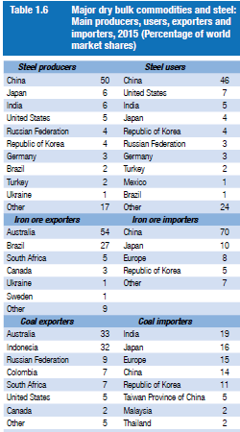
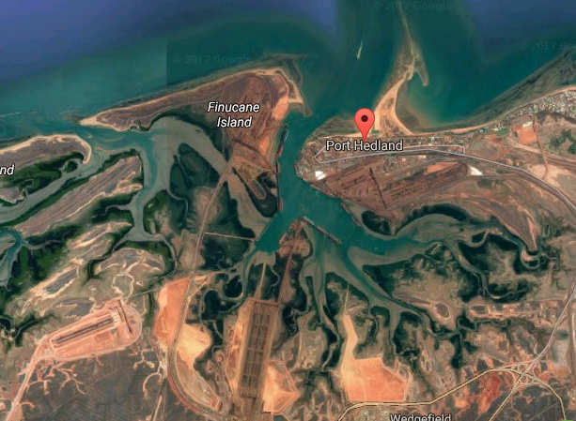
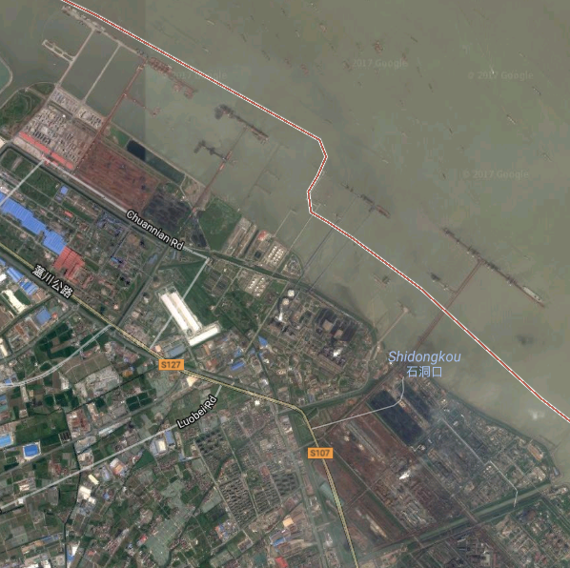
10 most common types of warehouses
1. Raw materials storage
Raw materials for production: Plastics, coal, bauxite, iron ore, precious metals (gold, silver, and platinum), aggregates (sand, gravel, crushed stone, slag)
Close to the extraction/manufacturing point
Source: Review of Maritime Transport (UNCATD, 2016)

Slide 5
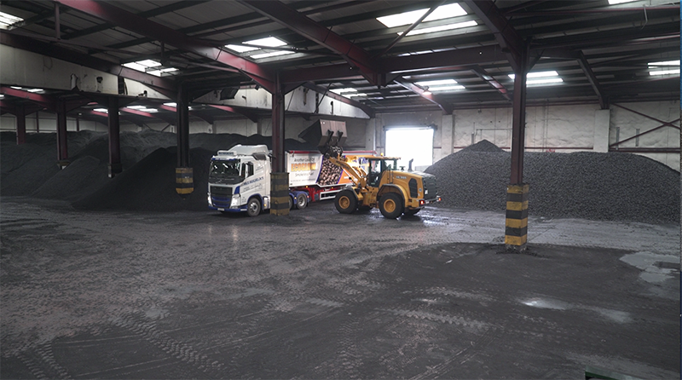
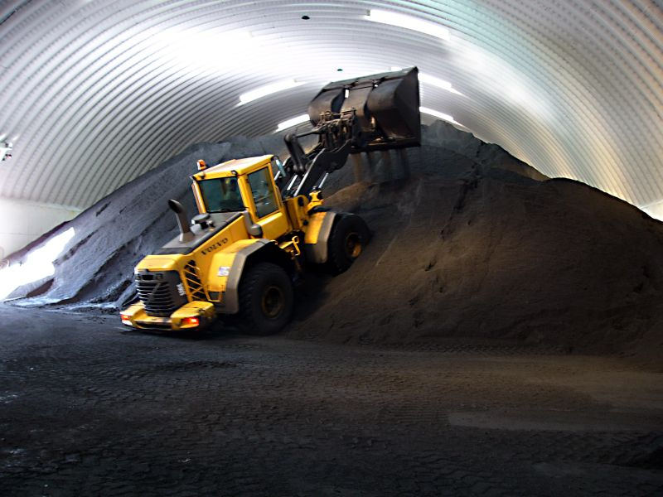
Coal warehouses

Slide 6
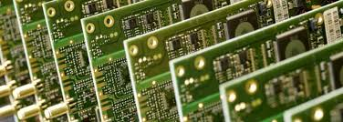
10 most common types of warehouses
2. Intermediate, postponement, customise or sub-assembly facility
Used to customise products before final delivery
Postponement and sub-assembly activities
Packing, labeling, printing (bespoke pictures on T-shirts)
Computer assembly: CPU, memory, software)
Bundling for promotion: “buy one get one free” at Christmas seasons
Country-specific items: electrical plugs
Special-messages: greeting messages on mobile phone

Slide 7
10 most common types of warehouses
3. Finished goods storage
Used to store ready-for-sale products
4. Consolidation centres (transit warehouses)
Amalgamating (consolidating) the products received from different sources for onward delivery to the customer or a production line
Just-in-time centres (preparing for production): automotive parts are consolidated before going to the assembly line
Retail stock consolidation centers: economies of scale in transportation to retail stores/distribution centers*

Slide 8
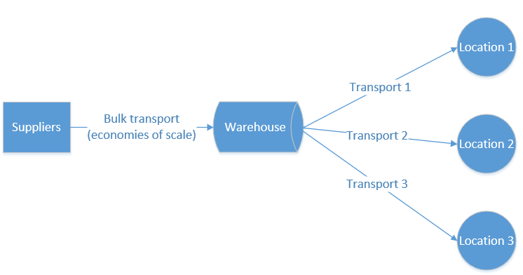
10 most common types of warehouses
6. Transshipment (break-bulk) centres
Taking advantage of both economies of scale and flexibility in transportation

Slide 9
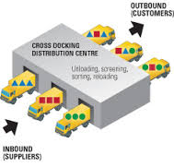
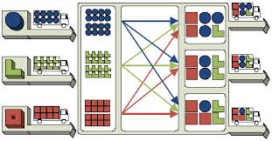
10 most common types of warehouses
5. cross-dock centres
Moving goods quickly through the whole supply chain
Requiring deliveries into these centres to be already labelled and ready for onward delivery
Typical products in a cross-dock center are time-sensitive or perishable items: fruit, vegetables, meat and fish*
YouTube: Cross Docking Automatizado – Retrotech

Slide 10
10 most common types of warehouses
7. Sortation centres
Goods are received from all parts of the country, sorted by e.g. post code, consolidated and delivered overnight to their destinations
Typical users: letter, parcel and pallet distribution companies

Slide 11
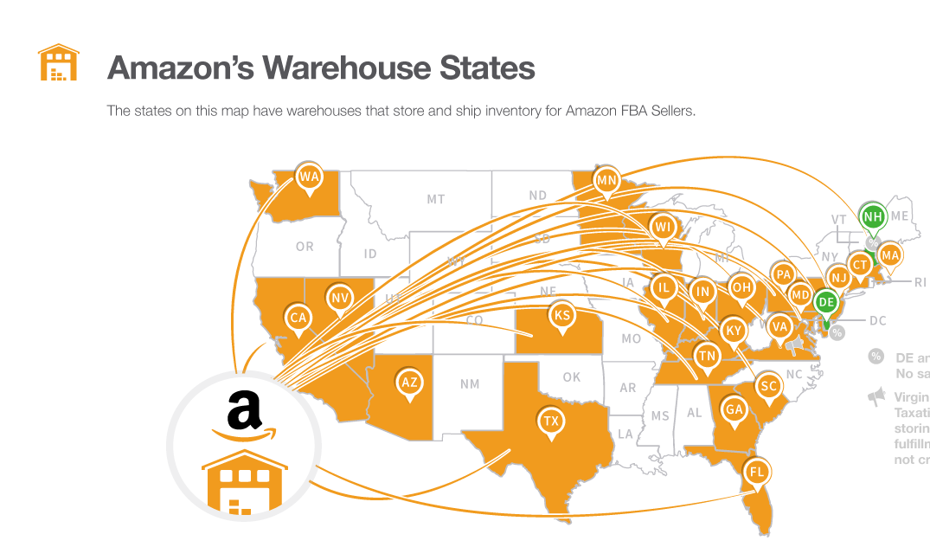
10 most common types of warehouses
8. Fulfilment centres
Popular because of e-commerce (online shopping)
Large volumes of small orders
A large percentage of returns
YouTube: UK - Amazon Fulfilment Centres
https://www.techradar.com/au/news/amazon-australia-begins-building-second-fulfilment-centre-in-sydney

Slide 12
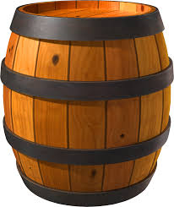
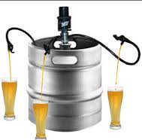
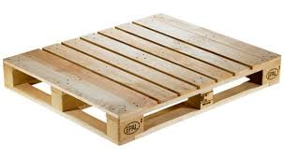
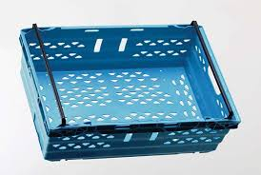
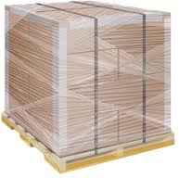
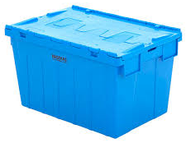
10 most common types of warehouses
9. Reverse logistics centres
European Union’s Waste and Electrical and Electronic Equipment (WEEE)
Dealing with “Returned” things from the logistics system
Returned products: unwanted/defective
Returned packaging materials (shrink wrap, straps, carton cardboard)
Returned reusable transit packaging equipment: roll cages, barrels, kegs, pallets, totes, trays, dollies
What should we do? Check, reuse, repair, repackage, recycle, or dispose of them!
It matters since it affects the cash flow and environments

Slide 13
10 most common types of warehouses
10. Public sector warehouses
Storing materials for natural disasters (earthquakes, droughts, tsunamis)
Warehouses in humanitarian logistics (wars, natural disasters)
Stock for government facilities (schools and offices): stationary, uniforms, furniture, computer hardware and software, etc.
May be managed by governments or third-party logistics providers

Slide 14
Difference between 3Pl and 4Pl
3PL companies tend to specialize in:
Inbound and outbound freight
Customs
Freight consolidation
Warehousing
Distribution
Order fulfillment
Cross-docking
Inventory management
4PL companies tend to provide (generally through 3PL partners):
Distribution
Procurement
Storage
1PL: First Party Logistics
The consigner of goods
2PL: Second Party Logistics
Own the means of transportation
5PL: Fifth Party Logistics
Manages networks of supply chains with an extensive e-business focus

Slide 15
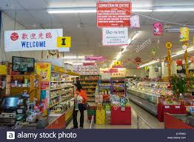
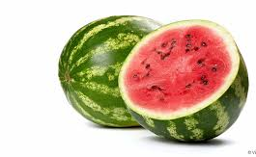
Why Warehousing? (Benefits)
1. Discrepancy between supply and demand in time (seasonality) and or space
Mouth water for cherries when living in China?
Miss Asian cuisines when living in Australia?
Want watermelons in winter?
Like durians in the whole year?
Warehouses: buffers solving these discrepancies!

Slide 16
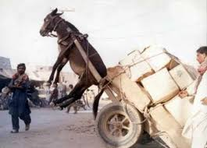
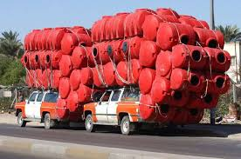
Why Warehousing? (Benefits)
2. Economies of scale in transportation
The more cargo you carry in a vehicle, the less you will pay for unit cargo transport (freight rate)
Warehouses accumulate and consolidate goods before transportation
Consolidation centre
Break-bulk centre

Slide 17
Examples of Economies of scale in transportation
day | month | No-truck | Tonnes | Annual Sales (weight) | Unit cargo transport | Annual shipping cost
30 | 12 | 200 | 15.5 | 1,116,000 | $700 | $50,400,000
 |  | 172 | 18 | 1,116,000 | $700 | $43,400,000
 |  |  |  |  |  | $7,000,000

Slide 18
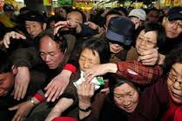
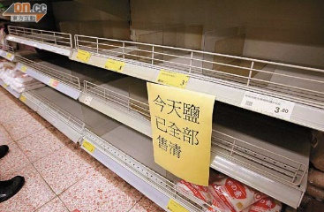
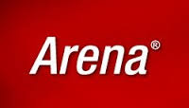
Why Warehousing? (Benefits)
3. Uncertainties
Customers come to stores randomly, based on their moods, availability in time, and other requirements
http://www.chinadaily.com.cn/a/201806/12/WS5b1f2788a31001b82571f813.html
Suppliers/manufactures might shut down their operations for vacations, machine maintenance and stock counts
Other factors, like weather and natural disasters, also cause demand uncertainty for some products (ice cream, suntan lotion, umbrella, beers, tents, bottled water, etc)
Even a rumor can dramatically increase or decrease the demand of a product (e.g. Fukushima nuclear leaks in 2011 cause people’s fear of radiation: Chinese rushed to buy table salt)
“I have 2 kilograms of salt in stock, do you want to marry me?”
We have to keep more goods than expected in warehouses to fight these uncertainties, since nobody wants to lose sales
“SIMULATION” also helps when you determine your inventory level in the dynamic and uncertain world! [“Arena”, the best simulation software package used in industry, will be adopted in the study of this unit through the whole semester]

Slide 19
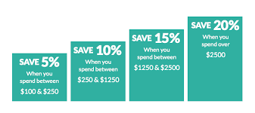
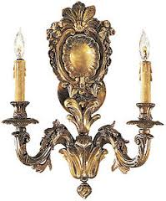
Why Warehousing? (Benefits)
4. Discount via bulk buying
Buy more, save more!
Additional cost to maintain the inventory:
storage cost + handling cost + capital interest + discounted/disposal sales
Maintain a warehouse if Additional costs < discount earns via bulk purchase
5. Investment stock
Fine wines and spirits
Cigars
Precious metals and stones
Antiques and fine arts

Slide 20
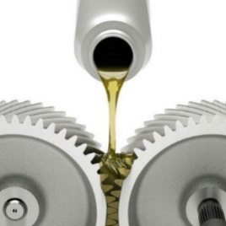
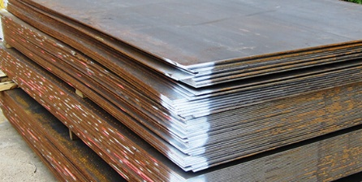
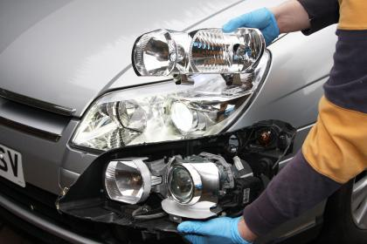
Stock inside a warehouse(1)
Raw materials;
Iron ore
Coffee
Supplementary materials;
lubricating oil,
Cooling water,
Polishing materials
Semi-manufactured products;
Steel plate,
Rolled wire
Plastic foils
Components;
lamp units
Batteries,
Engine parts,
Electronic parts and transmissions

Slide 21
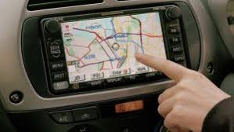
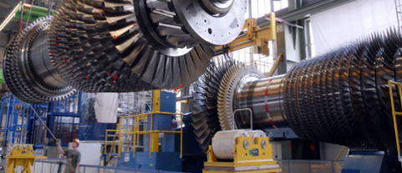
Stock inside a warehouse (2)
Finished products;
Navigation systems
Roof systems,
Investment goods or capital equipment;
Machines used in production
Computers
Buildings
Maintenance, repair and operating materials
(MRO items);
Office supplies,
Cleaning materials

Slide 22
Warehouse location
Key factors shaping location choice
Proximity to economic centers
Transport cost
Real state cost
Proximity to parcel hub, motorway network
Availability of affordable, skilled labour
Transport links for staff
Availability of the modern and efficient infrastructure (existing building)
Proximity to ports, airports
Location of suppliers and manufacturer points

Slide 23
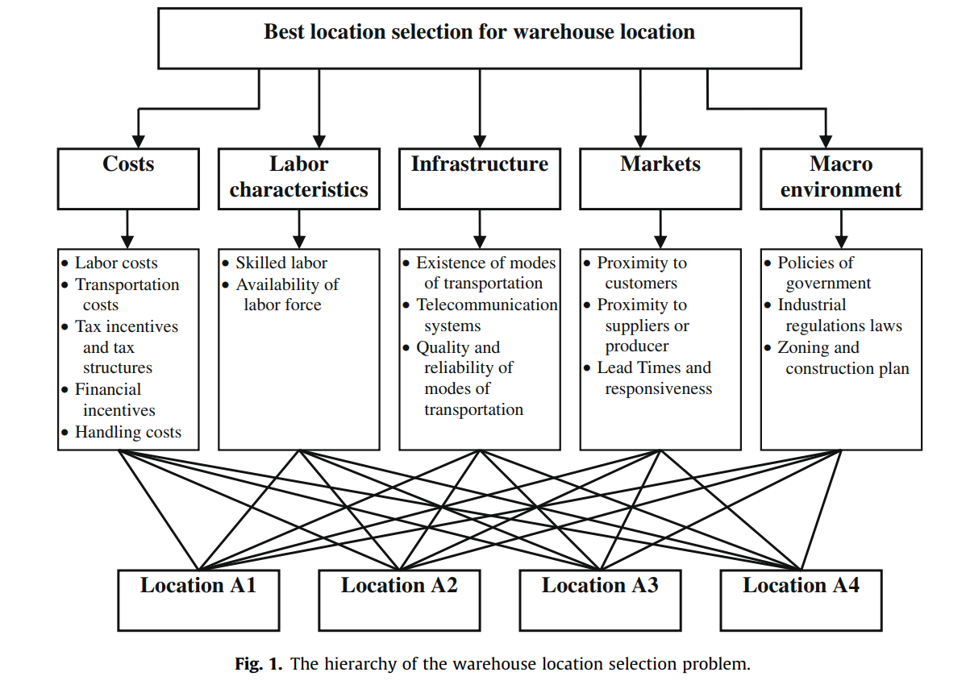
Factors determining the location of a warehouse
The decision on where to site a warehouse via software
Quantitative and qualitative data
Minimising distances to customers and from suppliers
Multi-criteria warehouse location selection using Choquet integral

Slide 24
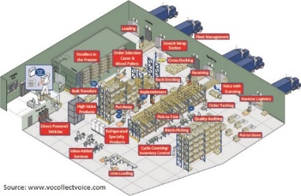
What is warehouse design?
Designing a warehouse is nothing but to:
determine the layout of warehouse based on the operations (functions) inside (receiving/unloading, put-away, storage, order-picking, packaging, sortation, dispatching/loading, value-adding services, offices);
choose the best storage strategies and equipment (simply stacking blocks, or some racking systems);
select the suitable material handing equipment (forklifts, conveyors/carousels, robots, etc.);
find the appropriate WMS supporting the operations; and
evaluate the possible workforce (staff) requirements and possible costs associated with this,
in order to
fulfill the storage requirements, and
accelerate the goods flow through the warehouse (throughput), while
minimising the operating costs

Slide 25
How do we design a warehouse? (design process)
Source: www.logisticsbureau.com

Slide 26
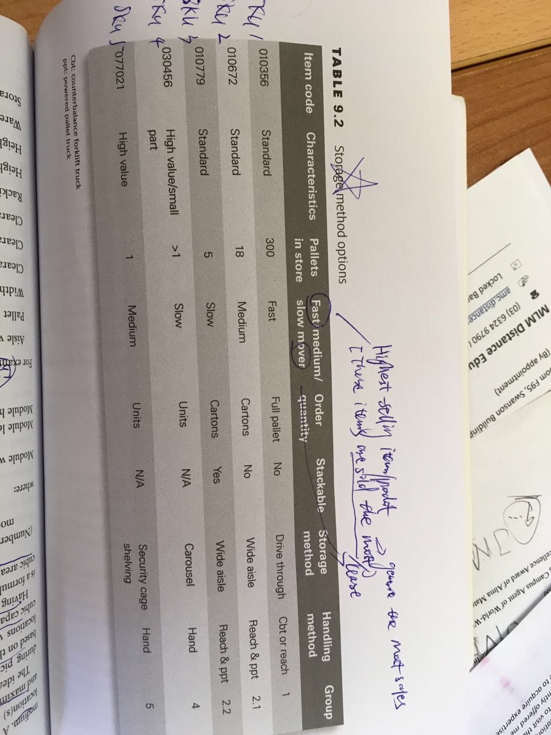
How do we design a warehouse? (design process)
Step 1: Data, data, and data
Collect historical data (if any) as much as possible, analyse the data to clarify the requirements of a warehouse:
How many deliveries do we have from suppliers?
What is the loading capacity for each supplier delivery? (number of pallets, number of cartons)
How many dispatches do we have to customers?
What is the loading capacity for each dispatch? (number of pallets, number of cartons)
For each line/SKU (product code; product) in the storage list, what is the number of items? What is the throughput for each product?
Which products are fast-moving (type A), medium-speed-moving (type B), or slow-moving (type C)? (ABC analysis)
Are there any obsolete stocks which should be disposed of?
Are there any peak hours every day or peak days every week in which the throughput overspill occurs?
These questions answer the loading, unloading, storage, and manpower requirements of a warehouse. They also give some insights about equipment and software requirements.

Slide 27
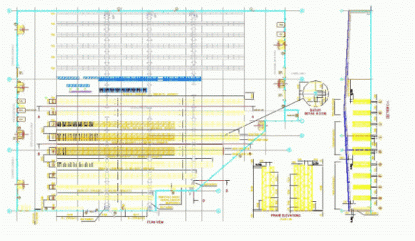
How do we design a warehouse? (design process)
Step 2: Warehouse Options Design & Layout
A number of warehouse layout options are designed by experienced consultants
Different options may have different implementation and warehouse operational costs, by considering the budget constraints and revenue expectations
The designs include high level CAD drawings of the warehouse layout and materials handling equipment, manning levels and probable warehouse expansion options
We may choose a preferred option from the all of the options available to us, against our constraints in timing, IT, budget and our goals for profit
Source of the content in this slide: www.logisticsbureau.com

Slide 28
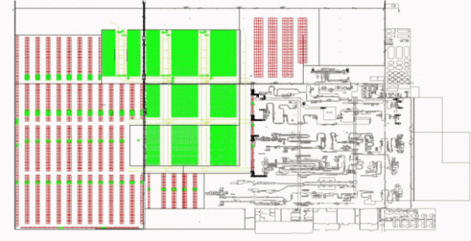
How do we design a warehouse? (design process)
Step 3: Detailed Warehouse Layout and Design
The detailed layout and design of the preferred facility option will include performance specifications, equipment layout, facility footprint and building design and cost (new building), specification of static and mobile materials handling equipment, high level (e.g. mezzanine) process design, detailed implementation and warehouse operational costs
Source of the content in this slide: www.logisticsbureau.com

Slide 29
Core areas of operation in a W/DC
Receiving
The act of handling products into a warehouse and onto a system.
Receipts may be for single products, objects, litres, cartons, packets, crates, kilograms or full pallets.
Items maybe large such as pallets, or as small as a split pin.
The best way to receive products is via an Advance Shipping Notice (ASN) from a supplier.
With this information on system, operators can scan consignment barcodes to bring up the ASN. If the delivery matches the ASN, then goods can be system-received.
https://www.youtube.com/watch?v=dAXdeqcHBp4

Slide 30
2. Put-away
The process commences when operators accept the put-away task from the Enterprise Resource Program (ERP) or Warehouse Management System (WMS), and then scanning the relevant barcode of goods to be put away.
If there is no barcode, then a manual entry can confirm that the goods have been identified.
At this point the system will be directing the put-away staff to deliver goods to the relevant storage location
Put away Process

Slide 31
3. Picking
There are two main types of picking
Primary. This is the first picking of goods. In some cases, the first picking is delivered directly to a staging area or packing bench for finalisation, consigning and dispatching, thus the first picking becomes the last picking.
Secondary: This is a second picking process. Some primary picks are subject to a second picking process, particularly where picked goods must be allocated to clustered orders (bunch of orders),
Samsung Vision Picking

Slide 32
4. Packing
Traceable in terms of location from which they are picked, plus relevant ‘use-by’ dates and/or ‘batch’ dates and codes.
Accuracy and QA checks.
Goods picking from different zones within the warehouse must be easily ‘combined’
Goods must be packed according to their size, quantity, temperature, toxicity, value, fragility, hygiene and legislative requirements.
Consignments must always be system-traceable to documents and/or invoice numbers for future traceability
Warehouse Manual Selection and Packing
Automatic Packing System

Slide 33
5. Dispatching
Having goods ready for departure, just in time for carriers to load their trucks.
Balance and forecast packing and dispatching according to carrier pick-up times.*
How to optimise warehouse dispatch areas? | Mecalux Group

Slide 34
6. Returns
The complexity around handling returns mandates the following rules:
What is being returned and why.
All returns must be traceable, to their order, document and invoice.
Return to stock, repair, destroy, discard, recycle, return to manufacturer, etc.
All credits must be system-recorded together with reasons why the goods are returned.
Inventory must be updated where goods are returned to stock, or held for further action.

Slide 35
7. Value-adding
Products are produced, kitted, assembled, relabelled, modified, ‘burnt-in’, or subject to some other value adding process.
‘ready for sale’*.
This process of value-adding can be complex, particularly when many different items are combined to form a new product.
Regal Logistics Value Added Services

Slide 36
Increasing the storage capacity of the warehouse
Why It Is Important to Improve Warehouse Capacity
Saving Money: store more items, chance to save money on bulk orders.
Avoiding Missed Sales: Store more items, sell more items
Increasing Employee Productivity: Increasing the number of orders your staff can fulfill in a given period of time.

Slide 37
How to Improve Warehouse Capacity
Use a Warehouse Inventory Management System
Real time information
Identifying obsolete inventory that can be donated or discarded.
Integrating your system with the platforms your suppliers use
Vendor managed inventory (VMI)
allow the supplier to manage and replenish product at the store or warehouse level.

Slide 38
How to Improve Warehouse Capacity
Use the Right Shelves at the Correct Height
be sure to position your shelves at a height that will prevent your employees from having to strain to reach the items they need to fulfill orders.

Slide 39
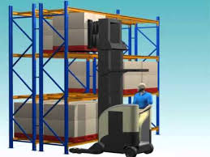
Single Deep Selective Racking Systems
Double Deep Selective Racking Systems

Slide 40
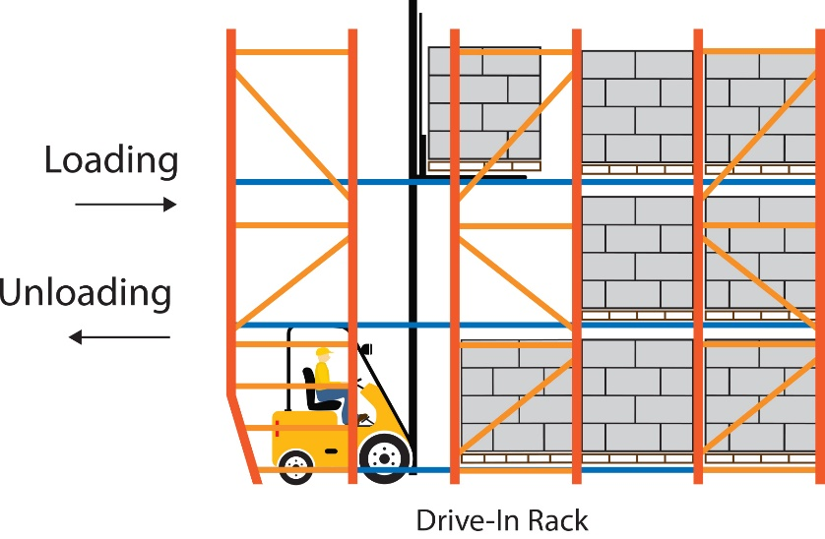
Pallet Flow Through Racking Systems
Drive-In Racking Systems

Slide 41
Push-Back Racking Systems
Pallet Runner Shuttle Systems

Slide 42
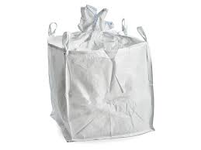
Use the Right Packaging
How do you package or store items on your shelves?
If you’re using larger bins or containers unnecessarily, you can reclaim some of your storage space simply by using smaller containers
Many warehouse managers often overlook how bulk bags can help increase your storage capacity.
Baffle Bags
Duffle Top Bulk Bags

Slide 43
Do Some Housekeeping
Doing so will not only protect the safety and well-being of your employees, it also has the potential to increase your warehouse’s storage capacity.
Just as pallets and boxes can consume valuable floor space, debris and clutter can also reduce the amount of room you have to store things.
The 5S method includes the following steps: sort, set in order, shine, standardize and sustain

Slide 44
Tutorial
In what way may cold-chain storage or refrigerated requirements affect warehouse operations?
When should a business consider building a warehouse?
Consider how the type of stock (goods or materials) a company is distributing and holding may affect the type of warehouse and its location. Reflect on the following three main types of stock:
raw materials and components – ready to use in production
work in progress – stocks of unfinished goods in production
finished goods ready for sale consumables – for example, fuel and stationery
A distribution centre is a specific type of warehouse. Online, carefully read the Wikipedia entry for ‘distribution centre’ and reflect on the following questions:
What is a distribution centre (DC)? Can the term be used interchangeably with warehouse?
What logistics operations are possibly involved in a DC?
What job opportunities can a DC create?

