Slide 2
Value Chain Management MGT804 Week 2
Strategy and managing the supply chain

Slide 3
Supply Chain Macro Processes in a Firm
Last week

Slide 4
Push/Pull system
Last week
https://paginas.fe.up.pt/~als/mis10e/ch9/chpt9-2bullettext.htm
Notes:
https://paginas.fe.up.pt/~als/mis10e/ch9/chpt9-2bullettext.htm

Slide 5
THE BULLWHIP EFFECT
Last week
https://paginas.fe.up.pt/~als/mis10e/ch9/chpt9-2bullettext.htm
Notes:
https://paginas.fe.up.pt/~als/mis10e/ch9/chpt9-2bullettext.htm

Slide 6
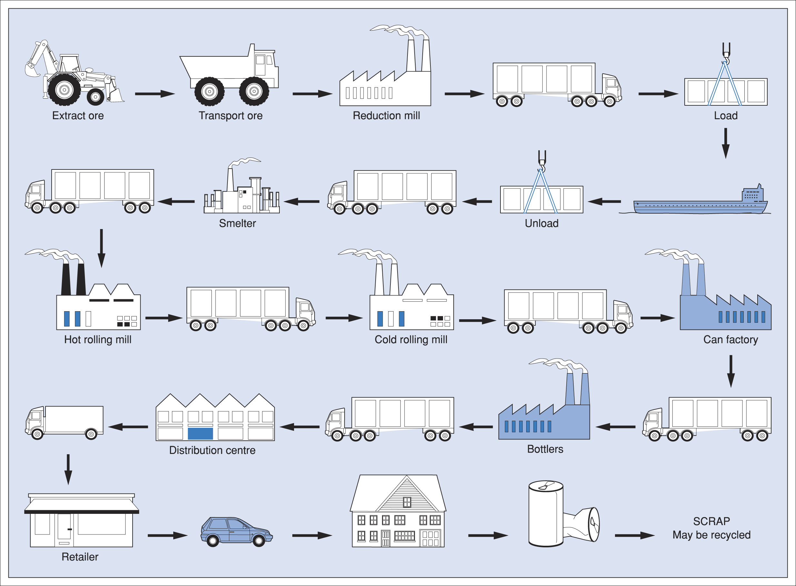
The value stream of a soft drink can
Notes:
As work proceeds, value is added to the material (for the purpose of this illustration value is represented as the amount that the next ‘customer’ in the chain from iron mine to driver pays for the material, less any costs of process or conversion). The various conversion or production operations begin with stocks of incoming material, and end with inventories of goods ready for the next operation. Transportation links the programmes. The diagram shows that cost is being added during storage and movement, but not value, and that if storage and movement can be minimised, value increases more steeply. In addition to the costs that are apparent between the main stages, there are also, of course, intra-organisational costs (costs within the main stages). For example, if the steelmaker can become more efficient through the reduction of wastes associated with the steelmaking process, the value-added slope will be a steeper one for that part of the chain. Value will be added more quickly.
Womack and Jones (1996) described the value stream for a soft drink can (Figure 2.28), recognising that the most difficult component of a can of cola to produce is the can itself. They highlight the stark contrast between the actual value-adding process time and the storage and movement time. They report that around 11 months elapse between the extraction of bauxite (aluminium ore) and the consumption of the contents of the can leading to disposal. Of these 11 months, only approximately 3 hours are spent on conversion of the product. In other words, for more than 99 per cent of the time the value stream is not flowing; the muda (waste) of waiting and queuing is being funded. Professor Dan Jones has referred to purchasing and supply professionals as ‘the architects of the value stream’. There is a good deal of inefficiency in most supply chains; as purchasing develops its more strategic and holistic view of supply as constituting an extended process linking consumers with raw materials, it is predicted that the benefits from increased efficiency will be great.

Slide 7
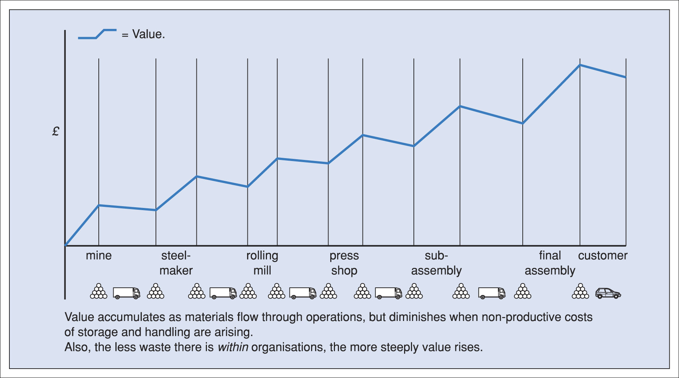
A simplified supply chain or value stream
Notes:
What supply chain management is about is the linkage of the immediate seller/buyer relationship into a longer series of events. A company’s suppliers have their own suppliers, and often the direct customers are not the ultimate consumers. Supply chain management sees the various buyers and sellers as being part of a continuum, and recognises the benefit to be derived from attempting to take a strategic and integrated view of the chain, rather than focusing on the individual links and thereby sub-optimising. In other words, the focus of managerial attention is not just the individual company or organ- isation, but the interactions between the series of organisations that constitute the chain. It might be helpful to visualise the firms in the chain and the flows of goods or services and information passing between them as links. Figure 2.26 may help in this respect. Consider Figure 2.27. It shows some of the major steps in the production of an automobile component in the form of a steel pressing. Iron ore is mined and converted into steel which is rolled into strip form; the component is pressed from the strip and then it is assembled, with others, to form the automobile. In practice there would almost certainly be many more steps; for example, the steel component would be rather likely to become part of a sub-assembly prior to being incorporated into the car.

Slide 8
The concept of strategy
There is no one generally accepted definition of strategy but many, of which the following are examples:
Strategy is the pattern or plan that integrates an organisation’s major goals, policies and action sequences into a cohesive whole. A well formulated strategy helps to marshal and allocate an organisation’s resources into a unique and viable posture based on its relative internal competencies and shortcomings, anticipated changes in the environment and contingent moves by intelligent opponents. (Quinn et al., 1995)
Corporate strategy can be described as an organisation’s sense of purpose. (Lynch, 2005)
Many organisations indicate the strategies they are likely to follow in their mission statements. A mission or philosophy statement is a generalised objective or expression of an organisation’s purpose – a master strategy.
Notes:
There is no one generally accepted definition of strategy but many, of which the following are examples: Strategy is the pattern or plan that integrates an organisation’s major goals, policies and action sequences into a cohesive whole. A well formulated strategy helps to marshal and allocate an organisation’s resources into a unique and viable posture based on its relative internal competencies and shortcomings, anticipated changes in the environment and contingent moves by intelligent opponents. (Quinn et al., 1995) Corporate strategy can be described as an organisation’s sense of purpose. (Lynch, 2005) Many organisations indicate the strategies they are likely to follow in their mission statements. A mission or philosophy statement is a generalised objective or expression of an organisation’s purpose – a master strategy.
In developing a strategy, the following need to be considered: Recipe/paradigm change Figure 2.3 A managerial recipe undergoing change 48 ■ What are target objectives? ■ How are target objectives to be achieved? Strategy covers: ■ moves and approaches which are ongoing; ■ new actions in the process of being mapped out; ■ innovation, risk taking; ■ choosing among alternatives; ■ doing the right things at the right times.
From Figure 2.3 it can be seen that if the recipe/paradigm is incorrect the organisation is likely to experience strategic drift. Typical symptoms of strategic drift are:
■ ■ ■ ■
poor performance; current culture/paradigm overly subscribed to; resistance to change; poor external focus.

Slide 9
The mission statement
This involves management’s vision of what the business is, or should be. Once established, this vision serves to:
shape the future direction the organisation should follow;
establish a strong organisational profile;
and identify core business.
Notes:
This involves management’s vision of what the business is, or should be. Once established, this vision serves to:
shape the future direction the organisation should follow;
establish a strong organisational profile;
and identify core business.

Slide 10
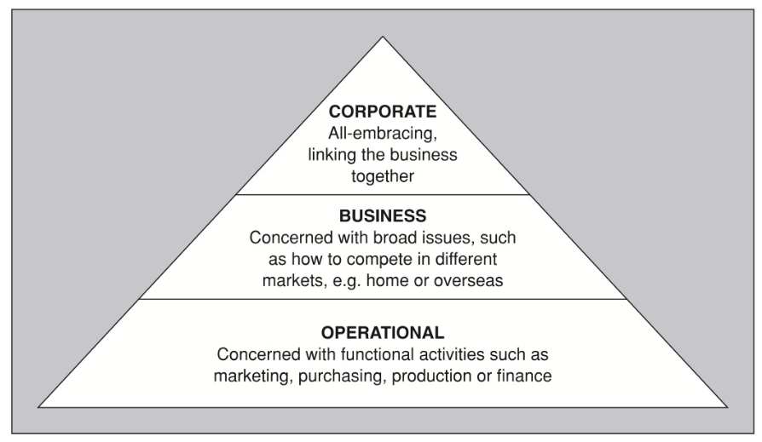
Levels of strategy
Strategies may be determined for various levels in the organisation
Notes:
Strategies may be determined for various levels in the organisation, as illustrated in Figure 2.4. If an organisation has successfully determined strategies at various levels, those strategies should operate together harmoniously. This, of course, requires total involvement and commitment by all concerned. Operational strategies are often reflected in vision statements, such as this example from IBM (UK) Manufacturing:

Slide 11
Strategic management
Strategic management can be divided into three major area:
Strategic analysis – position facing the organisation.
Strategic choice – formulation of alternative courses of action.
Strategic implementation – planning how the choice of strategy can be put into effect.
Notes:
Strategic management can be divided into three major areas:
1 Strategic analysis – position facing the organisation. 2 Strategic choice – formulation of alternative courses of action. 3 Strategic implementation – planning how the choice of strategy can be put
into effect.
Figure 2.6 indicates how these three areas interact, depending on whether one sees strategy as a formalised prescriptive approach (i.e. planned), or emergent (i.e. evolving, incremental and continuous).
Analysis is of particular importance. The emergent approach is more concerned with choice and implementation of a strategy. The emergent approach argues that there is too much turbulence in the analysis stage to predict accurately.
Strategic analysis
Strategic analysis is to do with understanding the relationship between different factors affecting the organisation and its choice of strategies.

Slide 12
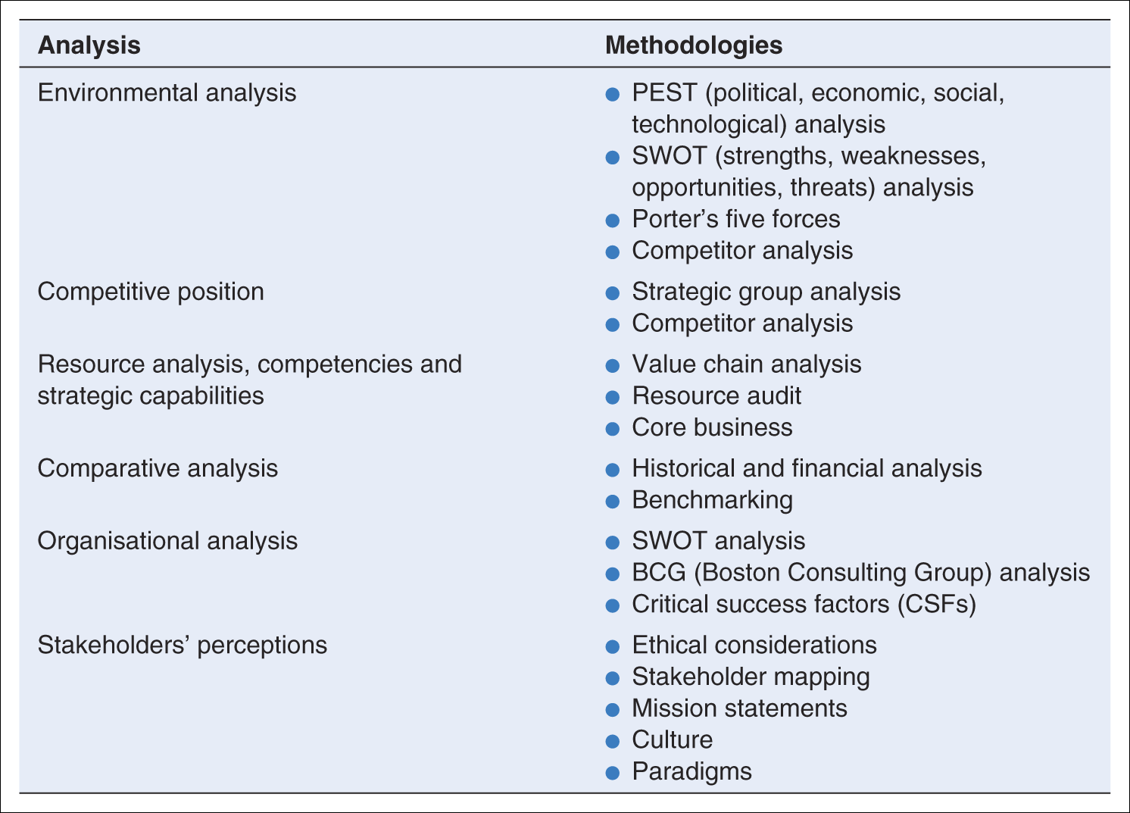
Examples of tools of analysis

Slide 13
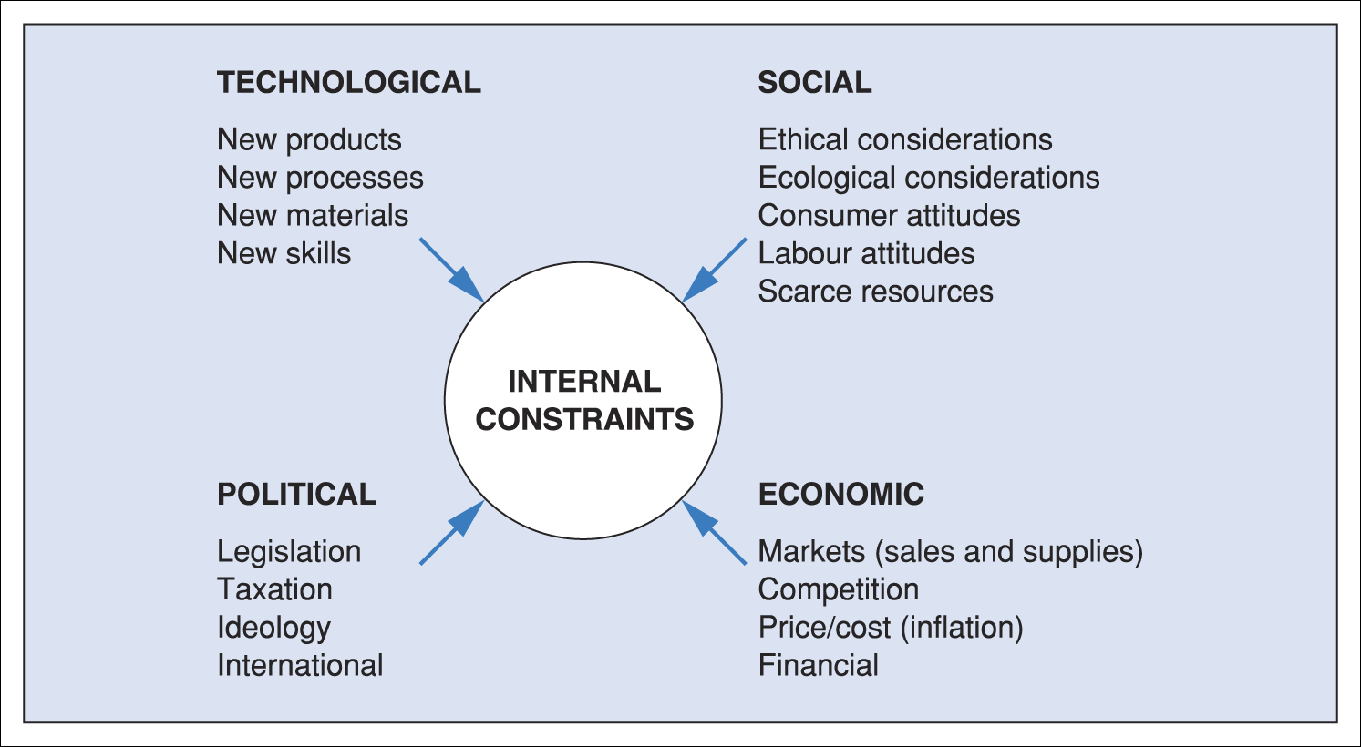
PEST analysis
Notes:
We are essentially thinking in terms of a PEST analysis, and this is illustrated in Figure 2.7, which shows the many factors – under the headings political, economic, social, technological – likely to affect an organisation. (The environment can also be analysed using Porter’s five forces model; see Figure 2.9.) PEST can provide a checklist for evaluating different influences and makes it possible to pinpoint key factors currently affecting the organisation as well as longer-term areas for concern. Organisations concerned with a more global approach will identify key drivers such as market convergence, cost advantage, government influences and global competition.
Bebin ruye khode title bezani ye hyperlink hast, ye site baz mishe kheili khube

Slide 14
Porter’s five forces
https://www.business-to-you.com/porters-five-forces/
Notes:
Porter’s five forces model helps to identify an organisation’s competitive advantage by pointing up those forces affecting the organisation in the environment in which it operates.
https://www.business-to-you.com/porters-five-forces/

Slide 15
Boston Consulting Group (BCG) matrix
Notes:
https://www.professionalacademy.com/blogs-and-advice/marketing-theories---boston-consulting-group-matrix

Slide 16
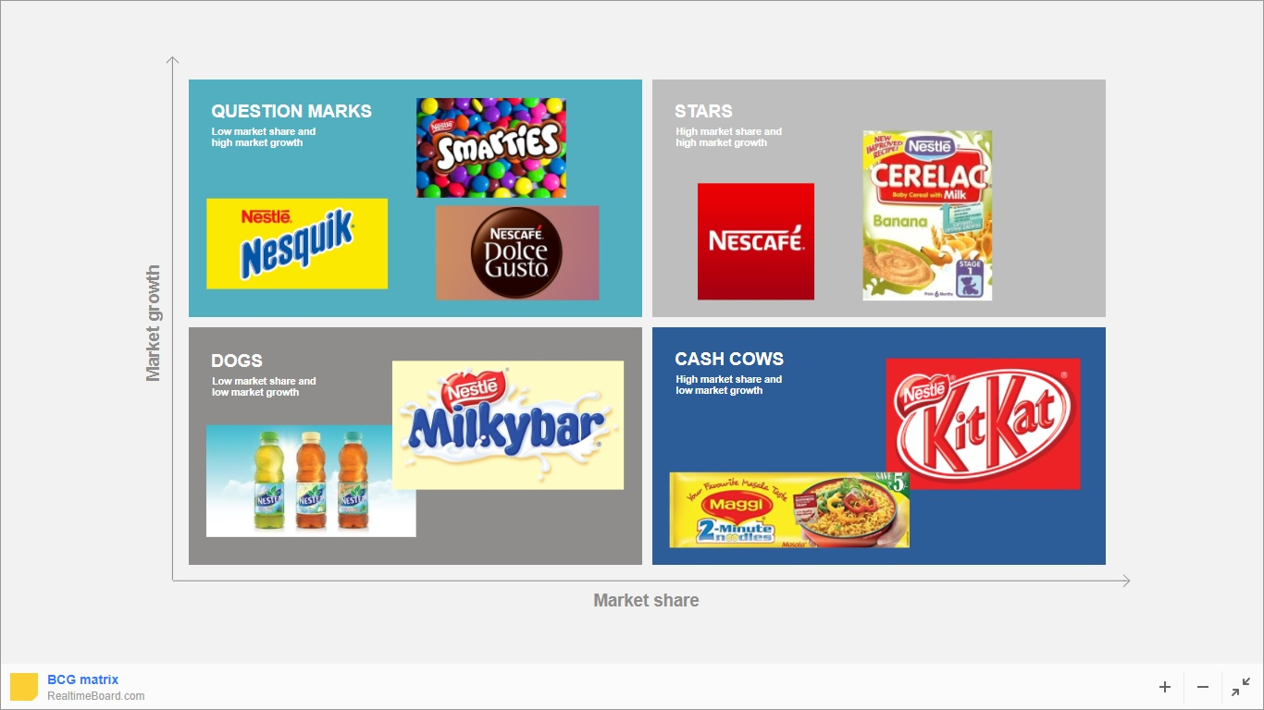
Boston Consulting Group (BCG) Matrix For Nestlé
https://realtimeboard.com/examples/bcg-matrix/

Slide 17
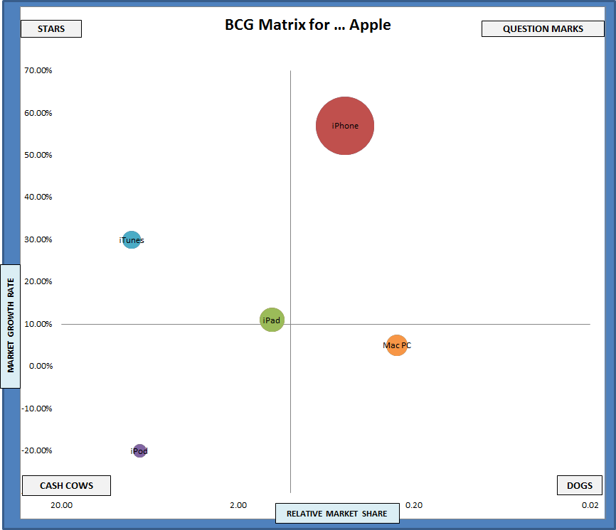
Boston Consulting Group (BCG) Matrix For Apple
http://www.business-portfolio-analysis.com/free-excel-template-download-of-the-bcg-matrix/

Slide 18
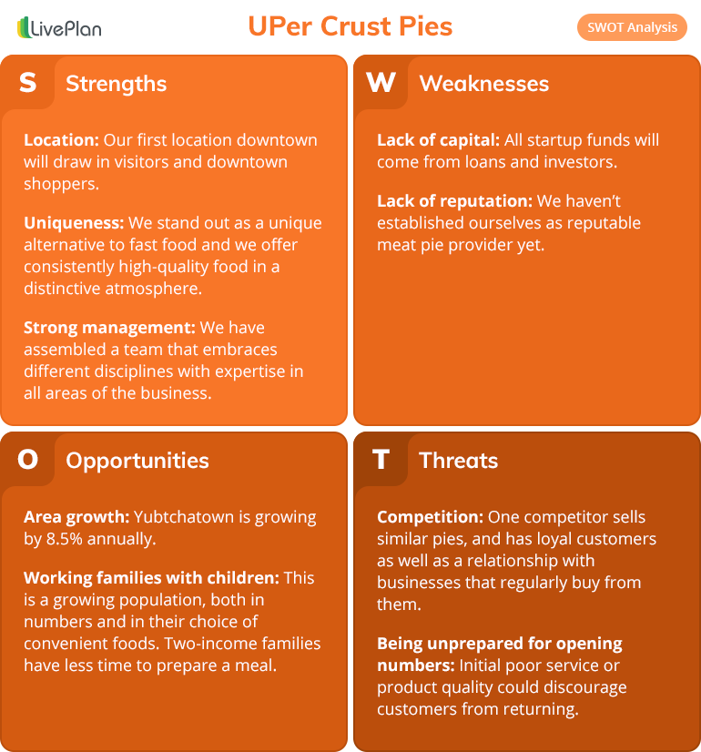
SWOT analysis
To help you get a better sense of what at SWOT example actually looks like, we’re going to look at UPer Crust Pies, a specialty meat and fruit pie cafe in Michigan’s Upper Peninsula. They sell hot, ready-to-go pies and frozen take-home options, as well as an assortment of fresh salads and beverages.
The company is planning to open its first location in downtown Yubetchatown and is very focused on developing a business model that will make it easy to expand quickly and that opens up the possibility of franchising. Here’s what their SWOT analysis might look like:
https://www.liveplan.com/blog/what-is-a-swot-analysis-and-how-to-do-it-right-with-examples/
https://www.liveplan.com/blog/what-is-a-swot-analysis-and-how-to-do-it-right-with-examples/
Notes:
https://www.liveplan.com/blog/what-is-a-swot-analysis-and-how-to-do-it-right-with-examples/

Slide 19
Strategic development

Slide 20
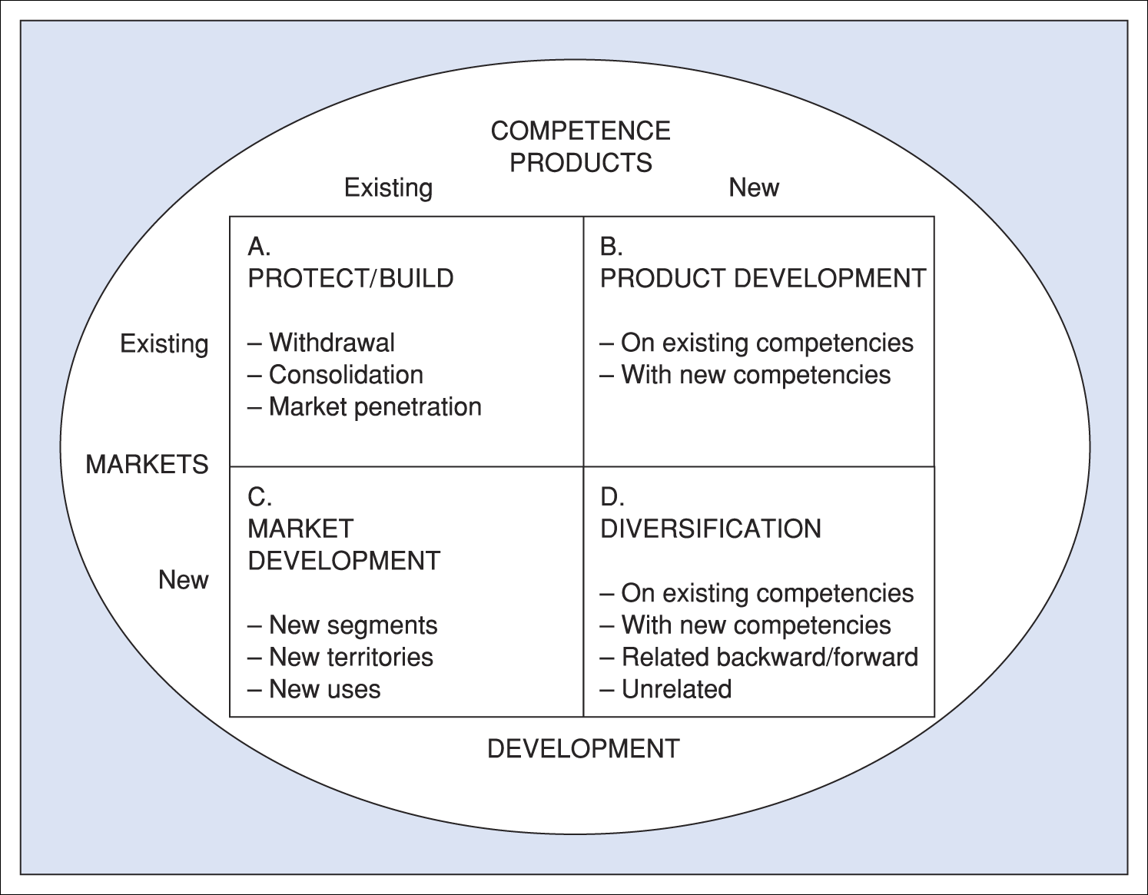
Directions for strategy development from Ansoff
Doogh
Notes:
https://aaronhoos.com/2011/03/01/sales-funnel-strategy-and-the-ansoff-growth-matrix/

Slide 21
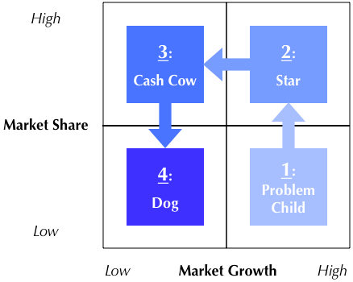
Boston Consulting Group (BCG) Matrix
https://themarketingagenda.com/2014/09/20/unilever-bcg-matrix/
Notes:
https://themarketingagenda.com/2014/09/20/unilever-bcg-matrix/

Slide 22
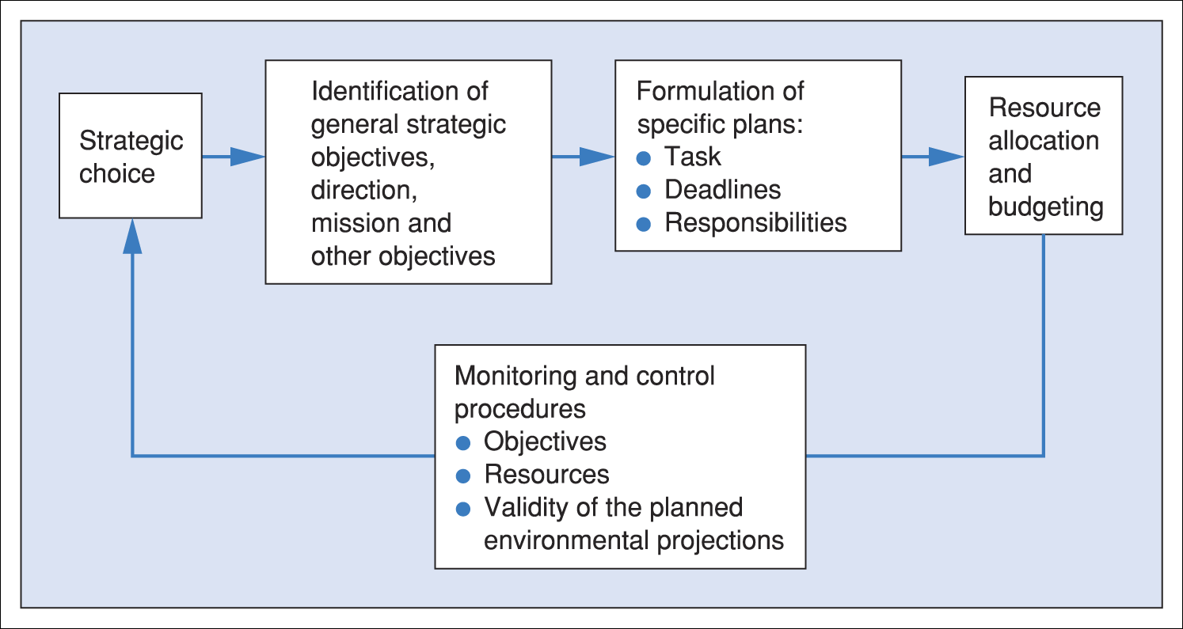
Strategy implementation
Having decided the strategic option, we need to implement the strategy. This involves resource allocation, planning and control, organisational aspects, human resource issues and management of change. Correct information is at the heart of the process. A time scale and action plan will need to be prepared. A typical implementation plan from Lynch is shown in Figure 2.1
Notes:
It might be useful at this stage to consider purchasing objectives in the form of a ‘hierarchy’. Figure 2.15 suggests the way in which this might be done, though of course the chart will differ from one organisation to another

Slide 23
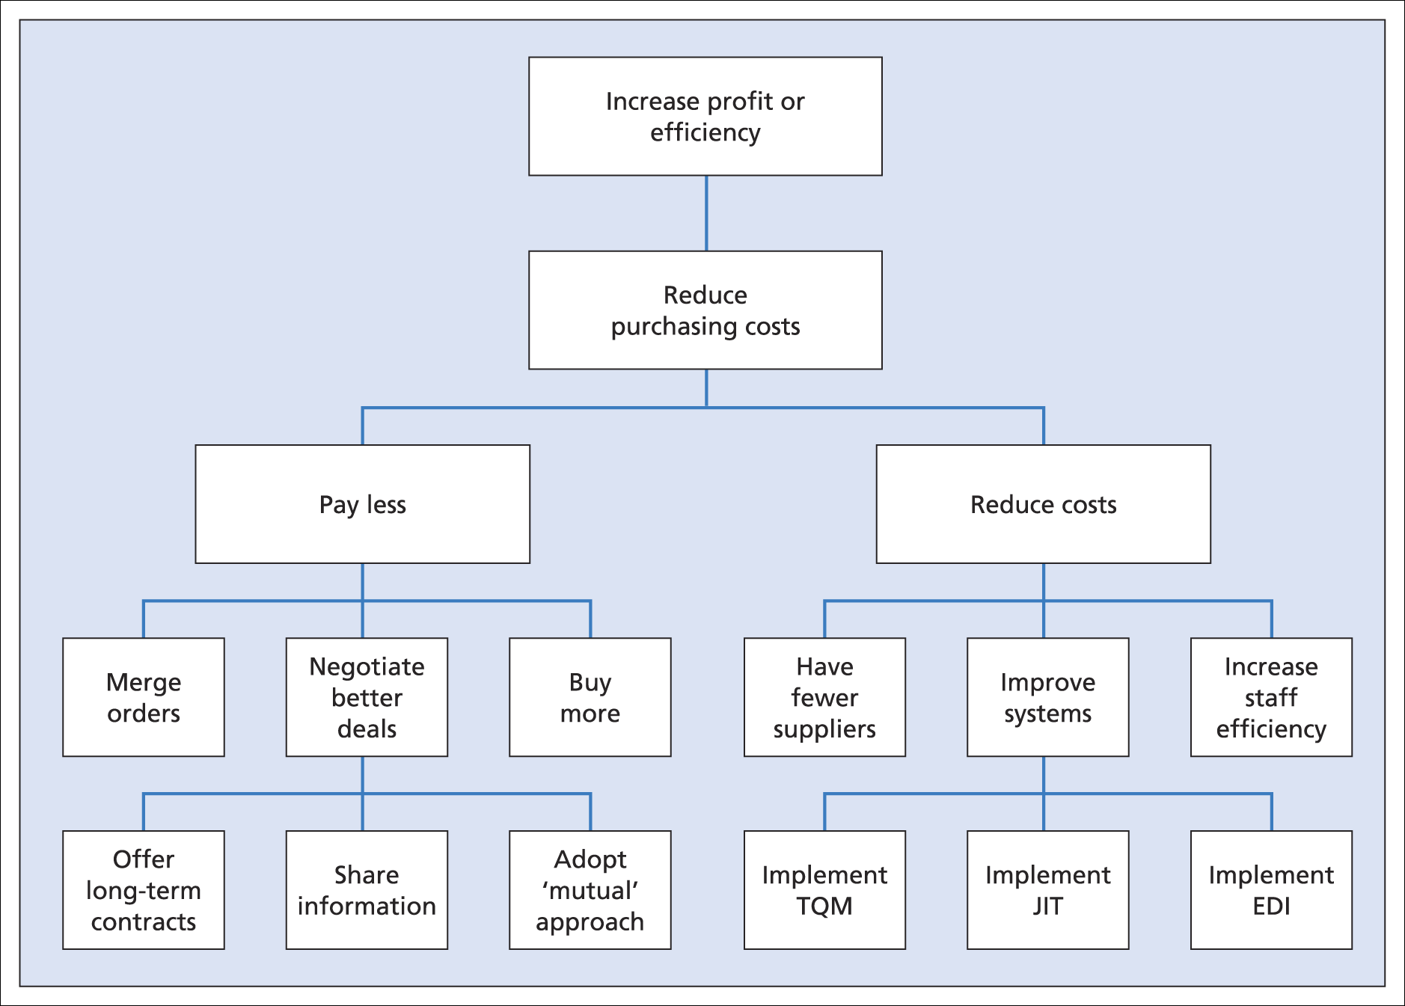
Analysis of cost reductions in purchasing

Slide 24
Balanced scorecard

Slide 25
Notes:
https://www.intrafocus.com/2016/06/balanced-scorecard-example/

Slide 26
BSC
https://www.intrafocus.com/2016/06/balanced-scorecard-example/

Slide 27
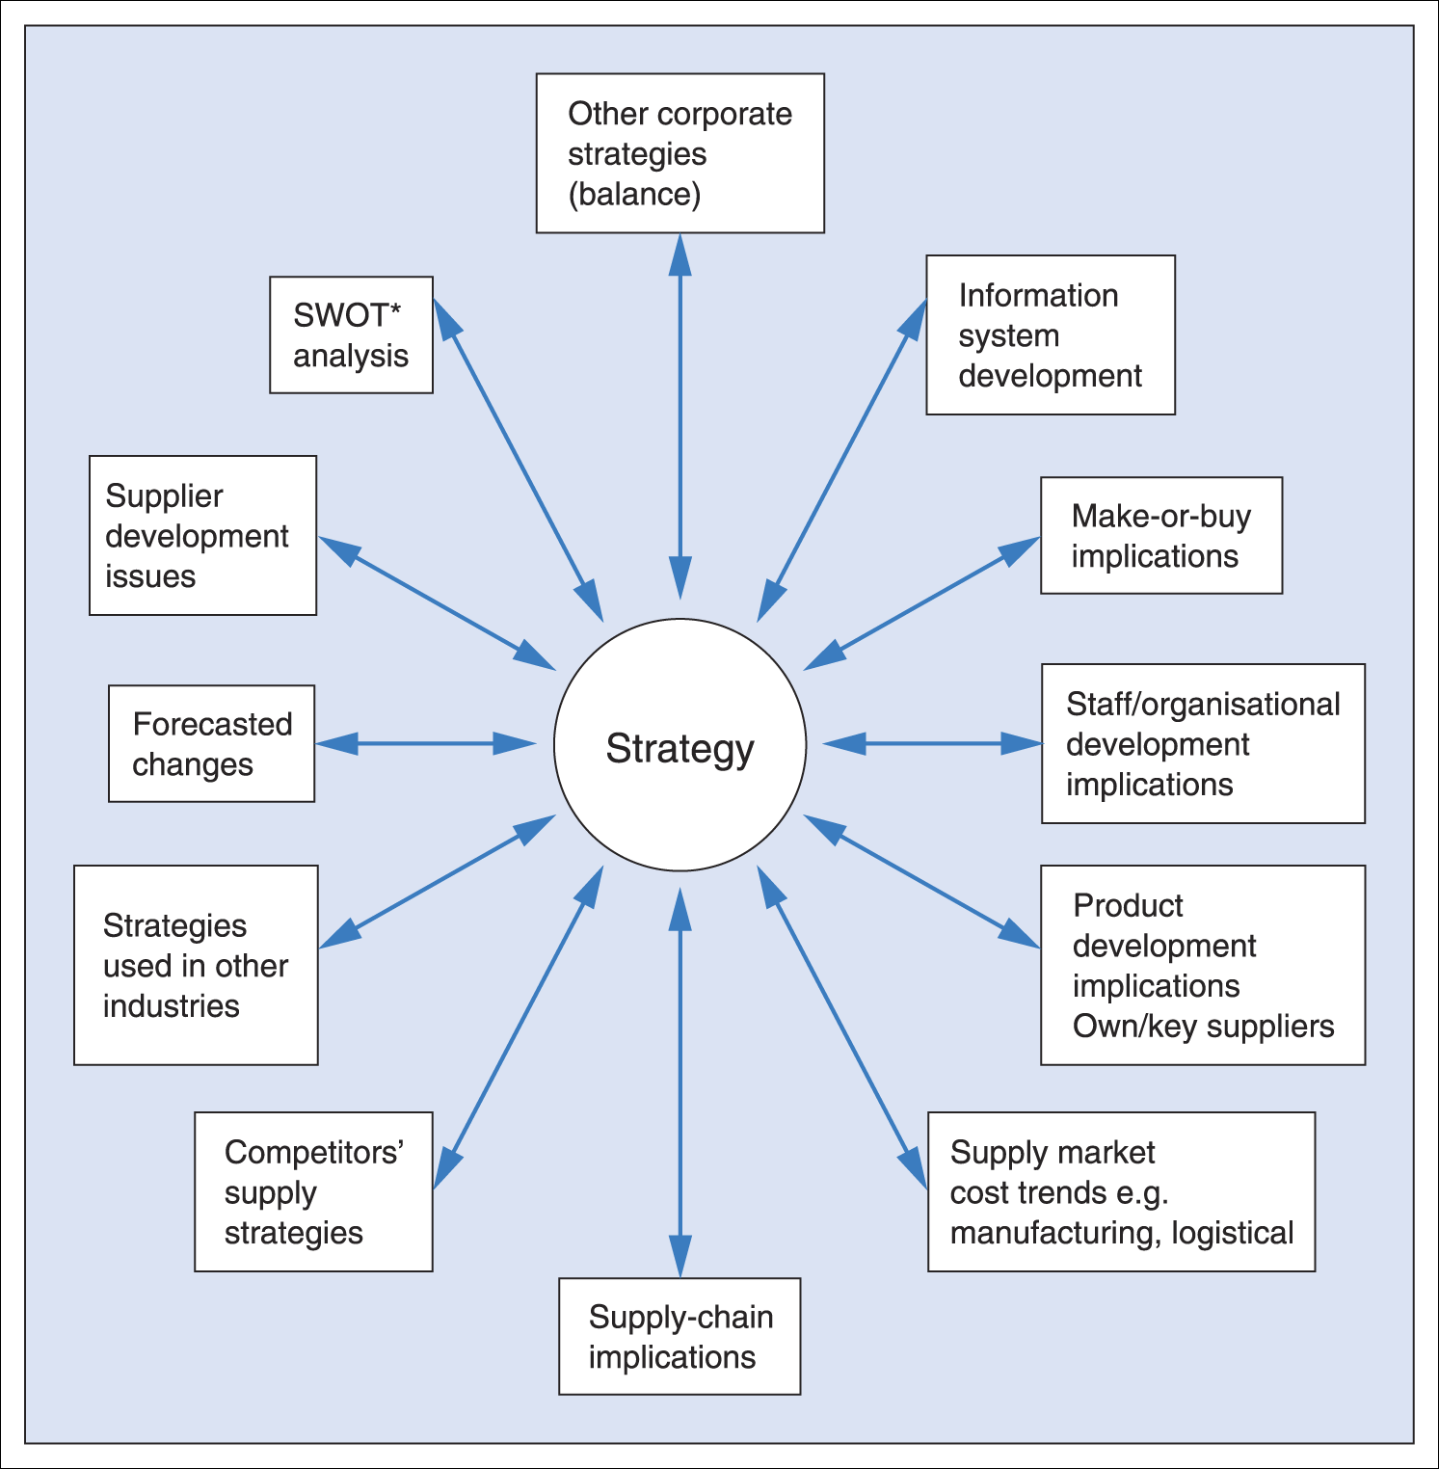
Some influences on strategy decisions
Note: *Strengths, Weaknesses, Opportunities, Threats
Notes:
Figure 2.16 illustrates some of the factors involved in selecting and developing a strategy. Clearly, tactical and operational behaviour must support the strategic approach selected. For example, if the aim of the strategy was to set up a range of dedicated suppliers – that is, suppliers who are the sole source for a particular item – it would be nonsense for buyers to seek quotations from other suppliers during the period of the agreement (at least with the implication that business might be placed). If the strategy involved developing a local source to avoid reliance upon an overseas supplier (involving currency management), it would be foolish not to support that supplier, even if, in the short term, it was more expensive.
As will be seen from Figure 2.16, many factors influence the choice of a strategy. Among them are:
■ The position of the business in its supply chain. For example, is it a supplier of raw materials, components or finished product? How many competitors does it have in its supply and end markets?
■ The number of effective sources in the company’s supply market. ■ The pace of technological development in the supply and end markets. ■ The volatility of the supply and/or end markets. ■ The degree of government involvement in the marketplace (e.g. the defence
market). ■ The ability of the buying company to manage a strategy (e.g. the quality
and number of staff in the area and the ability to influence behaviour in the business).
The key criteria in the development of effective purchasing strategies are the same as those that apply to marketing strategies. They should focus on the areas of greatest potential in terms of contribution; exploit the competitive advantages available to the buying company as a consequence of its particular mix of resources; emphasise creative management in use of those resources vis-à-vis competition (buyers or sellers); stress consistency and feasibility and specify who, what, when, why, where and how through an effective plan. Although there may be advantages in copying the strategies of competi- tors, they need to be considered carefully in the light of the company’s own strengths and weaknesses. There may be advantages too, with the same caveat, of considering the strategies of companies in other industries. What supply strategies currently being applied in other industries might be adaptable in our circumstances? (See Figure 2.17.) ■ Have we developed our IT capabilities particularly in the area of e-commerce? ■ How integrated are our supply chains?

Slide 28
Key terms/concepts check
PEST analysis
Porter’s five forces
Levels of strategy
Directions for strategy development from Ansoff
Strategic management
Boston Consulting Group (BCG) matrix
SWOT analysis
BSC

