Slide 2
Value Chain Management MGT804
Week 1
Introduction to Value
Chain Management

Slide 3
Supply Chain Management
Supply Chain: A supply chain consists of all parties involved, directly or indirectly, in fulfilling a customer request.
The supply chain includes not only the manufacturer and suppliers, but also transporters, warehouses, retailers, and even customers themselves.
Within each organization, such as a manufacturer, the supply chain includes all functions involved in receiving and filling a customer request. These functions include, but are not limited to, new product development, marketing, operations, distribution, finance, and customer service
Sometimes referred to as value chains

Slide 4
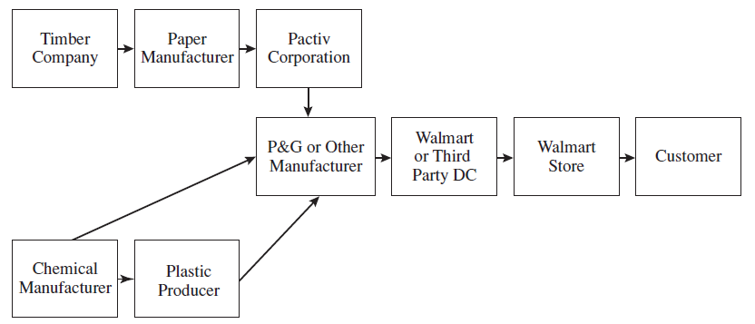
Example: Stages of a Detergent Supply Chain

Slide 5
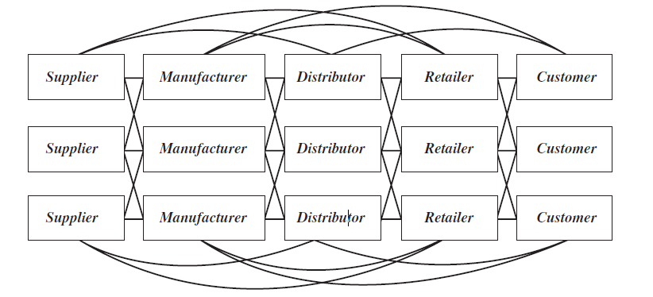
Supply Chain Stages
A typical supply chain may involve a variety of stages, including the following:
  Customers
  Retailers
  Wholesalers/distributors
  Manufacturers
  Component/raw material suppliers
Each stage in a supply chain is connected through the flow of products, information, and funds.

Slide 6
The Objective of a Supply Chain
The objective of every supply chain should be to maximize the overall value generated.
The value (also known as supply chain surplus) a supply chain generates is the difference between what the value of the final product is to the customer and the costs the entire supply chain incurs in filling the customer’s request.
Supply Chain Surplus = Customer Value - Supply Chain Cost
The value of the final product may vary for each customer and can be estimated by the maximum amount the customer is willing to pay for it.

Slide 7
The Importance of Supply Chain Decisions
There is a close connection between the design and management of supply chain flows (product, information, and funds) and the success of a supply chain:
Walmart has been a leader in sharing information and collaborating with suppliers to bring down costs and improve product availability. The results are impressive. In its 2013 annual report, the company reported a net income of about $17 billion on revenues of about $469 billion. These are dramatic results for a company that reached annual sales of only $1 billion in 1980. The growth in sales represents an annual compounded growth rate of more than 20 percent.

Slide 8
The Importance of Supply Chain Decisions
Seven-Eleven Japan is another example of a company that has used excellent supply chain design, planning, and operation to drive growth and profitability.
It has used a very responsive replenishment system along with an outstanding information system to ensure that products are available when and where customers need them. Its responsiveness allows it to change the merchandising mix at each store by time of day to precisely match customer demand.
As a result, the company has grown from sales of 1 billion yen in 1974 to almost 1.9 trillion yen in 2013, with profits in 2013 totaling 222 billion yen.

Slide 9
Video
Best Career in America: Supply Chain Management

Slide 10
Decision Phases in a Supply Chain
Successful supply chain management requires many decisions relating to the flow of information, product, and funds. Each decision should be made to raise the supply chain surplus. These decisions fall into three categories or phases:
Supply chain strategy or design
Supply chain planning
Supply chain operation

Slide 11
Supply chain strategy or design:
During this phase, a company decides how to structure the supply chain over the next several years.
It decides what the chain’s configuration will be, how resources will be allocated, and what processes each stage will perform. Strategic decisions made by companies include:
  whether to outsource or perform a supply chain function in-house,
  the location and capacities of production and warehousing facilities,
  the products to be manufactured or stored at various locations,
  the modes of transportation to be made available along different shipping legs, and
  the type of information system to be used.

Slide 12
Supply chain planning:
For decisions made during this phase, the time frame considered is a quarter to a year. Therefore, the supply chain’s configuration determined in the Strategic phase is fixed.
This configuration establishes constraints within which planning must be done. The goal of planning is to maximize the supply chain surplus that can be generated over the planning horizon given the constraints established during the strategic or design phase.
Companies start the planning phase with a forecast for the coming year (or a comparable time frame) of demand and other factors, such as costs and prices in different markets.
Planning includes making decisions regarding which markets will be supplied from which locations, the subcontracting of manufacturing, the inventory policies to be followed, and the timing and size of marketing and price promotions.

Slide 13
Supply chain operation:
The time horizon here is weekly or daily. During this phase, companies make decisions regarding individual customer orders. At the operational level, supply chain configuration is considered fixed and planning policies are already defined.
The goal of supply chain operations is to handle incoming customer orders in the best possible manner.
During this phase, firms allocate inventory or production to individual orders, set a date by which an order is to be filled, generate pick lists at a warehouse, allocate an order to a particular shipping mode and shipment, set delivery schedules of trucks, and place replenishment orders.

Slide 14
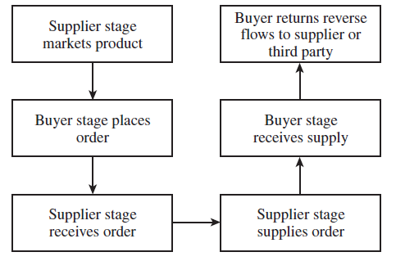
Subprocesses in Each Supply Chain Process Cycle

Slide 15
Supply Chain Macro Processes in a Firm
All supply chain processes can be classified into the following three macro processes
1. Customer relationship management (CRM): all processes at the interface between the
firm and its customers
2. Internal supply chain management (ISCM): all processes that are internal to the firm
3. Supplier relationship management (SRM): all processes at the interface between the
firm and its suppliers

Slide 16
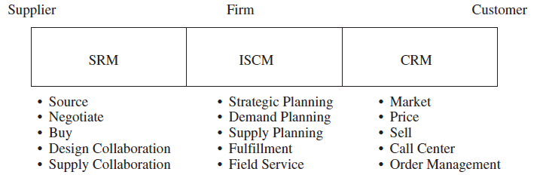
Supply Chain Macro Processes in a Firm

Slide 17
Functions and Activities
Forecasting
Purchasing
Inventory management
Information management
Quality assurance
Scheduling
Production and delivery
Customer service

Slide 18
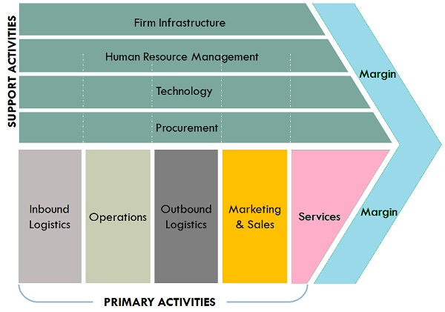
Value chain

Slide 19
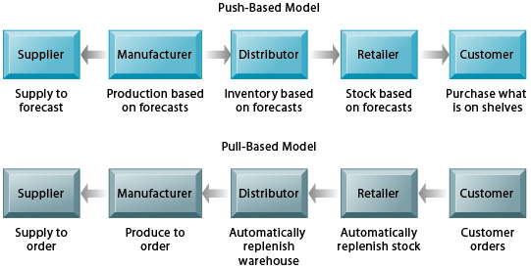
Push/Pull system
https://paginas.fe.up.pt/~als/mis10e/ch9/chpt9-2bullettext.htm

Slide 20
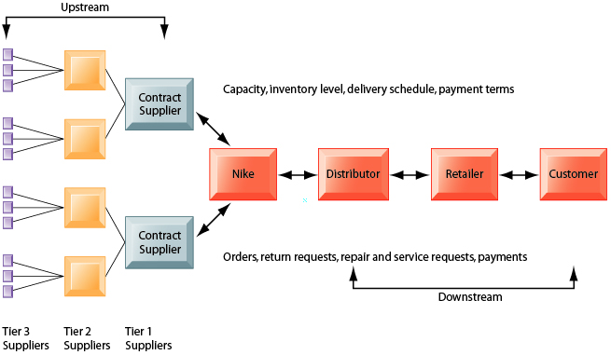
NIKE’S SUPPLY CHAIN
https://paginas.fe.up.pt/~als/mis10e/ch9/chpt9-2bullettext.htm

Slide 21
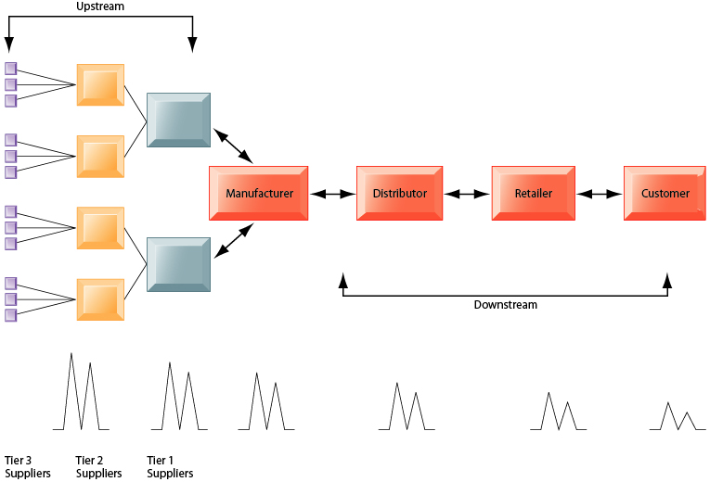
THE BULLWHIP EFFECT
https://paginas.fe.up.pt/~als/mis10e/ch9/chpt9-2bullettext.htm

Slide 22
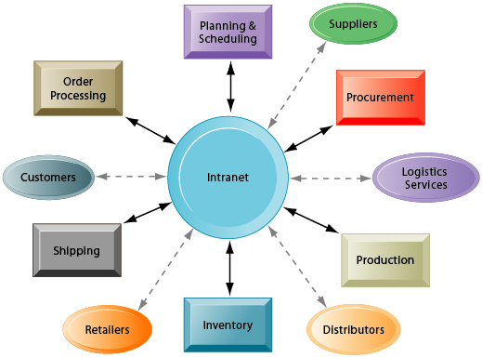
INTRANETS AND EXTRANETS FOR SUPPLY CHAIN MANAGEMENT
https://paginas.fe.up.pt/~als/mis10e/ch9/chpt9-2bullettext.htm

Slide 23
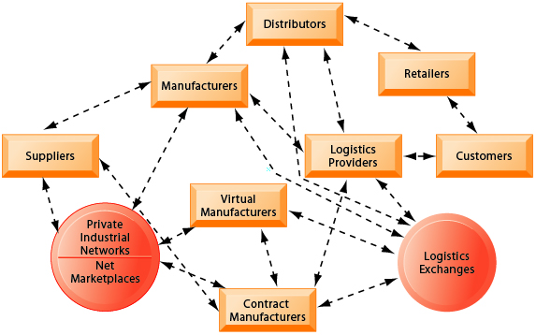
THE FUTURE INTERNET-DRIVEN SUPPLY CHAIN
https://paginas.fe.up.pt/~als/mis10e/ch9/chpt9-2bullettext.htm

Slide 24
Key terms
Supply Chain
Supply Chain Stages
Supply Chain Surplus
Supply chain strategy or design
Supply chain planning
Supply chain operation
CRM
ISCM
SRM
Push/Pull system
Upstream/downstream chain
The bullwhip effect

