Slide 2
MGT804 Value Chain Management
Week 9
Sales and Operations Planning

Slide 3
Sales and Operations Planning
Involves:
Strategic and tactical considerations
Top-down planning
Bottom-up planning
Optimization techniques

Slide 4
Sales and Operations Planning (S&OP)
Purpose: Select capacity options over the intermediate time horizon
Capacity options:
Workforces
Shifts
Overtime
Subcontracting
Inventories
etc.

Slide 5
Time Horizon View . . .
Short-Range Plan (days, weeks out) | S&OP (months out) | Long-Range Plan (years out)
Capacity levels considered “frozen” in the short-term | Changes in adjustable capacity possible | Changes in fixed capacity possible

Slide 6
S&OP continued
(2 - 18 months out)
Outside of time frame ⇨ strategic planning
Inside of time frame ⇨ tactical planning
“Big Picture” approach to planning
Families or groups (aggregation) of:
Products
Resources
Technologies or skills
Provide “rough” estimates

Slide 7
Position in the Overall Business Planning Cycle
Decisions | Time Frame
Product and process “Bricks and Mortar” | 18+ months
Employment and overall inventory levels What demand to meet? | 2 to 18 months
Specific products and times Scheduling of people and equipment | Less than 2 months
Long-Range
Plans
S&OP
Short-Range
Plans

Slide 8
Inputs to the Process
Demand Management
Forecasts of customer demand
Need for spares, etc.
Pricing
Strategic Capacity Levels
Existing buildings
Processes
S&OPs
External Capacities
Suppliers
Subcontractors

Slide 9
Advantages of S&OP
Negotiated process
“Agreed” demand
Functional coordination
Budgets and cash flow analyses
Reduces operations and supply chain tasks to “meeting the plan”

Slide 10
S&OP Approaches
Top-Down
Similar products OR stable mix
Standards available for planning
time, cost requirements from history and/or planning documentation
Can “Average” product
Bottom-Up
Different products AND unstable mix
Requires forecasts and production data for individual products
Can be extremely data-intensive

Slide 11
Planning Values
Translate forecast into:
Resources required
Labor hours per unit
Material quantities
Equipment hours
Subcontractors?
Costs
Materials
Labor
Subcontractors?
Hiring/firing costs
Inventory holding costs

Slide 12
Top-Down Planning
Develop the aggregate sales forecast and planning values.
Translate the sales forecast into resource requirements.
Personnel, equipment, materials
Generate alternative production plans.
Chase, level, mixed
Select the best of the plans.
Lowest cost, best fit to capability

Slide 13
Top-Down Example I (Pennington Cabinet Product Data)
Product | % of Total | Labor/Unit
A100 | 10% | 40 hours
B200 | 50% | 20 hours
C300 | 20% | 15 hours
D400 | 5% | 10 hours
E500 | 10% | 20 hours
F600 | 5% | 10 hours

Slide 14
Top-Down Example II (“Average” Products)
Product | % of Total | Labor/Unit
A100 | 10% | 40 hours
B200 | 50% | 20 hours
C300 | 20% | 15 hours
D400 | 5% | 10 hours
E500 | 10% | 20 hours
F600 | 5% | 10 hours
10%(40) + 60%(20) + 20%(15) + 10%(10) = 20 hours

Slide 15
Top-Down Example III (Conditions or Constraints)
Agreed upon demand to be met for upcoming 12 month period
Can vary workforce and inventory levels
No backordering
“Average” unit requires 20 worker hours
Each worker works 160 hours per month
Notes:
Class discussion about where these conditions or constraints can come from: Top management, company culture, general policy, desired service level for customers, etc.

Slide 16
Top-Down Example IV (Demand Forecast for 12 months)
Month | Demand |  | Month | Demand
January | 750 |  | July | 910
February | 760 |  | August | 910
March | 800 |  | September | 910
April | 800 |  | October | 880
May | 820 |  | November | 860
June | 840 |  | December | 840

Slide 17
Top-Down Example V (Other tidbits of data …)
Start and end with 100 workers (goal)
Start and end with about 100 units in inventory (goal)
The above conditions allow fair cost comparisons of various aggregate plans.

Slide 18
Pennington Cabinet
Strategic Capacity Level: 848 jobs per month
Company produces make-to-stock cabinets for sale at Lowe’s, etc.
Planning values:
Average hours of labor per cabinet = 20 hours
Regular production cost = $2000 per cabinet set
Overtime production cost = $2062 per cabinet set
Average monthly holding cost = $40 per cabinet set
Hours per month per employee = 160 hours
Hiring cost = $1750 per employee
Layoff cost = $1500 per employee
Allowable overtime = 16 hours per employee

Slide 19
Pennington (continued)
Raw Demand for next 7 months:
January 750 jobs
February 760
March 800
April 800
May 820
June 840
July 910
What are our options . . . ?
Notes:
Class discussion before proceeding, what would the students do?

Slide 20
Pennington (again) . . .
Raw Demand
1000
Monthly capacity = 848
500
Need 910
July

Slide 21
Detail of First Seven Months from Level Strategy
Month | Demand | Demand in Employee Hours | Employees to Meet Production Plan | Actual Employees | Actual Production | Hirings | Layoffs | Ending Inventory
January | 750 | 15000 | 94 | 105 | 840 | 5 | 0 | 190
February | 760 | 15200 | 95 | 105 | 840 | 0 | 0 | 270
March | 800 | 16000 | 100 | 105 | 840 | 0 | 0 | 310
April | 800 | 16000 | 100 | 105 | 840 | 0 | 0 | 350
May | 820 | 16400 | 103 | 105 | 840 | 0 | 0 | 370
June | 840 | 16800 | 105 | 105 | 840 | 0 | 0 | 370
July | 910 | 18200 | 114 | 105 | 840 | 0 | 0 | 300
Note: We develop a level strategy by setting “Actual Employees” equal to the average required for the 12 month planning period
Notes:
(840 cabinets x 20 hours)/(160 hours per employee)

Slide 22
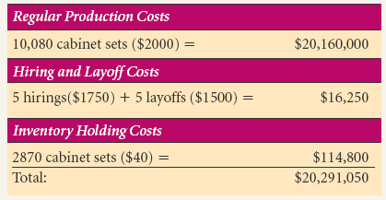
Level Plan Cost Details for the Full Year from the Text

Slide 23
Detail of First Seven Months from Chase Strategy
Month | Demand | Demand in Employee Hours | Employees to Meet Production Plan | Actual Employees | Actual Production | Hirings | Layoffs | Ending Inventory
January | 750 | 15000 | 94 | 94 | 752 | 0 | 6 | 102
February | 760 | 15200 | 95 | 105 | 760 | 1 | 0 | 102
March | 800 | 16000 | 100 | 105 | 800 | 5 | 0 | 102
April | 800 | 16000 | 100 | 105 | 800 | 0 | 0 | 102
May | 820 | 16400 | 103 | 105 | 824 | 3 | 0 | 106
June | 840 | 16800 | 105 | 105 | 840 | 2 | 0 | 106
July | 910 | 18200 | 106 | 105 | 848 | 1 | 0 | 106
Note: We develop a chase strategy by setting “Actual Employees” equal to the number needed in each period subject to maximum capacity constraint of 848 (see July, here remaining demand of 62 units is done by using overtime).

Slide 24
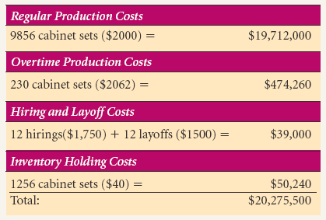
Chase Plan Cost Details for the Full Year from the Text

Slide 25
Mixed Strategy
A compromise between level and chase plan extremes to reduce total cost. For the Pennington example, we
Keep 100 employees at beginning, which builds up inventory slowly
Reduces hiring/layoff costs by only changing workforce gradually
Use overtime only toward the end of the year.

Slide 26
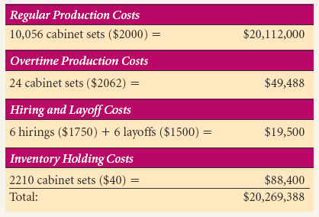
Mixed Plan Cost Details for the Full Year from the Text

Slide 27
Top-Down Example (Other Issues …)
Are complete costs shown?
Expand out for budget and cash flow analysis
“Input” (suppliers) and “output” (logistics and warehousing) considerations
Lead time, materials availability, storage space?
Variations in actual production
Scrap, rework, equipment breakdowns

Slide 28
Top-Down Option (We could subcontract production)
Maximum subcontract of ??? units/month..
Cost is more per unit than internal production cost
Will this option:
1) increase costs?
2) decrease costs?
3) have no effect on costs?
Issues:
Quality?
Source of materials (separate supplier allowed?)
Loss of proprietary information

Slide 29
Bottom-Up Iterative Approach (Similar to Top Down)

Slide 30
Detail from Philips Toys Bottom Up Plan
Notes:
From Table 13.9 in text

Slide 31
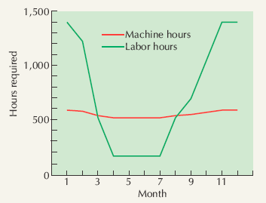
… and Load Profile for Production

Slide 32
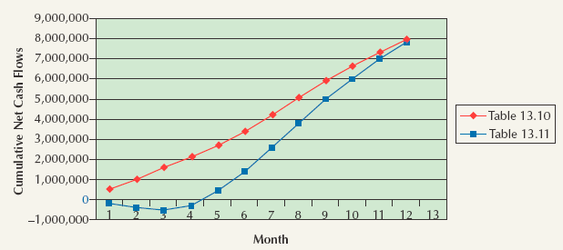
Cash Flow Analysis
Net cash flow = cash inflows – cash outflows
Different sales scenarios can have significant effect on cash flow as shown for the Pennington example in the text.

Slide 33
Advanced Topic: Optimization Modeling
What is optimization modeling?
Essential conditions
Application to operations problems

Slide 34
Optimization Modeling
Family of mathematical techniques used to allocate limited resources among competing demands in an optimal way
What is our financial objective?
What are our constraints?

Slide 35
Optimization Example 1
Product mix:
Find the product mix that will maximize revenue, given limits on materials, labor hours, and machine hours available

Slide 36
Optimization Example 2
S&OP:
Find the workforce and inventory levels which will minimize hiring, layoff, and inventory costs while still meeting demand.

Slide 37
Choosing Between Plans
Effect on supply chain partners?
What are the cash flows like?
Is there space for the inventory?
Effects on the workforce morale?
Is staffing available when needed?
How flexible is the plan?

Slide 38
Options for Services
Smooth out demand:
Appointments
Discounts and promotions
Seasonal complements
Yield management
Tiered workforce:
Full-time and part-time
Customer involvement (offloading)

Slide 39
Linking S&OP Throughout the Supply Chain
Good information systems (EDI) are necessary for success, flexibility, and reducing uncertainty

Slide 40
S&OP Optimization
Two major types of problems
Maximize profit or revenues subject to resource constraints
Minimize costs subject to demand requirements

Slide 41
Optimization Essential Conditions I
Explicit objective function
Maximize revenue or profit
Minimize costs
2. Some constraint(s)
Resource limits
Demand requirements

Slide 42
Optimization Essential Conditions II
Conditions can be expressed mathematically
Revenue = $1000X
Variable cost = $310X
Assembly hours needed = 15X
Divisibility OK to make half a unit or hire two thirds of an individual

Slide 43
Optimization Example 1
Transportation Problem: Minimize the cost of shipping items from different plants to different stores

Slide 44
Optimization Example 2
Material Yield: Minimize the amount of scrap generated by cutting steel, fabric, wood, etc.
Scrap Material

Slide 45
Minimization Problem
S&OP: “Meet the production plan with the minimum total hiring, firing, and inventory cost”
Can you figure out how the problem would be defined?

Slide 46
What to Take Away from this ...
Essential conditions:
Explicit objective function
Constraints
Linearity
Divisibility
Write out an objective function or constraint for simple problem
Can use Excel Solver

Slide 47
Further Reading:
Kaipia, R., Holmström, J., Småros, J., & Rajala, R. (2017). Information sharing for sales and operations planning: Contextualized solutions and mechanisms. Journal of Operations Management, 52, 15-29.
Qi, J., & Ellinger, A. E. (2017). A conceptual framework of organizational orientation antecedents of sales and operations planning. In Creating Marketing Magic and Innovative Future Marketing Trends (pp. 13
Hulthén, H., Näslund, D., & Norrman, A. (2017). Challenges of Measuring the Sales and Operations Planning Process. Operations and Supply Chain Management, 10(1), 4-16.19-1329). Springer, Cham.

Slide 48
Vidal, J. B., Lauras, M., Lamothe, J., & Miclo, R. (2018, September). Adaptive sales & operations planning: Innovative concept for manufacturing collaborative decisions?. In Working Conference on Virtual Enterprises (pp. 362-374). Springer, Cham.
Stentoft, J., Freytag, P. V., & Eckhardt, S. (2018). Sales & Operations Planning: It's all about people. Dilf Orientering, 55(3), 42-49.
Schwarz, J. A. (2018). Sales and operations planning for product rollovers: structural insights.

Slide 49
Noroozi, S., & Wikner, J. (2017). Sales and operations planning in the process industry: a literature review. International Journal of Production Economics, 188, 139-155.
Darmawan, A., Wong, H., & Thorstenson, A. (2018). Integration of promotion and production decisions in sales and operations planning. International Journal of Production Research, 1-21.
Nemati, Y., Madhoshi, M., & Ghadikolaei, A. S. (2017). The effect of Sales and Operations Planning (S&OP) on supply chain’s total performance: A case study in an Iranian dairy company. Computers & Chemical Engineering, 104, 323-338.

