Slide 1
Week 8 - Leadership development and self awareness

Slide 2
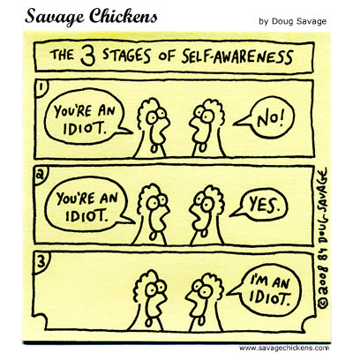
This week’s topic
Organisational leadership is both an individual and an organizational phenomenon.
This week we are focusing on the individual component and why the ability to understand your own personality is a precondition for effective leadership.

Slide 3
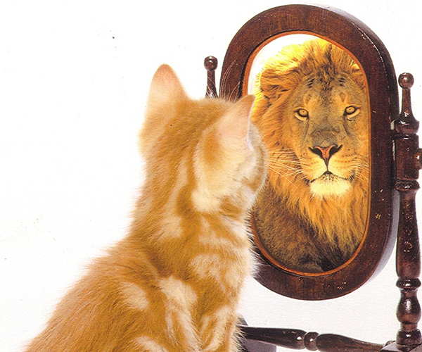
The importance of self-awareness
Self-awareness means being conscious of the internal aspects of one’s nature, such as personality traits, emotions, values, attitudes, and perceptions, and appreciating how your patterns affect other people
Who are you?
And what do you stand for?
When leaders understand themselves, they remain grounded. People know what to expect from them.

Slide 4
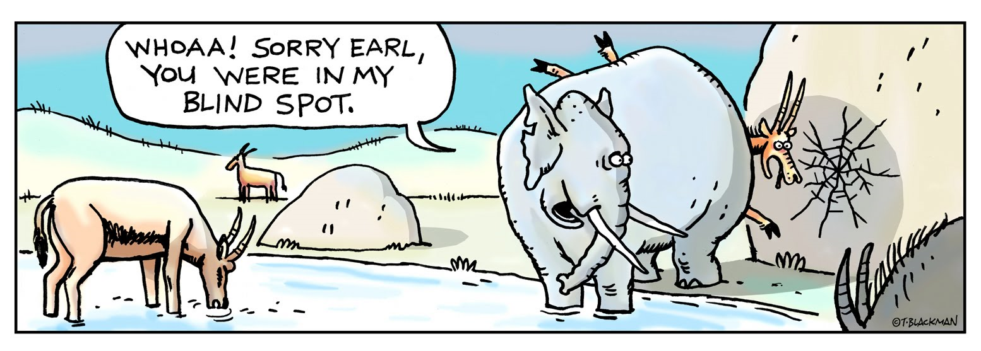
Detect your blind spots
Blind spots
things we are not aware of or don’t recognize as problems
Two common blind spots for leaders
Aggressive, confrontational style Being too nice

Slide 5
A model of personality
Personality is the set of unseen characteristics and processes that underlie a relatively stable pattern of behaviour in response to ideas, objects, or people in the environment.
The big 5 personality dimensions:
Extroversion (sociable, talkative, dominant)
Agreeableness (cooperative, compassionate, understanding, trusting)
Openness to new experiences (creative, curious, broad interests)
Conscientiousness (responsible, persistent, achievement oriented)
Emotional stability

Slide 6
What is personality?
Personality:
The sum total of ways in which an individual reacts and interacts with others; measurable traits a person exhibits
Where does Personality come from? Nature v Nurture

Slide 7
What is personality?
Personality traits:
Enduring characteristics that describe an individual’s behaviour
Where does Personality come from? Nature v Nurture

Slide 8
What is personality?
Personality:
– The particular way an individual affects others and understands him or herself •
Early personality theorists such as Freud were generally biologists and physicians who tried to understand personality development by the study of physiology •
An early question in this study was “Are great men born, or are they made?

Slide 9
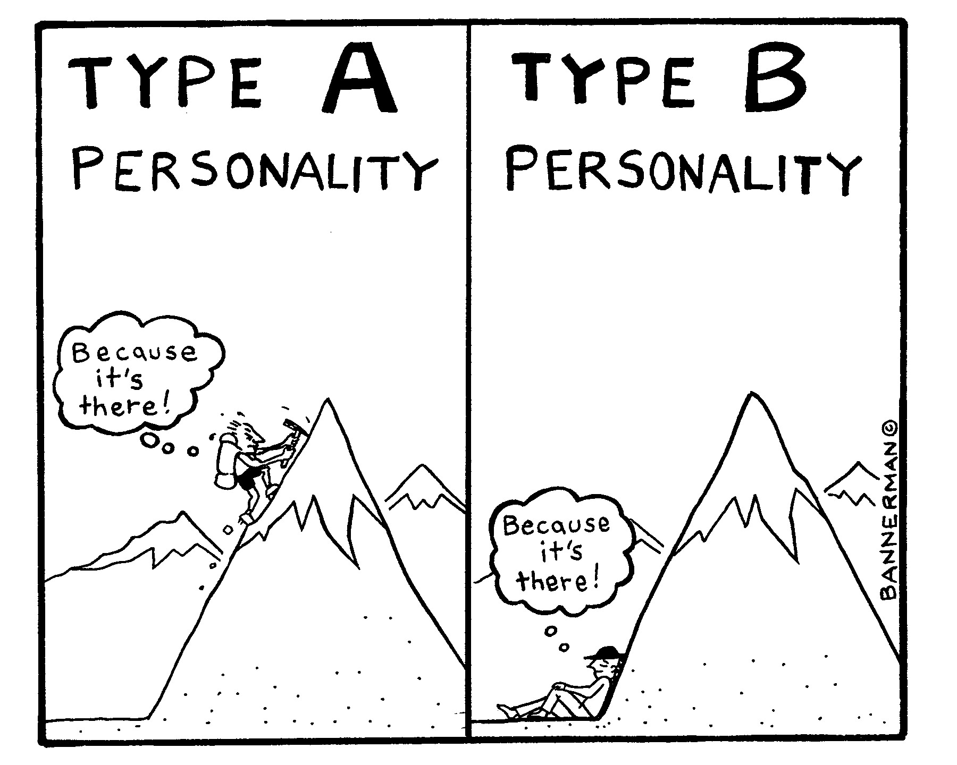
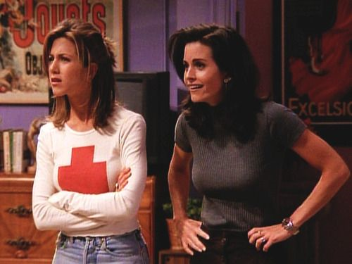
Simple Classification of Personality Type
Type A - competitive, high achievers, high sense of time urgency.
Type B – relaxed, laid back and not easily stressed.

Slide 10
The Myers–Briggs Type Indicator
Myers–Briggs Type Indicator (MBTI)
A personality test that taps four characteristics and classifies people into one of 16 personality types
http://www.truity.com/view/types

Slide 11
The Myers–Briggs Type Indicator
Personality types
Extroverted versus Introverted (E or I)
Sensing versus Intuitive (S or N)
Thinking versus Feeling (T or F)
Judging versus Perceiving (J or P)
Score is a combination of all four (e.g., ENTJ)
http://www.truity.com/view/types

Slide 12
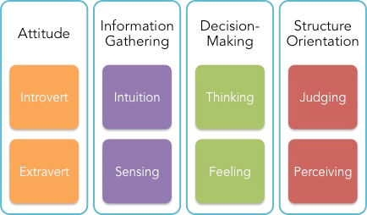
The Myers-Briggs Type Indicator (MBTI)
A commonly used assessment in how individuals differ in various areas. Based on the work of psychologist Carl Jung.

Slide 13
The Myers-Briggs Type Indicator (MBTI)
A commonly used assessment in how individuals differ in various areas. Based on the work of psychologist Carl Jung.
Extraversion ………….. Introversion
Sensing …………………….. iNtuitive
Thinking …………..………….. Feeling
Judging …………….……. Perceiving

Slide 14
The Big Five Model of personality dimensions
Extroversion
Sociable, gregarious and assertive
Agreeableness
Good-natured, cooperative and trusting
Conscientiousness
Responsible, dependable, persistent and organised
Emotional stability
Calm, self-confident, secure under stress (positive), versus nervous, depressed and insecure under stress (negative)
Openness to experience
Curious, imaginative, artistic and sensitive

Slide 15
The Dark Triad
Three other socially undesirable traits, which we all have in varying degrees, are relevant to organisational behaviour:
Machiavellianism
Narcissism
Psychopathy
Owing to their negative nature, researchers have labelled these three traits the Dark Triad—though, of course, they don’t always occur together.

Slide 16
Caution
Self-reporting nature of Personality tests
Research often finds no relationship between personality and workplace performance
Situational strength theory
Trait activation theory
What ‘impact’ does personality testing have on workers?

Slide 17
Values
Definition:
Basic convictions that a specific mode of conduct or end-state of existence is personally or socially preferable to an opposite mode of conduct (i.e., what is right and good)
Terminal values
Desirable end states
Instrumental values
The ways/means for achieving one’s terminal values
Value system
A hierarchy based on a ranking of an individual’s values in terms of their intensity
Note: values vary by cohort

Slide 18
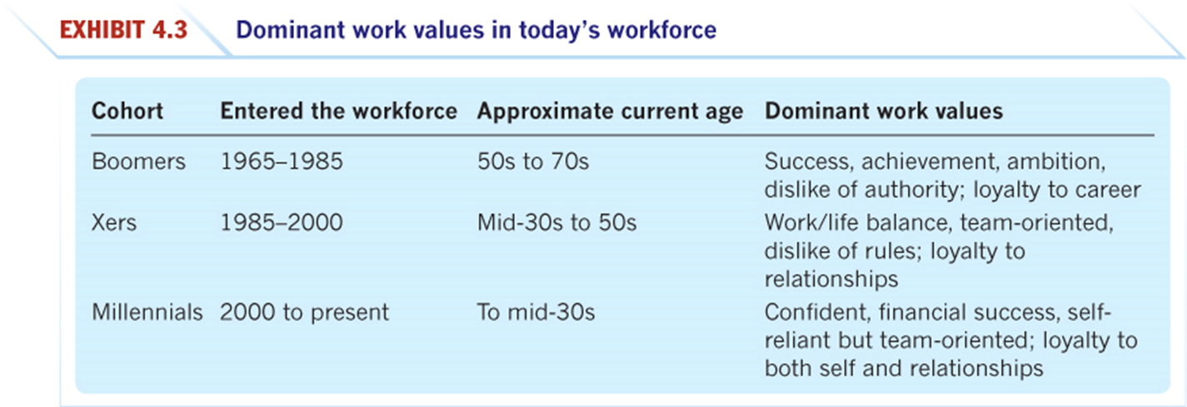
Dominant work values in today’s workforce

Slide 19
Achieving person–job fit
Personality–job fit theory (Holland)
Identifies six personality types and proposes that the fit between personality type and occupational environment determines satisfaction and turnover
Personality types:
Realistic
Investigative
Social
Conventional
Enterprising
Artistic

Slide 20
Person–organisation fit
Researchers in recent years have looked at matching people to organisations as well as to jobs.
The person–organisation fit essentially argues that people are attracted to and selected by organisations that match their values, and they leave organisations that are not compatible with their personalities.
Research on person–organisation fit has looked at whether people’s values match the organisation’s culture. This match predicts job satisfaction, commitment to the organisation and low turnover.

Slide 21
Leaders who are self-aware
Tend to have a greater understanding of others
Can relate to or empathise with co-workers
Tend to be more trusted
Are generally perceived as being competent
Are generally able to reduce the potential for conflict
Are more likely to be open to feedback

Slide 22
Self Awareness of knowing our
Weaknesses
Strengths
Biases
Attitudes
Values
Perceptions
Motivations
Preferences
Personal styles ……….

Slide 23
Self Awareness is knowing our
. and understanding how these factors influence our:
Judgements
Decisions
Interactions with other people
Effective leaders should monitor the affect they have on other people
…….

Slide 24
Activity
. Answer each of these questions honestly:
Be aware of
others’
perceptions
Appropriate
self-disclosure
Be open to
diverse
experiences
Be willing to
self-analyse
Developing Self-awareness
(self concept)
GREATER EMOTIONAL INTELLIGENCE

Slide 25
Ways to self analyse
. Answer each of these questions honestly:
What are your strengths?
What are your weakness?
What are your short-term goals?
What are your long-term goals?
What are your top 5 values?

Slide 26
Behaviour
Behaviour is influenced by many things including
our:
Values
Feelings
Motivations
Needs
Experience
Patterns develop through:
Reactions to events
Actions over a period of time

Slide 27
Behaviour
Attitudes are determined by those values
and emotions we choose to act on
these vary from situation to situation
are derived from parents, teachers, peers, society, and our own experiences
easier to influence and change than our behaviors or values
can have an impact on our professional and personal relationships

Slide 28
Perception
May not always be consistent with reality
Important to be aware of ours and others
Influenced by many factors

Slide 29
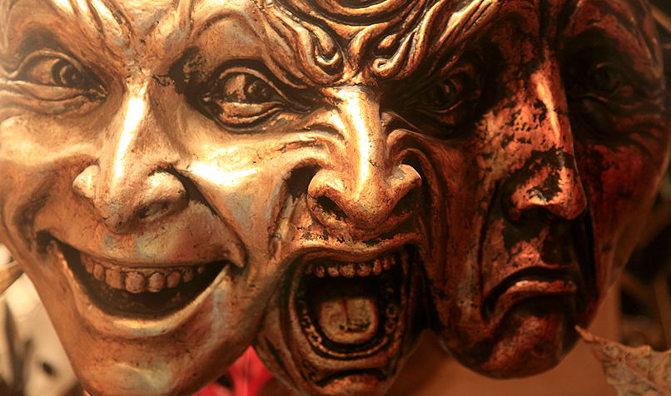
Assessing your personality
Personality and other psychometric tests help people better understand themselves and relate to one another. They facilitate self-reflection, which leads to better self-awareness
However, constant self-observation and seeking for feedback are crucial factors on the way of becoming a successful leader. The trinity of self-awareness is: know yourself, improve yourself, and complement yourself.

Slide 30
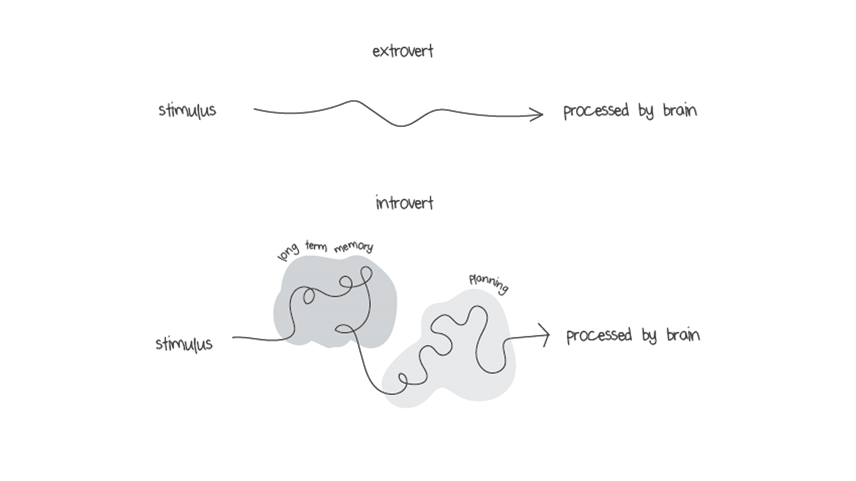
The power of introverts ….
… in a world that can’t stop talking. Susan Cain
Misconceptions about introverts
Introverts are shy and antisocial
Introverts have a personality flaw
Introverts don’t make good leaders

Slide 31
Locus of control and authoritarianism: Personality attributes significantly affecting our behaviour
Internals believe their actions determine what happens to them
Externals believe they have little control over their fate
Locus of control
Low degree: Belief that power and status differences should not exist within organizations
High degree:
Adherence to rules, obey authority, respect power, disapprove expression of personal feelings
Authoritarianism

Slide 32
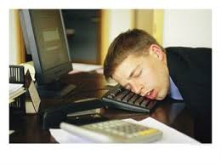
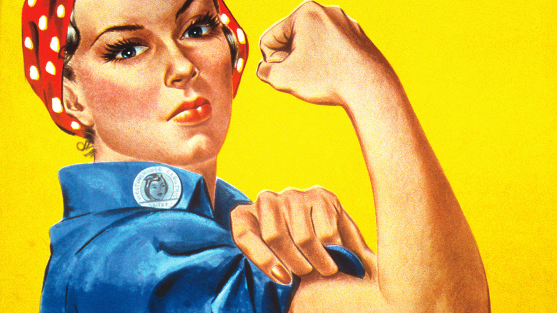
Leader’s attitudes
An attitude is an evaluation – either positive or negative – about people, events or things. A leader’s attitude toward followers influence how he or she relates to people.
Theory X
People are basically lazy, not motivated to work. They need to be coerced, controlled, directed.
Theory Y
People are motivated, want to learn, are imaginative and seek responsibility.

Slide 33
Dealing with perceptual distortions
Perception: Process people use to make sense out of the environment by selecting and interpreting information. Perceptual distortions: Errors in judgement that arise from inaccuracies in the perceptual process.
4 Perceputal Distortions
1
2
3
4
Stereotyping:
Assigning an individual to a broad category, then attribute generalizations about the group to the individual
Halo effect:
Overall impression of a person based on one characteristic
Projection:
Tendency to see one’s own personal traits in other people
Perceptual defense:
Tendency to protect oneself by disregarding situations and people that are unpleasant

Slide 34
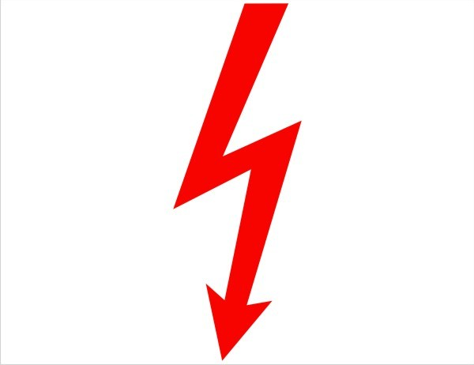
Attributions – Judgements about what caused an event or behaviour
Two major approaches:
Internal attribution: Characteristics of the person led to the behaviour
External attribution: Something about the situation caused the person’s behaviour.
Fundamental Attribution Error
Underestimation of external factors and overestimation of internal factors
Self-Serving Bias
To give too much credit for what you do well and blame external factors when failing

Slide 35
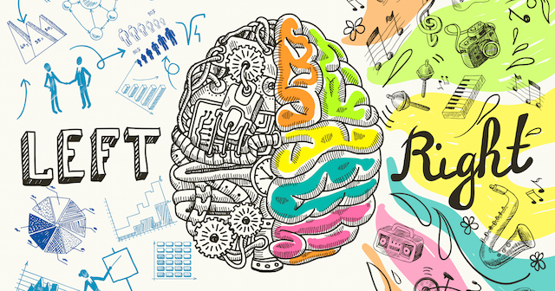
Brains are different: How we perceive, process, interpret and use information
Creativity
Imagination
Think holistic
Intuition
Arts
Rhythm
Feeling
Tune of Song
Logic
Analysis
Sequencing
Mathematics
Language
Think in words
Words of Song
Concept of left-brained and right-brained thinking is not entirely accurate physiologically, but it is a powerful and useful metaphor.

Slide 36
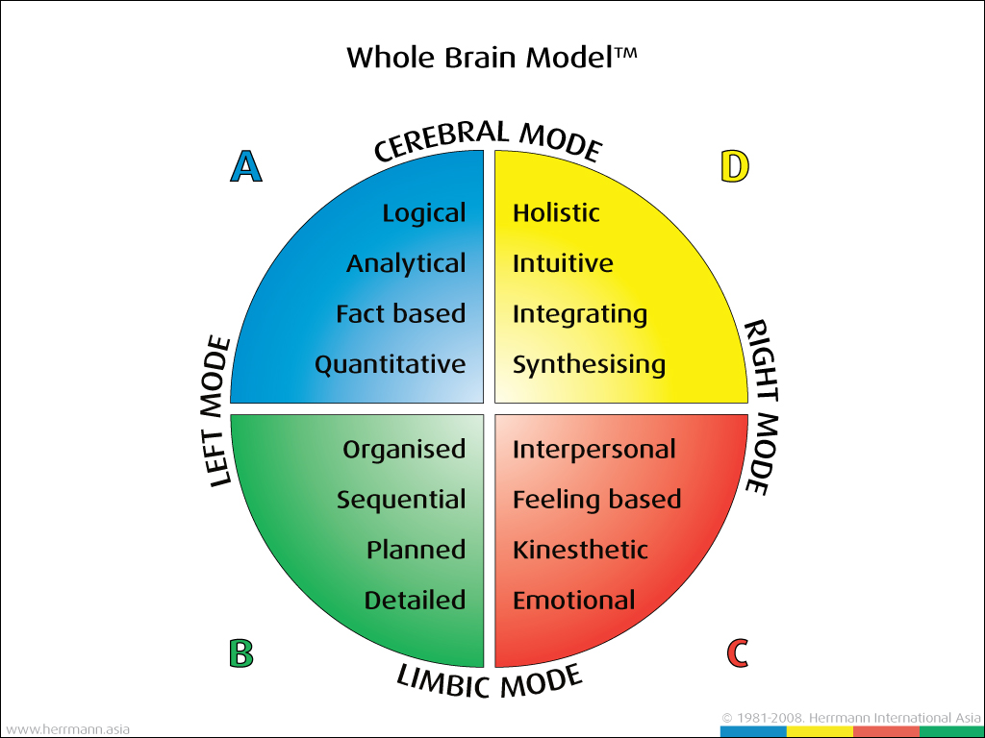
Ned Hermann’s Whole Brain Concept
Leaders tend to be directive and authoritative
Leaders are visionary, take risks and break rules
Leaders are conservative and risk averse
Leaders are friendly, supportive and trusting

Slide 37
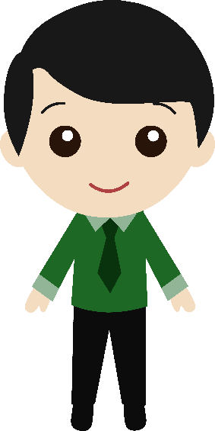
Working with different personality types
Treat everyone with respect
Understand your own personality
Understand how others perceive you and how you react to others
Acknowledge each person’s strengths
Strive for understanding
Remember that everyone wants to fit in

