Slide 1
Week 6
Leadership and Change in a Global Context

Slide 2
Learning Objectives
Recognize the environmental forces creating a need for change in today’s organizations
Describe the qualities of a change leader and how leaders can serve as role models for change
Implement the eight-stage model of planned change

Slide 3
Learning Objectives
Use appreciative inquiry to engage people in creating change by focusing on the positive and learning from success
Apply techniques of enabling immersion, facilitating brainstorming, promoting lateral thinking, allowing pauses, and nurturing creative intuition to expand your own and others’ creativity and facilitate organizational innovation

Slide 4
Learning Objectives
Provide a positive emotional attractor, supportive relationships, repetition of new behaviors, participation and involvement, and after-action reviews to overcome resistance and help people change

Slide 5
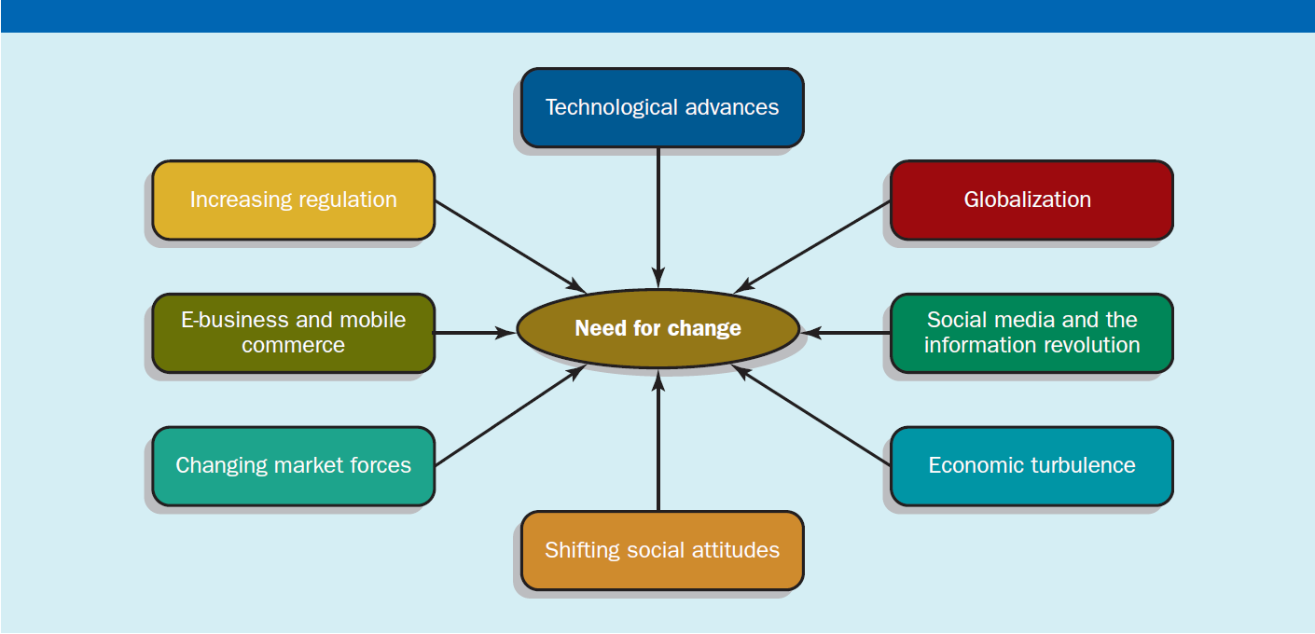
Exhibit 15.1 – Forces Driving the Need for Change Leadership

Slide 6
Resistance to Change
Most people naturally resist change
Leaders should be prepared for resistance and find ways to enable people to see the value in changes needed to succeed

Slide 7
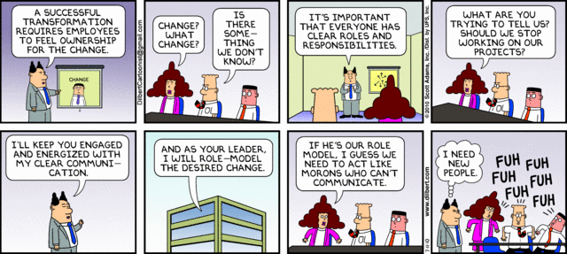
Change management require a compelling change story, communicating it to employees and following it up with ongoing communications and involvement

Slide 8
Characteristics of a Leader as a Change Agent
Define themselves as change leaders
Demonstrate courage
Believe in employees being responsible
Assimilate and articulate values that promote adaptability
Recognize and learn from their own mistakes
Capable of managing complexity, uncertainty, and ambiguity
Have vision

Slide 9
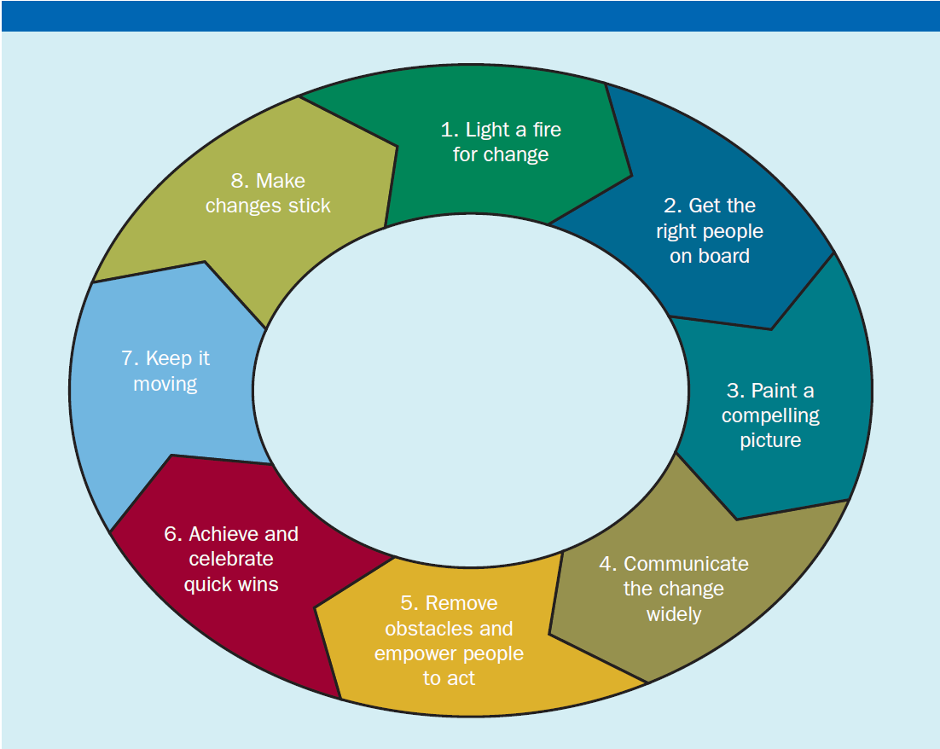
Exhibit 15.2 – The Eight-Stage Model of Planned Organizational Change
Sources: Based on John P. Kotter, Leading Change (Boston: Harvard Business School Press, 1996), p. 21.

Slide 10
Appreciative Inquiry (AI)
A technique for leading change that engages individuals, teams, or the entire organization by reinforcing positive messages and focusing on learning from success

Slide 11
Exhibit 15.3 – Four Stages of Appreciative Inquiry
Source: Based on Gabriella Giglio, Silvia Michalcova, and Chris Yates, ‘‘Instilling a Culture of Winning at American Express,’’ Organization Development Journal 25, no. 4 (Winter 2002), pp. 33–37

Slide 12
Applying Appreciative Inquiry Every Day
Developing followers
Strengthening teamwork
Solving a particular work issue
Resolving conflicts

Slide 13
Creativity
The generation of ideas that are both novel and useful for improving the efficiency and effectiveness of the organization

Slide 14
Instilling Creative Values
To instill creative values:
Foster a creative culture
Promote collaboration

Slide 15
Foster a Creative Culture
Idea incubator
Safe harbor where ideas from employees throughout the organization can be developed without interference from company bureaucracy or politics
Corporate entrepreneurship
Internal entrepreneurial spirit that includes values of exploration, experimentation, and risk taking
Idea champions
People who passionately believe in a new idea and actively work to overcome obstacles and resistance

Slide 16
Promote Collaboration
Create cross-functional teams and self-managed teams
Remodel spaces so people from different areas work side by side
Use internal Web sites that encourage cross-organizational collaboration
Speedstorming

Slide 17
Speedstorming and Brainstorming
Speedstorming
Using a round-robin format to get people from different areas talking together, generating creative ideas, and identifying areas for potential collaboration
Brainstorming
A technique that uses a face-to-face group to spontaneously suggest a broad range of ideas to solve a problem
Electronic brainstorming
Bringing people together in an interactive group over a computer network; sometimes called brainwriting

Slide 18
Keys to Effective Brainstorming
No criticism
Freewheeling is welcome
Quantity desired

Slide 19
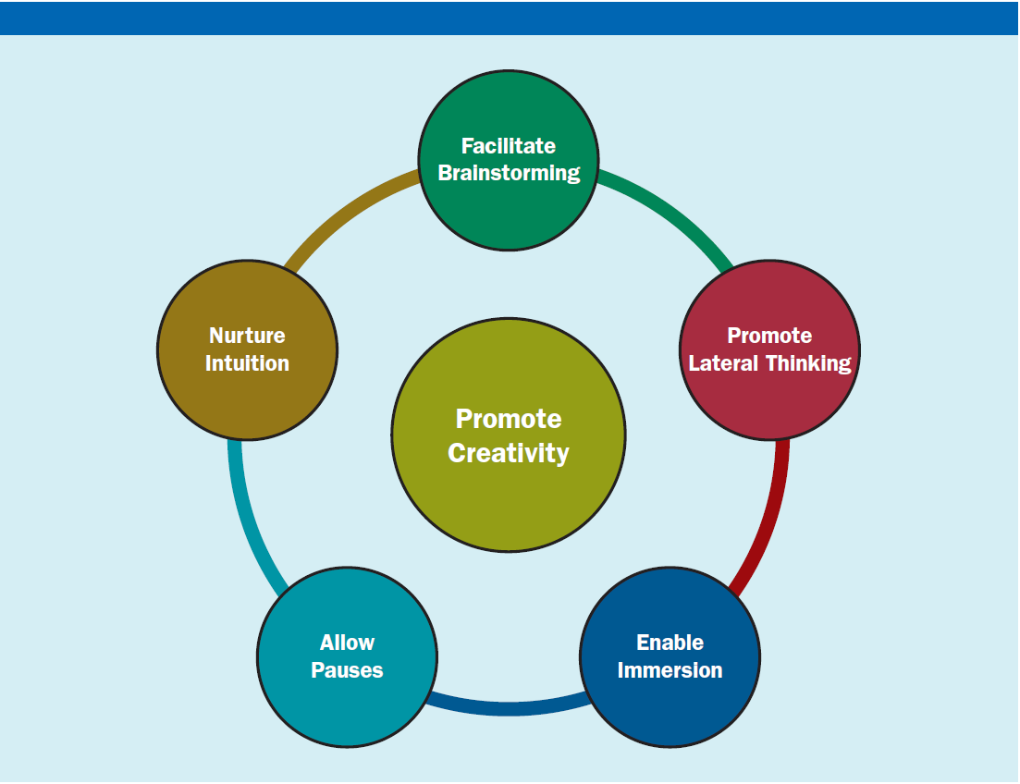
Exhibit 15.4 – Tools for Helping People Be More Creative

Slide 20
Lateral Thinking
A set of systematic techniques for breaking away from customary mental concepts and generating new ones

Slide 21
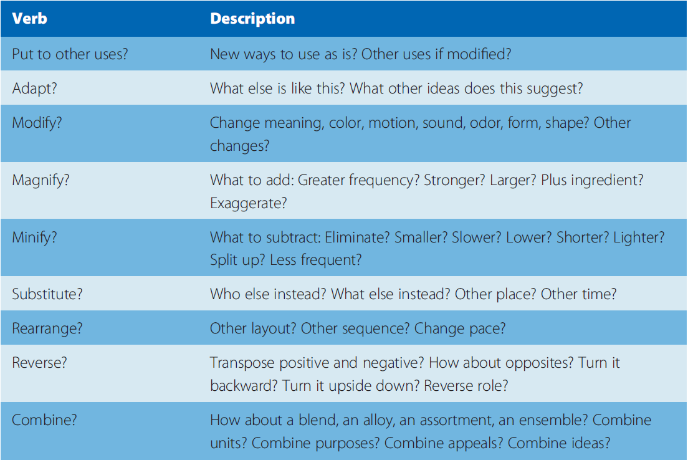
Exhibit 15.5 – Lateral Thinking Checklist
Source: Based on Alex Osborn, Applied Imagination (New York: Charles Scribner’s Sons, 1963).

Slide 22
Immersion
To go deeply into a single area or topic to spark personal creativity

Slide 23
Allow Pauses
Activates different parts of the brain
Creativity occurs during a mental pause
Activities like showering, exercising, driving, walking, and meditating let the intuitive right brain find solutions
Leaders should allow people to have quiet spaces when needed

Slide 24
Nurture Creative Intuition
Creativity involves two stages
Data gathering
Flash of insight
Creative intuition has a broader reach than any analytical process focused solely on the problem at hand

Slide 25
Personal Compact
The reciprocal obligations and commitments that define the relationship between employees and the organization

Slide 26
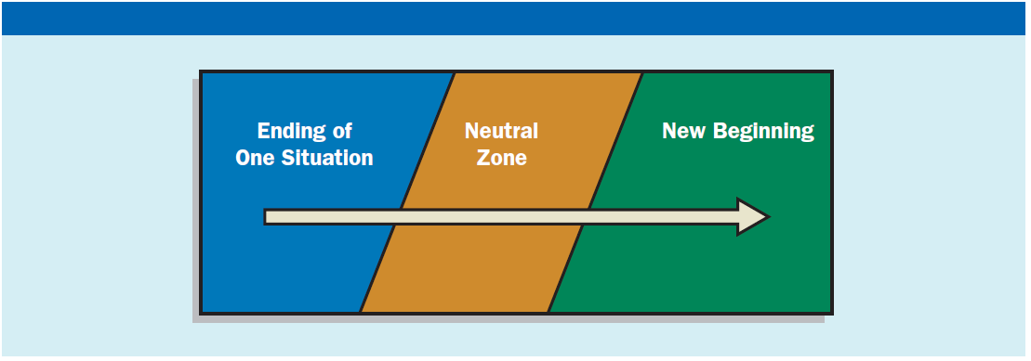
Exhibit 15.6 – Endings Precede Beginnings for Successful Change
Source: Based on ideas in William Bridges, Managing Transitions: Making the Most of Change (Cambridge, MA: Da Capo Lifelong Books, 2009).

Slide 27
Keys That Help People Change
Provide a positive emotional attractor
Make sure people have a support system
Use repetition
Involve people early
Apply after-action reviews

Slide 28
Thank You

