Slide 1
Week 3 Feb 2019 MGT808
Responsible Leadership Across Cultures

Slide 2
Culture and Norms
Culture
The set of key values, assumptions, understand-ings, and norms that is shared by members of an organization and taught to new members as correct
Norms
Shared standards that define what behaviors are acceptable and desirable within a group of people

Slide 3
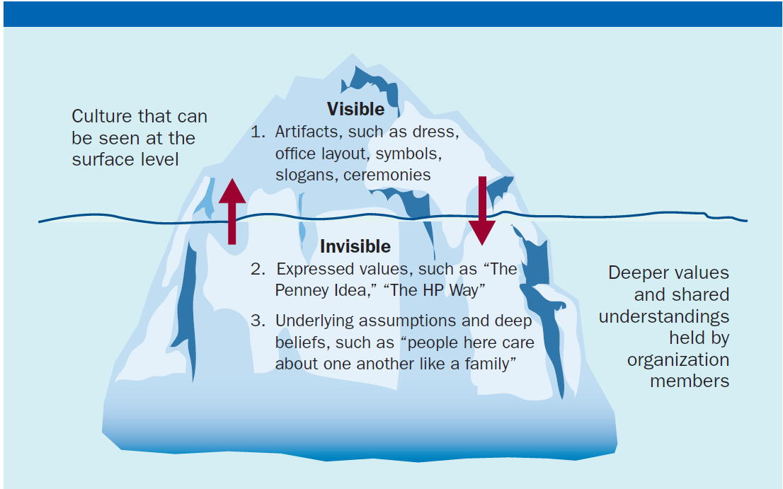
Exhibit 14.1 – Levels of Corporate Culture

Slide 4
Importance of Culture
It integrates members so that they know how to relate to one another
It helps the organization adapt to the external environment

Slide 5
Internal Integration (slide 1 of 2)
Develops a collective identity
Helps members work together effectively
Guides day-to-day working relationships
Determines how people communicate
in the organization

Slide 6
Internal Integration (slide 2 of 2)
Determines what behavior is acceptable
Determines how power and status are
allocated

Slide 7
External Adaptation
Determines how to meet goals and deal with outsiders
Helps to respond rapidly to customer needs or the moves of a competitor
Encourages employee commitment to the core purpose of the organization
Determines what is needed to meet external challenges
Embodies the values and assumptions needed to succeed

Slide 8
Culture Strength
The degree of agreement among employees about the importance of specific values and ways of doing things

Slide 9
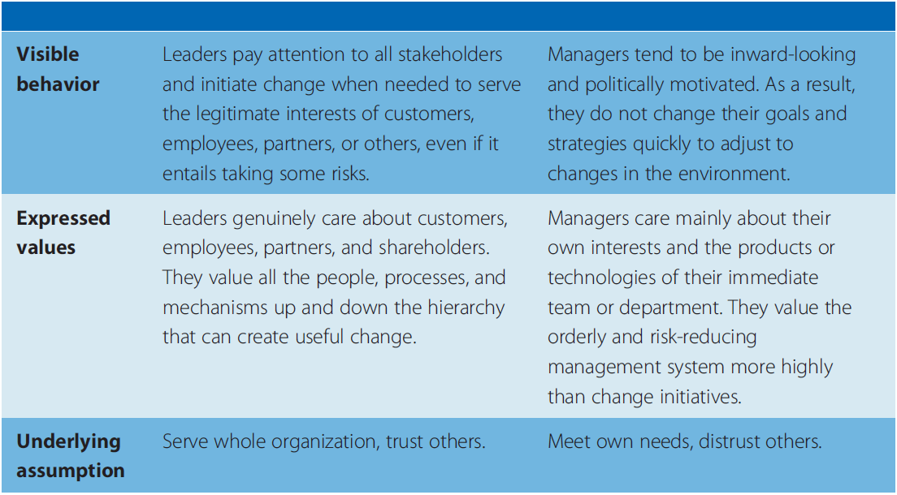
Exhibit 14.2 – Responsive versus Resistant Cultures
Source: Based on John P. Kotter and James L. Heskett, Corporate Culture and Performance (New York: The Free Press, 1992), p. 51.

Slide 10
Culture Gap
The difference between desired and actual values and behaviors

Slide 11
High-Performance Culture
A culture that is based on a solid mission, embodies shared responsive values that guide decisions, and encourages individual ownership of both bottom-line results and cultural values

Slide 12
Cultural Leader
A leader who actively uses signals and symbols to influence corporate culture

Slide 13
Cultural Leadership
Cultural leaders influence culture
Articulate a vision for the organizational culture that employees can believe in
Heed the day-to-day activities that reinforce the cultural vision

Slide 14
Mechanisms That Enact Cultural Values (slide 1 of 2)
Rites and ceremonies
Stories
Symbols
Specialized language

Slide 15
Mechanisms That Enact Cultural Values (slide 2 of 2)
Selection and socialization
Daily actions

Slide 16
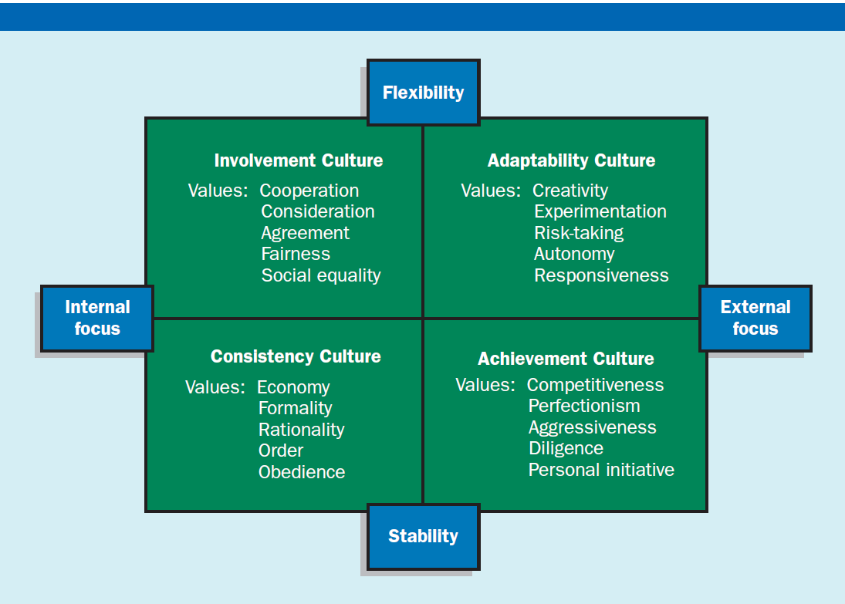
Exhibit 14.4 – Four Corporate Cultures
Source: Based on Paul McDonald and Jeffrey Gandz, ‘‘Getting Value from Shared Values,’’ Organizational Dynamics 21, no. 3 (Winter 1992), pp. 64–76; Deanne N. Den Hartog, Jaap J. VanMuijen, and Paul L. Koopman, ‘‘Linking Transformational Leadership and Organizational Culture,’’ The Journal of Leadership Studies 3, no. 4 (1996), pp. 68–83; Daniel R. Denison and Aneil K. Mishra, ‘‘Toward a Theory of Organizational Culture and Effectiveness,’’ Organizational Studies 6, no. 2 (March–April 1995), pp. 204–223; Robert Hooijberg and Frank Petrock, ‘‘On Cultural Change: Using the Competing Values Framework to Help Leaders Execute a Transformational Strategy,’’ Human Resource Management 32, no. 1 (1993), pp. 29–50; and R. E. Quinn, Beyond Rational Management: Mastering the Paradoxes and Competing Demands of High Performance (San Francisco: Jossey-Bass, 1998).

Slide 17
Types of Corporate Culture (slide 1 of 2)
Adaptability culture
Culture characterized by values that support the organization’s ability to interpret and translate signals from the environment into new behavior responses
Achievement culture
Culture characterized by a clear vision of the organization’s goals and leaders’ focus on the achievement of specific targets

Slide 18
Types of Corporate Culture (slide 2 of 2)
Involvement culture
Culture with an internal focus on the involvement and participation of employees to meet changing expectations from the external environment
Achievement culture
Culture with an internal focus and consistency orientation for a stable environment

Slide 19
Thank You .

