Slide 1
Week 2 - Leadership Roles and Styles

Slide 2
Recap: Q&A session on last week’s learning
By the end of this week, students will be able to
Understand the role of leadership in organisations
Describe some key characteristics and styles of leaders
Apply leadership theoretical frameworks and principles to understand the different roles of a leader

Slide 3
Definitions
Leadership is about making others better as a result of your presence and making sure that impact lasts in your absence.’ (Harvard Business School definition of leadership, cited by Sandberg, 2013, 158).
‘Leaders can and do change society, so it is imperative that they do so in a socially responsible and ethical way’ (Clegg et al., 2005, 233).
‘Leadership is a social relationship with three key components – leaders, followers, and the contexts in which they interact’ (Nye, 2008, p. xviii)
(Nye, 2008, p. xviii)

Slide 4
What do/should Leaders do:
Align people (i.e. manage meaning) to achieve workable unity
Serve as a symbol
Focus attention through a compelling vision
Communicate meaning to their followers
Develop trust through reliability and integrity

Slide 5
Leaders
Look at the next 2 slides
1. How do we know these are leaders?
2. On what basis do we label these as leaders?
Discuss in pairs for 15 minutes

Slide 6
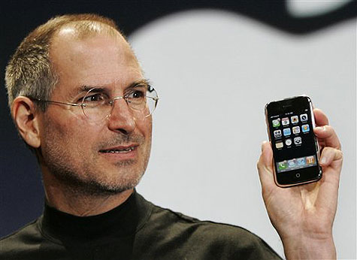

Slide 7
https://www.forbes.com/sites/carminegallo/2013/08/16/10-powerful-quotes-from-the-steve-jobs-movie-and-what-they-teach-us-about-leadership/#72dd864e6c8d
Read article given in the above link and discuss the 10 Powerful Quotes From The Steve Jobs Movie And What They Teach Us About Leadership

Slide 8
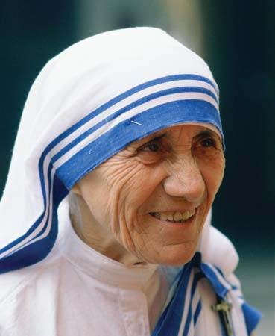

Slide 9
Core Leadership Theories
  A ‘theory’ is an explanation. It is a logical argument or framework designed to explain why certain things happen eg,
    Why does hot air rise?
    Which leadership styles/behaviours lead to greater job satisfaction among employees?
    Why do we consider some people to be leaders?

Slide 10
Leadership theories
Great Man Theory/
Trait Theory
1900-1940s
Behavioural Theories
1940’s-1950s
Contingency Theories
1960s
Transactional & Transformational Leadership
1970 – 1990s
Values-based leadership
2000s

Slide 11
Core Leadership Theories
1.Trait theories
2. Behavioural theories
3. Contingency theories

Slide 12
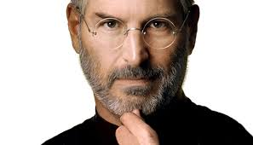
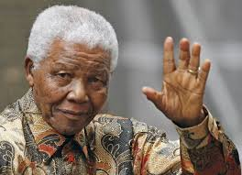
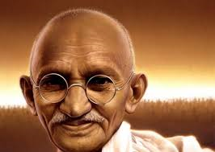
Theories – What Type of Person Makes a Good Leader?
Traits theory
Managers who are born with some traits become leaders. Others stay managers
Behavioural theory
Leaders are managers who behave differently under different conditions
Contingency theory
looking at defining leadership style and the situation, and attempts to answer the if-then contingencies (that is, if this is the context or situation, then this is the best leadership style to use).

Slide 13
Trait Theories – What Type of Person Makes a Good Leader?
Trait theories argue that effective leaders share a number of common personality characteristics, or "traits.“
Mainly developed in the 1950s.
Fundamental to this theory: Idea that some people are born with traits that make them natural leaders. (Great Man Approach)
But: Theory is highly contentious.

Slide 14

Trait Theories – Know your Strengths
A strengths arises from a natural talent that has been supported and reinforced with knowledge and skills.
“Concentrate on your strengths, not your weaknesses.”
Your personal strengths reflect your core values and provide you with a sure sense of direction. They energize and satisfy you.

Slide 15
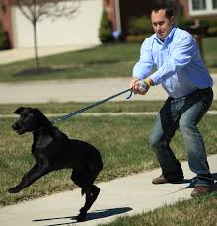
Behavioural Theories – What Does a
Good Leader Do?
Behavioural theories focus on how leaders behave.
Do leaders dictate what needs to be done and expect cooperation?
Do they involve their teams in decision-making?
Early research attempted to identify the “best leadership style” for all situations.
Three types of leaders
(Kurt Lewin):
Autocratic leaders
Democratic leaders
Laissez-faire leaders

Slide 16
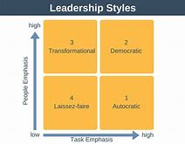
What style suits you best?

Slide 17
University of Iowa Studies
Autocratic
makes the decisions,
tells employees what to do, and
closely supervises workers
Democratic
encourages participation in decision,
works with employees to determine what to do, and
does not closely supervise employees

Slide 18
University of Michigan Leadership studies
Job-centred leader
takes charge to get the job done,
closely directs subordinates with clear roles and goals,
tells them what to do and how to do it, and
enforces standards
Employee-centred leader
focuses on meeting the human needs of employees while developing relationships,
is sensitive to subordinates, and
communicates to develop trust, support, and respect while looking out for their welfare.

Slide 19

Behavioural Theories – Uncovering effective leadership behavior
Exercise in pairs
Which leadership style is most efficient in which situation?
Different leadership behaviours are appropriate at different times.
The best leaders are those who can use many different behavioural styles, and choose the right style for each situation.

Slide 20
Contingency Theories – How Does the Situation Influence Good Leadership?
The best leadership style depends on the situation. These theories try to predict which style is best in which circumstance
When you need to make quick decisions, which style is best?
How to lead, when you need the full support of your team?
Should a leader be more people-oriented or task-oriented?

Slide 21
Contingency Theories – How Does the Situation Influence Good Leadership?
Contingency leadership variables
Followers
Capability
Motivation
Leader
Personality traits
Behaviour
Experience
Situation
Task
Structure
Environment

Slide 22
Contingency Theories – Path-Goal-
Theory (Robert House, 1971)
Leadership Styles
Supportive Leadership
Directive Leadership
Participative Leadership
Achievement-oriented leadership
Help: Helping team members to identify and achieve their goals
Support: Clearing away obstacles
Motivation: Offering appropriate rewards

Slide 23

Contingency Theories – 4 Types of Situational
Leadership
The Situational Leadership Model suggests that there is no “one size fits all” approach to leadership.
Leaders must consider the readiness level of their followers by analyzing the group’s ability and willingness. Depending on the level of these variables, leaders must apply the most appropriate leadership style to fit the given situation.
Four types of Leadership:
Directing
Coaching
Supporting
Delegating

Slide 24
The Golden Circle
How Great Leaders Inspire Action, by Simon Sinek
https://www.inspiringleadershipnow.com/best-ted-talks-on-leadership/
Notes:
29 million views, Simon Sinek is now on the A-List of leadership gurus, after he gave this incredible talk.
As Sinek himself says, “As it turns out, all the great inspiring leaders and organizations in the world, whether it’s Apple or Martin Luther King, Jr. or the Wright brothers, they all think, act and communicate the exact same way. And it’s the complete opposite to everyone else. All I did was codify it, and it’s probably the world’s simplest idea. I call it the Golden Circle.”

Slide 25
View the video on leadership :
https://www.youtube.com/watch?v=vlpKyLklDDY
for discussion in Week 3

Slide 26
Please go through Week 3 Lesson Plan-Responsible Leadership and influencing organisation culture
By the end of this week 3, students will be able to
• Understand and apply how leaders shape culture and values
• Know how responsible leadership instills healthy values in the organisational culture
• Identify the values associated with adaptability, achievement, involvement, and consistency cultures and the environmental conditions associated with each

Slide 27

Thank You
.

