Slide 2
MGT804 Value Chain Management
Week 12
Sourcing materials and services Procurement

Slide 3
Learning Objectives
Understand how important sourcing decisions go beyond simple material purchasing decisions.
Demonstrate the “bullwhip effect” and how it is important to synchronize the flow of material between supply chain partners.
Describe how characteristics of supply and demand have an impact on structuring supply chains.
Know the reason for outsourcing capabilities.
Illustrate what “green” sourcing is.
Analyze the total cost of ownership.
Calculate inventory turnover and days of supply.

Slide 4
Strategic Sourcing
Strategic sourcing: the development and management of supplier relationships to acquire goods and services in a way that aids in achieving the immediate needs of the business
In the past, sourcing was another name for purchasing
As a result of globalization, sourcing implies a more complex process suitable for products that are strategically important

Slide 5
The Sourcing/Purchasing Design Matrix

Slide 6
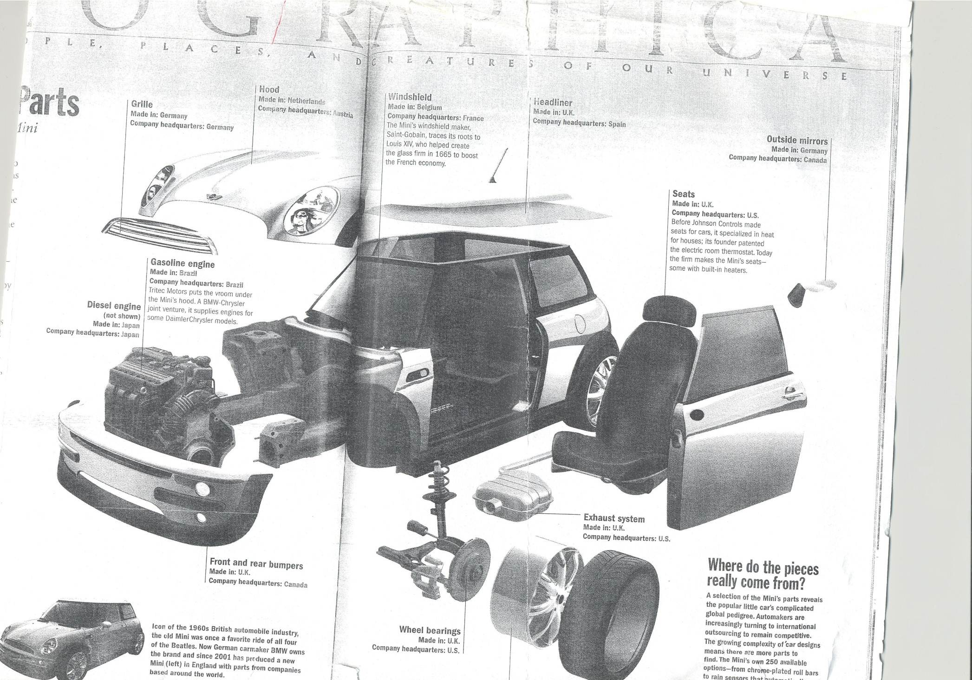

Slide 7
Strategic Sourcing Continued
Specificity: refers to how common the item is and, in a relative sense, how many substitutes might be available
  Commonly available products can be purchased using a relatively simple process
A request for proposal (RFP) is used for purchasing items that are more complex or expensive and where there may be a number of potential vendors
Vendor managed inventory: when a customer actually allows the supplier to manage an item or group of items for them

Slide 8
Increasing Variability of Orders up the Supply Chain

Slide 9
The Bullwhip Effect
Bullwhip effect: phenomenon of variability magnification as we move from the customer to the producer in the supply chain
  A slight change in consumer sales ripples backward as magnified oscillations upstream, like the result of a flick of a bullwhip handle
Continuous replenishment: inventory is replaced frequently, as part of an ongoing process

Slide 10
Functional Products
Functional products include the staples that people buy in a wide range of retail outlets, such as grocery stores and gas stations
  Product life cycle of more than two years
  Contribution margin of 5 to 20 percent
  Only 10 to 20 product variations
  An average forecast error of only 10 percent
  Lead time for make-to-order products of from six months to one year

Slide 11
Innovative Products
Innovation can enable a company to achieve higher profit margins
Newness of the innovative products makes demand
for them unpredictable
Typically have a life cycle of just a few months
  Imitators quickly erode the competitive advantage that innovative products enjoy
  Companies are forced to introduce a steady stream of newer innovations
The short life cycles and the great variety typical of these products further increase unpredictability

Slide 12
Four Types of Supply Chain Strategies
Efficient supply chains: utilize strategies aimed at creating the highest cost efficiency
Risk-hedging supply chains: utilize strategies aimed at pooling and sharing resources in a supply chain to share risk
Responsive supply chains: utilize strategies aimed at being responsive and flexible
Agile supply chains: utilize strategies aimed at being responsive and flexible to customer needs

Slide 13
Outsourcing
Outsourcing: the act of moving a firm’s internal activities and decision responsibility to outside providers
Allows a company to create a competitive advantage while reducing cost
An entire function may be outsourced, or some elements of an activity may be outsourced, with the rest kept in-house

Slide 14
Reasons to Outsource and the Resulting Benefits

Slide 15
Logistics
Logistics: the management functions that support the complete cycle of material flow
  Purchase and internal control of materials
  Planning and control of WIP
  Purchasing, shipping, and distribution of finished product
Emphasis on lean inventory means there is less room for delivery errors

Slide 16
Logistics
Logistics: the art and science of obtaining, producing, and distributing material and product in the proper place and in proper quantities
International logistics: managing these functions when the movement is on a global scale
Third-party logistics company: an outside company used to handle logistics functions
Notes:
3

Slide 17
Decisions Related to Logistics
How material will be transported
  Truck: great flexibility
  Ship: high capacity and low cost but slow
  Plane: fast but expensive
  Train: low cost but slow and variable
  Pipeline: highly specialized and limited to liquids, gases, and solids in slurry form
  Hand delivery: last step in many supply chains
Multimodial solutions are the norm

Slide 18
Logistics-System Design Matrix

Slide 19
Cross-Docking
Cross-docking: large shipments are broken down into small shipments for local delivery in an area
  Minimizes inventory in the warehouse
Hub-and-spoke systems: the sole purpose of the warehouse (the hub) is sorting goods to consolidation areas, where each area is designed for shipment to a specific location

Slide 20
Green Sourcing
Being environmentally responsible has become a business imperative
Many firms are looking to their supply chains to deliver “green” results
Financial results can often be improved Through going green
A comprehensive green sourcing effort should assess how a company uses items that are purchased internally
It is also important to reduce waste

Slide 21
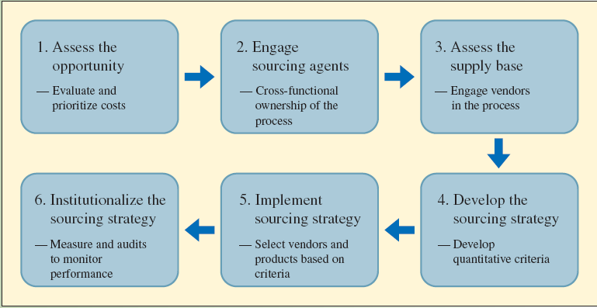
Six Step Process to Green Sourcing

Slide 22
Total Cost of Ownership
Total cost of ownership (TCO): an estimate of the cost of an item that includes all the costs related to the procurement and use of an item, including any related costs in disposing of the item
Can be applied to internal costs or more broadly to costs throughout the supply chain

Slide 23
Measuring Sourcing Performance
Inventory turnover: how often inventory is replaced during the year
  Cost of goods sold: the annual cost for a company to produce the goods or services provided to customers
  Average aggregate inventory value: the total value of all items held in inventory
Weeks of supply: how many weeks’ worth of inventory is in the system at a particular point in time

Slide 24
Calculations

Slide 25
Example

Slide 26
Further Reading:
Baily, P. (2017). Procurement. In Contracting for Project Management (pp. 105-116). Routledge.
Zincir, O., Ünal, A., & Erdal, M. (2017). Lean and Digital: A Case Study on Procurement and Supply Chain Professionals' Online Social Network. In Key Challenges and Opportunities in Web Entrepreneurship (pp. 79-102). IGI Global.
Kaur, H., & Singh, S. P. (2018). Heuristic modeling for sustainable procurement and logistics in a supply chain using big data. Computers & Operations Research, 98, 301-321.

Slide 27
Ensafian, H., & Yaghoubi, S. (2017). Robust optimization model for integrated procurement, production and distribution in platelet supply chain. Transportation Research Part E: Logistics and Transportation Review, 103, 32-55.
Ghadge, A., Kidd, E., Bhattacharjee, A., & Tiwari, M. (2018). Sustainable procurement performance of large enterprises across supply chain tiers and geographic regions.
van Dijk, L., & Gunnarsson, J. (2017). Procurement of Sustainable Logistics: Application, transfer, and response to sustainable requirements in the supply chain.

