Slide 1
Topic 10
Transformational and Moral Leadership
Primary Source: The Leadership Experience, Richard Daft

Slide 2
Learning Objectives (slide 1 of 2)
Act as a communication champion and a “sensegiver” rather than just as an information processor
Use key elements of effective listening and understand why listening is important to leader communication
Use candor appropriately to improve communication effectiveness, and recognize and apply the difference between dialogue and discussion

Slide 3
Learning Objectives (slide 1 of 2)
Combine a rational approach to leadership with a concern for people and ethics
Understand how leaders set the ethical tone in organizations and recognize the distinction between ethical and unethical leadership
Recognize your own stage of moral development and ways to accelerate your moral maturation

Slide 4
Learning Objectives (slide 2 of 2)
Know and use mechanisms that enhance an ethical organizational culture
Apply the principles of stewardship and servant leadership
Recognize courage in others and unlock your own potential to live and act courageously

Slide 5
Ethical Climate in Business
Leaders face pressures that challenge their ability to do the right thing
Obstacles for leaders:
Personal weakness and self-interest
Pressures to:
Cut costs and increase profits
Meet the demands of vendors or business partners and look successful
Please shareholders

Slide 6
Leaders Set the Ethical Tone (slide 1 of 2)
Act as positive role models
Signal what matters by their behavior
Focus on employees, customers, and the greater good
Not paying attention to gaining benefits themselves
Honest with employees, partners, customers, vendors, and shareholders

Slide 7
Leaders Set the Ethical Tone (slide 2 of 2)
Strive for fairness and honor agreements
Share the credit for successes and accept the blame when things go wrong
Speak up against acts they believe are wrong

Slide 8
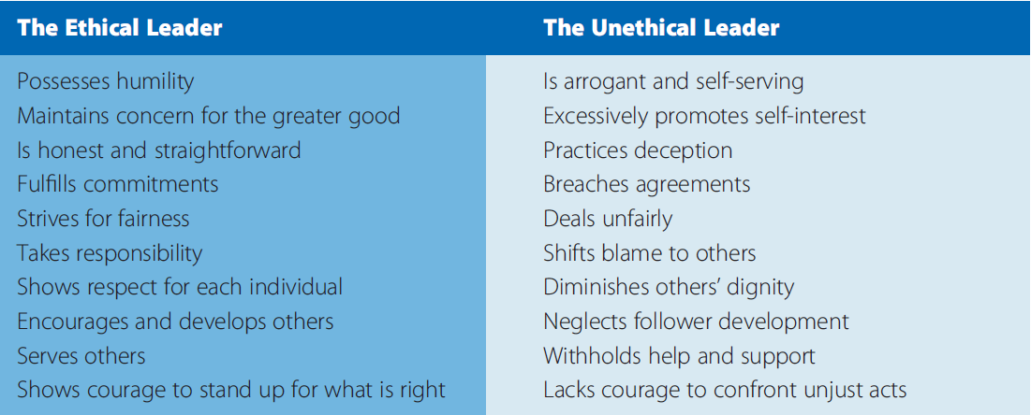
Exhibit 6.1 – Comparing Ethical versus Unethical Leadership
Source: Based on Donald G. Zauderer, ‘‘Integrity: An Essential Executive Quality,’’ Business Forum (Fall 1992), pp. 12–16.

Slide 9
Acting Like a Moral Leader
Business is about values and not just economic performance
The single most important factor in ethical decision making in organizations is whether leaders show a commitment to ethics in their talk and especially their behavior

Slide 10
Exhibit 6.2 – How to Act Like a Moral Leader
Source: Based on Linda Klebe Treviño, Laura Pincus Hartman, and Michael Brown, ‘‘Moral Person and Moral Manager: How Executives Develop a Reputation for Ethical Leadership,’’ California Management Review 42, no. 4 (Summer 2000), pp. 128–142; Christopher Hoenig, ‘‘Brave Hearts,’’ CIO (November 1, 2000), pp. 72–74; and Patricia Wallington, ‘‘Honestly?!’’ CIO (March 15, 2003), pp. 41–42.

Slide 11
Exhibit 6.3 – More Than Wheels Core Values
Source: More Than Wheels Mission and Core Values, http://www.morethanwheels.org/mission (Retrieved May 18, 2013).

Slide 12
Moral Leadership
Distinguishing right from wrong and doing right; seeking the just, honest, and good in the practice of leadership

Slide 13
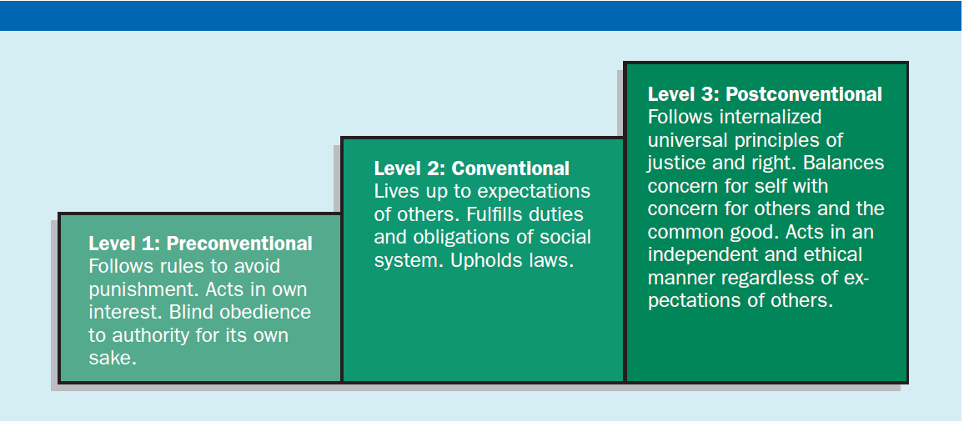
Exhibit 6.4 – Three Levels of Personal Moral Development
Sources: Based on Lawrence Kohlberg, ‘‘Moral Stages and Moralization: The Cognitive-Developmental Approach,’’ in Moral Development and Behavior: Theory, Research, and Social Issues, ed. Thomas Likona (Austin, TX: Holt, Rinehart and Winston, 1976), pp. 31–53; and Jill W. Graham, ‘‘Leadership, Moral Development, and Citizenship Behavior,’’ Business Ethics Quarterly 5, no. 1 (January 1995), pp. 43–54.

Slide 14
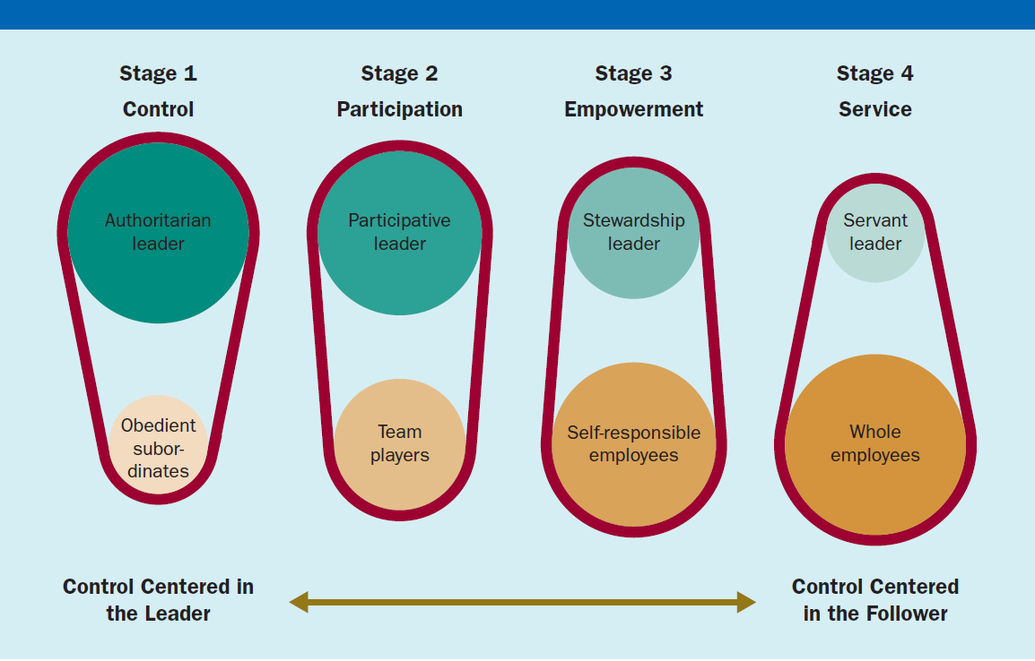
Exhibit 6.5 – Changing Leader Focus from Self to Others

Slide 15
Authoritarian Management
Traditional leadership
Organizational stability and efficiency are paramount
Leaders
Direct and control their people
Set the strategy and goals, as well as the methods and rewards for attaining them
Subordinates are controlled by leaders

Slide 16
Participative Management
Increased employee participation through employee suggestion programs, participation groups, and quality circles
Paternalistic mindset
Leaders determine purpose and goals, make final decisions, and decide rewards
Employees suggest quality improvements, act as team players, and take greater responsibility for their own jobs
Employees are not true partners in the enterprise

Slide 17
Stewardship
A belief that leaders are deeply accountable to others as well as to the organization, without trying to control others, define meaning and purpose for others, or take care of others

Slide 18
Framework for Stewardship
Adopt a partnership mindset
Give decision-making power and the authority to act to those closest to the work and the customer
Tie rewards to contributions rather than formal positions
Expect core work teams to build the organization

Slide 19
Servant Leadership
Leadership in which the leader transcends self-interest to serve the needs of others, help others grow, and provide opportunities for others to gain materially and emotionally

Slide 20
Framework for Servant Leadership
Put service before self-interest
Listen first to affirm others
Inspire trust by being trustworthy
Nourish others and help them become whole

Slide 21
Courage (slide 1 of 2)
The mental and moral strength to engage in, persevere through, and withstand danger, difficulty, or fear

Slide 22
Courage (slide 2 of 2)
Courage means accepting responsibility
Courage often means nonconformity
Courage means pushing beyond the comfort zone
Courage means asking for what you want and saying what you think
Courage means fighting for what you believe

Slide 23
Abilene Paradox
The tendency of people to resist voicing their true thoughts or feelings in order to please others and avoid conflict

Slide 24
How Does Courage Apply to Moral Leadership
Acting like a moral leader requires personal courage
Opposing unethical conduct requires courage

Slide 25
Whistleblowing
Employee disclosure of illegal, immoral, or unethical practices in the organization

Slide 26
Finding Personal Courage
Believe in a higher purpose
Draw strength from others
Harness frustration and anger
Take small steps

Slide 27
THANK YOU
ANY QUESTIONS ???

