Slide 1
MGT 811
Contemporary Management Capabilities
Week Five, Emotional Intelligence
Stephen Rodwell srodwell@icms.edu.au

Slide 2
Outline for today
Definition of Emotional Intelligence
Emotional Intelligence and Leadership
Emotional Intelligence and Leadership Styles
The Four Emotional Intelligence Competencies
How the Competencies Inter-relate
Emotional Intelligence and Teamwork
Model of Emotional Intelligence and Leader-Team Effectiveness
Emotional Intelligence and Organizational Citizenship
Human Resource Specialists and the Emotional Intelligence Factor
Some Emotional Intelligence Inventories
Some Criticisms of Emotional Intelligence

Slide 3
What is Emotional Intelligence?
Emotional intelligence -“is a term used to describe the various competencies that are essential for building, developing and managing relationships” (Peters, 2008). Emotional intelligence consists of two dimensions, intrapersonal intelligence and interpersonal intelligence.
Intrapersonal intelligence – “being intelligent in identifying our own thoughts and feelings (self awareness) and being effective at dealing with those thoughts and feelings (self management)” (Palethorpe, 2006).
Interpersonal intelligence – “being intelligent in identifying the thoughts and feelings of others and between others (other awareness) and being effective in how we tailor our actions to work with others most appropriately (relationship management)” (Palethorpe, 2006).
Intrapersonal intelligence + Interpersonal Intelligence = Emotional Intelligence

Slide 4
Emotional Intelligence and Leadership
“Emotional intelligence is correlated to charismatic or transformational leadership. Transformational leaders project a vision that their followers believe in, and inspire and motivate their followers. Transformational leaders stimulate their followers’ intellect, and provide individual consideration and succor to their followers” (Ashkanasy & Daus, 2002).
“There is, however a dark side to charismatic leadership. Leaders can be manipulative and emotionally demanding, especially when followers are open to such exploitation” (Ashkanasy & Daus, 2002).

Slide 5
Emotional Intelligence and Leadership Styles
Resonant styles: “Company performance is boosted through the use of positive emotional experiences. Resonant styles include visionary, coaching, affiliative and democratic”.
Dissonant styles: “Useful, but must be used with caution. The dissonant styles are pace-setting and commanding” (Peters, 2008).

Slide 6
The Four Emotional Intelligence Competencies
Self-Awareness: The ability to read one’s own emotions and recognize their impact. The two core dimensions are an accurate self–assessment, and self confidence.
Self-Management: Consists of six core dimensions: emotional self-control, transparency, adaptability, achievement, initiative, and optimism.
Social Awareness: Consists of three core dimensions: empathy, organizational awareness, and service.
Relationship Management: Consists of six core dimensions: inspirational leadership, influence, developing others, change catalyst, conflict management, building bonds and teamwork, and collaboration (Peters, 2008).

Slide 7
How do the competences inter-relate?
Self-Awareness
Social Awareness
Self-Management
Relationship Management
Emotional Intelligence Areas | Strengths | Areas to improve
Self-awareness | I know my own emotions and how they might be observed by others | I sometimes ignore my intuition
Social awareness | I know when my staff are unhappy or unmotivated | I need to improve my understanding and awareness of my boss’ thoughts
Self-management | I am open, trustworthy and flexible | I need to be more resilient under pressure
Relationship management | People trust me. They are open with me | I need to improve how I manage conflict. I also want to improve how I manage my boss.

Slide 8
Emotional Intelligence and Teamwork
Druskat and Wolff (2001) define emotional intelligence in groups as “a team atmosphere in which the norms build emotional capacity (the ability to respond constructively in emotionally uncomfortable situations) and influence emotions in constructive ways”.
Prati, Douglas, Ferris, Ammeter, and Buckler (2003) identify three norms that are universal to any team with a high emotional intelligence:
  “Team members recognize the prescribed level of emotional intensity allowed to be displayed during team member interactions, and act accordingly”.
  “Team members are self-aware in that they monitor their emotional expressions, and are sensitive to the feedback others provide with regard to social acceptance of those expressions”.
  “Emotionally intelligent team members effectively regulate the intensity of their emotional displays [to outsiders] to be sure the displays do not exceed the bounds set by team standards”.

Slide 9
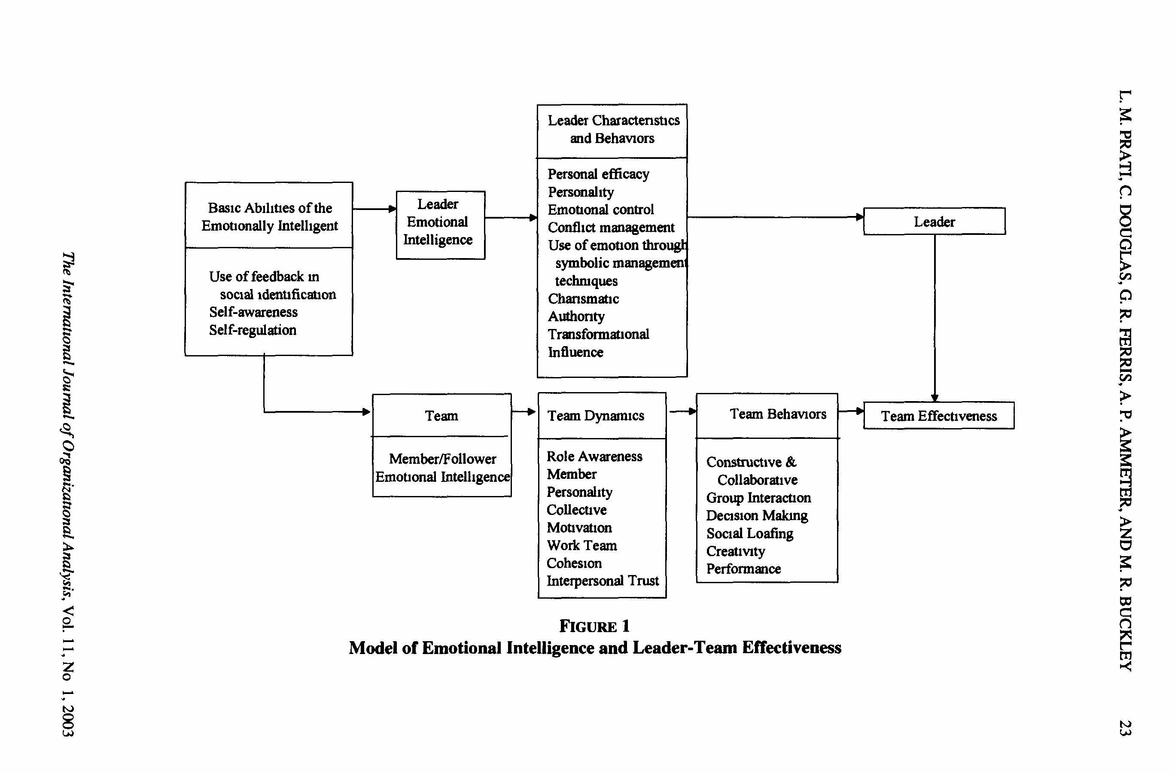
Model of Emotional Intelligence and Leader-Team Effectiveness

Slide 10
Emotional Intelligence and Organizational Citizenship
Good organizational citizenship behavior (OCB) involves those behaviors that are not required by the job, but are performed by employees to enhance organizational effectiveness.
  A study conducted by Cote and Miners (2006) found that “Emotional intelligence and cognitive intelligence are compensatory with respect to task performance and OCB directed at the organization … employees with low cognitive intelligence perform tasks correctly and engage in OCB frequently if they are emotionally intelligent”.
  “Agreeable individuals with high levels of emotional intelligence displayed higher task performance than those with medium or low emotional intelligence abilities” (Shaffer & Shaffer, 2005).
  “The emotional intelligence of employees is positively and significantly related to the processes of organizational learning” (Singh, 2007).

Slide 11
Human Resource Specialists and the Emotional Intelligence Factor
A study conducted by Aydin, Leblebici, Arslan, Kilic and Oktem (2005) concludes that “evidences for the relationship between pre-eminent achievement and EQ [exist]. Therefore, human resource specialists…should focus on future performance criteria that can probably be provided by tests measuring personality characteristics”.
Carson, Carson, Fontenot and Burdin (2005) recommend that when hiring, questions that address emotional intelligence, the following factors should be developed:
    Altruism, helping out others in the organization.
    Conscientiousness, doing the right thing.
    Sportsmanship, not complaining about minor issues.
    Involvement, attending voluntary functions.
    Civic virtue, assessing what is best for the organization.

Slide 12
Some Emotional Intelligence Inventories
Bar-On (1997): This 133-item inventory was designed to measure five main elements of emotional intelligence:
  intrapersonal,
  interpersonal,
  adaptability,
  stress management, and
  general mood.
  There are several versions of the Bar-On, this is just one of them.
The Leadership Dimensions Questionnaire (LDQ): Measures three leadership dimensions related to intellectual competencies, five managerial competencies, and seven emotional competencies.
The Multifactor Emotional Intelligence Scale (MEIS): Includes tasks such as judging emotions in faces and designs, generating and then reasoning with an emotion, defining complex emotional terms, and selecting an optimal emotional decision-making strategy.

Slide 13
Some Criticisms of Emotional Intelligence
An article by Antonakis (2003) made some valid criticisms of most studies conducted on emotional leadership:
  They did not control for competing variables (e.g., intelligence, personality).
  They failed to avoid common-methods variance.
  The did not use measures designed to tap EI (e.g., use measures of empathy).
  They used student populations (note: individual difference measures may demonstrate differential effects depending on context).
In a study conducted by Grubb and McDaniel (2007) the Emotional Quotient Inventory Short Form (EQ-i:S) revealed two major faults:
  “When responded to honestly, the EQ-i:S is predicted by the Big Five with a multiple correlation of .79. Therefore, the EQ-i:S can be viewed as an aggregation of The Big Five constructs”.
  “When faking, respondents were able to improve scores on the EQ-i:S, each of its subtests, and each of The Big Five measures”.

Slide 14
Why it is Important to Know What Emotional Intelligence is?
Emotional intelligence is essential in effective leadership and has a direct impact on work performance.
At Egon Zehner International, an employment search firm, analyzed 515 senior executives and found that the executives with strong emotional intelligence test results were more likely to succeed than were other executives whose strength areas were in either relevant previous experience or traditional IQ scores.
Research at the Center for Creative Leadership has shown that the primary cause of executive turnover was individual deficiency in the area of emotional competence.
In another study that involved 130 executives, results showed that there is a strong correlation between how well an individual handled personal emotions and the willingness of others to work with that individual.
  A leader with a positive mood and attitude tends to interact with others in a way that results in a positive, helpful, and cooperative workgroup, thereby increasing workplace efficiency.
Notes:
At this point you may be thinking, well, why do I even need to know about Emotional intelligence?
Well hopefully you are interested in learning more about it in general since you are here….but if not, I am going to tell you why you should know about it, and know how it can help you.

Slide 15
Four Clusters of Emotional Intelligence
1. Self-Awareness
2. Self-Management
3. Social Awareness
4. Social Skills
Notes:
Now that we know why EI is important to know about in genral, I am going to go into detail about what EI actually involves. EI consists of four clusters, each containing competencies which total 20 in all. Not only am I going to tell you what they are and why they are important, I am also going to tell you how you can develop and improve on them.

Slide 16
1. Self-Awareness
Self-Awareness is the ability to accurately sense and identify personal feelings, along with the ability to understand and evaluate them. To be fully aware of your feelings you must first identify them, and then you must acknowledge and accept them.
Self-awareness is concerned with knowing about your own internal states, preferences, resources, and perceptions.
As you become more self-aware, you become better able to be in touch with your own feelings.
Self-awareness is very important to achieving success at work. Not being in touch with your own feelings in sufficient degree can handicap your overall effectiveness.
Individuals who have high self-awareness are able to conduct accurate self-appraisals, are self-confident, are authentic, welcome feedback, perceive situations accurately, and are willing to take risks for what they believe to be right.
Notes:
The first and the most important of the four emotional intelligence cluster is Self-Awareness.

Slide 17
2. Self-Management
Self-Management is the ability to understand your emotions and then use that understanding to turn situations to your benefit.
Self-management is also the ability to use your feelings to reason well and act intentionally.
Why is Self-Management Important?
Self-management is important because when people are able to better managing their emotions, they do better in life.
The more people allow emotions to control and direct their behaviour, the worse they do in life.
People who are good managers of their emotions are open to change, effective in mood management, consistent in stress management, they are intentional, productive, and behave in a reasonable and rational way.
Notes:
The second cluster in emotional intelligence is Self-Management.

Slide 18
3. Social Awareness
Social awareness refers to how people handle relationships and awareness of others’ feelings, needs, and concerns.
It is the ability to recognize and appropriately respond to the emotions and feelings of others.
Three Competencies within Social Awareness
The Social Awareness cluster contains three basic competencies or subcategories:
  Empathy
  Organizational awareness
  Service orientation
Notes:
The third cluster in emotional intelligence is social awareness.

Slide 19
4. Social Skills
Social Skills refers to a proficiency at suggesting desirable responses in others.
People with good social skills are good business leaders, leaders in society, and effective parents who understand that personal success and group or family success are inseparable.
They lead by example, encouraging others in positive ways, validating them and creating trust within them
Why are Social Skills Important?
  Social skills are the basic skills everyone needs to have in order to be effective at anything they do. Not having the basic social skills can severely limit the quality of work that you produce.
Notes:
The fourth and final cluster in emotional intelligence is social skills.

Slide 20
Why is it Important to Develop My Own Emotional Intelligence?
Recent research suggests that the competencies associated with emotional intelligence are not set in stone at birth, but that the emotional competencies can indeed be learned and developed.
There are many benefits associated with developing your own emotional intelligence capabilities, and those benefits range from the personal to the organizational.
  The higher your emotional intelligence, the more likely you are to succeed in personal and professional relationships.
  There is a strong correlation between well-developed emotional intelligence and personal self-satisfaction and overall self-confidence.
  Having a good understanding of yourself, your strengths, and your weaknesses is essential to superior performance when on the job.
  When your emotional intelligence is fully developed, it is easier to work well under constantly changing circumstances and to act on your ideas in ways that benefit the organization.
Notes:
Okay so now we have all of these tools to help us to develop and improve the difference competencies of emotional intelligence, why is that important?

Slide 21
How Does Emotional Intelligence Help Us?
Identifying emotions provides awareness of emotions and the ability to accurately read other people’s emotions. Using emotions provides a means to generate ideas, a feeling, or a team spirit. Understanding emotions offers insights into what motivates people and others’ points of view. Finally, managing emotions allows you to stay open to your emotions, which have valuable information, and use them constructively.
There is evidence to suggest that emotionally intelligent leadership is the key to creating a work climate in which employees are nurtured and encouraged to do their best.
In a study at Johnson & Johnson, high performing managers had higher levels of self-awareness, self, management capability, social skills, and organizational savvy which are all considered part of emotional intelligence and are learned responses that are needed for superior leadership.
Several researchers have successfully demonstrated that emotions are related to several of the key issues in leadership. Several quantitative and qualitative studies have provided evidence that empathy is an important trait that predicts and plays a role in leadership emergence.
Other studies have concluded that the management of group members’ emotions is an important part of the leadership process, emotional displays have large effects on perceptions of leaders, and leaders who successfully manage group processes can substantially influence performance.
Notes:
Okay, so one final question, I now know what emotional intelligence is, and its components, and I know what I can do to help me to improve my emotional intelligence, ---what does this do for me again??

Slide 22
Any Questions?

Slide 23
Activity
You should have read through the Emotional Intelligence Handout prior to coming to class. Conduct the EQ Quiz (link on moodle) and, referring to the information in the handout, write at least three ways in which you can work on your EQ.
Discuss with those around you in class why you think EQ is or isn’t important within the work environment.
We’ll then talk this through in class.

Slide 24
THANK YOU
Week One, Introduction to the Unit
Stephen Rodwell srodwell@icms.edu.au

