Slide 1
MGT 811 Contemporary Management Capabilities
Week Four, Service Orientation and Servant Leadership
Stephen Rodwell srodwell@icms.edu.au

Slide 2
Outline for today
Introduction
Background
Characteristics
Paradoxes
Practice
Examples
More Information
Group activity

Slide 3
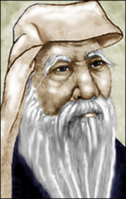
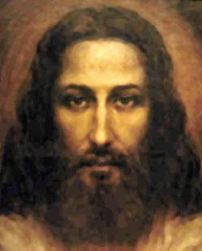
Origins of Servant Leadership
The concept of servant-leadership is thousands of years old.
600 BCE Lao Tzu:
The greatest leader forgets himself and attends to the development of others.
375 BCE Chanakya’s Arthashastra:
The [leader] shall consider as good, not what pleases himself but what pleases his subjects.
First Century ACE Jesus of Nazareth:
But the greatest among you shall be your servant (Matthew 23:11); The one who is the greatest among you must become like the youngest, and the leader like the servant. (Luke 22:26)
1970’s Robert K. Greenleaf:
The servant-leader is servant first… It begins with the natural feeling that one wants to serve, to serve first.
Notes:
Speaking Points:
Servant-Leadership, as a concept, has its origins tracing back to the earliest history
It is not a religious concept
It is, however, supported by most of the world’s major religions
I am a Christian and while many people point to Jesus as the epitome of servant-leadership, I wish I could boast it originated as a Christian concept. Instead, I can only say that it is the only leadership practice fully aligned with the teachings of our religion, as it is with most of the world’s major religions. Greenleaf (a Quaker) sites one of the greatest servant-leaders he ever knew to be his personal friend, Rabbi Abraham Joshua Heschel, a “liberal activist”.
4th Century B.C.
Chanakya or Kautilya, the famous strategic thinker from ancient India, wrote about servant leadership in his 4th century B.C. book Arthashastra:
"the king [leader] shall consider as good, not what pleases himself but what pleases his subjects [followers]" "the king [leader] is a paid servant and enjoys the resources of the state together with the people".
NOTE: His lessons were not always Servant-leadership focused. Some quotes downright in opposition, but in many areas, he understood the key concepts of Servant-Leadership as with the quote cited.
600 B.C.
In approximately 600 B.C., the Chinese sage Lao Tzu wrote The Tao Te Ching, a strategic treatise on servant leadership: FORTY-NINE The greatest leader forgets himself And attends to the development of others. Good leaders support excellent workers. Great leaders support the bottom ten percent. Great leaders know that The diamond in the rough Is always found “in the rough.” (Quote from The Way of Leading People: Unlocking Your Integral Leadership with the Tao Te Ching.)

Slide 4
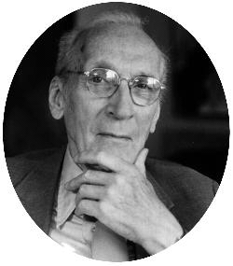
Robert K. Greenleaf
Largely considered the father of modern Servant-Leadership
Career:
38 Years at AT&T, largely in management training and development
25 Years consulting on Servant Leadership thereafter
Coined the term Servant-Leader in 1970’s
Founded Center for Applied Ethics (now Greenleaf Center for Servant-Leadership)
Inspiration:
Hermann Hesse’s short novel Journey to the East in 1960’s
Account of a mythical journey by a group of people on a spiritual quest
True leadership stems first from a desire to serve
Essays:
The Servant as Leader (1970)
The Institution as Servant (1972)
Trustees as Servants (1972)
Notes:
Speaking Points:
Most of his career was at AT&T
Much of his time was spent in leadership training and management
Often considered the father of modern servant-leadership (coined the term)
While his writing was very theoretical and academic in nature, it had its roots in his real-world experience and often included examples from his own experience

Slide 5
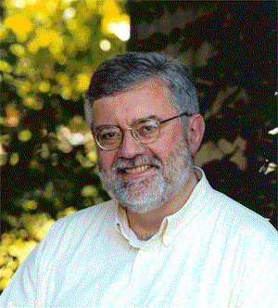
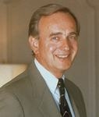
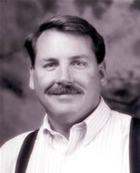
Post-Greenleaf
Following Greenleaf, a wealth of Servant-Leadership experts emerged
Larry Spears:
President / CEO of Greenleaf center for 25 years
Author of hundreds of publications on Servant-Leadership
Founded the Spears Center
James Autry:
President of magazine group for Meredith Corporation
Author of 8 Books
Focus on implementation
James C. Hunter:
25 Years in Servant-Leadership
2 of the most popular books on Servant-Leadership
Consulted many of the world’s most admired companies
Others: Ken Blanchard, Stephen Covey, Peter M. Senge, Jim Collins….
Notes:
Speaking Points:
Larry Spears
Protégé of Greenleaf
Studied under Greenleaf
Took over the Greenleaf center and ran it for many years
Experience largely academic and consulting work
Publications very academic
Website: http://www.spearscenter.org/
James Autry
No Bull kinda guy
Tells it like it is
Lots of real-world experience and examples
Connects the theory to practice to real world examples in almost everything
Website: http://members.aol.com/jamesautry/
James C. Hunter
Like Spears, has dedicated his professional career to Servant-Leadership
Authored one of the most popular books on Servant-Leadership since Greenleaf’s work
Clients include American Express, Nestlé, Microsoft, Procter & Gamble, Best Buy and the United States Air Force & Army.
Others
Many of the world’s greatest leadership experts, authors and consutlants preach Servant-Leadership principles and credit the concept for the foundation of true leadership
Ken Blanchard – One Minute Manager and many more (Secular and Christian books on leadership)
Stephen Covery – The 7 Habits of Highly Effective People
Peter M. Senge – The Fifth Discipline and Change management author
Jim Collins – Built to Last, Good to Great
Level 5 Leadership is essentially Servant Leadership
Mentions in book concern over using the name “Servant Leadership”
There are many more too – but most of the information in this presentation is based upon the work of Greenleaf, Spears, Autry and Hunter.

Slide 6
Servant / Service Orientation
Definitions of Servant:
one who serves, or does services, voluntarily or on compulsion; a person who is employed by another for menial offices, or for other labor, and is subject to his command; a person who labors or exerts himself for the benefit of another, his master or employer; a subordinate helper.
a person in the service of another.
one who expresses submission, recognizance, or debt to another.
a person working in the service of another.
in a subordinate position.
a person who is hired to work for another.
Definitions of being Service Orientated:
An act of assistance or benefit; a favor
an act of helpful activity; help; aid.
work done by one person or group that benefits another
The performance of work or duties for a superior or as a servant
be of service, to be helpful or useful
Notes:
Speaking Notes:
No need to read entire slide
Want to call attention to the highlighted (bolded) words
READ THROUGH SOME
Emphasis is on OTHERS, helping, aiding, benefitng, serving, submission, etc… all for other people
Humility is key – usefulness to others, selflessness
References for Definitions:
American Psychological Association (APA):
Servant. (n.d.). Dictionary.com Unabridged (v 1.1). Retrieved July 11, 2008, from Dictionary.com website: http://dictionary.reference.com/browse/Servant
Chicago Manual Style (CMS):
Servant. Dictionary.com. Dictionary.com Unabridged (v 1.1). Random House, Inc. http://dictionary.reference.com/browse/Servant (accessed: July 11, 2008).
Modern Language Association (MLA):
"Servant." Dictionary.com Unabridged (v 1.1). Random House, Inc. 11 Jul. 2008. <Dictionary.com http://dictionary.reference.com/browse/Servant>.

Slide 7
Leadership
Definitions of Leader:
a person or thing that leads.
a guiding or directing head, as of an army, movement, or political group.
One that leads or guides.
One who is in charge or in command of others.
One who heads a political party or organization.
One who has influence or power, especially of a political nature.
a person who rules or guides or inspires others
a person who is in front or goes first
a person who is the head of, organizes or is in charge (of something)
The head …of any body… as of a tribe, clan, or family; a person in authority who directs the work of others.
Notes:
Speaking Notes:
Pretty much what you would expect from defining a leader
Guide, Direct, Influence or Power, Head of, organizes, in charge, authority, directs…..

Slide 8
A Definition of Servant Leadership
Adapted from “The Servant as Leader”:
The servant-leader is servant first… It begins with the natural feeling that one wants to serve, to serve first. Then conscious choice brings one to aspire to lead. That person is sharply different from one who is leader first…
…The best test, and difficult to administer, is: Do those served grow as persons? Do they, while being served, become healthier, wiser, freer, more autonomous, more likely themselves to become servants? And, what is the effect on the least privileged in society? Will they benefit or at least not be further deprived?"

Slide 9
Greenleaf’s Model of Servant Leadership
Servant leaders are leaders who put other people’s needs, aspirations and interest above their own
Servant leaders deliberate choice is to serve others
A Servant leaders’ chief motive is to serve first, as opposed to lead

Slide 10
Ten Characteristics of a Servant Leader
Spears extracted 10 characteristics from Greenleaf’s work:
Listening
Empathy
Healing
Awareness
Persuasion
Conceptualization
Foresight
Stewardship
Commitment to the Growth of People
Building Community

Slide 11
Characteristic Breakout
Breaking out Spears’ characteristics into 3 dimensions…
Servant
Leader
SERVANT-LEADER
Listening
Empathy
Healing
Stewardship
Commitment to People
Building Community
Awareness
Persuasion
Conceptualization
Foresight
Notes:
Speaking Points:
All characteristics are relevant to Servant-Leadership
After reviewing these characteristics and reading many interpretations of Spears’ work and Greenleaf’s original texts, it seems to me these characteristics can be easily recognized and remembered by the two dimensions of SERVANT and LEADER

Slide 12
Servant Characteristics
Focusing on serving others through these characteristics:
Listening
Active, not just passive
360°, top to bottom
Listen completely before deciding
Empathy
Separate person from their work
Walk a mile in their shoes
Personable with appropriate individuals
Healing
Help your staff become whole
Consider their history
Build a future together
Notes:
Talking Points:
Listening
Active, not just passive – use active listening skills, repeat what you hear to ensure confirmation
360°, top to bottom – Listen to everyone around you, from CEO to shareholders, to board to staff to janitors, the SL realizes we were given two ears and one mouth for a reason.
Listen completely before deciding – BEFORE proposing changes, hear from representative parties. Proposing a solution and then asking what they think is not really listening – it’s telling them what you want asking them to align.
Empathy
Separate person from their work – Be empathetic to their personal life, they must meet expected deliverables, but when personal matters may be extreme, be as flexible as possible.
Walk a mile in their shoes – Combined with listening, make sure you really understand each individual’s diverse perspective.
Personable with appropriate individuals – Some people are more personable than others, some where their heart on their sleeves. Be open to sharing with those that are comfortable, but don’t pressure those that are not.
Healing
Help your staff become whole – Sounds touchy-feely, I know. But whether it was an uncompleted degree, a bad boss that dominated by position power rather than earned authority, or any other incomplete or negative experience – help to resolve the matter
Consider their history – See number 1, and put their work and personal concerns in context with their history
Build a future together – As you help them heal, together with your vision for the future of the organization and your vision for their complete performance an individual contributions, you will be stronger as a team.

Slide 13
Leader Characteristics
Focusing on Leading others through these characteristics:
Awareness
Self & Organization
“Sharply awake and reasonably disturbed” (Greenleaf)
Persuasion
Opposite of positional authority
Convince and build consensus – quickly
Conceptualization
B.H.A.G. but S.M.A.R.T.
Make time for strategy
Foresight
Consequences of present decisions on future outcomes
Notes:
Talking Points:
Awareness
Self & Organization – Self awareness often means confronting your weakness and being constantly aware of them. Organizational awareness means not brushing concerns under the covers, but addressing them.
“Sharply awake and reasonably disturbed” (Greenleaf) – As Greenleaf put it so clearly, the aware leader is constantly awake and likely always reasonably disturbed as they know the constant tradeoffs each organization is making and knows the opportunities for failure, weaknesses in processes and misalignments with organizational mission, vision or culture.
Persuasion
Opposite of positional authority – Not using power to coerce, but leveraging earned authority
Convince and build consensus (quickly) – Build concensus among team, peers and stakeholders. Naysayers will say there is not time – bologna. If you’ve earned the right to be in your position, most critics will trust your decisions by that right and be easy to build concensus. Remember, concensus by definition does not mean ALL people – but it does mean a majority of the RIGHT people.
Conceptualization
B.H.A.G. but S.M.A.R.T. – Big Hairy Audacious Goals, but make sure they are Specific, Measurable, Action-Oriented, Realistic and Time-delimited. The good leaders are able to paint clear pictures of the future that are easily understood by all, but they are reaching – visionary goals that stretch the organization and staff to ever higher levels of performance, provided they are SMART.
Make time for strategy – Most leaders today are torn between tactical and strategic. It takes the outstanding leader to ensure time is left for focusing on strategic concerns.
Foresight
Consequences of present decisions on future outcomes – The servant leader learns from the past, recognizes the realities of the present, and foresees the probable result of current decisions on the future of their organization (Spears).

Slide 14
Combined Characteristics
Characteristics emerging from the combined Servant & Leader dimensions:
Stewardship
Entrusted with resources of others
Return on investments
Commitment to the Growth of People
“Green and growing or ripe and dying” (Hunter)
Not just your favorites
Building Community
Effectiveness
Camaraderie
Notes:
Talking Points:
Stewardship
Entrusted with resources of others – As a servant leader, you would recognize that it is NOT “YOUR Budget”, it is the budget entrusted to you to manage. They are not “YOUR Staff”, it is the team that looks to you for leadership, guidance and the avoidance of all the grabage flowing downhill. You are entrusted with resources for their optimal management, not given them to do with as you please.
Return on investments – You are responsible for managing the optimal ROI for all resources entrusted to you. As a servant leader, you do not shirk this responsibility, point fingers at others for blame or otherwise avoid this responsibility. No, as a servant leader you accept responsibility for the best performance of your staff, budget, vendors, products and investments.
Commitment to the Growth of People
“Green and growing or ripe and dying” (Hunter) – James C. Hunter relayed this quote from a farmer and all good Servant-Leaders recognize that everyone is Green and Growing or has the potential to be. Therefore, the Servant Leader takes it upon themselves to ensure the continuous development of their staff and others.
Not just your favorites – All people. And this is where it may get tough. The best path for growth for someone may be outside your organization and so you may have to let them go. Still, the true servant leader insists on supporting their further development by assisting them in any way possible- maximizing outplacement resources, supporting for ongoing education, providing genuine, sincere recommendation letters for appropriate positions and so on.
Building Community
Effectiveness – Communities help each other out. They don’t say, “sorry, that’s not in my job description” or “my union says I don’t have to do that”. Instead, communities cooperate and help each other to be better – to ensure the sum of the whole is greater than the sum of the parts.
Camaraderie – A strong community is a happier workplace. Employees with friends at work are happy, more productive and likely to stay longer. Building community builds camaraderie.

Slide 15
Paradoxes
Servant-Leadership, itself a paradox, requires a constant balance:
Great
Be Without Pride
Planned
Be Spontaneous
Compassionate
Enough To
Discipline
Right
Say, “I’m Wrong”
Serious
Laugh
Wise
Admit You Don’t Know
Busy
Listen
Strong
Be Open To Change
Leading
Serve
Notes:
Speaking Notes:
References:
Adapted from Brewer (as cited by Hansel), Spears, Greenleaf and Hunter

Slide 16
Examples of Balance
Paradoxes are not easy to balance. Here are a few examples:
Great Enough to be Without Pride
Team gets the credit, you get the blame
Compassionate Enough to Discipline
Must not be soft – set high expectations and follow through
Right Enough to Say, “I’m Wrong”
Leaders make mistakes too, admit you are human
Wise Enough to Admit You Don’t Know
Find out quickly, but do not mislead
Busy Enough to Listen
Beware the busy manager – they do not lead
Notes:
Talking Points:
Great Enough to be Without Pride
Team gets the credit, you get the blame – When things go right, credit your staff, when things go wrong – NEVER point the blame at your people or elsewhere. If it was in your domain – accept responsibility. If it was TRULY outside your domain, find the root-cause and eliminate it. Then give your team the credit. ☺
Compassionate Enough to Discipline
Must not be soft – set high expectations and follow through: Autry gives excellent examples of performance plans and leading teams to high expectations. You MUST hold your staff accountable for their actions, responsibilities and deliverables. Not doing so for any staff member or team is not being a servant-leader for the rest of the organization. This is up to and including firing staff when there simply are no other options to bring them around to accepted performance within the organization. But if you do, you must be truly commited to helping them find a better role – within or outside the greater organization, that they would be better suited to perform. That is a true servant-leader to that individual and the greater organization.
Right Enough to Say, “I’m Wrong”
Leaders make mistakes too, staff should know you are human: I once did not hear a boss say he was sorry for 18 months, regardless of his repeated back-stepping resulting in repeated efforts by our team. We understood – mistakes happen, but can you imagine how unhappy we were when the blame was deflected to the group? All it would have taken was a simple admission, apology and commitment of their time / resources to help the solution. You’re not unfallable, let your team realize you know this and that you are committed to solutions together.
Wise Enough to Admit You Don’t Know
1. Find out quickly, but do not mislead: NEVER pretend to know something you do not – this includes the silent nod of agreement when you are truly uncertain. This will almost always hurt you – or worse, your staff, down the road. But when you don’t know – you must commit to finding the answer quickly and DELIVER on that promise. This ensures your stakeholders they can trust you when you commit to something and rely on you to find answers. Otherwise, trust may be broken and that is very difficult to repair.
Busy Enough to Listen
1. Beware the busy manager – they do not lead. Great article by Harvard Business Review of the same title (“Beware the Busy Manager”). Reality is anyone who seems to busy to listen to their staff, is. That is not a leader. That’s an individual contributor PRETENDING to be a leader. As a leader, it is your responsibility, NOBODY ELSE’s, to ensure you have time to listen to your stakeholders. A lack of listening is a lack of Leading.

Slide 17
Organization Hierarchy
Changing the perspective on the structure:
CEO
CIO
Operations
Development
CFO
Accounting
Commander
Management
Labor
Finance
Traditional
“Primus Inter Pares”
CxO
CEO
CxO
(First Among Equals)
Management
Staff
Shareholders
Staff
Management
Shareholders
Flipped Pyramid
Notes:
Talking Points:
Traditional = Standard stuff: Command and control model. NOT Servant-Leadership, more autocratic. Regardless of the lip service, conceptualizing the hierarchy in this manner suggests a lack of value placed in the individual contributors.
“Primus Inter Pares” was the purest approach suggested by Greenleaf and it means first-among-equals. Greenleaf suggests the true Servant-Leader should surround themselves with equals and whoever is best prepared to lead based on any number of circumstances is then set as the Primus Inter Pares – the first among their equals and leader.
Great theory
In practice, seems a bit impractical
Have yet to see an organization running this model – especially of significant size.
Flipped Pyramid: The Servant-Led organization recognizes that staff, or individual contributors belong at the top of organizational structures. As Herb Kelleher put it:
“If the employees come first, then they're happy, ... A motivated employee treats the customer well. The customer is happy so they keep coming back, which pleases the shareholders. It's not one of the enduring (great) mysteries of all time, it is just the way it works.”

Slide 18
Team Performance
Aligning corporate HR practices with Servant-Leadership:
Job Description – Non Servant-Leader Approach
Objective: Command and control
Created once, revised only during turnover
Written by hiring manager each time
Job Description – Servant-Leader Approach
Objective: mutual understanding
Dynamic, reviewed annually
Initial draft by employee
Performance Standards – Servant-Leader Approach
To meet my performance objectives this quarter, I must…
Employee initiates, manager reviews
Servant-Leader must ensure staff does not take on too much
Notes:
Talking Points:
Policies and procedures are not just bureaucratic or for autocratic leaders
Difference is in approach – should be for clarity and mutual understanding only
Must provide employee opportunity to define and contribute – setting their own goals with your agreement
“Having minimum standards and procedures by which everyone is assured of fair treatment when it comes to what their jobs are, what is expected, upon what they will be evaluated, and by what guidelines they will be rewarded.” (Autry, 59-60)
Key is in approach and intent behind your use – providing clarity or used for command control?
Must have constant review, contact, check points, what have you (going back to the key of making time to listen).
When was the last time you reviewed your Job Description? Right – that’s what I thought. Does it accurately reflect what you do? What you are responsible for? Why not? It needs to be a living document – an understanding between you and your superior, whoever that may be.
Autry suggests after hiring, each annual review should be initiated by employee, then reviewed and revised by manager and combined conversation.
References:
- Largely adapted from Autry

Slide 19
Developing SL Muscles
Honing servant-leadership skills requires tracking progress and feedback.
James C. Hunter Recommends the “Three F’s” to Support Your Servant-Leadership Development, Including:
Step 1: Foundation
Training, research, mentoring – understanding what is expected
Step 2: Feedback
360° Feedback on Servant-Leadership Gaps
Paired with measurable action plans to close gaps
Step 3: Friction
Require S.M.A.R.T. objectives
Answer to a panel or advisor on performance against objectives
Notes:
Talking Points:

Slide 20
Organisations
Some of the most well respected companies practice Servant-Leadership:
Fortune’s 100 Best Companies to Work For: 1/3 of Top 35
10 of America’s Most Admired Companies
Notes:
Speaking Points:
Wal-Mart originally pursued the concept – Sam Walton was huge on Servant Leadership, that’s not to say it is continuing today, unfortunately
References: Hunter, p. 18/

Slide 21
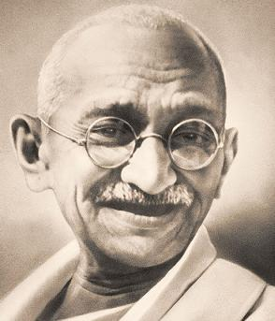
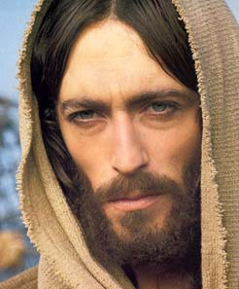
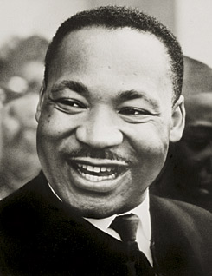
Individuals
Some examples of historic Servant-Leaders:
Mahatma Gandhi
Jesus of Nazareth
Martin Luther King, Jr.
Notes:
Speaking Notes:

Slide 22
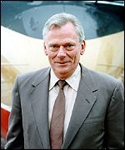
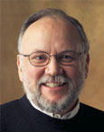
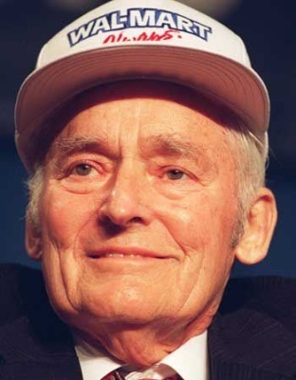
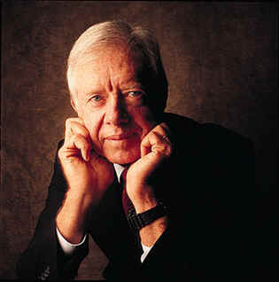
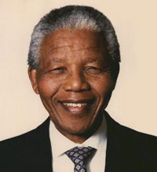
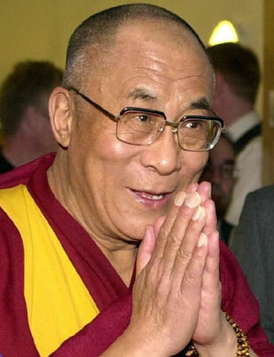
Individuals
Some examples of modern Servant-Leaders:
Herb Kelleher
Howard Behar
Sam Walton
Jimmy Carter
Nelson Mandela
The Dalai Lama
Notes:
Speaking Notes:
Herb Kelleher: Helped load baggage on Thanksgiving day, has been seen dressing up as Elvis for fun for the staff
Howard Behar: Retired in 1999, but in 2001, the CEO asked him back as interim president because the company had begun “to lose focus on the greater good” (Autry) and so they brought in servant-leadership.
Sam Walton – Wal-Mart has its issues today, but one of Sam’s most reiterated quotes was, “If you take care of your people, your people will take care of the customer and the business will take care of itself.”
Jimmy Carter – Long after leaving his presidency, he has been marked by hard work and constant contributions to causes like Habitat for Humanity. As one reporter put it, “In a world where power is often equated with force, Jimmy Carter reminds us that what endures is the power of example.” (http://community.seattletimes.nwsource.com/archive/?date=20000119&slug=4000096)
Countless Unknown – Remember, the very concept of Servant-Leadership necessitates a lack of pride and ego. It is not self-centered. So many of the world’s greatest Servant-Leaders go unknown.

Slide 23
Three Groups of Servant Leadership
Relationship-building Actions
Listening – (to self and others)
Empathy – (understanding)
Healing – (search for wholeness of self and others)
Awareness – (of self and of others)
Future-oriented Actions
Persuasion – (building consensus)
Conceptualization – (dreams and of day-to-day operations)
Foresight – (intuitive ability to learn from past and see future consequences of actions)
Community – oriented Actions
Stewardship – (holding institution in trust for the good of society)
Commitment to Growth – (personal, professional, spiritual of self and others)
Building Community – (benevolent, humane, philanthropic, to benefit others)

Slide 24
How Does One Become a Servant Leader?
From what we can understand, becoming a servant leader is more a state of mind than a set of directions.
Becoming a servant leader does not follow a step by step process.
This style of leadership development is an on-going, life-long learning process.
Survey shows that 85% of those who become a leader do so because of the influence of other leaders.
Great leaders influence and reproduce themselves.
The law of reproduction is to identify, prepare, and affirm.

Slide 25
Any Questions?

Slide 27
Activity
Work your way through the Servant Leadership Questionnaire (in the activity sheet)
Once you have completed this very simple self-assessment, reflect on areas you might need to improve
Come up with one thing you can do in the next week to improve in each of these areas
We’ll then talk this through in class.

Slide 28
THANK YOU
Week One, Introduction to the Unit
Stephen Rodwell srodwell@icms.edu.au

