Slide 1
MGT 811 Contemporary Management Capabilities
Week Three, Work Ethic
Stephen Rodwell srodwell@icms.edu.au

Slide 2
Outline for today
What is Work Ethic
Time Management and Work Balance
Bettering Yourself
Earning Respect
Organisational Work Ethic
Group activity

Slide 3
What is work ethic?
A set of values that advocate hard work and diligence
Emphasize the moral benefits of work
Said to enhance character

Slide 4
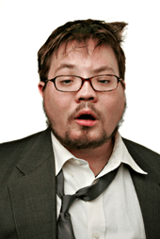
People with work ethic
People without work ethic
Better positions
Prosperous future
A good sense of responsibility
unmotivated
poorly trained or managed
Minor position

Slide 5
Protestant Work Ethic: Max Weber
A concept in sociology, economics, and history.
Weber believes Protestantism brought new values on the necessity of hard work and worldly success in order to confirm one’s redemption
Hard work and worldly success are seen as duties and obligations rather than outside a religious life

Slide 6
Support of work ethic
Benjamin Franklin: “Time is Money.”
A philosophy laden with moral language.
Laziness is morally wrong
Critique of work ethic
Slacker, hippie, and hackers cultures tend to rebel against work ethic: it only brings positive results for the bosses but little benefit for the workers themselves
Workers are alienated from their work
So-called work ethic is nothing but being loyal servants to the elite

Slide 7
Time Management
Time-management shows:
How you treat yourself and others
Your work attitude
Your ability to prioritize

Slide 8
Why is work balance important?
At Work:
Feeling more rested and energized
Working more productively and getting more accomplished, leading to greater career success
More fulfillment from work
In Life:
Improving relationships with family and friends
Better physical and mental health
Making choices about your priorities, rather than sacrifices among them
More leisure time to spend with loved ones, or time for yourself

Slide 9
Work aversion
This usually occurs in persons who have previously been employed, and can have a variety of causes, including:
Boredom
Depression
Obsessive-compulsive disorder
Panic disorder
Post-traumatic stress disorder
Abrupt termination
Phobia

Slide 10
Learning to Observe
Learn About the Various Kinds of Power and Influence in the office
Figure Out the Organisational Culture of the company
Keep a regular Feedback and Compliments File

Slide 11
Always Better Yourself
Know Yourself and what you need to do
Build Skills to strengthen your competitiveness
Read Internal Job Postings just in case you need to switch jobs

Slide 12
Take Charge Of Your Own Career Planning
Measure Your Progress constantly and evaluate
Take Over Your Professional Development
Work with Your Mentors and learn from them
Know When to ‘move on’ and switch jobs or careers

Slide 13
Ask Questions
Different people may have different preferences. Observe and choose.
Identify your best sources for questions on different topics.
Let everyone know you're the new kid on the block, and ask them to take the lead and guide you.

Slide 14
Be Sure the Timing Is Right
Pay attention to what others are up to before you interrupt with a question.
Consider their body language and tone of voice.
Consider going to another source or accumulating multiple questions so you only have to bother the person once.

Slide 15
Take Notes
Access information as soon as possible when you need it.
Make sure your how-to instructions and various lists are well-organized.
Use a portable notebook or accordion folder with labeled dividers that you can even take home for review.
Ask for Examples
If you're not sure how to fill out a form or craft a document, ask for an example you can keep on file.
File these samples in your notebook or folder as well.

Slide 16
Sign Up for Professional Development
Many companies offer complimentary courses to help employees get up to speed on a variety of tasks.
Ask your supervisor for a list of available classes.

Slide 17
Four Ways to Earn Respect in the Workplace
1. You Don’t Know What You Don’t Know
Don’t assume that you know how things should be done
Tread lightly when it comes to sharing your “groundbreaking” ideas
Resist the temptation to jump in and take over projects
2. A Sincere ‘Thank You’ Goes a Long Way
Your manager is a human being who likes to feel appreciated
Reply with a heartfelt ‘thank you’ if your manager, compliments you, takes you to lunch, gives you a gift, bonus or raise, or even hosts a company party

Slide 18
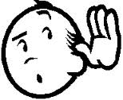
Four Ways to Earn Respect in the Workplace (cont.)
3. Few Go Above and Beyond
Take on additional assignments or put in extra time once in a while
Have a can-do attitude whilst leaving your ego at the doorstep
4. Listening Is Highly Underrated
Don’t speak without listening first.
Ways to Listen carefully:
Prepare — be mentally and physically ready to listen
Shut Up — remaining silent the majority of the time
Concentrate — put other thoughts out of your mind
Walk a Mile in Someone Else's Shoes — If someone says something that sets you off, let it go, move on, and continue to listen to what they’re saying.

Slide 19
Concern for Ethical and Societal Issues
Business Ethics:
The standards of conduct and moral values governing actions and decisions in the work environment.
Social responsibility.
Balance between what’s right and what’s profitable.
Often no clear-cut choices.
Often shaped by the organization’s ethical climate.

Slide 20
The Contemporary Ethical Environment
High profile investigations and arrests are in the headlines.
The vast majority of businesses ethical.
New corporate officers have been charged with deterring wrongdoing and ensuring ethical standards.

Slide 21
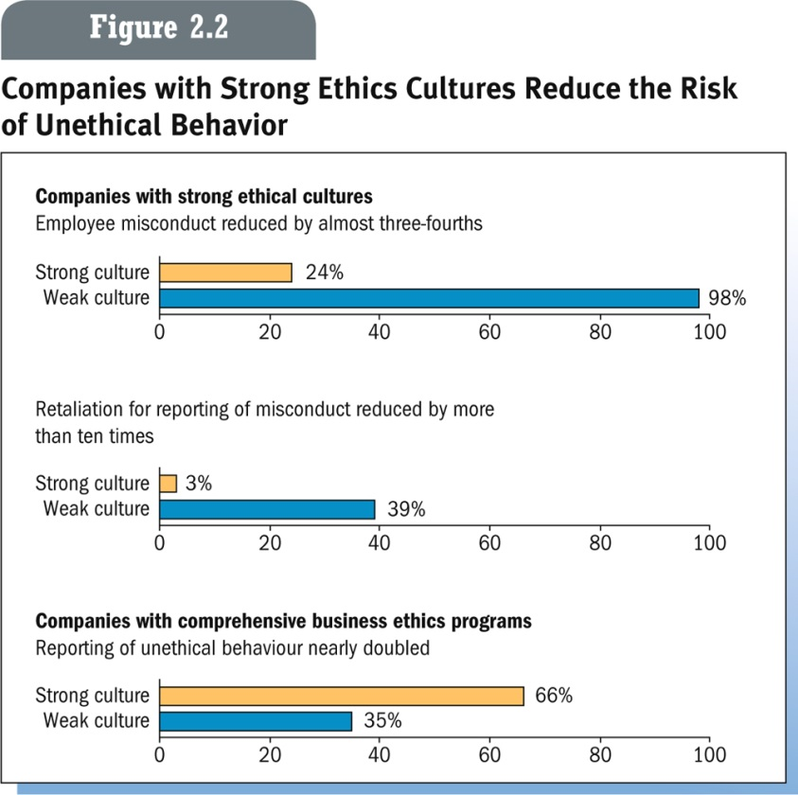
Individuals Make a Difference
Individuals can make the difference in ethical expectations and behavior
Putting own interest ahead of the organization
Lying to employee
Misrepresenting hours
Safety violations
Internet Abuse

Slide 22
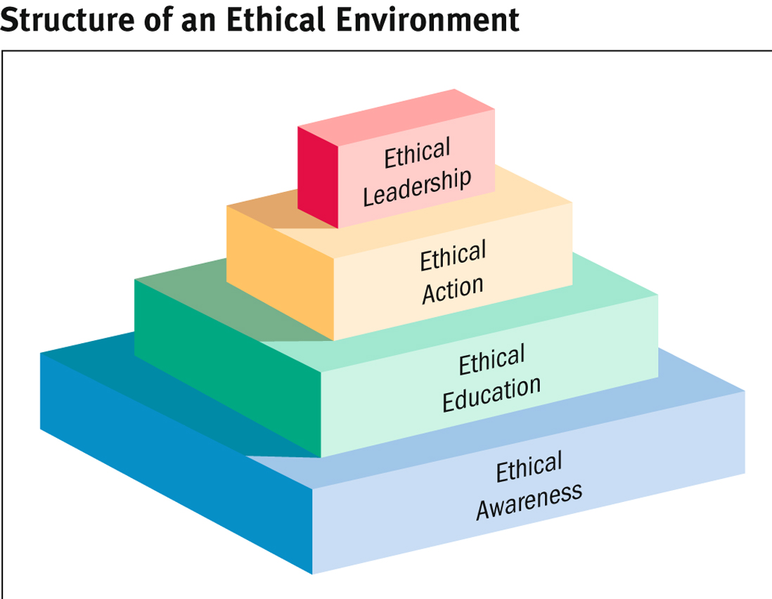
How Organizations Shape Ethical Conduct

Slide 23
Ethical Awareness
Code of Conduct: Formal statement that defines how the organization expects and requires employees to resolve ethical questions.
Ethical Education
Codes of conduct cannot detail a solution for every ethical situation, so corporations provide training in ethical reasoning.

Slide 24
Ethical Action
Helping employees recognize and reason through ethical problems and turning them into ethical actions.
Ethical Leadership
Executives must demonstrate ethical behavior in their actions.

Slide 25
Final Word
Be Punctual
Be Friendly
Be a Team Player
Dress appropriately
Treat every one with Respect
Be Productive
Be Organized
Communicate clearly
Cooperate with your colleague

Slide 26
Any Questions?

Slide 27
Activity
Research online examples of attitudes towards the work-ethic of your generation.
Write an answer to the following questions:
Do you agree with the general sentiment of the perspectives you have read?
How might an employer connect with your generation to inspire a stronger work-ethic?
We’ll then talk this through in class.

Slide 28
THANK YOU
Week One, Introduction to the Unit
Stephen Rodwell srodwell@icms.edu.au

