Slide 1
MAN707 Strategy, change & leadership
Culture & Performance
Lecture 9

Slide 2
Assessment 3 – Strategy Report
Have you identified 2-3 growth opportunities for your business case?
Need to do a gap analysis to find what these might be (internal situation vs. external and industry environment)
Are these worthwhile exploring?
Need to be linked with the business strategy – vision/ mission/ purpose
If the current strategy/ purpose of the business are not clear, this may need to be looked at first

Slide 3
Culture & Performance - Learning Objectives
Explain the relationship between national culture, organisational culture and organisational performance
Evaluate the effectiveness of organisational culture and make recommendations

Slide 4
National Culture

Slide 5
Introduction
The global nature of today’s business and growing diversity within countries, businesses and organisations need to know how to:
interact across national boundaries;
manage the diversity of their staff effectively; and
communicate effectively with variety of stakeholders.

Slide 6
Is this a worldly mindset or not? …pause for a thought
https://youtu.be/oWp_djG3zjw
Notes:
What do Americans think about China?

Slide 7
Culture: Hofstede (2001)
‘The collective programming of the mind distinguishing the members of one group or category of people from other’
National culture is a key source of people’s values and beliefs
National culture has a noticeable influence on behaviour and dictates rules about how to behave
e.g., solve problems, make decisions

Slide 8
Culture
Values
Beliefs
Norms
Symbols
Language
Traditions
Dress & morality
Religion
Public & private behaviours
Notes:
Interconnected culture elements shared by a society or group
Preferences for certain behaviour; desirable vs. non-desirable

Slide 9
Six Dimensions of Culture
Hofstede’s national culture dimensions help global managers improve their understanding of cultural differences and cope with workplace diversity:
Power Distance
Individualism Vs. Collectivism
Masculinity Vs. Femininity
Uncertainty Avoidance
Long-term orientation Vs. Short-term orientation
Indulgence Vs. Restraint
Notes:
Hofstede’s cultural dimensions have been proven to be empirically effective in differentiating one country from another

Slide 10
Power Distance (PD)
The amount of inequality that exists and is accepted by people
High PD: Society accepts the unequal distribution of the power hierarchy
Low PD: People question authority and attempt to distribute power
---
Organisationally
High: managers tend to prefer autocratic or directive managerial style; employees tend to expect structure and close supervision; managerial decisions are made with limited employee communication
Low: flatter organisations, staff equality
Notes:
https://www.youtube.com/watch?v=DqAJclwfyCw

Slide 11
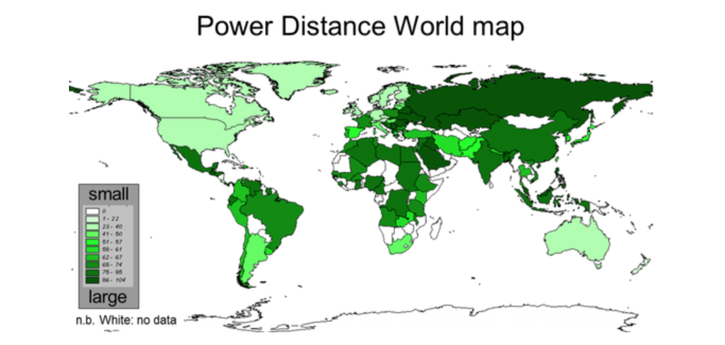
Source: https://geerthofstede.com/culture-geert-hofstede-gert-jan-hofstede/6d-model-of-national-culture/
Notes:
https://www.youtube.com/watch?v=DqAJclwfyCw

Slide 12
Individualism Vs. Collectivism (IDV)
The strength of connection with community
Individualistic cultures: assume that people look after their own interests; focus on ‘I’; express own thoughts and opinions; question teachers/ employees; manage rather than avoid conflict. Western countries
Collectivist cultures: emphasise the ‘group’; ‘we’; protect interest of others but expect loyalty in return; tend not to express thoughts openly; likely to avoid conflict and confrontation to ‘save face’. South American and Asian countries.
---
Organisationally
High (individualistic): value personal achievement/challenges/ reward for effort, respect privacy
Low (collectivist): team-building/harmony/intrinsic rewards
Notes:
https://www.youtube.com/watch?v=zQj1VPNPHlI

Slide 13
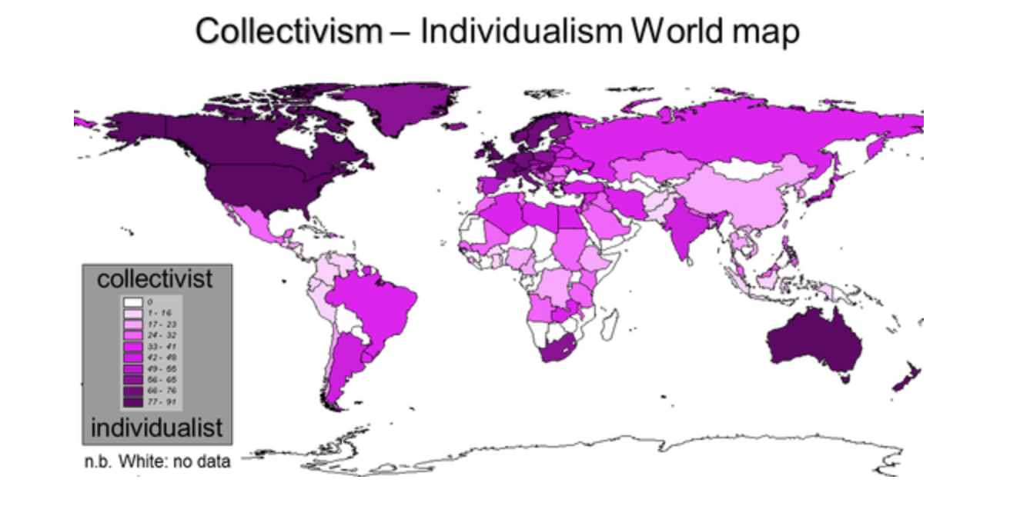
Source: https://geerthofstede.com/culture-geert-hofstede-gert-jan-hofstede/6d-model-of-national-culture/
Notes:
https://www.youtube.com/watch?v=zQj1VPNPHlI

Slide 14
Masculinity Vs. Femininity (MAS)
Extent to which a society adopts male-oriented work values that differ from feminine values
Masculine society: define gender roles more rigidly; distinguish between goals for men and women; preference for assertiveness, achievement, ambition, material acquisition and competition. Japan
Feminine societies: preference for nurturance and caring for others; value quality of life (non-material values), more flexible and accept overlapping roles for men and women. Sweden and Norway
---
Organisationally
High (masculine): strong egos, importance of status, money and achievement
Low (feminine): relationship oriented , focus on quality of life
Notes:
https://www.youtube.com/watch?v=Pyr-XKQG2CM

Slide 15
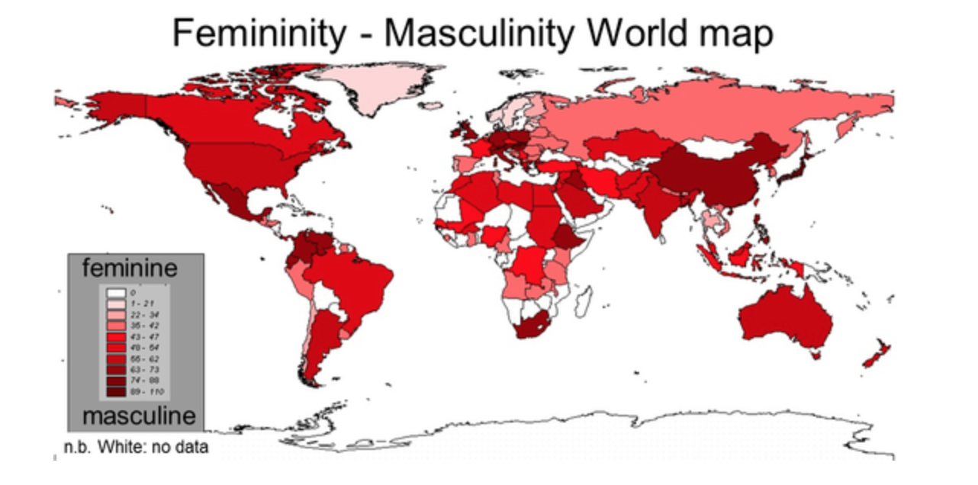
Source: https://geerthofstede.com/culture-geert-hofstede-gert-jan-hofstede/6d-model-of-national-culture/
Notes:
https://www.youtube.com/watch?v=Pyr-XKQG2CM

Slide 16
Uncertainty Avoidance (UA)
Extent to which members of a culture feel nervous about, or are threatened by, ambiguous, unclear or unstructured situations
High UA: risk averse, maintain strict codes of behaviour, establish more formal rules, tend to be resistant to change.
Low UA: take more risks, require fewer structures, more informal and relaxed, willing to accept change.
---
Organisationally
High (UA): conservative, rigid and structured
Low (UA): open to change , innovation, less sense of urgency
Notes:
https://www.youtube.com/watch?v=fZF6LyGne7Q

Slide 17
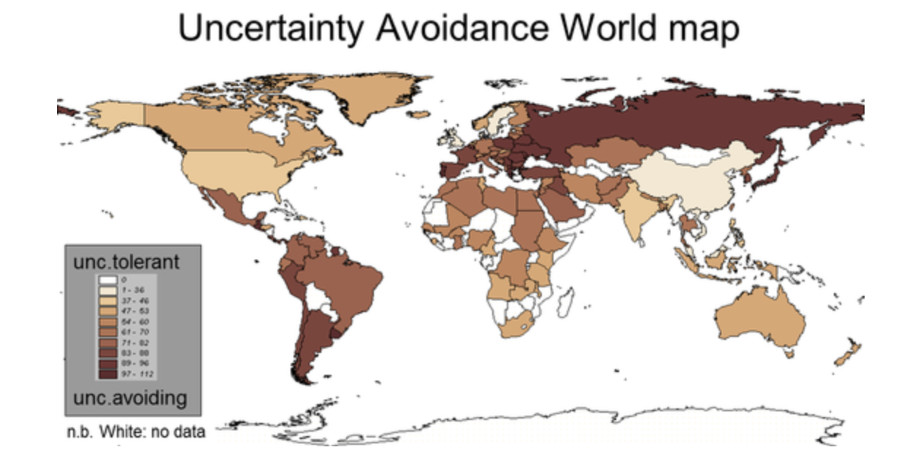
Source: https://geerthofstede.com/culture-geert-hofstede-gert-jan-hofstede/6d-model-of-national-culture/
Notes:
https://www.youtube.com/watch?v=fZF6LyGne7Q

Slide 18
Short-term Vs. Long-term Orientation
Extent to which societies maintain some links with its own past while dealing wit the challenges of the present and future
Low degree (Shot-term) indicates that traditions are honored and kept; being firm is valued. Western countries
High degree index societies (Long-term): view adaptability and pragmatic problem-solving as essential. Asian countries
Notes:
https://www.youtube.com/watch?v=H8ygYIGsIQ4

Slide 19
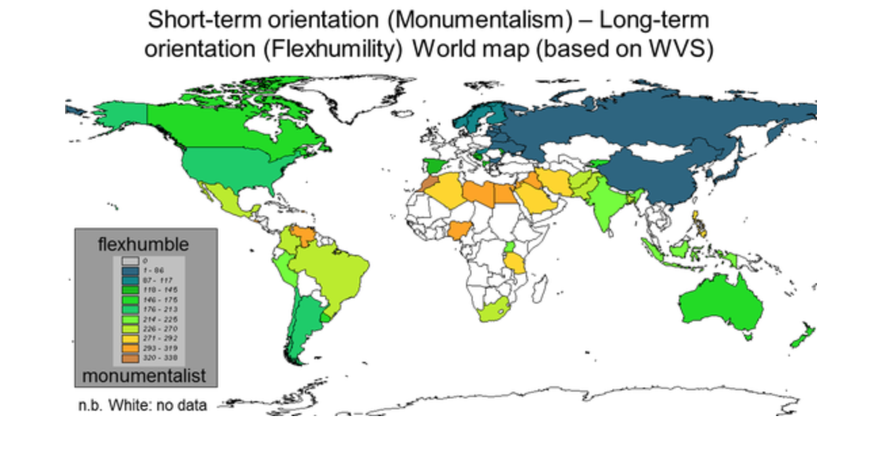
Source: https://geerthofstede.com/culture-geert-hofstede-gert-jan-hofstede/6d-model-of-national-culture/
Notes:
https://www.youtube.com/watch?v=H8ygYIGsIQ4

Slide 20
Indulgence Vs. Restraint (IVR)
The extent to which people try to control their desires and impulses
High IVR allows/encourages free gratification of ones drives and emotions, having fun. Australia, US
Low IVR emphasises on suppressing gratification, regulating behaviour and stricter social norms. China, Japan
---
Organisationally
High: optimistic, freedom of speech, happy
Low: pessimistic, controlled behaviour
Notes:
https://www.youtube.com/watch?v=V0YgGdzmFtA

Slide 21
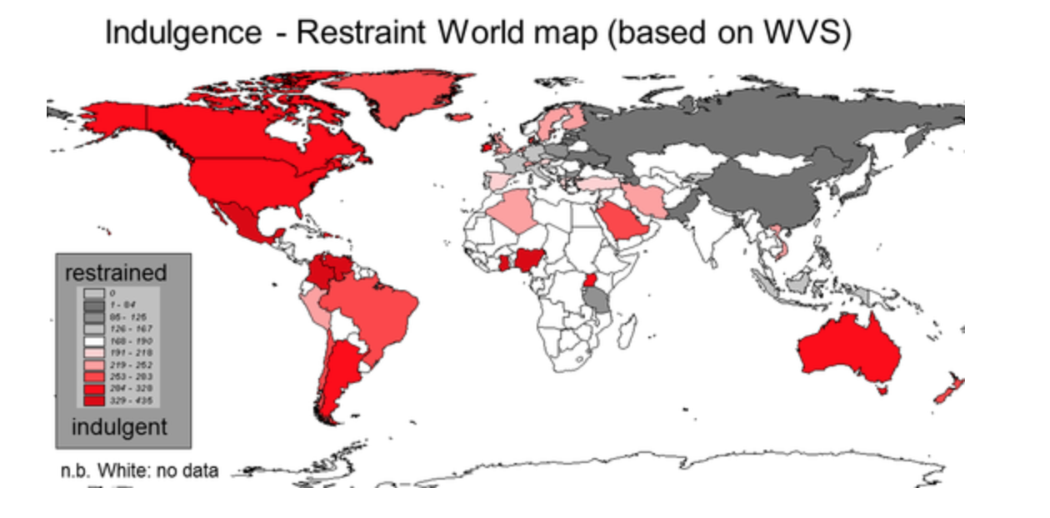
Source: https://geerthofstede.com/culture-geert-hofstede-gert-jan-hofstede/6d-model-of-national-culture/
Notes:
https://www.youtube.com/watch?v=V0YgGdzmFtA

Slide 22
Comparing countries
https://www.hofstede-insights.com/product/compare-countries/

Slide 23
Activity
Find a student of other cultural background to your own to get an understanding of their world.
Use the Hofstede’s dimensions to get the conversation started:
Power Distance (High/ Low)
Individualism Vs. Collectivism
Masculinity Vs. Femininity
Uncertainty Avoidance (High/ Low)
Debrief: What new insights have you gained? How would this activity and these insights change your worldly mind-set?

Slide 24
National Culture and Workplace
National culture norms play an important part in interpersonal relationships and communication in the workplace
Between employees
Between managers & their staff
Between teams & their members
Culture differences can act as barriers to effective communication, which may also affect the overall organisational performance

Slide 25
Organisational Culture

Slide 26
Organisational Culture
A company’s DNA: an invisible yet powerful template that shapes employee behaviour
The values & assumptions shared within the organisation
Like an organisation’s personality

Slide 27
Why is Organisational Culture Important?
There is a relationship between organisational culture and performance: individual, team, and organisational level
---
Organisational culture (e.g., service orientation, employee orientation, quality orientation etc.) is linked with effectiveness and profitability
Notes:
Example: hospitals

Slide 28
Sources of Organisational Culture
Founders
Vision, mission & values
Behaviour of top management
The way things have been done
http://au.youtube.com/watch?v=zicgut4gpwU
*A good example of how management behaviour drives organisational performance

Slide 29
The ways employees learn culture
Stories
Symbols
Rituals
Language
https://www.youtube.com/watch?v=jTh6Oo9LbbA
Notes:
Good example of how powerful stories could be used in an organization to foster behaviour/ change

Slide 30
Organisational culture: Strong Vs. Weak
Strong Culture | Weak Culture
Values widely shared | Values limited to a few people – usually top management
Culture conveys consistent messages about what is important | Culture sends contradicting messages about what is important
Most employees can tell stories about company history | Employees have little knowledge of company history
Employees strongly identify with culture | Employees have little identification with culture
There is a strong connection between shared values and behaviours | Little connection between shared values and behaviours
Notes:
Stronger organizational cultures exert greater influence on individual and group behaviour
It is important for THE firms to develop effective, customer oriented organizational culture

Slide 31
Three Levels of Culture Model: Schein (1985)
Artifacts
Observable culture components
Values
Goals, norms & principles held by the organisation
Assumptions
Unconscious beliefs, perceptions & feelings; source of values and action
Notes:
Artifacts: At the first level are organizational artifacts. Artifacts refer to the things one might see, hear or feel when
confronted with a new environment and are easily identifiable. While easily observable, these artifacts may be difficult to decipher. Put simply, symbols can be ambiguous, and subsequently may send mixed messages to the observer.
Greater exposure to the culture’s deeper levels and use of a variety of artifacts to craft an accurate depiction becomes important to counter ambiguity.
Values: Groups learn collectively and begin to create belief systems. For example, if an event manager uses technology to counter a difficult scheduling problem, the group may collectively believe that this is the appropriate way to confront such issues. Over time, these beliefs become ingrained in the culture and become both motivational and restrictive (restrictive, as these become habits and would not contribute to innovative thinking).
Example: a hotel company that says it values customers, but continues to find ways to provide less personalized service quality or treats service employees poorly, may be out of sync.
Assumptions: At the deepest level, organizations make assumptions about how the world works and how it operates
within it. These assumptions are created over time and provide behavioral influence. For example, if is assumed
that customer satisfaction is predominantly determined by the technical components of service (i.e., speed of service, efficiency, etc.), the personal side of service quality may be discounted.

Slide 32
Organisational culture audit
Examine cultural artifacts and determine their consistency with espoused values and assumptions
2. Identify conflicts in espoused and actual beliefs and values
3. Re-examine deeply held assumptions and identify their validity
4. Develop an action plan for addressing inconsistencies in any of the cultural levels

Slide 33
Culture Audit
Steps | Activities
Step 1 | Identification of organisation’s vision, mission, values & strategic goals
Step 2 | The desired culture narrative
Step 3 | Audit team
Step 4 | Data collection
Step 5 | Interpretation & reporting

Slide 34
Culture Audit
Step 1
Identification of organisation’s vision, mission, values & strategic goals to uncover inconsistencies
Where is the organisation going?
What is the plan to get there?
*Answers may provide direction for the type of culture (e.g., high level customer service culture – need employees to value this culture)

Slide 35
Culture Audit
Step 2
Writing the culture narrative to covey important values & beliefs
Questions to consider in this step:
How do you want your employees to view the organisation?
How do you want guests to view the organisation?
What ‘feeling’ do you want to permeate throughout organisation?
What stories best represent what this organisation stands for?
Who are the legendary leaders in this organisation and what do they represent?

Slide 36
Culture Audit
Step 3
Audit team (various organisational managers)
The aim is to search for the meaning behind the artifacts, symbols, policies, practices, etc. that make up the organisational culture

Slide 37
Culture Audit
Step 4
Data collection
Site visits, review of physical artifacts
Observations of employee and guest interactions
Viewing documents: training manuals, orientation manuals, standard operating procedures

Slide 38
Culture Audit
Step 5
Interpretation and reporting
Positives and negatives
Physical reporting areas
Signage (quantity and style)
Furniture & accessories
Tradition vs. Modern
Colors
Symbols & logos
Lighting
Sounds, level and type
Uniforms
Cleanliness & organisation

Slide 39
Culture Audit
Step 5
Identify conflict between artifacts & beliefs; values & actual organisational actions
Are the assumptions still valid or have they been negated by changes in the environments?
Make recommendations on what should be changed
Custom & Norm reporting areas
Greeting
Language & phrases
Common employee interactions
Expectations set by leadership
Common leader-employee interactions
Common leader/ employee-guest interactions
Unspoken rules
Uniforms norms

Slide 40
Current issues concerning organisational culture
Creating an Ethical Culture
communicate ethical expectations
provide ethics training
be a visible role model
visibly reward ethical acts and punish unethical ones
provide protective mechanisms so employees can discuss ethical dilemmas and report unethical behaviour without fear

Slide 41
Current issues concerning organisational culture
Creating a Customer Responsive Culture
Hire customer-focused employees
Have few rules & regulations
Empower employees
Develop listening skills
Ritz-Carlton: https://www.youtube.com/watch?v=mACUOnvSS6c

Slide 42
Current issues concerning organisational culture
Creating an organisational culture that embraces sustainability
Ingrain deep sustainability values
Strategic positioning
Top management support
Systematic alignment
Stakeholder engagement
Metrics

Slide 43
National Culture, Organisational Culture & Organisational Performance – concluding points
National culture affects organisational culture
Organisational culture affects organisational performance
Tourism and hospitality players aiming to operate in international destinations need to consider both, the national and organisation culture, when making important business decisions (e.g., global Vs. local approach)

Slide 44
Questions?

