Slide 1
MAN707 Strategy, change & leadership
Change Management & Continuous Improvement
Lecture 8

Slide 2
Learning Objectives
Describe the elements of Lewin’s force field analysis model
Discuss the reasons people resist organisational change
Outline strategies for minimising resistance to change
Understand and apply the change management process
Identify a connection between change & continuous improvement

Slide 3
Think about a change you have tried to make…
…in your life | …in your workplace
What did you want to change? Why did you think there was a need to change? How did you go about the change? What were the steps within the process? Was this change successful? Explain why Yes or NO | What did you want to change? Why did you think there was a need to change? How did you go about the change? What were the steps within the process? Was this change successful? Explain why Yes or NO
Notes:
Own reflection (4 mins)
Share (2 x 2 mins)
Debrief (5 mins)
Common themes (2 mins)

Slide 4
When it comes to large scale organisational change, 70% of change programs do not meet their targets
…30% of efforts succeed
- McKinsey & Company (2019)
Notes:
What is your personal success rate?
What is your professional (workplace) success rate?

Slide 5
Change needs to be managed
Manager/ management team must figure out HOW everyone within the business/ organization will go the same way
…make the change thrilling

Slide 6
Examples…
Last 3 months were difficult, let’s make more money:
by upselling & cross-selling
by connecting with our customers
by spending less money?
through new products/ services (quicker)
by going digital?

Slide 7
…pause for thought
HOW are we going to get all individuals to THINK and BEHAVE differently is SUSTAINED manner in pursuit of a COMMON goal?
…we have 20/ 200+ employees
HOW are we going to get them to do this?

Slide 8
Lewin’s force field analysis model
Model used to diagnose the forces that drive & restrain proposed organisational change
Driving forces
Push organisations towards change
Leader’s vision
Restraining forces
Resistance to change
Employee behaviours that block the change process
Driving forces
Restraining Forces

Slide 9
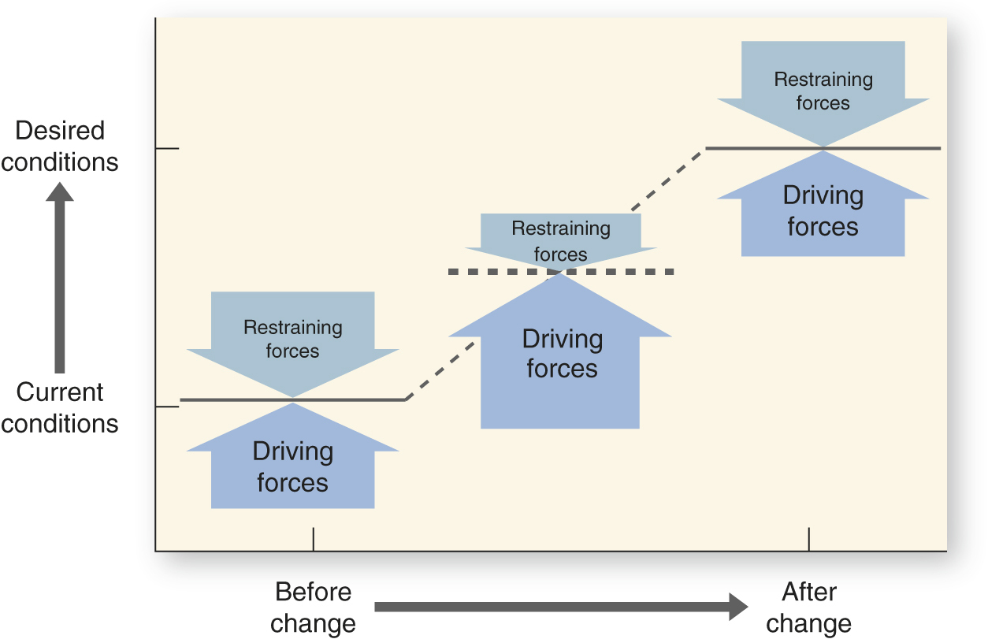
Lewin’s force field analysis model
Any change journey typically follows an S-curve
Source: Robbins, S. P., DeCenzo, D. A., Coulter, M. K., & Woods, M. (2016). Management : the essentials. Pearson Australia.
Notes:
-

Slide 10
Restraining forces: Resistance to change
Many forms of resistance:
Passive non-compliance
Attitude
Low productivity
Absenteeism etc.
--- Why ---
Fear of unknown
Concern about being unable to adjust
Perceived personal loss
Moving away from own ‘comfort zones’
Requires time/effort to learn new routines
Viewing resistance as a resource:
Identify symptoms of deeper problems by understanding employees’ mind-sets
Engage in mind-set change – from fixed mind-set to growth mind-set

Slide 11
…moving from fixed mind-set to growth mind-set
Manager/ management team can engage employees in sharing their current mind-sets to see how people think…then help them to see things differently…
“my job is to give customers what they want”
Vs.
“my job is not to be an order taker but to add value in the customer-employee conversation – help them to understand their needs”
---
* Once you un-lock the new growth mind-set, you can’t un-know it – you have to do something about it

Slide 12
Lewin’s change model
Unfreezing: reducing the forces that maintain behaviour
Moving: shifts behaviour to a new level
Refreezing: stabilises the organisation at a new state of equilibrium
https://www.youtube.com/watch?v=uhrbO7lrHro

Slide 13
Reducing the restraining forces
Communication
Learning
Involvement
Stress management
Negotiation
Coercion

Slide 14
Reducing the restraining forces
Highest priority and first strategy for change
Generates urgency to change
Reduces uncertainty (fear of unknown)
---
Problems: time consuming & costly
Communication
*The key is to help people to understand WHY the change is needed and WHY employees need to do what they’ve been asked to do

Slide 15
Reducing the restraining forces
New knowledge/skills
Coaching
Helps break old routines and adopt new roles
---
Problems: potentially time consuming & costly
Learning
*The key is to enable the change by helping people to change

Slide 16
Reducing the restraining forces
Involvement
Employees participate in change process
Reduces fear of unknown
---
Problems: time consuming, potential conflict
*The key is to engage employees in the change process in a healthy manner

Slide 17
Reducing the restraining forces
When communication, learning & involvement are not enough to minimise stress
Potential benefits:
more motivation to change
less fear of unknown
fewer direct costs
---
Problems: time consuming, expensive, doesn’t help everyone
Stress management
*The key is to provide support and psychological safety

Slide 18
Reducing the restraining forces
Influence by exchange
May be necessary when people clearly lose something and won’t otherwise support change
---
Problems:
expensive
gains compliance, not commitment
Negotiation
*The key is to continue the shift in how the business wants to operate

Slide 19
Reducing the restraining forces
When all else fails
Assertive influence
Radical form of ‘unlearning’
---
Problems:
reduces trust
may create more subtle resistance
encourages politics to protect job
Coercion
*The key is to continue the shift in how the business needs to operate

Slide 20
Managing the change process

Slide 21
Managing change
1
Aspiration: What are our strategic objectives? What are our health goals?
2
Assess: What are our current skills, capabilities & mind-sets? What are we going to need to implement the needed change?
3
Architect stage: Creating the change plan & supporting environment to increase the likelihood of how people think and behave

Slide 22
Managing change
4
Act: implementing the change (the steep part of the S-curve)
5
Advance: getting to the top of the S-curve; stage of continuous improvement

Slide 23
Managing change
To achieve effective change outcomes, there is a need for PERFORMANCE & HEALTH balance
PERFORMANCE | HEALTH
Decisions relevant to the following business activities: Buy - inputs Make – products/ services/ experiences Sell – mind-sets/ techniques | Decisions relevant to the people side of the business: Align – How do we align everyone on the direction we need to go? Execute – How do we execute the change with minimum friction in the system? Re-new - How do we create a sense of meaning & renewal that fuels & continually improves the business as we go?

Slide 24
Change Example: Movie Theaters
https://www.youtube.com/watch?v=zlcJlMpgAks
How have Hoyts/ Village changed over the years?
What are the takeaways from these insights for a business you are currently research on?
Notes:
10 mins

Slide 25
Assessment 2 tips
Have you updated your SWOT?
What are the 2-3 key aspects that your business could consider in order to achieve better growth?
Are these aligned with the current vision/ purpose of the business?

Slide 26
Questions?

