Slide 1
23369 Critical Leadership Intercultural LeaDERSHIP Week 14
Andrew Stewart and Chianu Dibia
andrew.stewart@port.ac.uk

Slide 2
Objectives for this workshop:
To understand the issues surrounding Intercultural leadership.
Discuss and explore leading edge international research on leadership in a global context

Slide 3
 Group Discussion:
 To what extent does leadership and therefore the characteristics of leaders differ by culture?

Slide 4
Culture defined
“customary and traditional way of thinking and doing things” (Jaques 1952:251)
“configuration of norms, values, beliefs, ways of behaving and so on that characterize the manner in which groups and individuals combine to get things done” (Eldridge and Crombie 1974:89)
“How things are done around here” (Drennan 1992:3)

Slide 5
What is culture? The collective programming of the mind? Hofstede (1981)

Slide 6
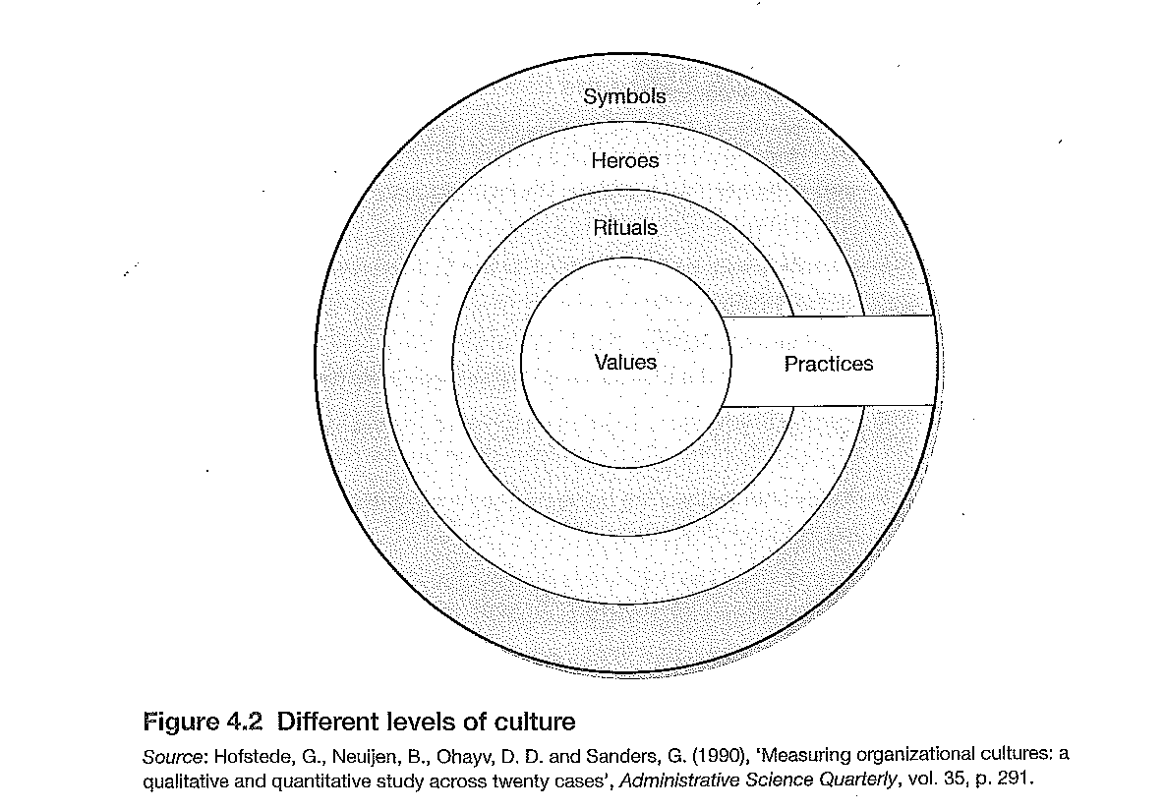
Analysing culture – Model 1

Slide 7
Rituals

Slide 8
Impact of National cultures
Hofstetde`s dimensions of national culture (1984, 1985, 2001)
Based on research in IBM
Power-distance
Individualism/collectivism
Masculinity/femininity
Uncertainty avoidance
Long term/short term orientation
There is no right or wrong

Slide 9
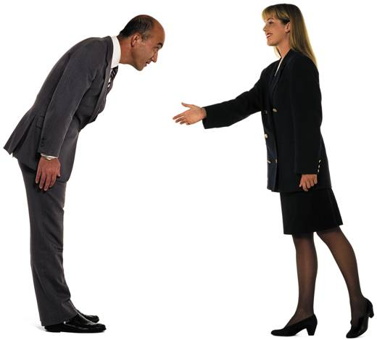
Power Distance
Power distance is a term that describes how people belonging to a specific culture view power relationships - superior/subordinate relationships - between people, including the degree that people not in power accept that power is spread unequally.

Slide 10
Collectivism – in group
The degree to which individuals show pride, loyalty and commitment in their work organisations or families

Slide 11
Performance orientation
Degree to which members of a society or work organisation encourage or reward individuals for high performance

Slide 12
 categorising societies along bipolar dimensions
matched samples or experimental conditions
external measurable features-so comparison
between countries (but is this necessary?)
Is this stereotyping?
 Where do we draw boundaries?
Scotland, England, Wales, Northern Ireland?
Northern and Southern Ireland?
Cornwall, The North East?
 To what extent do organisational cultures
supersede national cultures? (See: Gerhart, 2008)

Slide 13
Project GLOBE
The largest ever cross-cultural study on leadership
Project GLOBE (ongoing from 1993): a major multi-phase project by House et al.
Focuses on Relationship between national/societal culture, organisational culture and leadership effectiveness

Slide 14
Project GLOBE objectives
identify any universally accepted leader behaviour, attributes and organisational practices
or…are there some that are effective in some cultures only?
locate cultures along 10 dimensions (clusters)
Notes:
The Globe Project attempts to explain differences in preferred management and leadership styles worldwide. With reference to Globe Project dimensions and other relevant theoretical approaches, discuss how international culture may influence preferred leadership style.
How might national culture influence preferred leadership style
Tried to find what was wanted as well as what happened.
Is it universal or culture/country based

Slide 15
Scope of Project
17,000 participants
950 work organisations
62 societies/cultures
Long-term, Ongoing project
Notes:
Not all countries in the world

Slide 16
G.L.O.B.E. definition of leadership
‘the ability of an individual to influence, motivate and enable others to contribute toward the effectiveness and success of the organizations of which they are members’
Notes:
Leadership within organisations
A good manager is usually a good leader.
‘leadership not a quality but a state of mind- dessert island disks’ ‘it is what happens when the leader is not there that is is the sign of success’
More of globe later

Slide 17
GLOBE’s clusters (see French (2015) page 151 for breakdown of countries)
Anglo cultures
Latin Europe
Nordic Europe
Germanic Europe
Eastern Europe
Latin America
Sub-Saharan Africa
Arab cultures
Southern Asia
Confucian Asia
Notes:
H
ttp://www1.worldbank.org/publicsector/anticorrupt/SummaryJan29BBag.htm
http://www.grovewell.com/pub-GLOBE-intro.html
http://www.thunderbird.edu/wwwfiles/sites/globe/pdf/process.pdf
Some questions over cluster eg
Southern Asia included Iran and Thailand and Phillipines dubious Branine p64
Israel was in with Latin Europe which included French and Italian sectors of Switzerland
May be argued culture is not enough- but history economic and political factors also involved

Slide 18
Identification of leadership styles
Charismatic/value based
Self protective
Autonomous
Humane
Participative
Team oriented
Notes:
Visionary inspiring
Status conscious, self centred
Independent, individualistic
Modesty as a personal quality
Participative willing to delegate participative
Benevolent team builder
Reports are on Victory – read of want to do an exam question on this area.

Slide 19
Assertiveness
The degree to which individuals are assertive, confrontational or aggressive in their relationships with others in a particular cultural setting

Slide 20
Humane
The degree to which members of a society elicit, encourage or reward individuals for their fairness, altruism or generosity to others

Slide 21
Attributes
Universal attributes showing good leadership include charisma, team oriented
Cultural variations e.g. autonomous, self protective, participative, humane
(cited in Browaeys 2011)
Notes:
Browaeys 159
Autonomous – independent and individual yes in East Europe and Germany but not in Netherlands
Self protective – OK in Albania, Taiwan Egypt Iran Kuwait but not in Northern Europe
Participative - high in anglo and Northern Europe

Slide 22
A few findings
Anglo cluster. How should things be?
Low score for Power Distance. High on Collectivism
Within individualistic, democratic societies, participative leadership and delegation important
Notes:
In group collectivism

Slide 23
Southern Asia…how things should be
high on all dimensions except
performance orientation
gender egalitarianism
Power Distance
wish to see humane, patriarchal, team-oriented leadership (Ashkanasy 2002)
Notes:
Not so worried about gender equals but want less distance from managers.

Slide 24
Some specific findings too e.g. The Netherlands
‘place emphasis on egalitarianism and are sceptical about the value of leadership. Terms like leader and manager carry a stigma. If a father is employed as a manager Dutch children will not admit this to their school mates.’
Notes:
Very different emphasis –put down someone who tries to exert too much power

Slide 25
Arabs, Iranians, Malaysians
‘Arabs worship their leaders - as long as they are in power’
‘Iranians seek power and strength in their leaders’
‘Malaysians expect their leaders to behave in manner that is humble, modest and dignified’
Notes:
Differences here

Slide 26
Universal Attributes (Browaeys 2011)
Reflect good leadership
Impede good leadership
Integrity
Charisma
Team oriented
Orientation towards excellence
Decisiveness
Intelligence
Irritable
Egocentric
Loner
Non explicit
Asocial
Dictatorial
Ruthless
Un co-operative
Notes:
Browaeys 1 interpretation of Globe
In more details 59

Slide 27

Group Discussion:
 How trainable are these ‘good attributes’?
Integrity
Charisma
Team oriented
Orientation towards excellence
Decisiveness
Intelligence

Slide 28
Some criticisms of Project Globe
Too much on management
Restricted sector
Limited age range
Different understanding of terminology
Does not consider subcultures (China, India, the US)
Dynamic process of culture
Issues
Untranslatability of ‘leadership’
Universal theorisation of leadership
The relative value
Notes:
Financial services, Food processing, tele communication
Age range 30-40
What is charisma

Slide 29
GLOBE – underlying theory
Cultural values and practices affect what leaders do
Leadership affects organisational form, culture and practices
Societal values and practices impact at the organisational level
Organisational ‘contingencies’ e.g. size, technology
Relationships between contingencies and practices
moderated by cultural forces
Leader effectiveness from acceptance
Notes:
Culturally Endorced Implicit Leadership Theories
See model

Slide 30
Reading and references
Ashkanasy, N (2002) in International Journal of Organisational Behaviour 5 (3)
Branine, M (2011) Managing across Cultures London:Sage
Browaeys, M., Price, R. (2011) Understanding Cross Cultural Management
French, R. (2015) Chapter 7.
Guirdham (2005) pages 304-316
House, R. Javidan,M. & Dorfman,P, (2001) (2002) see Victory
McKenna,S. (1998) in Leadership and Organisation Development Journal 19 (2) pages 106-112.
Schneider & Barsoux (2003) pages 106-114 http://www.sciencedirect.com/science/article/pii/S1090951601000694

