Slide 1
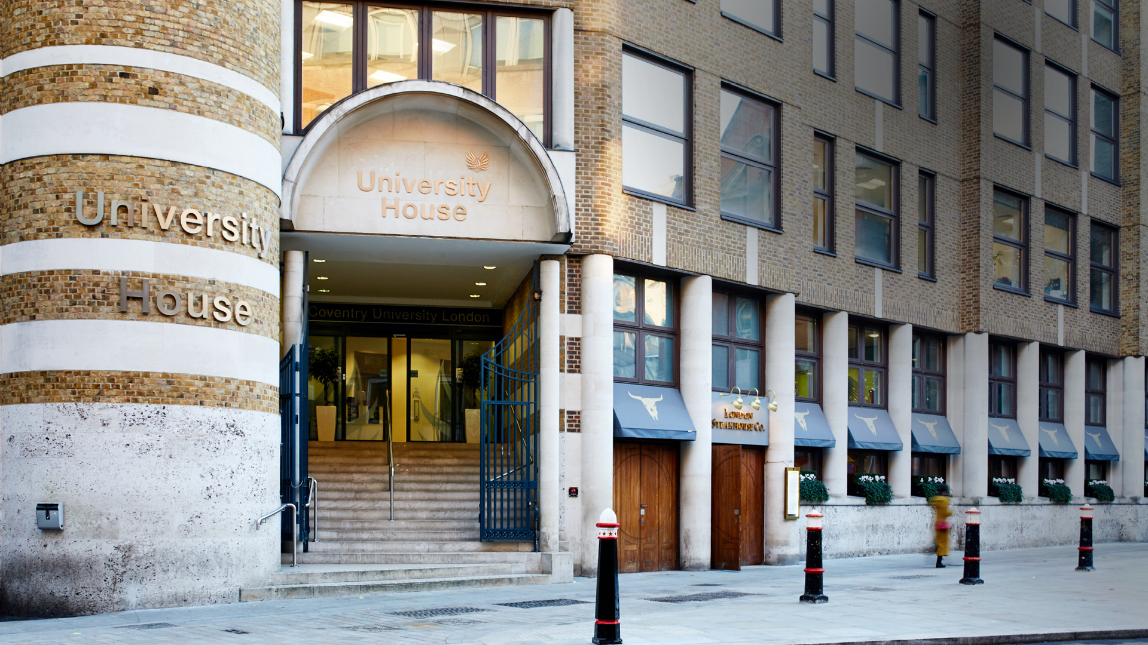

Unit 9: Seminar

Slide 2

Motivating your Team

Slide 3

Quiz Time

Slide 4


Slide 5
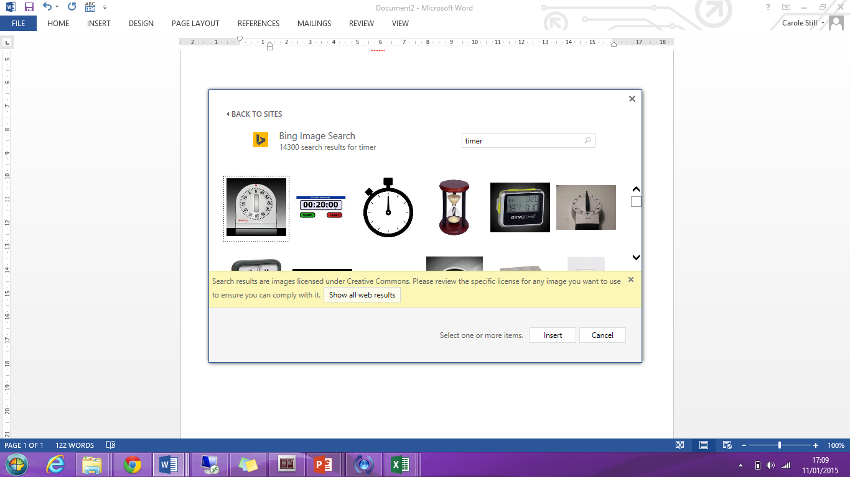
15
Review: Lecture
Outline the key theories highlighted in Unit 9’s Lecture
Apply and discuss it’s relevance to today’s discussion or presentation based on the case study ‘Motivational Theory in Practice at Tesco’
Reflect your learning from this week’s flipped lecture to:
- it’s relevance and limitation to your own country of origin
- challenges today’s leaders experience in motivating a changing workforce

Slide 6
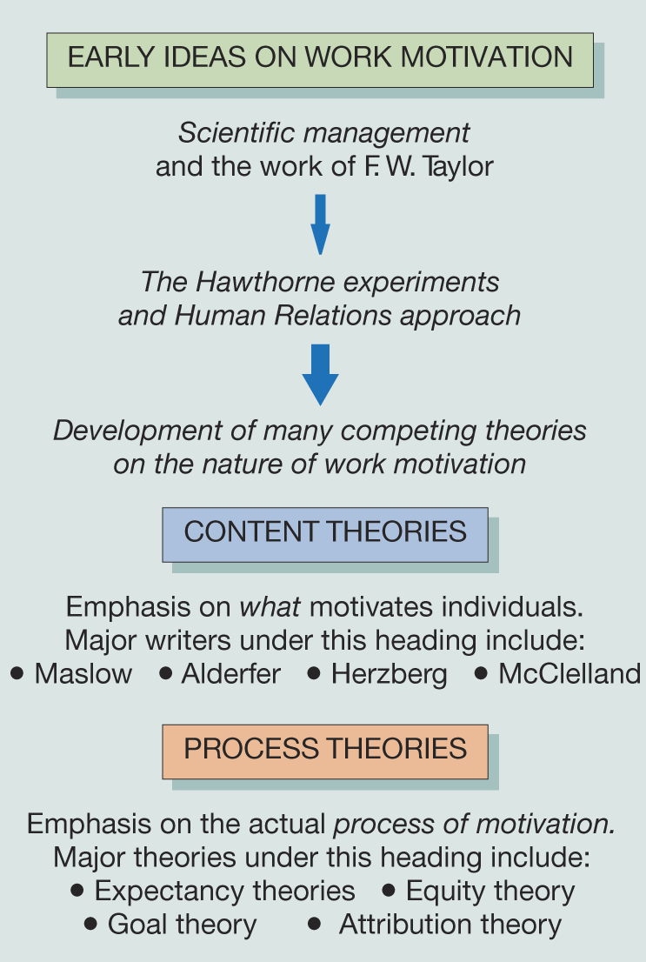
Case Study: Work Motivation
Prioritise the key motivation practices in the case study:
Most important and least important and why?
How do they reflect content and process theories of motivation?
How do they reflect your own motivators?
Critically evaluate:
To what extent do we see the different theories of motivation in the policies and practices of organisations?
How applicable are these theories of motivation to our understanding of non-Anglo-American cultures and global organisations?

Slide 7
Discussion: Some Key Themes
Use role of financial incentives as part of an organisation’s Reward strategy
Use of Performance Management frameworks in organisations
Value of intrinsic motivation in the design & application of HR policies/procedures
Traditional origins of management and organisational theories
Impact of translation of key terms and meaning into other languages
Extent to which different cultures believe they have an external locus of control
Impact of ‘globalisation’ and ‘one best way’ organisational cultures
Challenges of ‘think global, act local’ in delivering global business strategies
Impact of the quality of implementation and ongoing delivery of policies and strategies by key organisational stakeholders
Employee impact of change on the formal & psychological contractual expectations
How applicable are these theories of motivation to our understanding of non-Anglo-American cultures and global organisations?

Slide 8
Discussion: The Psychological
Contract
Implied series of mutual expectations and satisfaction of needs
Expectations of:
  Rights and privileges
  Duties and obligations
May change over time however consistently influences individual’s behaviour
Relates to the social responsibility of the manager or leader
?
How do you identify the features of the psychological factors in an organisation?
What impact does the psychological contract on how employees experience change?
Individual
Organisation

Slide 9

Group Activity: Movie Time
The Surprising Truth about what motivates us – Daniel Pink
http://www.ted.com/talks/dan_pink_on_motivation?language=en

Slide 10
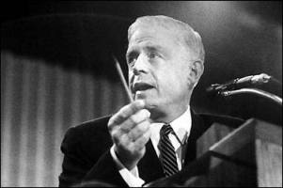
The Impact of the Leader on
Individuals
What characterises great managers and leaders is their ability and willingness to individualise their management of their people:
Willingness to treat each person differently
Willingness to establish more than a transactional relationship with each individual, developing trust and friendship
Acceptance of other people’s individual needs and drives
Recognise the role of the manager/leader is to facilitate performance
Use trust as a key skill in managing the performance of their team
“Fire you? I just spent $10 m educating you. I just want to be sure you learned the right lessons”. Tom Watson Jnr, IBM.
(The Why of Work: Ulrich 2010)

Slide 11
Group Discussion:
In Search of Job Satisfaction
Factors | Examples
Individual | Personality, education, abilities, orientation to work
Social | Relationships, group working, norms, the informal organisation
Cultural | Attitudes, beliefs, values
Organisational | Nature, size, structures, policies, work organisation, technology, leadership styles
Environmental | Economic, social, technical, governmental
?
Do you think satisfaction leads to performance?
Or
Performance leads to satisfaction?
How might you measure this complex topic?
Based on:
Mullins, L.J. (2016), Management and Organisational Behaviour

Slide 12
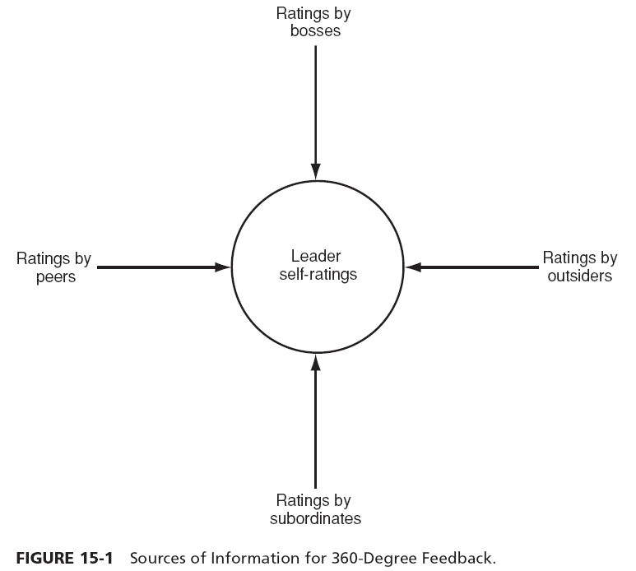
Learning from 360° Feedback
Source: Yukl (2010)

Slide 13
A Leader’s Impact on Learning
Development of yourself
  Learning what to do – skills and knowledge
  Learning how to be – role behaviour
  Learning the ropes – socialisation
Development of others
  Personal development
  Planned learning events
Development of learning culture
  Role modelling by leaders
  Developing practices to support the ‘Learning Organisation’
  Sharing learning through Knowledge Management processes
  Based on: Mullins (2016)

Slide 14
Group Activity: Appraisal
Feedback: how not to & how to
http://www.youtube.com/watch?v=kedEM5KWx_M

Slide 15
Group Activity: Giving Feedback
Specific
Behaviour
Describe what they did
Impact
Describe the effect
Future
Suggest alternative behaviour
Use an example
Use an example
Use their exact words or actions
Be honest
Describe the situation
In pairs share the following information:
Give 2 examples of what your colleague has done well during this class.
  What exactly did they do?
  What was the impact?
  How could they do more of this in the future?
Give 1 example of what your colleague could improve that you noticed in this class.
  What exactly did they do?
  What was the impact?
  How could they improve in the future?

Slide 16
Preparation for week 10
Read the Semco case study and come discuss the following questions within your group and come prepared to class:
What are the organisational reasons that led Ricardo Semler to radically change Semler’s organisational culture and how would you describe the pre and post organisational culture.
How would you characterise Semler’s early leadership style? And his later leadership style?
What impact do you believe the changes made will have on the motivation of employees and why?
Where do you see Lewin’s 3 step model reflected in his drive to change?
To what extent do you think Ricardo would succeed as a leader in organisations in your culture?

Slide 17
Preparation for week 10
Attend week 10’s Lecture on ‘Leading and Change’.
Quiz Time: Seminar Lecturer will allocate a group to come prepared to conduct a Kahoot quiz based on Unit 9’s Lecture on “Leading and Motivation” (a minimum of 10 questions)
Read the prescribed readings. You will find this information under Unit 9 – Instructions
COME PREPARED!

Slide 18

Any Questions?

