Slide 1


Unit 9: Motivating your Team
(Knowledgecast)

Slide 2
Today’s Knowledgecast
As a result of today’s Knowledgecast, you should be able to:
Critically analyse what motivates individuals to follow a specific course of behaviour in the workplace
Assess what individuals expect from their experience at work and the extent to which a line manager can meet those expectations
Appraise the link between job satisfaction and job performance in the workplace

Slide 3
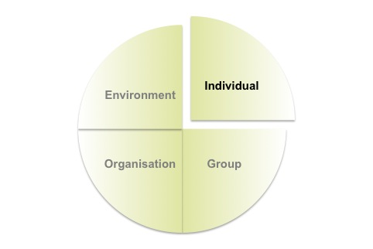
Understanding Individuals
Employee behaviour is influenced by
a combination of 4 factors
Understanding individuals requires an
appreciation of differences in:
  Personality
  Emotions
  Ability
  Emotional Intelligence
  Attitude
  Source:
  Mullins (2016)

Slide 4
What aspect of work do
you think most people look for
Meaningful work
Collaboration
Autonomy
Recognition
Growth
Money

Slide 5
What aspect of work most interests you?
Meaningful work
Collaboration
Autonomy
Recognition
Growth

Slide 6
3 Problems to Solve
  Problem 1
  Why don’t the people in my team behave like me?
  Problem 2
  Why do some people seem to lose interest quickly in work that needs to be done?
  Problem 3
  Why are some teams more enjoyable and more successful over time than others?

Slide 7


3 Problems to Solve
  Problem 1 Why don’t the people in my team behave like me?
Leaders/managers must understand their workforce
People have unique needs, behaviours, desires, goals
Behaviour is influenced by multiple factors – inherited characteristics * social environments
Diversity – not one size fits all
Managing others needs self understanding
Sense of self is shaped by extrinsic & intrinsic forces
Personality, theories – can they help?
Culture Shock

Slide 8
Motivating Individuals
Motivation =
Content Theories vs. Process Theories
Content Theories:
What actually motivates individuals at work
Identifies Needs, Strength of Needs and Goals
Process Theories:
How behaviour is initiated, directed and sustained
Motivation =
Direction
+ Persistence of action
Motivation is:
Individual
Usually intentional
Aroused
Choice driven
Predictable
Source:
Mullins (2016)

Slide 9
3 Problems to Solve
  Problem 1
  Why don’t the people in my team behave like me?
  Problem 2
  Why do some people seem to lose interest quickly in work that needs to be done?
  Problem 3
  Why are some teams more enjoyable and more successful over time than others?

Slide 10
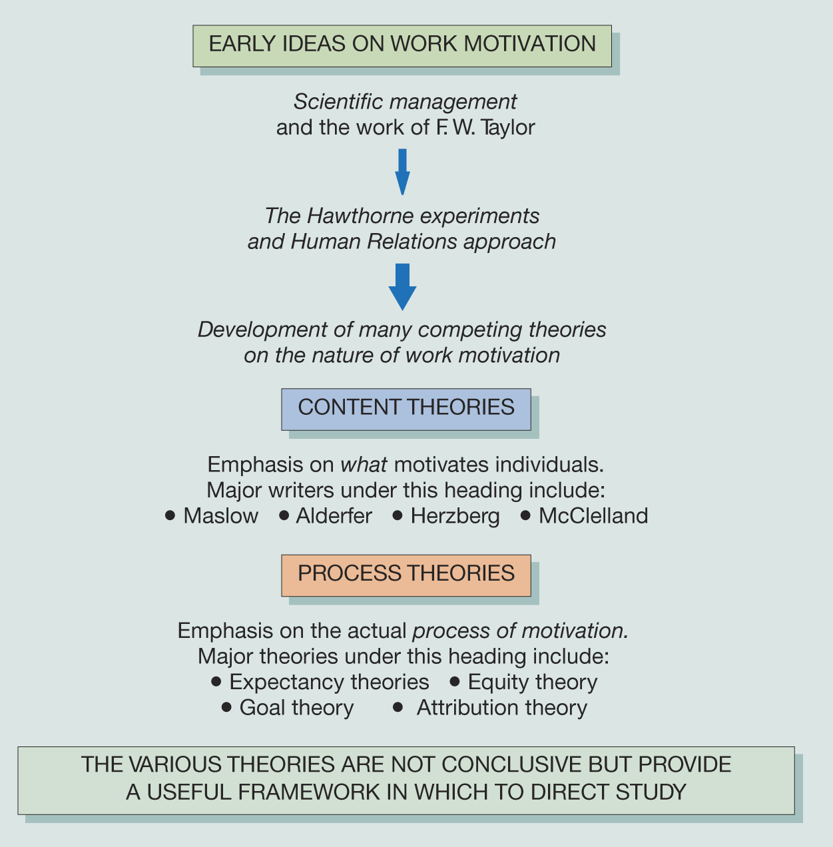
Key Theories of Work Motivation
Content theories 1950s – early 1960s
search for specific things within individuals that initiate, direct, sustain & stop behaviour - internal factors that energise and motivate behaviour
Maslow, Herzberg
Process theories mid 1960s
explain how behaviour is initiated, directed, sustained and stopped
Vroom Expectancy theory
Goal setting theory (late 1960s)
Goals increase performance, defined as easy/low: difficult/high performance
Locke
Self efficacy theory (1970s)
a person’s perception of their belief that they have the power to achieve goals whether capable or not
Bandura Self Efficacy
Source:
Mullins (2016)

Slide 11
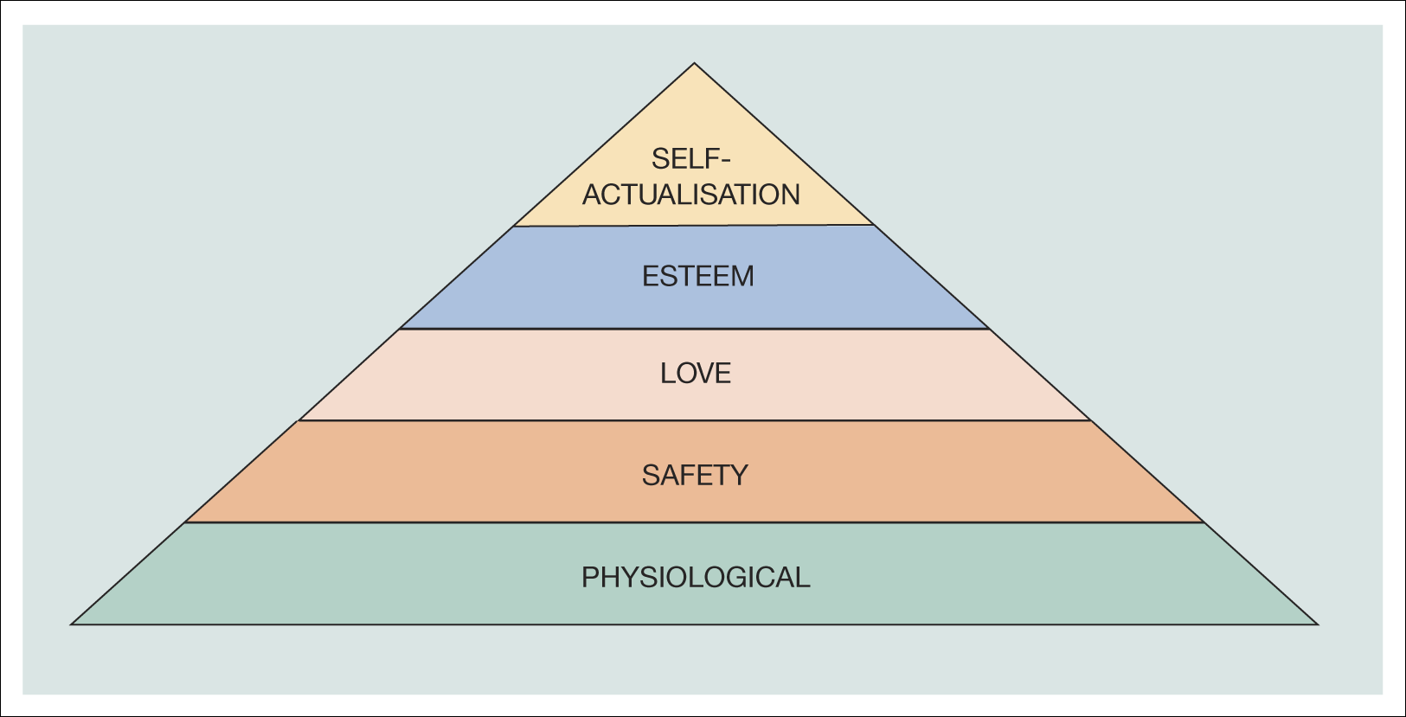
Content Theories:
Maslow
LIMITATION in the WORKPLACE:
People do not necessarily satisfy their needs, especially higher-level needs, just through work
There is doubt about the time that elapses between satisfying lower-level and emergence of higher-level needs
Some rewards or outcomes may satisfy more than one need
The motivating factors may not be the same for each person
Job satisfaction does not necessarily lead to improved performance)
Source:
Mullins (2016)

Slide 12
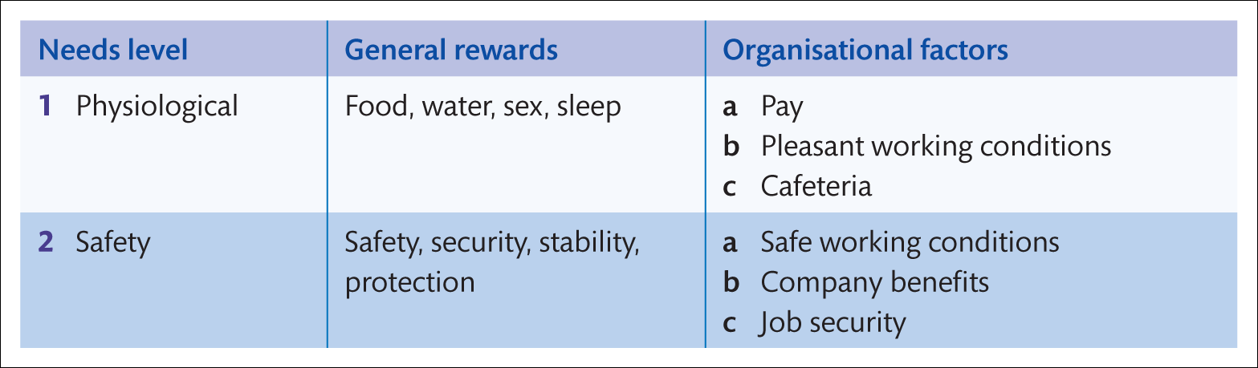
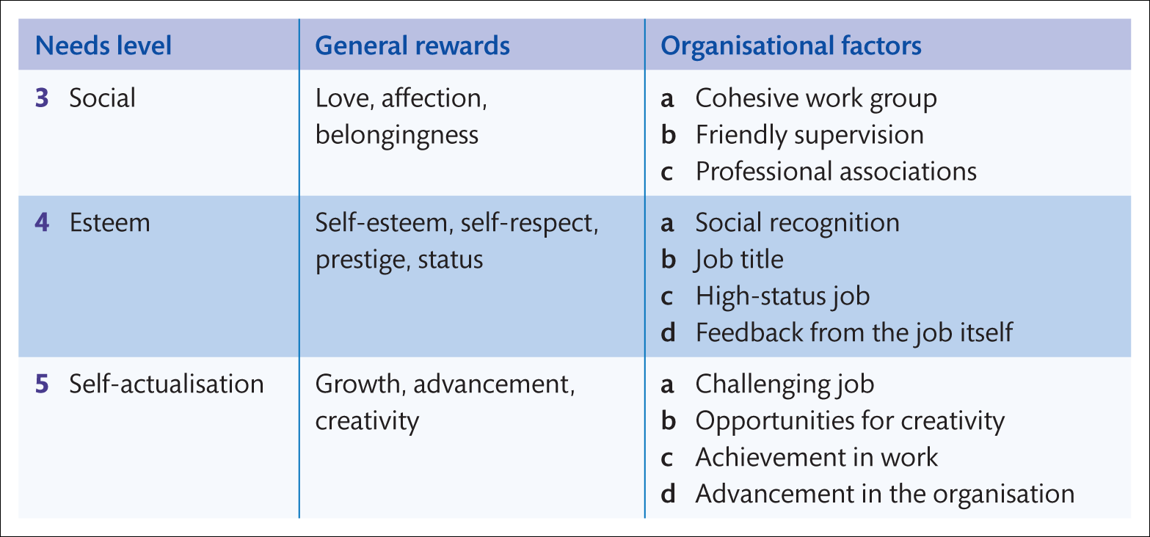
Content Theories: Maslow
5
4
3
2
1
5
4
3
2
1
5
4
3
2
1
Source:
Mullins (2016)

Slide 13
Content Theories: Herzberg 2 factor theory
Hertzberg: the opposite of Job Satisfaction is a lack of satisfaction
Hygiene factors (extra job factors)
Could lead to Dissatisfaction
Company policy
Interpersonal Relations:
Supervisor/ peers / subordinates
Work conditions
Salary
Relationship with Peers
Status
Job security
A psychological need for safety, security and order
Extrinsic factors ie relations with co-workers
Motivators
Leading to Satisfaction
Challenging work
Achievement
Recognition
Work itself
Responsibility
Advancement
Growth
A psychological need to grow, develop & advance
Intrinsic factors ie recognition coming from within the work itself
Motivation & job satisfaction, Mark A Tietjen & Robert M Myers. Management Decision 36/4 1998 pp 226-231

Slide 14
Process Theories - Goal Setting
An influential motivational technique across cultures
LIMITATIONS in the WORKPLACE
Less relevant to knowledge workers where ‘output’ cannot always be easily quantified (read Drucker’s “The Landmarks of Tomorrow”)
Dependent on the ability of the line manager and employee to agree on a ‘motivating’ goal
Used now in context of Performance Management which integrates development planning and reward
Source:
Mullins (2016)
Clearly defined
Challenging
Committed to
Regular Feedback
Recognise complexity
‘At present, goal-setting is one of the most influential theories of work motivation applicable to all cultures’. Hannagan (2005:363)
Based on Goal Theory (Locke 1968)

Slide 15
3 Problems to Solve
  Problem 1
  Why don’t the people in my team behave like me?
  Problem 2
  Why do some people seem to lose interest quickly in work that needs to be done?
  Problem 3
  Why are some teams more enjoyable and more successful over time than others?
  Marcus Buckingham (unit 4): Strengths, Triggers, Learning style
  Poor Eric!

Slide 16
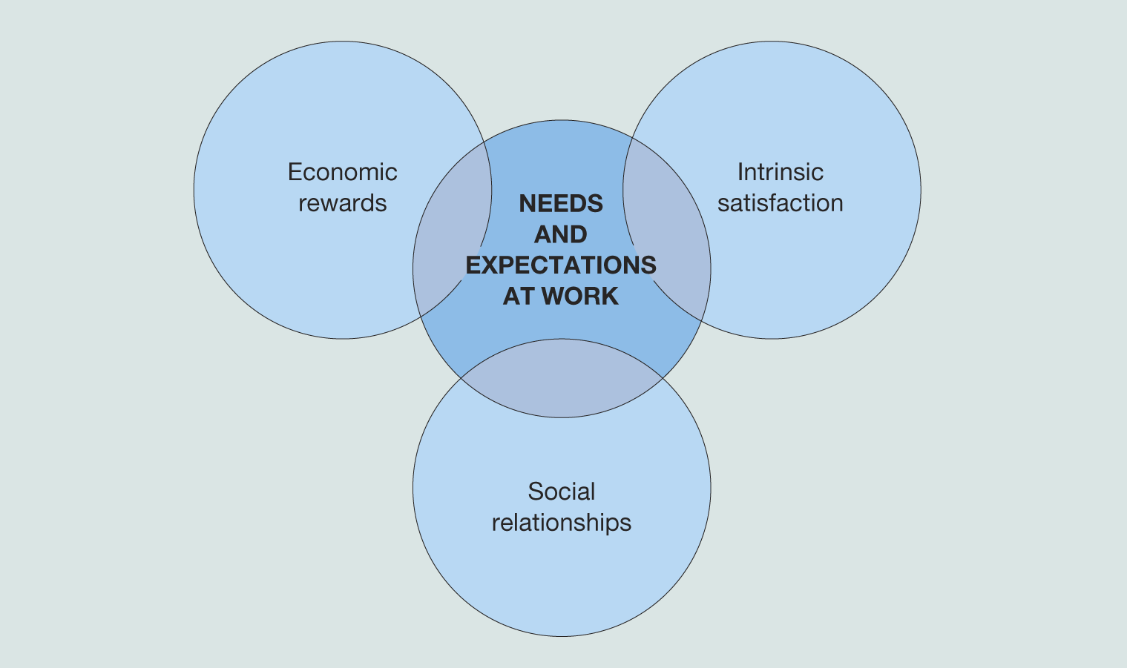
Why People Come to Work
Source:
Mullins (2016)

Slide 17
Developing a Passion for Work
According to Blanchard, the following need to be in place to get the best out of your team:
Meaningful work
Collaboration
Fairness
Autonomy
Recognition
Growth
Connectedness with leaders
Connectedness with colleagues
Source:
Cited in Mullins (2016)

Slide 18

Motivation & Performance:
owning the role
Job description
I’m laying a brick
Job description , goal, objective
I’m laying a brick. I plan to complete this wall by Friday & my work group plans to complete the whole wing in 3 months
Job description, goal, objective, mission
…..and we are all building a tower
Herzberg – Motivation
Harley - Empowerment

Slide 19
The Impact of the Leader on Individuals
Talented employees need great managers. The talented employee may join a company because of its charismatic leaders, its generous benefits, and its world-class training programs, but how long that employee stays and how productive he is while he is there is determined by his relationship with his immediate supervisor.
Buckingham and Coffman (2005:4)
A poor relationship with a line manger can be the push factor behind an individual’s decision to quit their job and leave the organisation.
CIPD (2009)

Slide 20
The Psychological Contract
Implied series of mutual expectations and satisfaction of needs
Expectations of:
  Rights and privileges
  Duties and obligations
May change over time however consistently influences individual’s behaviour
Relates to the social responsibility of the manager or leader
Individual
Organisation
Source:
Mullins (2016)

Slide 21
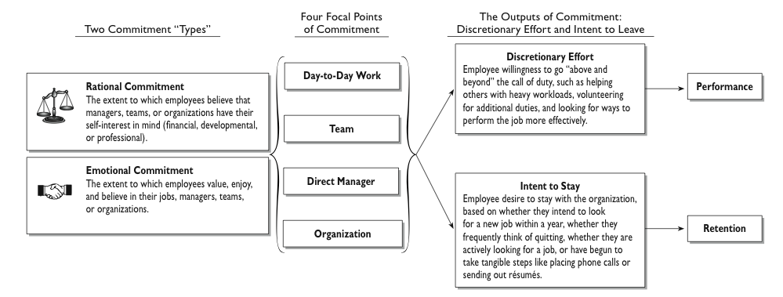
Perspectives on Employee Commitment
Source:
Corporate Leadership Council (2009)

Slide 22
Knowledgecast Summary
Reflect critically on and apply conceptual and practical approaches to leadership in a range of different organisational settings.
Critically evaluate techniques to address and overcome resistance to change.
Critically reflect upon personal experiences and aspirations around leadership enabling them to develop originality in their own leadership capabilities.
Explore the ethical relationships between leaders and followers.

