Slide 1


Unit 8: Seminar

Slide 2

Assignment Workshop

Slide 3

Quiz Time

Slide 4


Slide 5
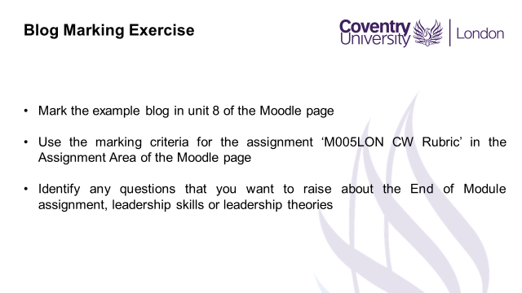

Slide 6
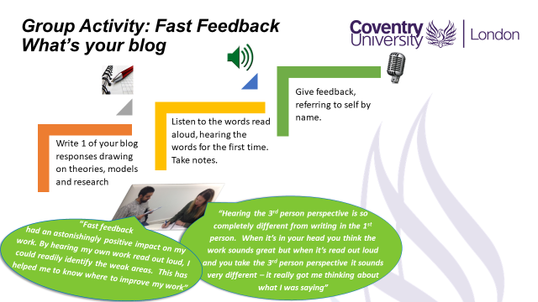

Slide 7
Preparation for Next Week – week 9
Read the case study on Motivational theory in practice at Tesco and explore the following questions:
What for you are the most important and least important practices used in this organisation and why?
How do these practices reflect content and process theories of motivation?
How do they reflect your own motivators?

Slide 8
Preparation for Next Week – week 9
Consider your own willingness and ability to:
- treat each person differently
- establish more than a transactional relationship with each individual, developing trust and friendship
- accept other people's individual needs and drives
- recognise the role of the manager/leader is to facilitate performance
- use trust as a key skill in managing the performance of your team
Identify 3 questions that you would like to discuss about Motivation in the workplace

Slide 9

Preparation for Next Week
Attend Unit 9’s Lecture
Quiz Time: Seminar Lecturer will allocate a group to come prepared to conduct a revision Kahoot quiz based on Unit 1 tp 7’s Lecture (a minimum of 10 questions)
Read the prescribed readings. You will find this information under Unit 9’s – Instructions
COME PREPARED!

