Slide 1


Unit 7: Power and Control
(Knowledgecast)

Slide 2
Today’s Knowledgecast
As a result of today’s Knowledgecast, you should be able to:
Analyse the nature and importance of control in delivering organisational goals
Debate the nature of power and management control with consideration to the sources and use of power
Evaluate the consequences of power for leadership effectiveness
Appraise the process of delegation and the importance of empowerment in supporting organisations to adapt to change

Slide 3
3 Problems to Solve
  Problem 1 Why don’t the people in my team behave like me?
Leaders/managers must understand their workforce
Each person has unique needs, behaviours, desires, goals
Behavour is influenced by multiple factors – discuss!
Defining theme of 21st century: Diversity – not one size fits all
Defining theme: Managing others needs self understanding
Sense of self is shaped by extrinsic & intrinsic forces
Personality, Emotions, Ability, EI, Attitude – explore!

Slide 4
Reminder: Rules & Motives
Question: How many ethical failures are the result of people not knowing what they were doing was wrong?
The Rules
Kantian ethics, Bentham & Mill Utilitarianism, natural law, divine law, command, etc
Moral Reasoning
Ethical Behaviour
If you do not have the character to do the right thing then knowing how to do the right thing is irrelevant
Motivation: individual emotional response: courage, integrity, justice, wisdom, benevolence, righteous, anger, honesty
Character

Slide 5
Power & Influence:
the theory of power & influence being relational
Source:
French & Raven (1968)
Coercive power typically decreases attraction causing significant resistance unless it is perceived to be legitimate!
Reward power increases attraction with minimal resistance
Key point: power often based on the subordinate’s perception of the leader’s ability to exert power
French & Raven examined the effect of power juxtaposed with attraction & resistance.
By measuring
Power -v-
Attraction -v-
Resistance

Slide 6
Power and Flexibility
Source:
French & Raven (1968)
Power
Reward
Coercive
Legitimate
Referent/
charisma
Expert

Slide 7
French & Raven
Which are the most effective sources of power?
Personal sources of power are more strongly related to organisational performance, job satisfaction, organisational commitment
Coercive power is negatively related to employee satisfaction, commitment and job performance
Are the sources related to each other?
Coercive power may reduce referent power
Expert power may also include legitimate power
Legitimate power may provide more reward/coercive with seniority
Source:
Lunenburg (2012)

Slide 8
Influencing Process: the effect
Outcome of Influencing the employees
Commitment - Agreement and great effort
Compliance - Apathy and minimal effort
Resistance - Opposed and avoidance
Motive for the Employees Actions
Instrumental Compliance - Expects reward or punishment
Internalisation - Committed to desirable proposal
Personal Identification - Please and imitate role model
Yukl (2010)
Discussion:
What factors that will influence a leaders purpose for influencing?
What part does a leader’s ethics and values play in determining the intended outcome?
What are benefits and limitations of each motive for action?

Slide 9
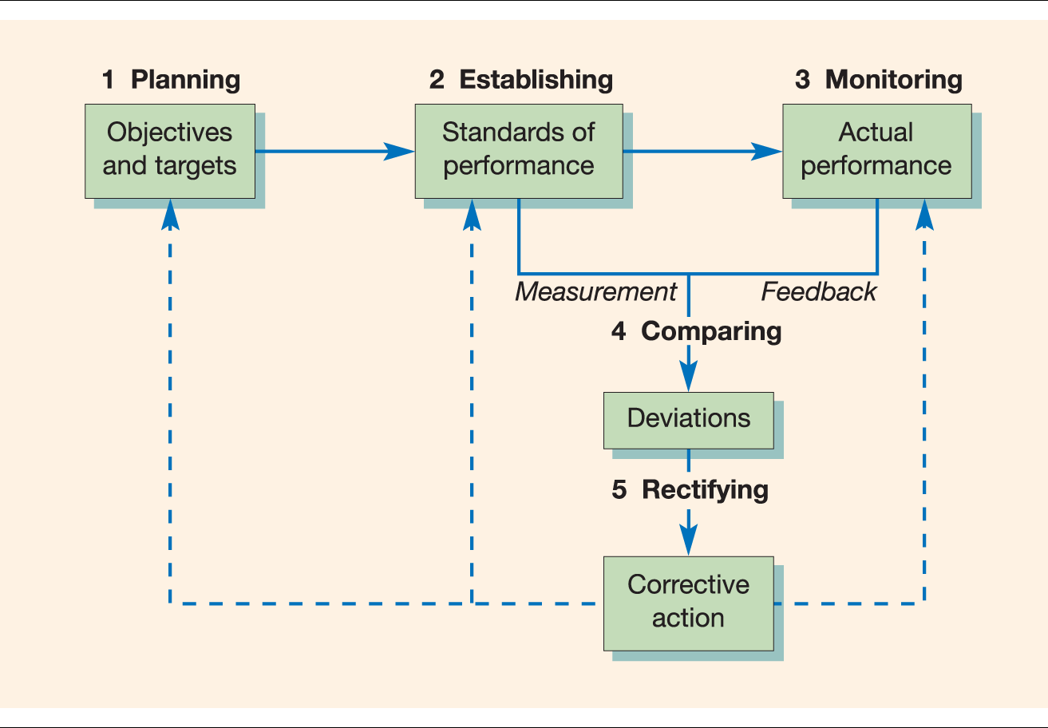
Organisational Performance
Control Systems - a close relationship between goal achievement and influencing individual behaviours
Control systems help managers/leaders to:
Check progress against objectives
Coordinate decisions
Measure Success
WHAT of ethics + the need to understand individual motivations to direct behaviour for the benefit of the organisation?

Slide 10
6 Strategies of Control
Framework to assess how control is used in organisations to ensure goal delivery
Personal & Centralised
Bureaucratic
Output
decision making centralised around the leader with focus on their close inspection of work
aims for predictability defined roles, procedures reinforced through rewards & punishments
standards & targets agreed, semi autonomous but only relevant where output is measured.
Source: Child (2005)
Electronic Surveillance
Human Resource Management
Cultural
Assesses speed & quality of performance against target, producing precise factual data
Select, develop & control behaviours, design & implement performance evaluation
Internalised compliance with management & belief in organisation, link to skills & autonomy

Slide 11
Controlling Process:
Individual Performance
Reliability – Order – Stability
Benefits of CONTROL for individuals:
Provide structure, definition and measurement of task performance
Receive feedback about their performance
Basis for reward systems based on performance
Remember Fayol
Mullins ARGUES control needs to be viewed from both an Organisational performance (providing structure) + individual behaviour (motivating, empowering, disempowering perspective). Individuals have their own capacity to experience, interpret and assign meaning to the experience of being controlled, and in turn formulate this into their actions. Therefore, a leader needs to be aware of the intended impact and purpose of their control.

Slide 12
Power and Compliance
3 dimensions: Etzioni = congruent compliance structure will be more effective. - What are the advantages and disadvantages of using each style of compliance?
Organisational Power
Coercive - Threats and sanctions
Remunerative - Resources and financial rewards
Normative Symbolic rewards
Individual Involvement
Alienative Against their wishes
Calculative Promise of extrinsic rewards
Moral - Driven by values and belief in goals
Individual Feelings
Alienative Negative orientation
Calculative - Negative or low positive orientation
Moral - High positive orientation

Slide 13
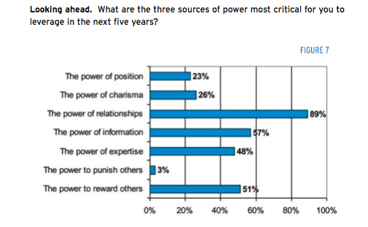
Future Priorities
What implications does this have for YOU?
How will Relationship power work in VIRTUAL Organisations?
What is the implication of the shift from Expertise to Reward?
Source:
Center for Creative Leadership (2008)

Slide 14
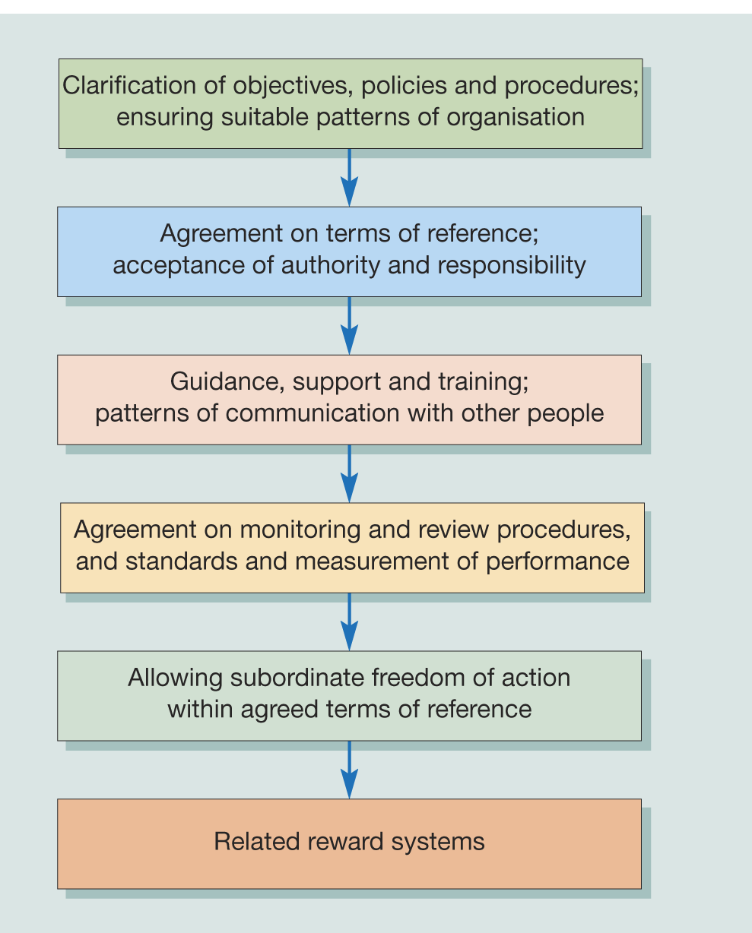
Power and Empowerment
Source: Mullins (2016)

Slide 15
Power and Empowerment
Empowerment can support organisations to remain flexible to change by:
Involving teams in decision making and goal setting in relation to activities that affect them
Ongoing development of the workforce to handle change and develop future skills and competencies to meet succession requirements
Four questions to ask before delegating:
1. What tasks could be performed better by others?
2. What opportunities are there for learning and development through delegation?
3. How and to whom should the responsibility be given?
4. What forms of monitoring and control would be most appropriate?
Source:
Mullins (2016)

Slide 16
What Stops Us from Delegating?
Why don’t managers and leaders delegate?
may fear that the individual is not capable of doing a sufficient job
may fear being blamed for the individual’s mistakes
may fear that the individual will do too good a job
may find it hard to trust others
Source:
Mullins (2016)
As a future leader reflect on the following:
What are the success criteria for effective delegation?
What are the skills required for effective delegation
What is the link between delegation and empowerment?

Slide 17
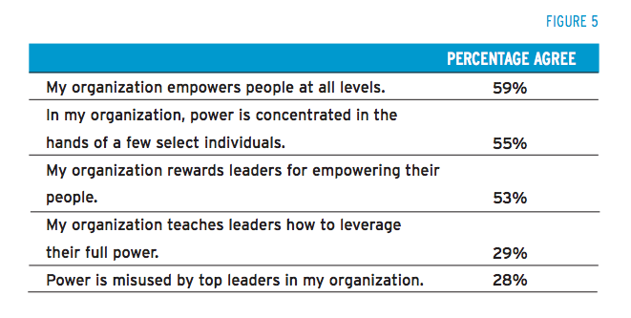
Power in Organisations
Source:
Center for Creative Leadership
(2008: 08)

Slide 18
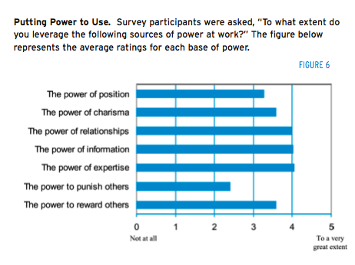
2008 Research: Power at work
Position
Charisma
Relationships
Information
Expertise
Punishment
Reward
Source:
Center for Creative Leadership (2008)

Slide 19
Knowledgecast Summary
Apply to their analysis an understanding of the key tensions within leadership and how it relates to other business themes such as globalisation, strategy, innovation and organisational change
  Debate the value of sources of power to lead diversity in global organisations
Critically reflect upon personal experiences and aspirations around leadership enabling them to develop originality in their own leadership capabilities
  Evaluate the skills of leaders to engage and empower their teams
Explore the ethical relationships between leaders and followers
  Appraise the use of control systems in influencing the efforts of others to achieve organisational goals

Slide 20
What are we going to cover next?
In our next Knowledgecast, we will:
Analyse current research on the role of leadership in relation to managing change
Critically evaluate techniques to address and overcome resistance to change
Critically evaluate an incident of strategic organisational change by exploring the role of leadership

