Slide 1


Unit 6: Seminar Preparation

Slide 2

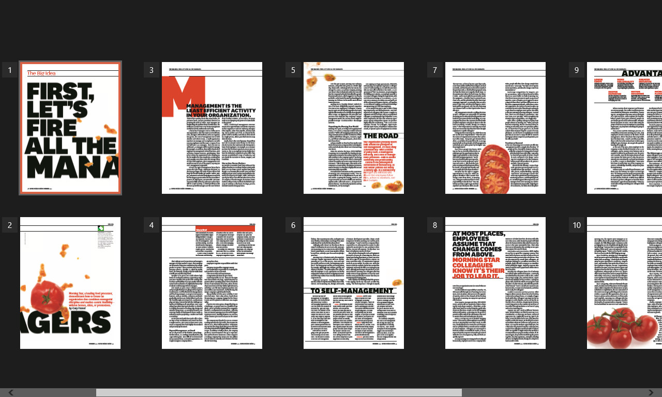
Preparation for week 6-
Read

Slide 3
Preparation for Week 6: Debate
Do companies really need managers?
Yes or NO?
There will be classroom debate for which we need 3 groups.
Group A will discuss why we DO need managers. (YES)
Group B will discuss why we DON’T need managers. (NO)
Group C: all week 6 team leaders chairing the discussion

Slide 4
Preparation for Week 6: Debate –
Extra Reading
Group A (YES): You argue that companies DO need managers. | Please read/watch and prepare: http://www.huffingtonpost.com/jacob-morgan/do-we-need-managers_b_6876846.html https://www.coursera.org/learn/managing-as-a-coach/lecture/ae6Ic/why-do-we-need-managers
Group B (NO): You argue that companies DON’T need managers. | Please read and prepare: https://hbr.org/2011/12/first-lets-fire-all-the-managers
Group C (Team leaders): You run the discussion, prepare a set of ground rules and determine the winner of the debate. | Please read and prepare: http://www.cmu.edu/teaching/solveproblem/strat-dontparticipate/groundrules.pdf

Slide 5

Preparation for week 6
Attend week 6’s Lecture
Quiz Time: Seminar Lecturer will allocate a group to come prepared to conduct a Kahoot quiz based on Unit 5’s Lecture on “Managing and Leading Teams” (a minimum of 10 questions)
COME PREPARED!

