Slide 1


Unit 5: Seminar

Slide 2

Leading Teams

Slide 3

Quiz Time

Slide 4


Slide 5
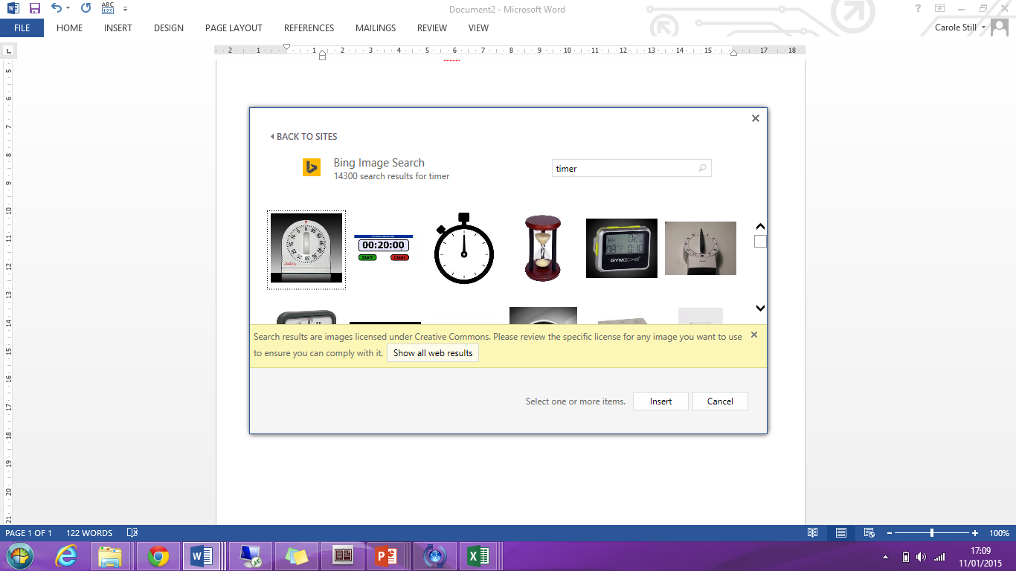
15
Review: Lecture
Outline the key theories highlighted in Unit 5’s Lecture
Discuss it’s relevance to today’s discussion or presentation on ‘Challenges of Working in Virtual Teams’
Reflect your learning from this week’s lecture to:
- it’s relevance and limitation to working in virtual teams in your own national culture
- challenges today’s global leaders / managers experience

Slide 6
Leading Virtual Teams
From your critical evaluation of:
Solomon, C., (2010), The challenges of working in virtual teams, published by RW3 CultureWizard
How do Virtual teams compare with traditional Face-to-Face teams?
What are key challenges for Virtual teams?
What is the role of the leader in Virtual teams?
What are your key learning points about leading Virtual teams?
Discuss or present your key findings with the rest of the class

Slide 7
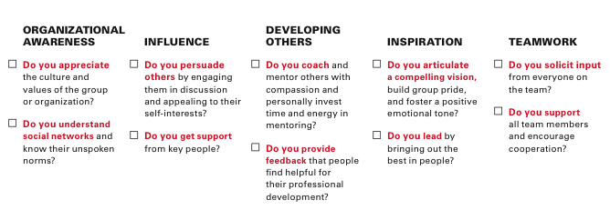
Communication Skills for Leaders
Goleman, D. and Boyatzis, R. (2008) Social Intelligence and the Biology of Leadership. In Harvard Business Review; Sep2008, Vol. 86 Issue 9, p74-81

Slide 8
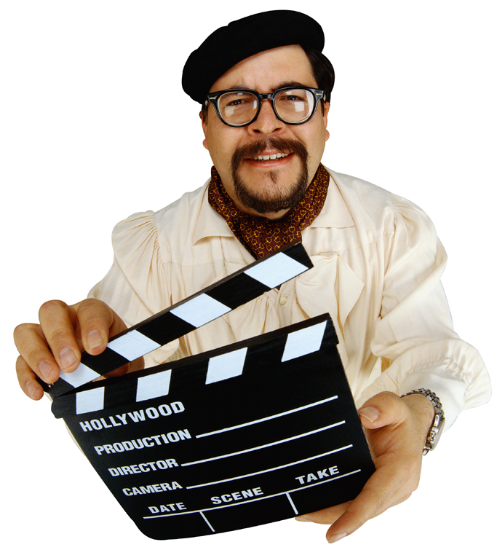
Group Activity: Role Play:
The Team That Wasn’t – Take 1
Take 1 – You will be given a character from
The Team That Wasn’t case study to role play
Role Play format
Board meeting
To prepare your starring role
How is your character feeling in this meeting?
What behaviours is your character demonstrating?
What impact are they having on the other
Take 1

Slide 9

Group Activity: Role Play:
The Team That Wasn’t – Take 2
Take 2 – Your goal is to improve the performance
of the team
Take 2 – Small Group Discussion
What management techniques are missing?
What meeting structure is missing?
What characters are missing from the meeting?
How would Tuckman's Team Development Model help?
Take 2
In your own style, present your proposed solution.
You have 10 minutes per group
Take 2

Slide 10


Group Activity: Identifying Blogging
techniques
25
In your teams, review 1 blog from the list on the next slide. Divide the following tasks among your team. If the links are not active, please search for a similar blog based on the title or topic from the list.
Identify a set of techniques about how:
  the author engages the reader
  with their argument
  how follower’s comments can be used to create a debate or expand on the
  point of view
Follower comments
Engaging author
Create your 5 Tips for Writing Blogs
Present your team’s 5 Tips for Writing Blogs to your class.

Slide 11
Group Activity: Blogging
Green, A. (2013) 'What New Managers Learn That Employees Don't Know,'
US News [online] 25 March. Available from <http://money.usnews.com/money/blogs/outside-voices-careers/2013/03/25/what-new-managers-learn-that-employees-dont-know> [03 May 2013]
Red Book Solutions (2013) Better Managers Blog
[01 May 2013] Available from
<http://blog.bettermanagers.com> [03 May 2013]
Clifton, J. (2013) The Chairman's Blog
[22 March 2013] Available from
<http:/hechairmans/tblog.gallup.com/2013/03/beware-of-managers-from-hell.html> [03 May 2013]
Toynbee, P. (2012) 'Teacher-bashing: a political sport with no winners,'
The Guardian [online] 22 April. Available from <http://www.guardian.co.uk/commentisfree/2013/apr/22/teacher-bashing-gove-performance-pay> [03 May 2013]
Gapper, J.( 2013) 'Managers are reining in staff - because they can'. Financial Times [online] 28 February. Available from <http://search.proquest.com/docview/1313228802/13DCF892A644CC8914D/13?accountid=10286> [03 May 2013]
NOTE: Some links may not be working now, so please use the titles of the blogs listed above to search for new links
Engaging author
Follower comments

Slide 12
Group Activity: Giving Feedback
Specific
Behaviour
Describe what they did
Impact
Describe the effect
Future
Suggest alternative behaviour
Use an example
Use an example
Use their exact words or actions
Be honest
Describe the situation
In pairs share the following information:
Give 2 examples of what your colleague has done well during this class.
  What exactly did they do?
  What was the impact?
  How could they do more of this in the future?
Give 1 example of what your colleague could improve that you noticed in this class.
  What exactly did they do?
  What was the impact?
  How could they improve in the future?

Slide 13

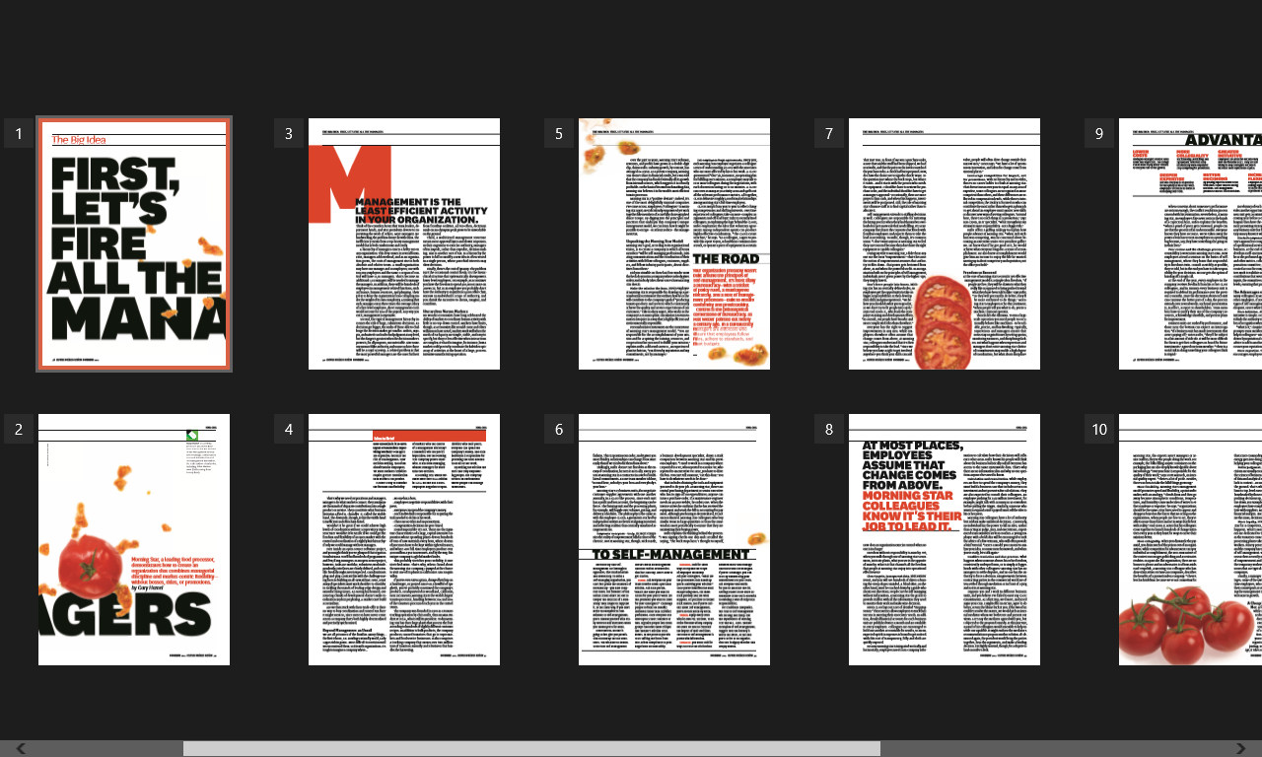
Preparation for week 6

Slide 14
Preparation for Week 6: Debate
Do companies really need managers?
Yes or NO?
There will be classroom debate for which we need 3 groups.
Group A will discuss why we DO need managers. (YES)
Group B will discuss why we DON’T need managers. (NO)
Group C: all week 6 team leaders chairing the discussion

Slide 15
Preparation for Week 6: Debate –
Extra Reading
Group A (YES): You argue that companies DO need managers. | Please read/watch and prepare: http://www.huffingtonpost.com/jacob-morgan/do-we-need-managers_b_6876846.html https://www.coursera.org/learn/managing-as-a-coach/lecture/ae6Ic/why-do-we-need-managers
Group B (NO): You argue that companies DON’T need managers. | Please read and prepare: https://hbr.org/2011/12/first-lets-fire-all-the-managers
Group C (Team leaders): You run the discussion, prepare a set of ground rules and determine the winner of the debate. | Please read and prepare: http://www.cmu.edu/teaching/solveproblem/strat-dontparticipate/groundrules.pdf

Slide 16
Preparation for week 6
Attend week 6’s Lecture
Quiz Time: Seminar Lecturer will allocate a group to come prepared to conduct a Kahoot quiz based on Unit 5’s Lecture on “Managing and Leading Teams” (a minimum of 10 questions)
COME PREPARED!

Slide 17

Any Questions?

