Slide 1
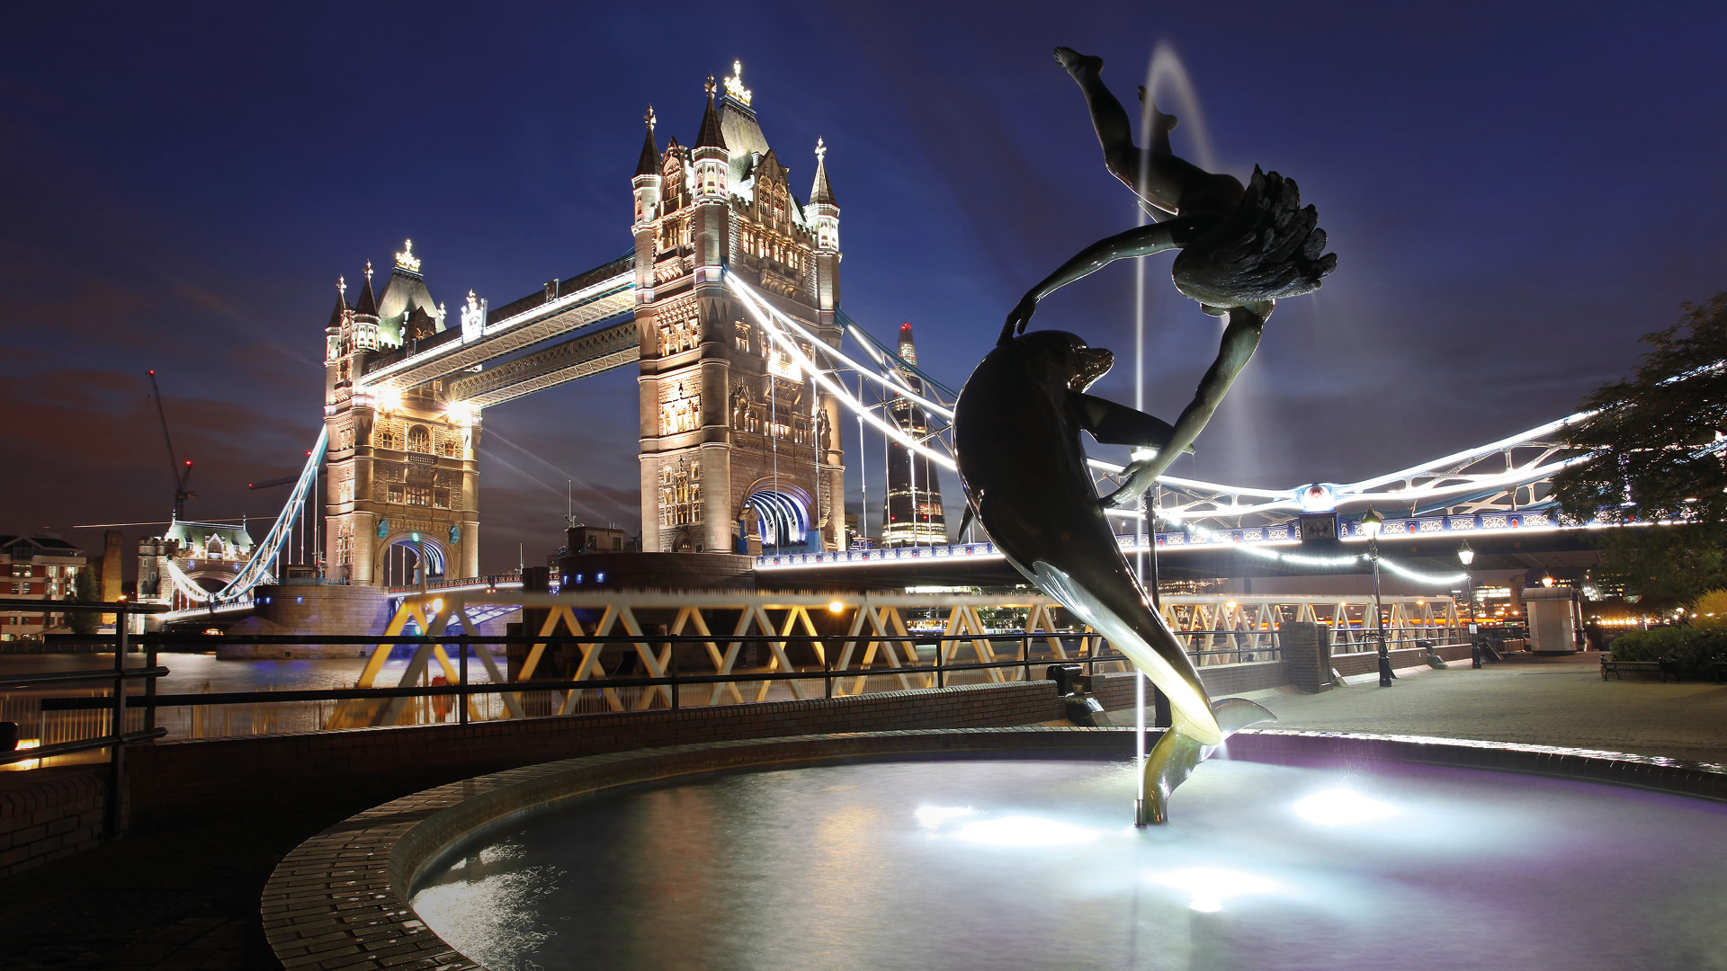

Unit 4: Seminar

Slide 2
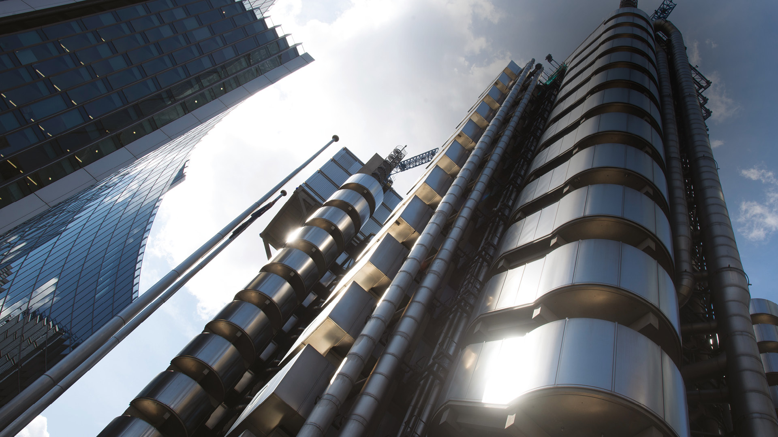
Changing Nature of Management

Slide 3
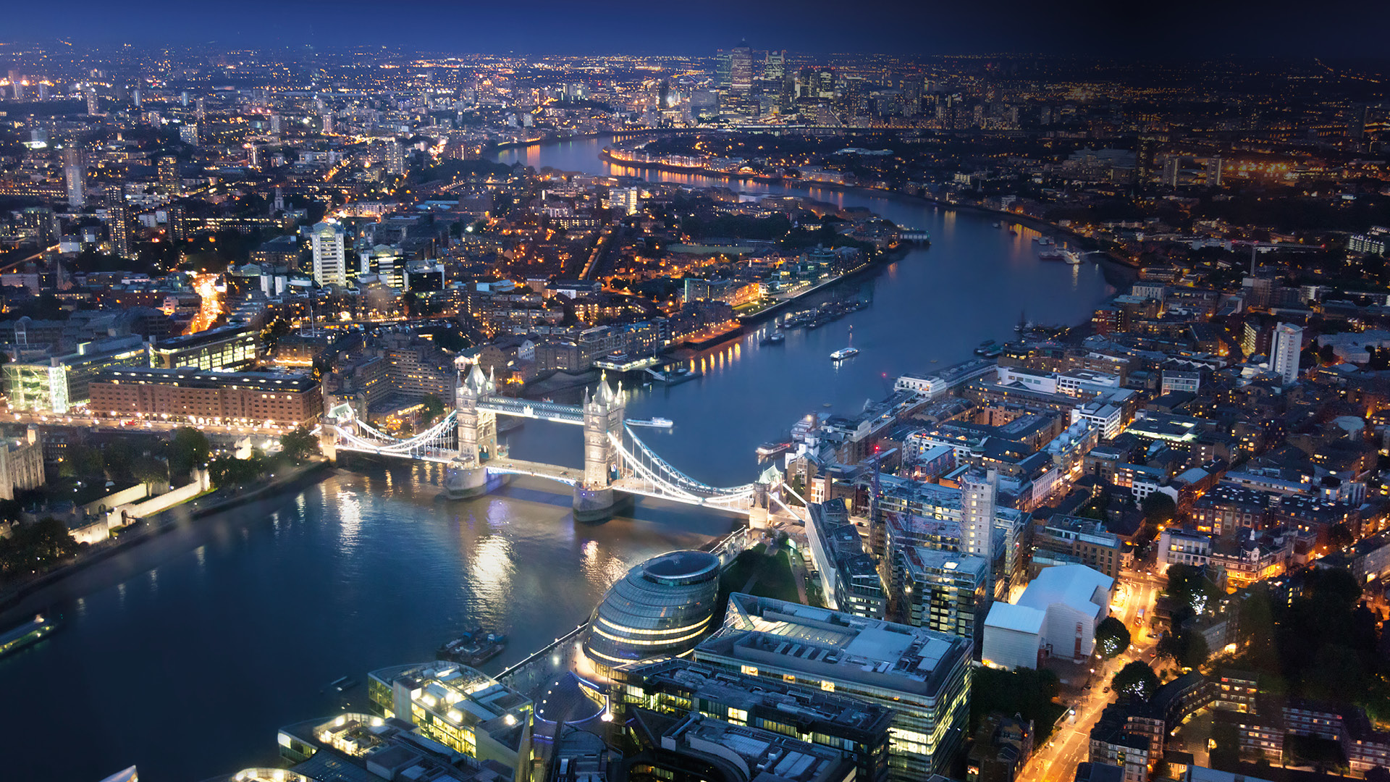
Quiz Time

Slide 4


Slide 5
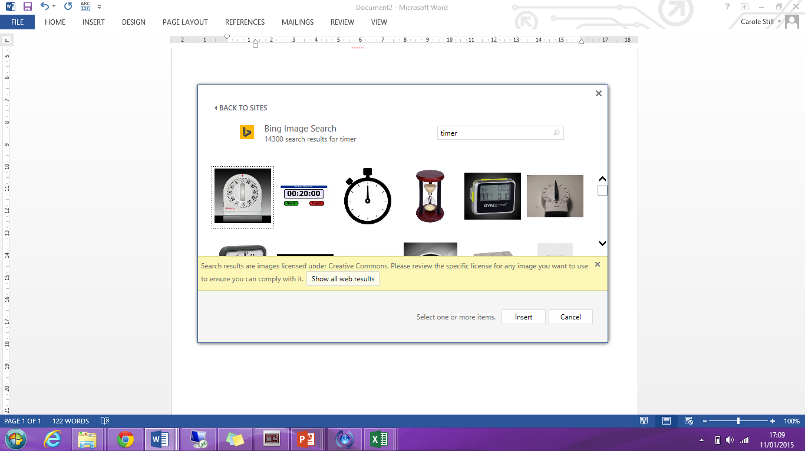
15
Review: Lecture
Outline the key theories highlighted in Unit 4’ Lecture
Reflect your learning from this week’s lecture and apply it to:
- today’s case study on ‘What Great Managers Do’

Slide 6
What Great Managers Do
Based on your reading of Buckingham (2005):
What did Michelle as a manager achieve? How did she do this?
What did Jim as a manager achieve? How did he do this?
What are the three levers for managers?
How do you use each lever as a manager of a team?
Michelle (Wallgreens) Identified Jeffrey’s organisational strengths & reassigned roles throughout the store to capitalise on his strengths & those of others using work schedules
Jim identified Manjits need for publicly displayed performance measures
3 levers: identify strengths, the triggers to activate the strengths & the preferred learning style
How do you use each lever as a manager of a team?

Slide 7

Marcus Buckingham’s case for strengths
Marcus Buckingham: case for strengths
Click to play

Slide 8
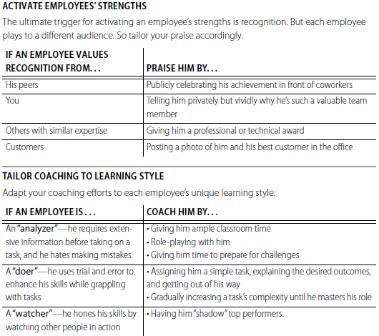



What Great Managers Do

Slide 9
What Great Managers Do
How do you measure Managerial Effectiveness?
Source:
Mullins (2016)
Measures
The strength of motivation and the morale of staff
The success of their training and development
The creation of an organisational environment in which staff work willingly and effectively
Indicators
Meeting important deadlines
Accuracy of work
Level of complaints
Adherence to quality standards
Productivity
Adhering to budgets set
What are the main limitations to the measurement of managerial
effectiveness?
How would you advise an organisation's leadership team how to
address these limitations

Slide 10

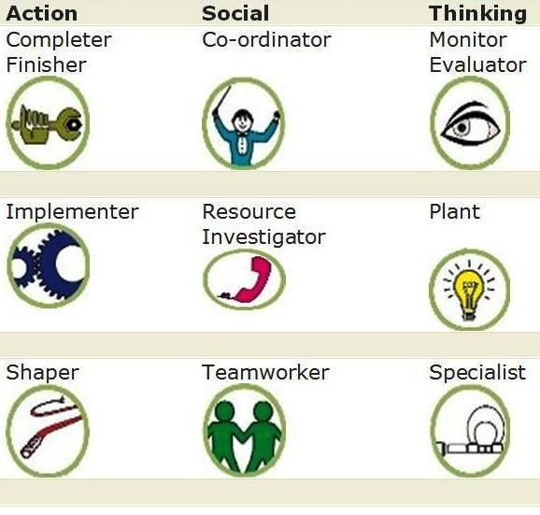
Group Activity:
Your Belbin Profile
15
In your teams share your Belbin Profile
Plot your profile(s) on the Belbin Team map
Discuss if your profile is a strength or preference
Identify which strengths or roles are missing in your team.
Discuss in your teams:
  What could be the impact on the performance of your team?
  How will you manage the risk of a negative impact?
  How will you monitor and adjust the team roles to ensure you can become a high performing team?

Slide 11
Group Activity:
An ideal manager
30
Put the cards into 4 categories:
Discard the 4th category
Choose 30 cards from the 3 remaining categories (max 20 from any category
Check your categories & add up the scores
Present your ideal manager
Ideal
Manager

Slide 12

Unit 5 Preparation: Leading Virtual Teams
Read: Solomon, C., (2010), The challenges of working in virtual teams, published by RW3 CultureWizard
How do Virtual teams compare with traditional Face-to-Face teams?
What are key challenges for Virtual teams?
What is the role of the leader in Virtual teams?
What are your key learning points about leading Virtual teams?
Come prepared to discuss or present your key findings with the rest of the class

Slide 13
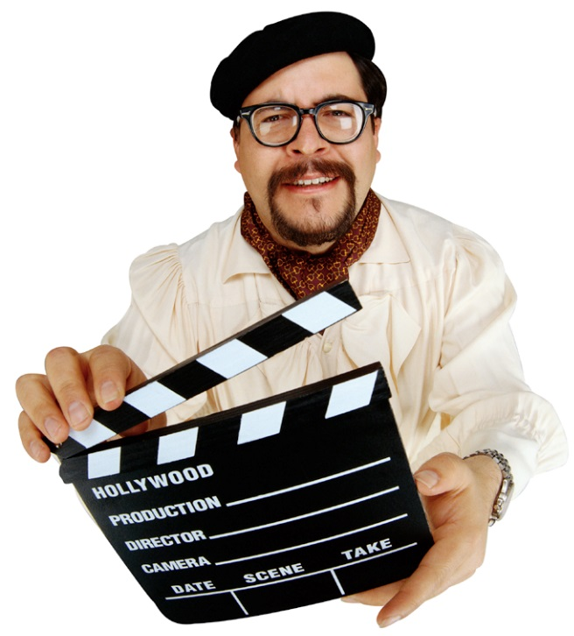
Unit 5 Preparation: Group Activity: Role Play: The Team That Wasn’t
Take 1 – You will be given a character from
The Team That Wasn’t case study to role play
Role Play format
Board meeting
To prepare your starring role
How is your character feeling in this meeting?
What behaviours is your character demonstrating?
What impact are they having on the other
Take 1

Slide 14

Unit 5 Preparation: Group Activity: Role Play: The Team That Wasn’t
Take 2 – Your goal is to improve the performance
of the team
Take 2 – Small Group Discussion
What management techniques are missing?
What meeting structure is missing?
What characters are missing from the meeting?
Take 2
In your own style, present your proposed solution.
You have 10 minutes per group
Take 2

Slide 15
Unit 5 Preparation:
Attend week 5’s Lecture
Quiz Time: Seminar Lecturer will allocate a group to come prepared to conduct a Kahoot quiz based on Unit 4’s Lecture on “Changing Nature of Management” (a minimum of 10 questions)
COME PREPARED !

Slide 16
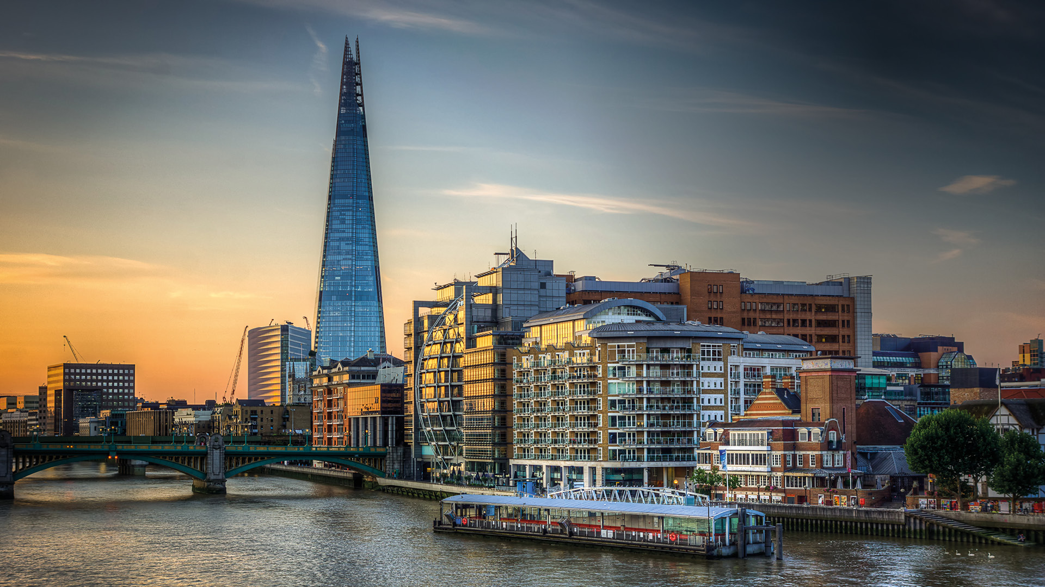
Any Questions?

