Slide 1
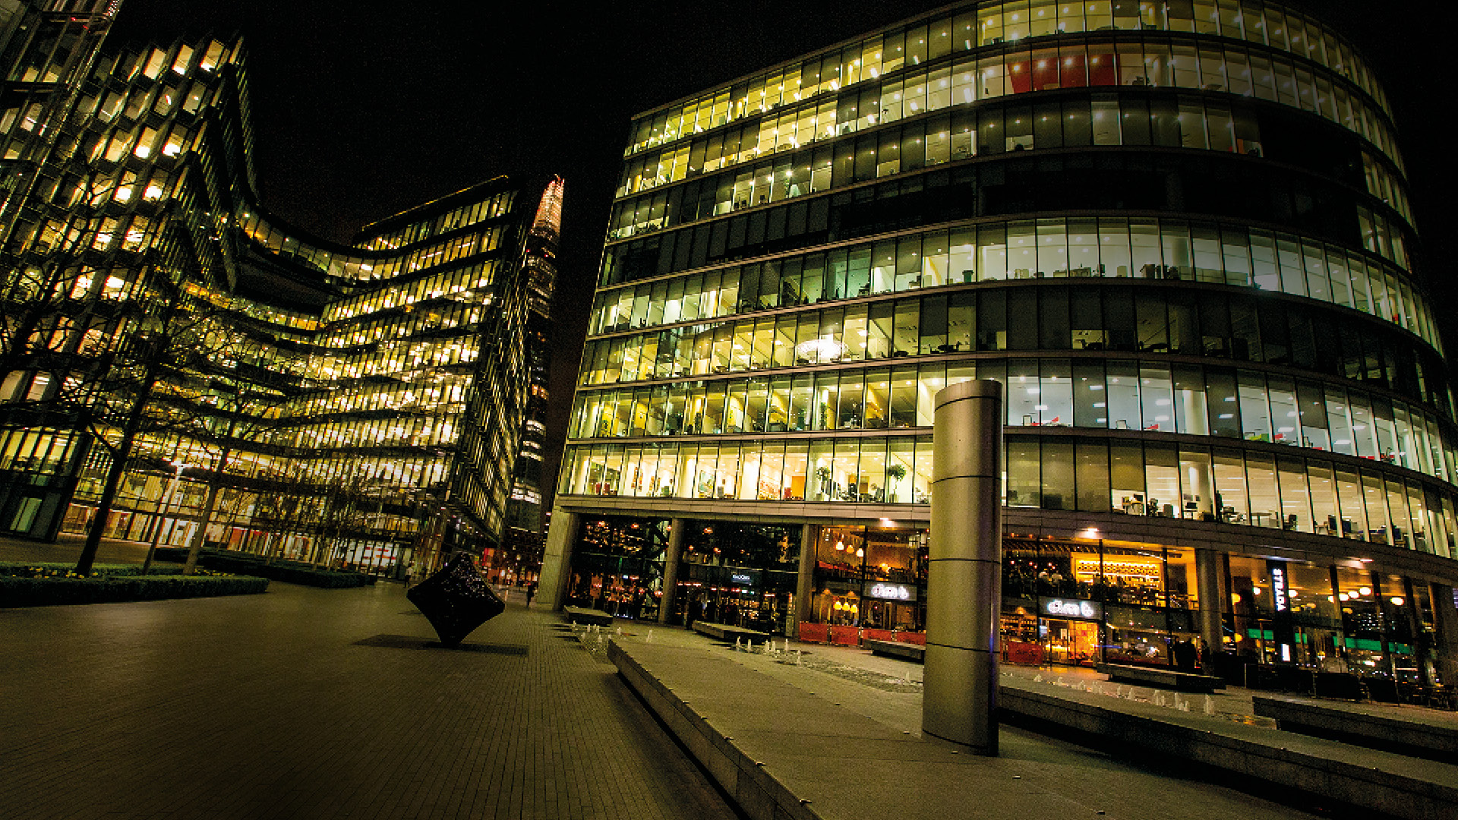

Unit 3: Seminar

Slide 2
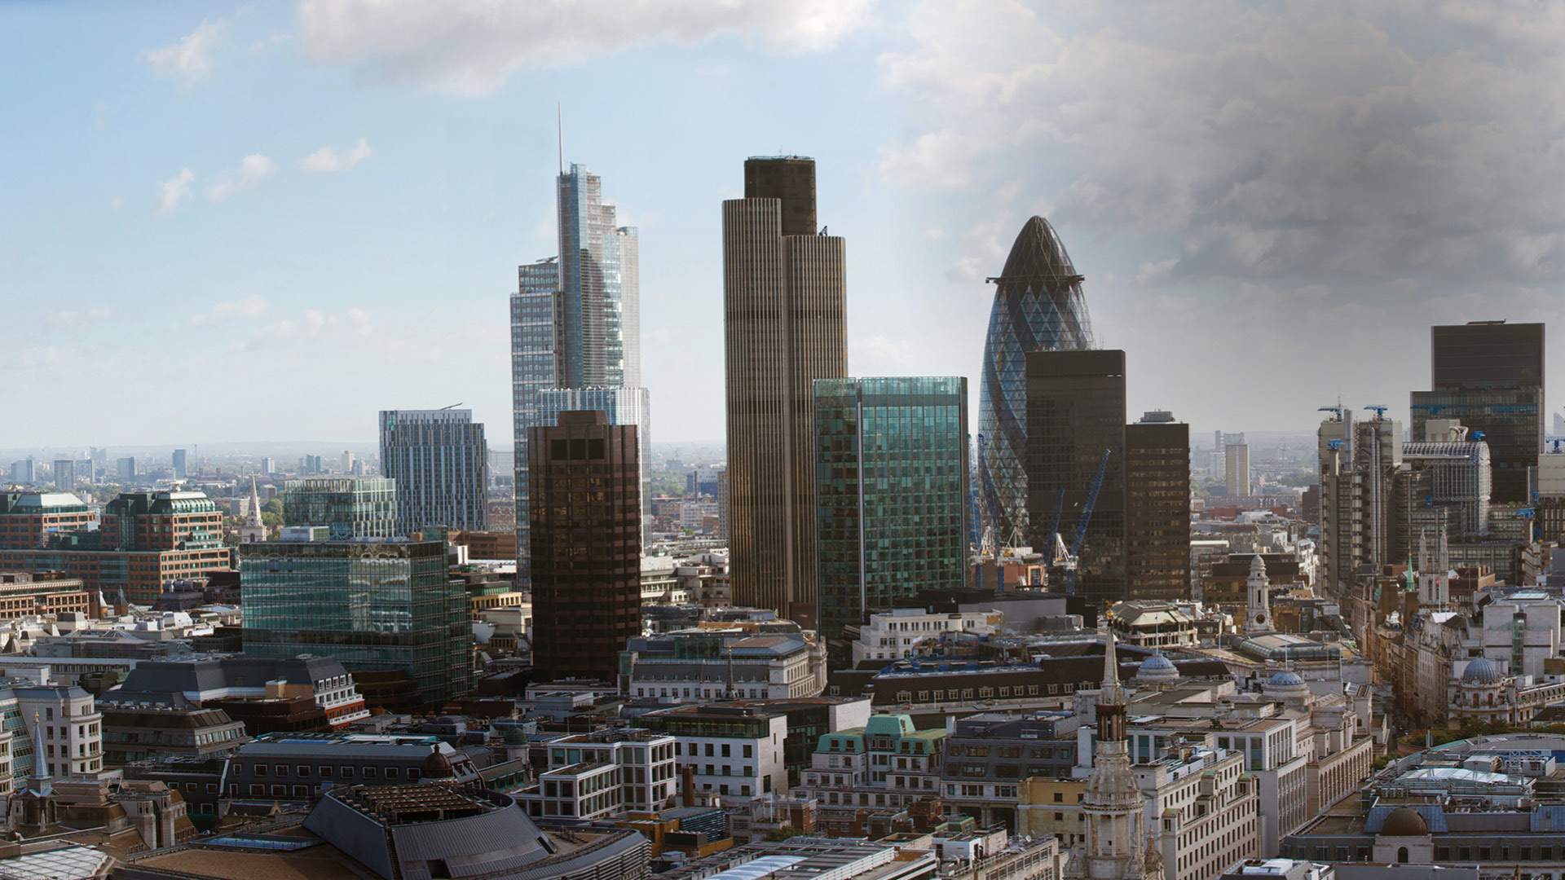
Organisational Culture

Slide 3

Quiz Time

Slide 4


Slide 5
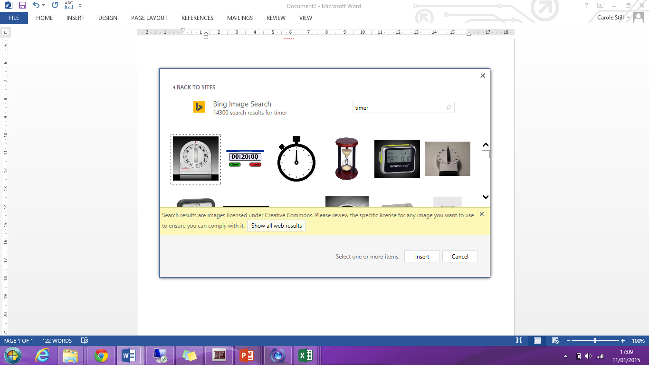
15
Review: Lecture
Outline the key theories highlighted in Unit 3’s Lecture
Discuss it’s relevance to today’s discussion or presentation on the ‘Aetna case study’
Reflect your learning from this week’s lecture to:
- it’s relevance and limitation to today’s organisations
- challenges today’s leaders experience in managing organisational culture

Slide 6
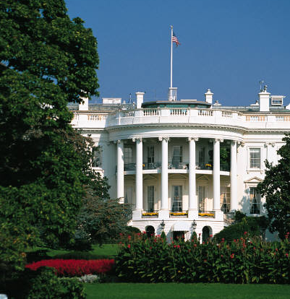
What do you think?
Does our language shape the way we think?
Language & cultures – the danger of miscommunication
http://www.youtube.com/watch?v=fbRLZxpKWA4

Slide 7

Seminar: Organisational Culture – Aetna case study
Case study discussion or presentation
30
What is meant by organisational culture. Identify the common aspects of the many definitions of organisational culture and comment upon levels of culture. Which level of culture do you near most in the film? | 4. Consider the role of culture in relation to organisational performance; explain what is meant by the “Fit” and the “Adaptation” perspective and evaluate these concepts in relation to Aetna, Inc.
2. Distinguish between values, espoused values, enacted values and assumptions; list the Aetna, Inc core (espoused values) and discuss how they were created | 5. Evaluate the leader's role (for example that of Ron Williams) in shaping and reinforcing culture
3. What is meant by a strong culture? How might such a culture impact upon organisational performance (you should consider both positive and negative consequences | 6. Can culture be managed? What approaches do you recommend managers use to manage culture. Why did Aetna develop a culture of empowerment and quality

Slide 8
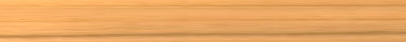


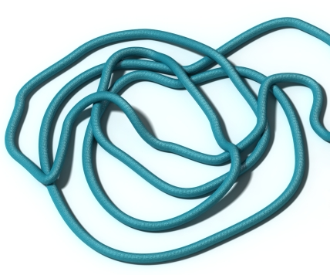
Group Activity: Your Team Culture
Team Competition:
A team challenge – unstable to stable

Slide 9
Group Activity: Your Team Culture
Debrief
At the end of the plank challenge:
Review what went well. What were they proud of?
Review what did not go well. What would they do differently?
What were the distinctive features of the culture of your team?
  Which national culture dimensions were observable? [Hofstede]
  How were decisions made and communicated? [Handy]
  How much risk vs. feedback is available to the group? [Deal and Kennedy]
  What examples of spoken and unspoken rules are there already in this team? [Johnson & Scholes – cultural web]

Slide 10
Group Activity: Giving Feedback
Specific
Behaviour
Describe what they did
Impact
Describe the effect
Future
Suggest alternative behaviour
Use an example
Use an example
Use their exact words or actions
Be honest
Describe the situation
In pairs share the following information:
Give 2 examples of what your colleague has done well during this class.
  What exactly did they do?
  What was the impact?
  How could they do more of this in the future?
Give 1 example of what your colleague could improve that you noticed in this class.
  What exactly did they do?
  What was the impact?
  How could they improve in the future?

Slide 11
Group Activity: Giving Feedback
  Do’s and Don’ts of Giving and Receiving Feedback
Do | Don’t
Be clear about why this feedback is important and relevant | Judge the other person and use the feedback as punishment
Use specific examples | Be vague
Be clear why you chosen to share this feedback now | Assume you know the person’s intentions
Be constructive | Be critical
Allow the other person to respond to the feedback | Be defensive

Slide 12
Defining the Manager and Leader –
A critical evaluation discussion
In many recent studies and leading thinking, it has been noted that
many of the models of management and leadership have their origins
in American white male perspectives on business (Mullins, 2016).
What are the implications of leadership & management
based on the American white male perspective vis-a-vis
  a diverse workforce
  a diverse leadership population
  a global organisational context

Slide 13
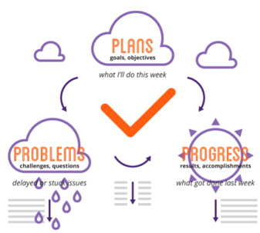
Your leadership preparation before next class
READ: Buckingham, M. (2005), What Great Managers Do, In Harvard Business Review; Mar2005, Vol. 83 Issue 3, p70-79
IDENTIFY: your Belbin Profile using the Belbin profiler in Unit 4 (please complete this before the seminar class)
Attend unit 4’s Lecture
Quiz Time: Seminar Lecturer will allocate a group to come prepared to conduct a Kahoot quiz based on Unit 3’s Lecture and Seminar materials on “Organisational Culture and Leadership” (a minimum of 10 questions)
COME PREPARED!

Slide 14

Any Questions?

