Slide 1
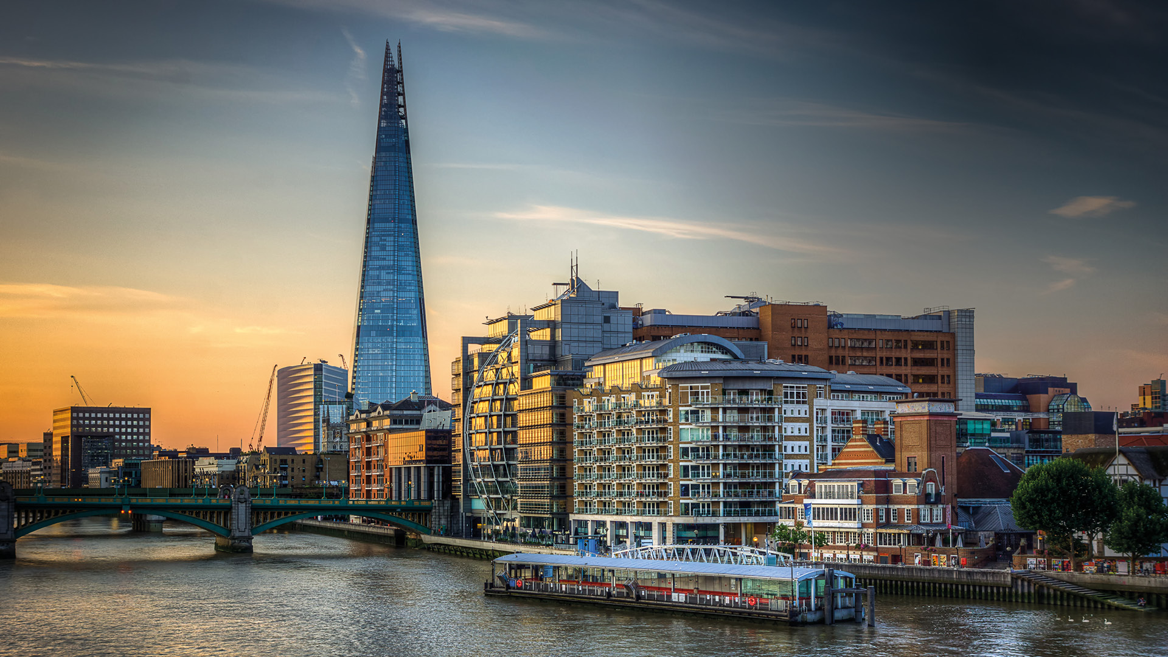

Unit 3: Organisational Culture
(Knowledgecast)

Slide 2
Today’s Knowledgecast
As a result of today’s Knowledgecast, you should be able to:
Identify the factors that create the overt and covert aspects of organisational culture
Examine a range of frameworks that can be used to analyse and interrogate an organisation’s culture
Appraise the sources of power leaders can use to influence the development of organisational culture to affect the achievement of an organisation’s goals

Slide 3
Defining Management and Leadership
Our working definitions:
Management is (Mullins, 2016):
Getting work done through the efforts of other people
Leadership is (Yukl, 2010:26):
The process of influencing others to understand and agree about what needs to be done and how to do it
And the process of facilitating individual and collective efforts to accomplish shared objectives

Slide 4
Defining Management and Leadership
Our working definitions:
Culture is (Egan, quoted in Mullins, 2016)
The assumptions, beliefs, values and norms that drive ‘the way we do things around here’
The largest controlling of the systems because it affects not only overt organisational behaviour but also the shadow-side behaviour
CIPD: Major change occurs approximately every 3 years with smaller changes occurring continually. CPD 2011 report: single biggest skills issue is inability to manage change (whilst managing the business)

Slide 5
Hofstede Organisational Cultural Dimensions
Culture only exists by comparison. The country scores on the dimensions are relative - societies are compared to other societies. Without make a comparison a country score is meaningless (Hofstede 2014).
Power Distance
The type of relationship with your boss
Individualism
Whether you value family and friends or individual needs
Masculine/
Feminine
Whether you focus on short term goals or legacies for future generations
Uncertainty Avoidance
Long Term Orientation
How much risk you like to take at work
How much conflict is expected in the work place to achieve results
Indulgence v Restraint
Generally free gratification of natural human drives, enjoying life & having fun versus suppression of gratification regulated by strict social norms
http://geert-hofstede.com/dimensions.html
http://geert-hofstede.com/organisational-culture.html

Slide 6
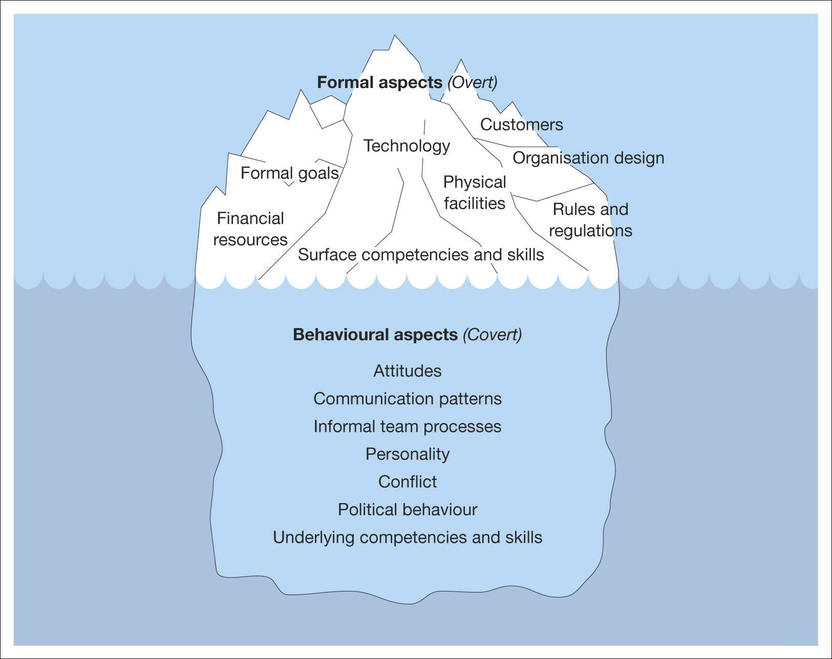
The Organisational Iceberg
What we can observe and control
What affects the productivity and quality of working life
The organisational iceberg
Source: Hellriegel, D., Jackson, S.E. and Slocum, J. W., Jr., Management, Eighth Edition, South-Western Publishing (1998), p. 6. Reprinted with the permission of South-Western,
a division of Thomson Learning (www.thomsonrights.com / Fax: 800-730-2215)

Slide 7
Relevance of Organisational Culture
So why focus on organisational culture?
Advantages and Benefits | Disadvantages and Limitations
A strong culture is crucial in organisational success as it enables employees to be certain about what they think and feel, making them more dedicated to the organisation (Deal and Kennedy 1988, Kanter 1984) | Emphasis on a strong culture has contributed to the demise of some of the biggest corporations (Robbins 2001) Privileges the views and ethics of managers in the organisation and enforces a uniformity of culture within the organisation (Wilmott 2002)

Slide 8
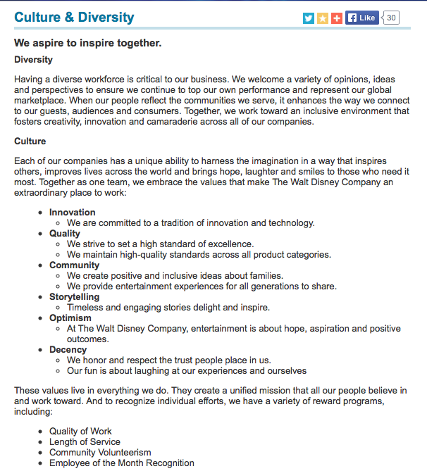
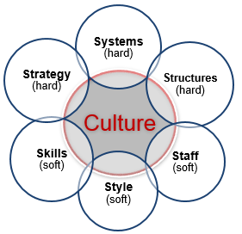
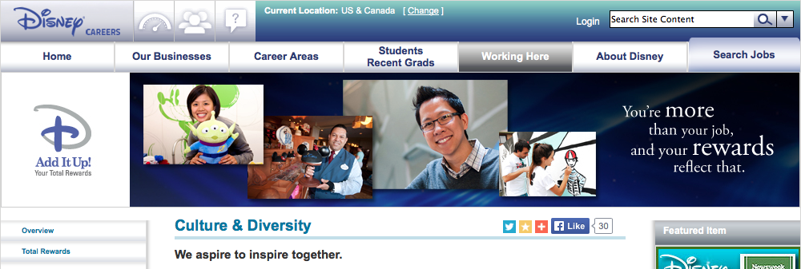
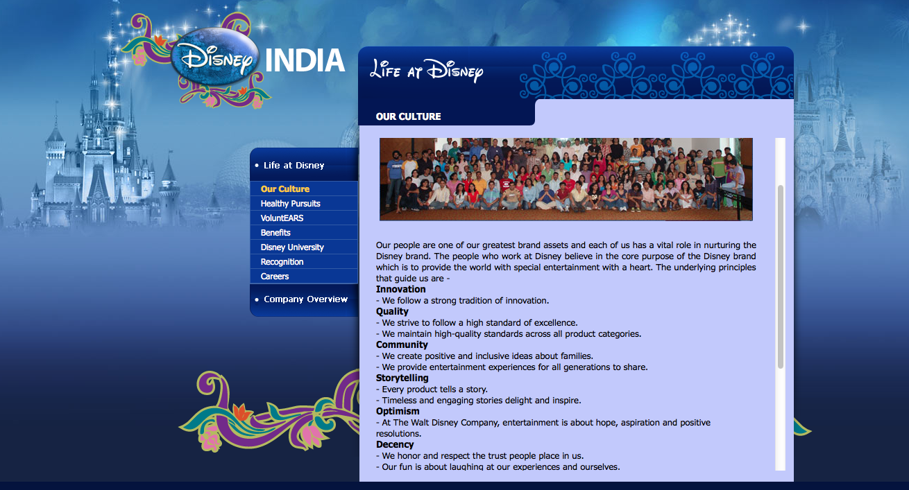
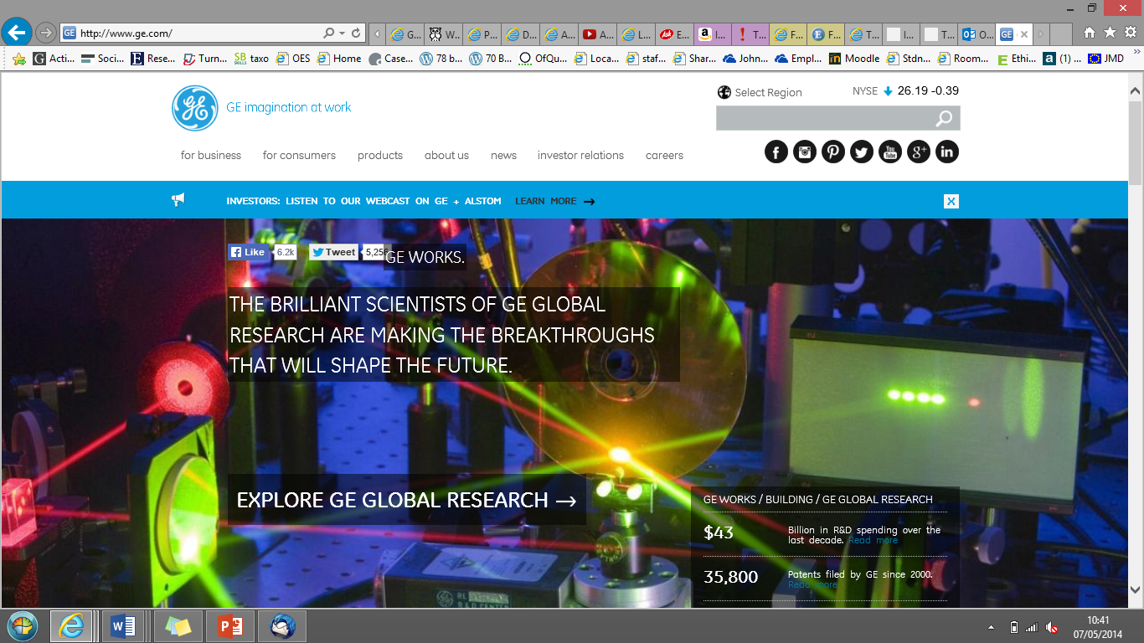
Strong Organisational Cultures
Source:
Disney
(2014)

Slide 9
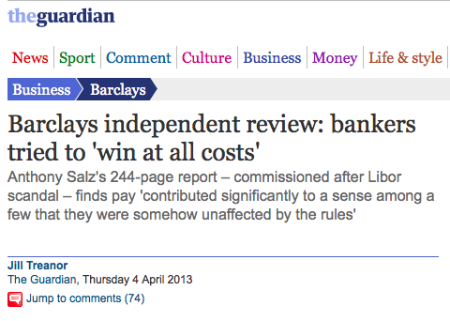

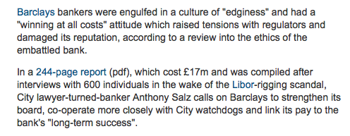

Danger of Strong Organisational
Cultures & Performance Reward Structures
Source:
The Guardian (2013)

Slide 10
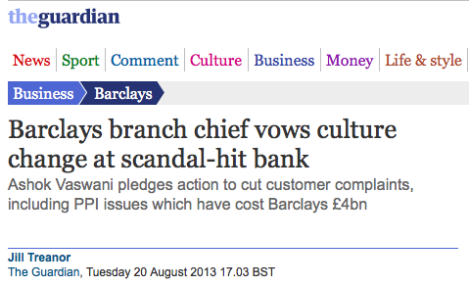
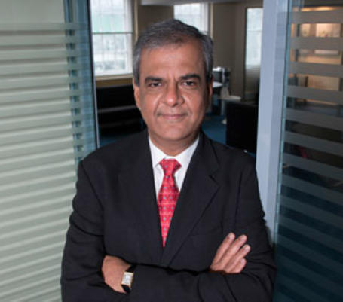

Changing Strong Organisational
Cultures & Performance
Source:
The Guardian (2013)

Slide 11
Types of Organisational Culture
Power Culture
Role Culture
Task Culture
Person Culture

Slide 12




Types of Organisational Culture
Power Culture
Role Culture
Task Culture
Person Culture
Dominance of an individual who makes the key decisions throughout the organisation.
Bureaucratic, hierarchical & job role specific. Rules based. Requires strong organisational pillars.
Job & project oriented team structures
Individuals are central and structures exist to serve individual needs e.g Barristers, Architects, Doctors, Entrepreneurs

Slide 13
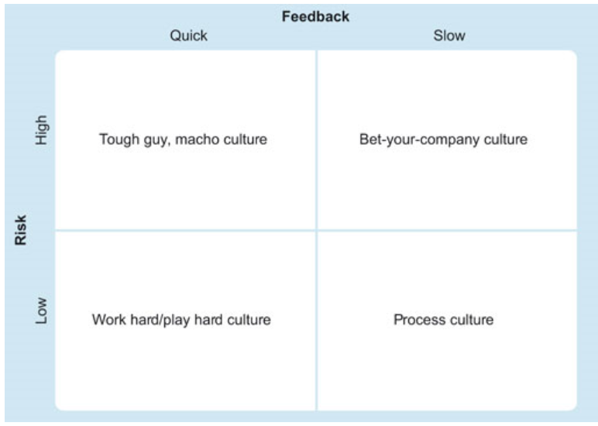


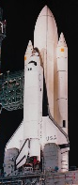




Types of Organisational Culture
Deal & Kennedy
Four Generic
types of culture:

Slide 14
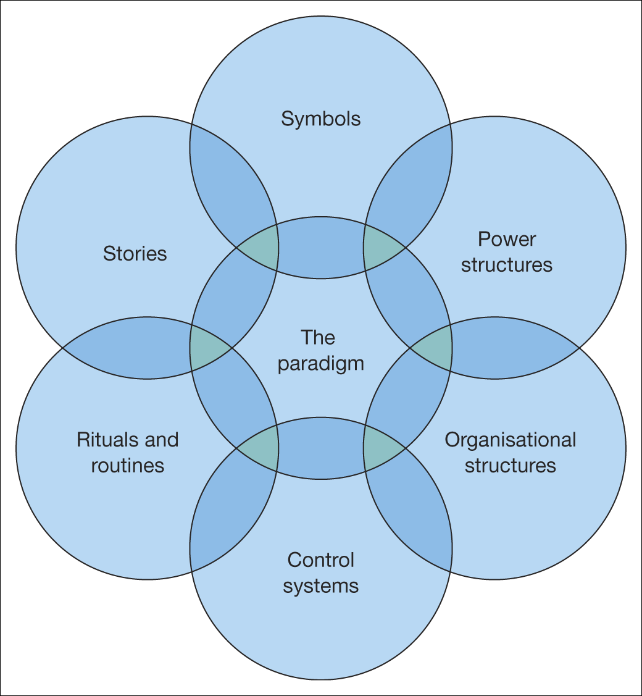
Analysing the Cultural Web
Source:
Johnson, Scholes and
Whittington (2005)
Individuals will be drawn to and gain job satisfaction if their attributes and values are consistent with the organisation’s culture, however it is perceived by the individual.
AGREE / DISAGREE?
How do you define the characteristics?
How do you measure the characteristics

Slide 15
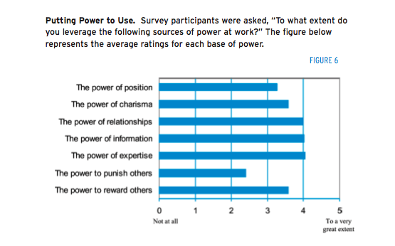
What influences culture
Source:
Center for Creative Leadership (2008)

Slide 16
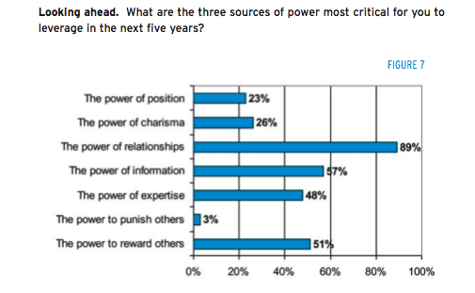
Influencing culture: Future priorities
Source:
Center for Creative Leadership (2008)

Slide 17
What you need to do before
Unit 4 next week
IDENTIFY: your Belbin Profile using the Belbin profiler in Unit 4.
READ: Buckingham, M. (2005), What Great Managers Do, Harvard Business Review; Mar2005, Vol. 83 Issue 3, p70-79 (in unit 4)

Slide 18
What are we going to cover next?
In our next Knowledgecast, we will:
Analyse current research on the role of leadership in relation to managing change
Critically evaluate techniques to address and overcome resistance to change
Critically evaluate an incident of strategic organisational change by exploring the role of leadership

