Slide 1


Unit 2: The Leader and National Culture
(Knowledgecast)

Slide 2

Module Overview
Leadership & Ethics
Change Management
Leadership & Culture
Leadership & Motivation
Management & Teamwork

Slide 3
Module Learning Outcomes
Throughout this module, you MUST keep a blog/diary of your:
key thoughts
learning points
reflections
received feedback from peers
on the role of the leader in the changing world to build a set of notes ready for your END OF MODULE ASSIGMENT
Reflect critically on and apply conceptual and practical approaches to leadership in a range of different organisational settings
Apply to their analysis an understanding of the key tensions within leadership and how it relates to other business themes such as globalisation, strategy, innovation and organisational change
Analyse current research on the role of leadership in relation to managing change
Critically evaluate an incident of strategic organisational change by exploring the role of leadership
Critically evaluate techniques to address and overcome resistance to change
Explore the ethical relationships between leaders and followers
Critically reflect upon personal experiences and aspirations around leadership enabling them to develop originality in their own leadership capabilities

Slide 4
Your Learning Approach to Leadership & Motivation
About
You
Find out how theories and models relate to you
About
Colleagues
Find out how theories and models relate to other people – what they say and what you observe
About Organisations
Find out how leaders in organisations use this knowledge
How? Reading industry relevant journals and news stories about how companies motivate their employees
How? Reading and Self Tests, identify what motivates you
How? Taking part in class activities and asking other people questions

Slide 5
Today’s Knowledgecast
The Leader and National Culture
Define the key terms of management and leadership as a starting point for your own analysis of this area of global business
Outline a set of factors that influence the importance and complexity of the study of managing and leading organisations & people
Examine how Hofstede’s cultural dimensions impact the discussion of leadership & management in organisations

Slide 6
Defining Management and Leadership
Our working definitions:
Management is (Mullins, 2016):
Getting work done through the efforts of other people
Leadership is (Yukl, 2010:26):
The process of influencing others to understand and agree about what needs to be done and how to do it
And the process of facilitating individual and collective efforts to accomplish shared objectives
What it implies?
What it does NOT imply?
Leading is a collective effort between leader & follower
What does this imply?
The leader as the only person with the power to decide how the effort is achieved.
Importance of the psychological contract between leaders & employees
A series of mutual expectations and satisfaction of needs ar6)ing from the people-organization relationships (Mullins, 2016)

Slide 7
Defining the Manager and Leader
“…success as a manager or administrator in modern organisations also involves leading. How to integrate the two processes has emerged as a complex and important issue...”
Yukl (2010:26)
“It is one thing for a leader to propound a grand vision, but this is redundant unless the vision is managed so it becomes real achievement.”
Dearlove (2001:538)
“We recognise that the Chinese approach to economic success may well require us to revisit some of the American universals in management practice and accept that there is no ‘best way’”.
de Valk (2008) Institute of Leadership & Management

Slide 8
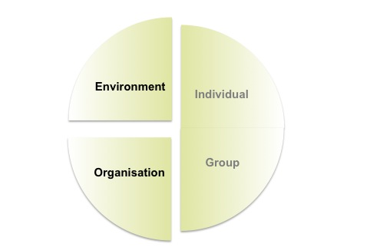
Understanding Organisations
Employee behaviour is influenced by
a combination of 4 factors
Understanding Organisations requires
an appreciation of differences in:
  Make up of Organisations
  Changing Nature of Organisations
  External Influences
  Changing Nature of the Workforce
  The impact on Leadership and Management Skills

Slide 9

Changing Nature of Organisations
Classification
Private enterprise
Public sector
Private-Public Interface
Not for Profit
Social Enterprise
New world of ‘Work 2.0’
  Baby boomers born 1943-1963 searching
  for security
  Generation X
  born 1964-1980 searching
  for rewards
  Generation Y born 1980-1995 searching
  for diversity
Globalisation
Integrating, operating & worldwide competition
Greater economic dependency on other markets
Strategy and Structure linked
Exploits Information & Communication technologies
Global civilians with greater cross-cultural awareness
Greater mobility of labour
Formal
Organisational charts
Policies & Procedures
Informal
Emotions and needs
Group norms
Power structures
Boundaryless
Project based work
Interfunctional teams
Distributed accountability
Networks

Slide 10
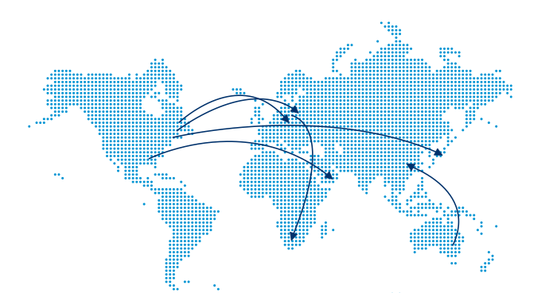
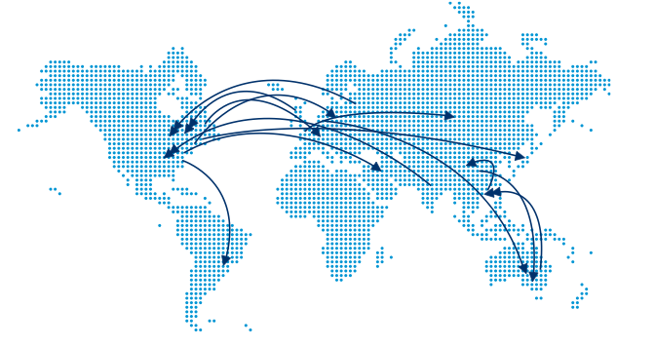
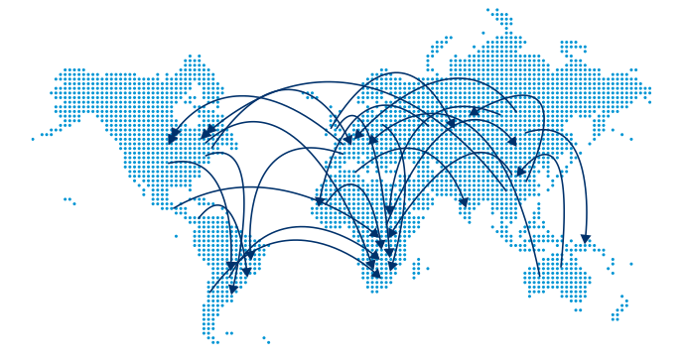
Changing Nature of the Workforce
Migration is key to long-term global economic growth
Consider how national culture impacts organisational performance & behaviour
1970-1990
1990-2010
Different communication norms
Different management and leadership styles
Different expectations of management & leadership styles
Different appreciation of diverse cultural norms
BY 2020
Source:
PWC (2010) Talent Mobility 2020

Slide 11
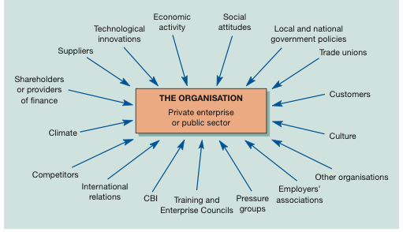
External Influences on Organisations
PEST
Successful performance = clear leadership to Identification
Response
Prediction

Slide 12
Factors in Organisations
Organisation
People
Objectives
Structure
Management
Leadership
Effective leadership enables organisations to adapt to internal and external changes
Interaction of people to achieve goals
Effective management enables the planning, organising, directing, coordinating & controlling to achieve the goals
Based on:
Mullins (2016)

Slide 13
Changing Skills of Managers & Leaders
“What is needed is a sea-change in employers’ awareness of the challenges facing them and the importance of improving managers’ knowledge and skills to meet these increasingly global challenges.”
de Valk (2008) Institute of Leadership & Management
“Changing expectations of work and the impact of new technologies will require managers and leaders to develop a new range of skills that focus on emotional and spiritual intelligence, judgment and the ability to stimulate creative thinking to improve productivity.”
Chartered Management Institute (2008)
“Executives say that global trends have becomes increasingly important, but few companies are addressing them successfully.”
McKinsey Quarterly (2008)

Slide 14



Awareness of Leaders & Managers: National Culture
There are clear implications for organisational behaviour in accommodating international dimensions of management and cultural differences (Mullins, 2016).
Organisations take this seriously in how they communicate and develop their managers and leaders. This includes:
Providing staff with guides on managing diverse teams
Delivering management and leadership training to diverse audiences from multiple countries
Using internal promotions and secondments to expose future leaders to different cultures

Slide 15
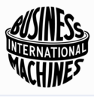

IBM & Hofstede
1967-1973 Hofstede conducted research in 40 countries & >100,000 IBM employees
Hofstede’s four dimensions are values that distinguish countries from each other
1991 Hofstede and Bond identified a fifth value: Long-Term versus Short-Term Life Orientation
Source: www.geert-hofstede.com

Slide 16
Hofstede Cultural Dimensions
Culture only exists by comparison. The country scores on the dimensions are relative - societies are compared to other societies. Without make a comparison a country score is meaningless (Hofstede 2014).
Power Distance (PDI)
Individualism versus collectivism (IDV)
Masculinity versus femininity (MAS)
Uncertainty avoidance (UAI)
Long-term versus short-term orientation (LTO)
Indulgence versus Restraint (IND)
http://geert-hofstede.com/dimensions.html

Slide 17
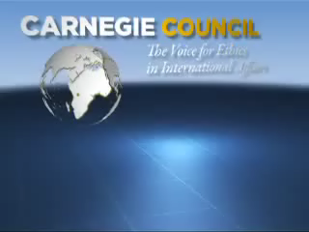
Ethics, values and culture
Ethics Matter: Top Risks and Ethical Decisions 2014 with Ian Bremmer

Slide 18

End of Module Assignment – Standards
From your reading of each topic, identify and respond to the key points to demonstrate your skills in:
Drawing on appropriate sources to evidence and support your evaluation. A minimum of 10 peer reviewed journal articles must be used in the body of your assignment
Peer reviewed journal articles can be found through
Researching examples of leadership practice in your own field of study of global business
Reflecting on your development as a future leader or manager of teams
Critically evaluating contemporary issues in leadership in global business – presenting arguments for and against points of view

Slide 19
Blog: Common errors and what to
do to avoid them
Lack of definition of theories or models YOU MUST DEFINE THEM
Lack of in-text citations to provide evidence INSERT THEM
Lack of reading - just ‘According to me” – READ high quality resources
Lack of critical evaluation of theories/models/practices – BE CRITICAL
Lack of success/failure examples in industry – GIVE EXAMPLES
Lack of reflection on what these issues mean for you as a future leader or manager in your chosen industry – REFLECT & PLAN
Lack of purpose definition in each blog theme – DEFINE THEM

Slide 20
End of Module Assignment:
Structure top tips
Identify the key terms in the Question
Use the Marking Criteria to understand your reader’s expectations.
Create an outline of your assignment to answer the question.
Check your answer addresses all areas of the marking criteria
Use your research and referencing to support all your points
Support your analysis and recommendations with evidence
Reflect your personality and who you are in your blog
Converse with your readers so they feel involved in a 2-way conversation
Give your readers something useful or interesting to readers
Update your blogs – all successful blogs are updated frequently
Based on: http://weblogs.about.com/od/startingablog/tp/5FactorsSuccessfulBlogs.htm

Slide 21
Knowledgecast Summary
Reflect on the types of data we have used in this Knowledgecast:
Academic sources
Professional bodies
Global consulting and research organisations
As we progress through this module, you should consider:
Who has provided the data that support the argument?
How has the data been collected and for what original purpose?
What benefits and limitations does this perspective offer us?
What else would you need to know about this subject?

