Slide 1


Unit 10: Leading and Change
(Knowledgecast)

Slide 2
Today’s Knowledgecast
As a result of today’s Knowledgecast, you should be able to:
Analyse current research on the role of leadership in relation to managing change
Critically evaluate techniques to address and overcome resistance to change
Critically evaluate an incident of strategic organisational change by exploring the role of leadership

Slide 3
Drivers of Change
Source:
Mullins (2016)
Forces that drive change and organisation-individual conflict:
Uncertain economic conditions
Globalisation
Government intervention and political interests
Outsourcing and the redefinition of core business
Increased demand for high quality goods, services and customer satisfaction
Fragmentation and distribution of work across people, organisations and locations
Changing demographics and expectations of workforce
Advances in technology
Increasing pace, scale and complexity of organisational change

Slide 4
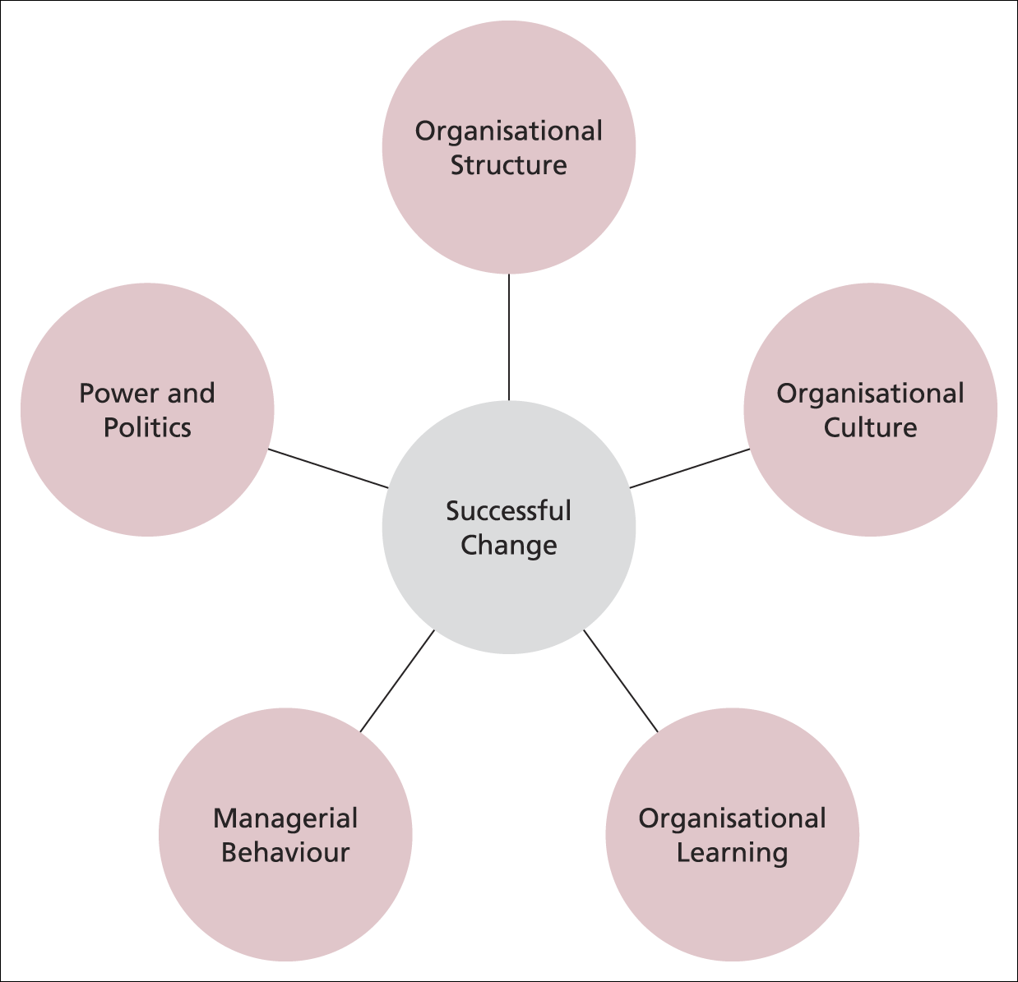
Emergent Change
Emergent change is:
‘based on the assumption that change is a continuous and unpredictable process of aligning and realigning an organisation to its changing environment’
Features of Emergent Change
Open-ended process
Adjusting to changing external
environment
Bottom-up
Unpredictable
Cannot be pre-planned
Learning process
No universal rules.
Links to our innate drivers
Source:
Burnes (2010)

Slide 5

Individual Resistance to Change
Individual resistance can arise from:
Selective perception
Habit
Inconvenience or loss of freedom
Economic implications
Security in the past
Fear of the unknown
Source:
Mullins (2016)

Slide 6
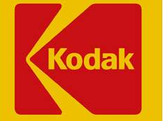
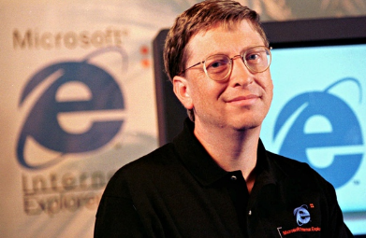

Organisational Resistance to Change
Organisational resistance can arise from:
Organisational culture
Maintaining stability
Investment in resources
Past contracts or agreements
Threats to power or influence
1975 Kodak’s engineer invented the digital camera but ssshhh it’s “filmless” so don’t tell anyone about it.
1990s: Bill didn’t think the internet would be a big business driver. Netscape the winner!
2007: Blackberry wrote off the iPhone.
By 2010 c73.5m iPhones sold!
CEO Mike Lazaridis thought it was a toy!
Source:
Mullins (2016)

Slide 7
Organisational Responses to Change
Factors Affecting Response
Developing New Capabilities
Based on:
Christensen & Overdorf (2000)
Access to Resources
Formal/Informal Processes
Values Based Judgements
Create New Structures
Create New Organisation
Acquire Ideal Organisation

Slide 8
Types of Organisational Culture
Power Culture
Role Culture
Task Culture
Person Culture
What impact do you think organisational and national culture will have on a leader’s influencing ability?
Power centred on 1 influential figure in the organisation
Bureaucratic requiring strong org pillars
Structures exist to serve individual needs
Job & project oriented
Source:
Handy (Organisational culture framework) (1993)

Slide 9

Managing and Leading Change
What successful transformations share
McKinsey Global Survey results
When organizational transformations succeed,
managers typically pay attention to “people issues,”
especially fostering collaboration among
leaders and employees and building capabilities
Source:
(McKinsey & Company 2010)

Slide 10
Managing and Leading Change
Strong leadership and maintaining energy for change among employees are two principles of success that reinforce each other when executed well.
Defined Targets
Whole company
Strong Leadership
Clear Structure
70% success rate: When leaders ensure that frontline staff members
feel a sense of ownership
71% success rate: When frontline employees take the initiative to drive change
79% success rate: When both principles are used
Source:
http://www.mckinsey.com/insights/organization/corporate_transformation_under_pressure

Slide 11
A Leader’s Role in Change
Change is more likely to be implemented successfully if the leader understands:
- The role of culture (national and organisational)
The drivers and types of change
The sequential phases of change
How to diagnose and approach organisational problems
Why individuals accept or resist change
How to lead effective change
Source: Yukl (2010)
CIPD: Major change occurs approximately every 3 years with smaller changes occurring continually. CPD 2011 report: single biggest skills issue is inability to manage change (whilst managing the business)

Slide 12
Planned Change and OD – is it easy? NO!
1951: Lewin identified 3 phase process.
1985: French et al identified 8 steps of change
1992: Harley identified 8 principles of empowerment
Eight critical principles of empowerment
William B. Harley Empowerment in Organizations
1995, Vol.3(1), p.5-12
Protect dignity
Manage Perceptions
Use organisation authority to release potential
Use Consensus decision making
Clarify vision, mission, objectives
Unshackle human desire to be of service
Provide feedback
Come from values

Slide 13
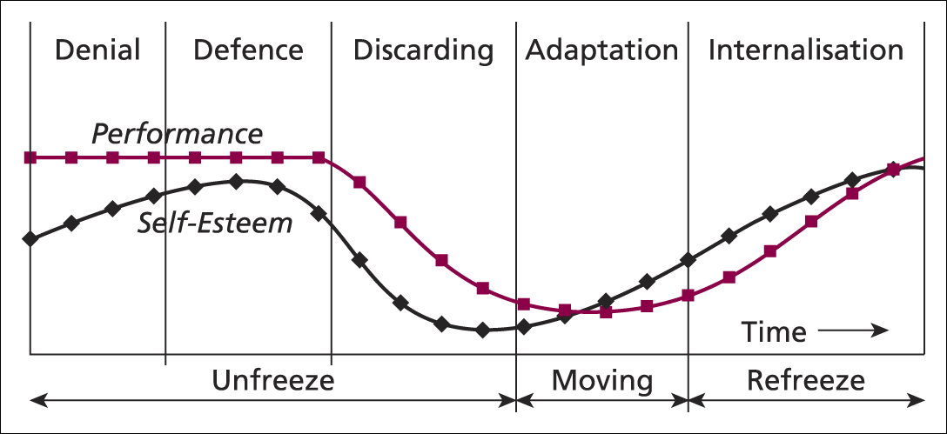
Diagnosing How People React to Change
Source:
Burns
(2009: 341)
-VE | Confusion Reservation Frustration Denial | Anxiety Resistance Despair | Unsure Ambivalence | Disruptive Dismissive
+VE | Excitement Anticipation | Creativity Innovation | IHigh energy Learning | Accomplished Long term commitment

Slide 14
Diagnosing the Impact of Change
Action
Evaluation
Research
Source:
Burnes (2009: 337)
A ‘felt-need’ that change is necessary

Slide 15
Adapting to Change
Source:
Burns (2010)

Slide 16
Management of Change
Environment of trust & shared commitment
Full and genuine participation
Participative management style
Supporting HRM policies & procedures
Incentive reward schemes
Maintain job satisfaction
Improved employee empowerment
Based on
Mullins (2016)

Slide 17
Actions to Secure Effective Change
Create a sense of urgency among relevant people
Build a guiding team which has credibility
Create visions that are sensible, clear and uplifting
Communicate the vision and strategy to induce understanding and commitment
Empower action and remove obstacles
Produce short term wins
Do not let up but maintain momentum
Make change stick by nurturing a new culture
Kotter & Cohen (2002)

Slide 18
Differentiating Leadership Skills
Senior Leadership Capability | Line Management Capability
Role modeling and empowering others | Support and help for employees through change
Vision and Values Communication of the bigger picture Making the vision and values real for all
Source: CIPD (2010)

Slide 19
Perspectives on the Change Agent
Different change situations require different types of change agent
Source:
Caldwell (2003)
Leadership Model | Management Model | Consultancy Model | Team Model
Senior Managers | Middle Managers/ Functional Specialists | External/Internal Consultants | Teams Across All Levels
Responsible for: Identifying Delivering strategic / transformational change | Responsible for: Delivering Supporting specific parts of change programme | Responsible for: Operating at any required level | Responsible for: Working as a composite team to deliver change programme

Slide 20
Knowledgecast Summary
Analyse current research on the role of leadership in relation to managing change
  Frameworks for defining organisational culture
  Drivers of change
Critically evaluate techniques to address and overcome resistance to change
  Culture as a key variable in delivering effective change
Critically evaluate an incident of strategic organisational change by exploring the role of leadership
  The role of planned and emergent change
  The contribution of Organisational Development in supporting capability to adapt to change

Slide 21
What are we going to cover next?
In our next Knowledgecast, we will:
Analyse current research on the role of leadership in relation to managing change
Critically evaluate techniques to address and overcome resistance to change
Critically evaluate an incident of strategic organisational change by exploring the role of leadership

