Slide 1
HOS801 – Strategic Management in Tourism and Hospitality
Week Three – Strategic Direction

Slide 2
Please discuss these questions with your group
What is the difference between a broad environmental (macro-environment) analysis and an operating environment (micro-environment) analysis?
Why is analysis of the broad environment important for effective strategic management?
What are the major components of the broad environment? Give an example of a trend in each area that could affect the welfare of a business organisation.
What is the difference between a trend and a fad? Give an example of a fad.
What are the five forces of competition? Is this related to the macro or micro-environment?
How does the macro and micro-environment relate to a SWOT analysis?

Slide 3
Learning Outcomes
Define strategic competitiveness, competition, competitive rivalry, behaviour and dynamics.
Describe market commonality and resource similarity as the building blocks of a competitor analysis.
Explain awareness, motivation and ability as drivers of competitive behaviours.
Discuss factors affecting the likelihood a competitor will take competitive actions or respond to actions taken against it.
Explain the competitive dynamics in each of slow-cycle, standard-cycle and fast-cycle markets.
Regression to the mean.
Strategic Vision and Mission.
Core Values and Ethics.

Slide 4
Strategic Competitiveness
Strategic competitiveness is the result of successful formulation and implementation of a value creating strategy.
By achieving strategic competitiveness and successfully exploiting its competitive advantage, a firm is able to attain its strategic objectives.

Slide 5
Competition
Competitors are firms operating in the same market, offering similar products and targeting similar customers.
Competitive rivalry is the ongoing set of competitive actions and competitive responses that occur among firms as they manoeuvre for an advantageous market position.
Competitive behaviour is the set of competitive actions and responses a firm takes to build or defend its competitive advantages and to improve its market position.
Competitive dynamics refers to all competitive behaviour – that is, the total set of actions and responses taken by all firms competing within a market.

Slide 6
Competitive Rivalry
Where competitive rivalry exists firms are mutually interdependent
  - a firm’s competitive actions have noticeable effects on competitors
  - a firm’s competitive actions elicit competitive responses from competitors
  - firms are affected by each other’s actions and responses
  - over time, firms take competitive actions and reactions.

Slide 7
Competitor Analysis
Competitor analysis is used to help a firm understand its competitors.
A firm studies competitors’ future objectives, current strategies, assumptions and capabilities.
With the analysis, a firm is better able to predict competitors’ behaviours when forming its competitive actions and responses.

Slide 8
Market Commonality
  Market commonality refers to the number of markets with which a firm and a competitor are jointly involved and the degree of importance of the individual markets to each competitor.
  Firms competing against one another in several or many markets engage in multimarket competition.
  A firm with greater multimarket contact is less likely to initiate an attack, but more likely to respond aggressively when attacked.

Slide 9
Resource Similarity
Resource similarity refers to how comparable a firm’s tangible and intangible resources are to a competitor’s in terms of both types and amounts.
Firms with similar types and amounts of resources are likely to have similar strengths and weaknesses and use similar strategies.
Assessing resource similarity can be difficult if critical resources are intangible rather than tangible.

Slide 10
Drivers of Competitive Actions and Responses
Awareness
Awareness is the extent to which competitors recognise the degree of their mutual interdependence that results from
    - market commonality
    - resource similarity.

Slide 11
Drivers of Competitive Actions and Responses
Awareness
Motivation
Motivation concerns the firm’s incentive to take action or respond to a competitor’s attack and relates to perceived gains or losses.

Slide 12
Drivers of Competitive Actions and Responses
Awareness
Motivation
Ability relates to each firm’s resources and the flexibility these resources provide.
Without available resources, a firm lacks the ability to attack a competitor and respond to a competitor’s actions.
Ability

Slide 13
Drivers of Competitive Actions and Responses
Awareness
Motivation
Ability
A firm is more likely to attack a rival with which it has low market commonality than one with which it competes in multiple markets.
Given the strong competition under market commonality, it is likely that the attacked firm will respond to its competitor’s action in an effort to protect its position in one or more markets.
Market Commonality

Slide 14
Drivers of Competitive Actions and Responses
Awareness
Motivation
Ability
The greater the resource imbalance between the acting firm and competitors or potential responders, the greater the delay in response by the firm with a resource disadvantage.
When facing competitors with greater resources or more attractive market positions, firms should eventually respond, no matter how challenging the response.
Market Commonality
Resource Dissimilarity

Slide 15
Strategic and Tactical Actions
Strategic actions are market-based moves that involve a significant commitment of organisational resources and are difficult to implement and reverse.
    Tactical actions are market-based moves that are taken to fine tune a strategy, usually involve fewer resources and are relatively easy to implement and reverse.

Slide 16
Likelihood of Attack
In addition to market commonality, resource similarity, awareness, motivation and ability, other factors affect the likelihood that a competitor will use strategic and tactical actions to attack its competitors.
These factors include
- First Mover incentives
- Organisational size
- Quality.

Slide 17
First Movers
First Mover is a firm that takes an initial competitive action in order to build or defend its competitive advantages or to improve its market position.
First Movers allocate funds for
  - product innovation and development.
  - aggressive advertising.
  - advanced research and development.
  First Movers can gain
  - the loyalty of customers who may become committed to the firm’s goods or services.
  - market share, which can be difficult for competitors to take during future competitive rivalry.

Slide 18
First Movers
First Movers
  - often build on a strategic foundation of superior research and development skills.
  - tend to be aggressive and willing to experiment with innovation.
  - tend to take higher, yet reasonable, risks.
  - need to have liquid resources – ‘slack’ – that can be quickly allocated to support actions.
  - can earn substantial benefits, but must beware of the learning curve.

Slide 19
Second Movers
Second Movers
- respond to the first mover, typically through imitation.
- are more cautious than first movers.
  - tend to study customer reactions to product innovations.
  - tend to learn from the mistakes of first movers, reducing their risks.
  - take advantage of time to develop processes and technologies that are more efficient than first movers, reducing their costs.
  - can avoid both the mistakes and the huge spending of first movers.
  - will not benefit from first mover advantages, lowering potential returns.

Slide 20
Size of the firm
Small firms are more likely
  to launch competitive actions
  to be quicker, to be more nimble and flexible competitors
  to rely on speed and surprise to defend their competitive advantage
  to have flexibility needed to launch a greater variety of competitive actions.
Large firms
are more likely to initiate competitive actions as well as strategic actions over time
often have greater slack resources
tend to rely on a limited variety of competitive actions, which can ultimately reduce their competitive success.

Slide 21
Likelihood of Response
In addition to market commonality, resource similarity, awareness, motivation and ability, firms evaluate the following three factors to predict how a competitor is likely to respond to competitive actions
  - type of competitive action
  - actor’s reputation
  - dependence on the market.
  A firm is likely to respond when the action significantly strengthens or inaction weakens the firm's competitive position.

Slide 22
Type of Competitive Action
The success of a firm’s competitive action is affected by the likelihood that a competitor will respond to it as well as by the type (strategic or tactical) and effectiveness of that response.
Strategic actions receive strategic responses
- strategic actions elicit fewer total competitive responses because of the significant resources required and their irreversibility
- the time needed to implement and assess a strategic action delays competitor’s responses.
Tactical responses are taken to counter the effects of tactical actions
- a competitor will most likely respond quickly to a tactical action.

Slide 23
Actor’s Reputation
An actor is the firm that is taking an action or responding.
Reputation is the positive or negative attribute ascribed by one rival to another based on past competitive behaviour.
A firm studies responses that a competitor has taken previously when attacked to predict likely responses.

Slide 24
Market Dependence
Market dependence is the extent to which a firm’s revenues or profits are derived from a particular market.
In general, firms can predict that competitors with high market dependence are likely to respond strongly to attacks threatening their market position.

Slide 25
Influences on Strategic Direction
Feedback that Guides Impressions, Expectations and Behavior
Broad
Environment
External
Stakeholders
Strategic Direction
Vision Mission
Business Definition
Growth Orientation
Organisational Ethics
Organisational
Actions
Organisational
Outcomes
Feedback that Guides Impressions, Expectations and Behavior
Internal
Stakeholders
History and
Inertia

Slide 26
What Defines Successful Strategy?
Need to answer three key questions –
    Who is being satisfied?
    What is being satisfied?
    How are these customer needs being satisfied?

Slide 27
Vision and Mission
Strategic managers provide direction for their firms, while at the same time balancing the competing interests of stakeholders.
The CEO has primary responsibility for defining the Vision.
A Vision is a forward looking view of what the firm wants to become, that unique place it wants to achieve in the medium to long term.
Mission statements communicate ideals and a sense of direction and purpose to internal and external stakeholders.
Businesses are defined in terms of customers, needs satisfied, capabilities and technologies and products and services.

Slide 28
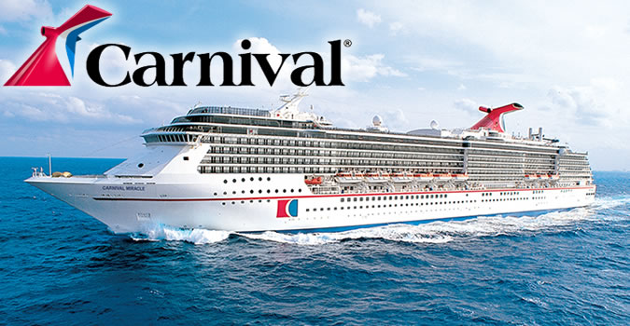
Organisational Vision
What do you think of the Carnival Vision?
“To consistently provide quality cruise vacations that exceed the expectations of our guests.”

Slide 29


Examples of Mission Statements
“Our mission is to completely delight and satisfy our guests. We are committed to making a difference every day; continually getting better to keep us the best.”
http://www.mandarinoriental.com/about-us/mission/
"The mission of The Walt Disney Company is to be one of the world's leading producers and providers of entertainment and information. Using our portfolio of brands to differentiate our content, services and consumer products, we seek to develop the most creative, innovative and profitable entertainment experiences and related products in the world."
http://disneycompanyprofile.weebly.com/

Slide 30


Organisational Values
The underlying philosophies that guide decisions and behavior in a firm.
Also called Core Values or Ethics.
CEO and other top managers have the most influence on values.
Also a reflection of societal values.
Your own experiences?
http://www.marriott.com.au/culture-and-values/core-values.mi

Slide 31

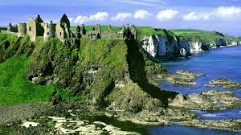
Core Values – Tourism Ireland
Are these core values? Why? Why not?
Ground-up - We want our communication materials to look and feel like they come from the people of Ireland rather than a 'representative body'.
Right People - People trust people, let's make sure we always use people who embody the meaning of the characters of Ireland. People who are spontaneous, engaging, fun and 'themselves'.
Interaction - Move from transactions to interactions. We're not distributing brochures, we're selling experiences in an engaging way.
More Senses - Everything we do should appeal to several of the senses.
Surprising - Always ask: 'What's surprising to consumers about this?' Add some character to what you’re doing.
https://www.tourismireland.com/About-Us

Slide 32
Social Responsibility
Economic Responsibilities.
Legal Responsibilities.
Moral Obligations.
Discretionary Responsibilities.

Slide 33
Enterprise Strategy
Joins ethical and strategic thinking.
Best possible reason for the actions it takes.
Focused on which stakeholder needs are given priority.
Mission statements often provide clues regarding the enterprise strategy of a firm –
  “We focus on satisfying customer needs.”
  “Our goal is to provide a satisfying work environment in which our employees can grow and develop.”
  “Our primary purpose is to maximize shareholder returns.”
  “We focus on giving back to the communities in which we operate.”

Slide 34
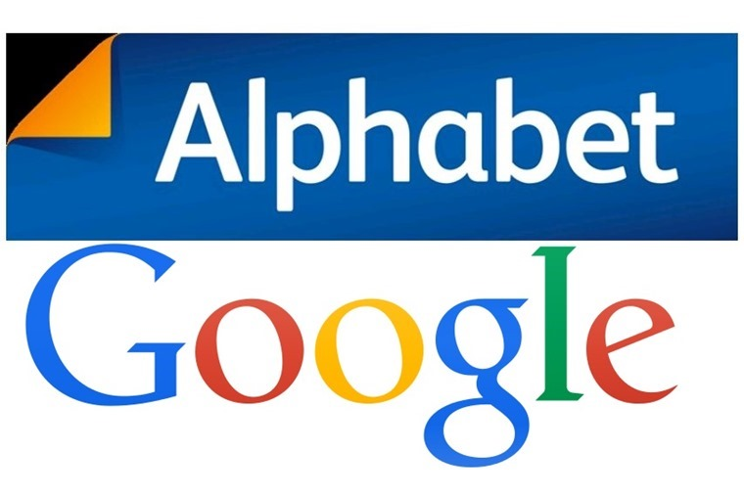
Code of Ethics
Communicate the values of the corporation to employees and other stakeholders.
Ethics systems are sometimes established to ensure compliance.
Formal systems may not be enough to ensure ethical behavior.
Often people do not personalise ethical behavior.
Ethical issues are even more difficult for firms working in more than
one country.
http://www.theverge.com/2015/10/3/9445453/google-dont-be-evil-replaced-in-alphabet

Slide 35

Five Ethical Frameworks
Economic Theory
The purpose of firms
is to maximise profits.
Legal Theory
Compliance with laws
ensures ethical behavior.
Religious Theory
Everyone should act in accordance
with religious teachings.
Utilitarian Theory
Focus on outcomes from decisions.
The greatest good for the greatest number.
Universalist Theory
Focus on the intent of the decision. “Would I be willing for everyone else
in the world to make the same decision?”

Slide 36

Ethical Considerations
Due to a decrease in demand for its services a firm is about to lose money. Managers are considering laying off 10 percent of their workforce. This would be the first layoff in company history. Employees are not organised into a union. The decrease in demand for services is expected to last into the foreseeable future; however, there may be other options for cutting costs.
What are the major issues to consider with regard to this problem from the perspective of each of the five frames of reference?
Economic theory.
Legal theory.
Religion.
Utilitarian theory.
Universalist theory.

Slide 37
Summary
Strategic managers provide long-term direction for their firms, while at the same time balancing the competing interests of stakeholders
Mission statements communicate ideals and a sense of direction and purpose to internal and external stakeholders
A mission is what a company is and its reasons for existing, while a vision is a forward-looking view of what the firm wants to become
Businesses are defined in terms of customers, needs satisfied, capabilities and technologies, and products and services

Slide 38
Group Case Analysis
Determine key problems
Note the relevant considerations for each problem area. Distinguish between symptoms and the core issue
Do appropriate analysis using the information at hand. Be aware of any assumptions you are making and note these
Develop a set of recommendations, supported by your analysis of the case data

Slide 39
Hints/Food for Though
Are consolidated industries like the cruise industry more or less competitive than fragmented industries? Why or why not?
Is the structure of the cruise industry more likely to resemble pure competition, duopoly, oligopoly, or monopoly? Explain your choice.
Do the various brands operated by Carnival Corp. have synergies? If so what are the synergies? If not, was it wise for Carnival to acquire brands outside of the contemporary market niche?
Who are Carnivals core guests? What do they want in a Fun Ship experience?
How should the existing customer information influence brand strategy in the future? How do intangible and tangible resources impact?
Can Carnival change existing customer perceptions of the brand? Should it?
How should the company grow in the future?
Think about the industry structure, how does the dominance of two large players influence competition?

Slide 40

Have a Productive Week!

