Slide 1
HOS 801 Strategic Management in Hospitality & Tourism

Slide 2
Welcome: Week 2
Re-cap
Environmental Analysis
  Group Exercise
Porter’s Five Forces Analysis
Group Case Analysis: Days Inn: Franchising hospitality assets in China

Slide 3
Re-Cap
What is strategy?
What is the traditional approach to strategic management?
What is the Resource-based View?
Stakeholder perspective?
What is the difference between the strategic planning process and strategic thinking?
What are the important characteristics associated with strategic thinking? How can an organisation encourage this sort of thinking?

Slide 4
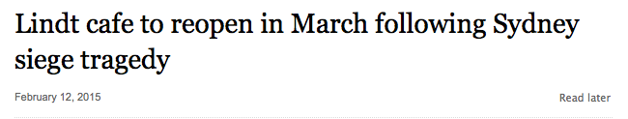
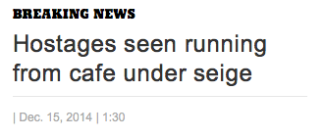
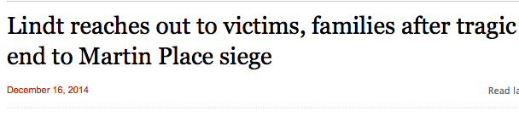
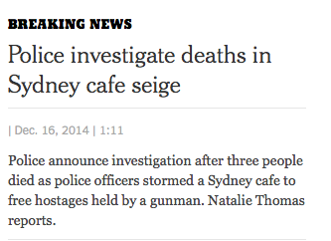

Notes:
What type of firms do you think were affected by this?

Slide 5
Learning Objectives
Identify the most important elements of the broad environment, including the sociocultural, economic, political, and technological contexts.
Know the difference between a trend and a fad.
Understand Porter's five forces model, and the nature of industry structure.
Explain the difference between the operating environment and the broad environment.
List and explain the various tactics managers can use to influence stakeholders.

Slide 6
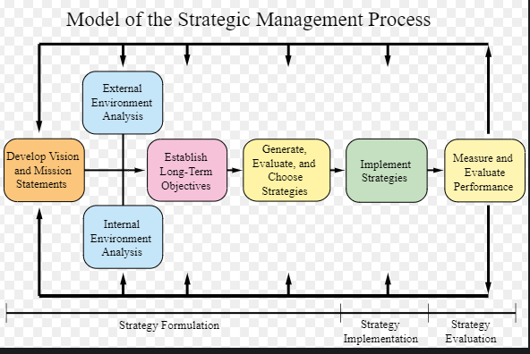
STRATEGIC MANAGEMENT PROCESS

Slide 7
POLITICAL/LEGAL Environmental legislation Consumer protection Government’s attitude Competition regulation Advertising standards Employment law Health and Safety Taxation law International trade barriers Strength of the rule of law | ECONOMIC Economic growth Taxation international trade Exchange Rate Employment law Health and Safety law Inflation Consumer confidence Minimum wage | SOCIAL/CULTURAL Income distribution Demographics Lifestyle changes Attitudes to work and leisure Education Fashion and Fads Health & Welfare Living conditions
TECHNOLOGICAL Changes in physical sciences New discoveries (e.g. apps/social media/trip advisor) Technological obsolescence Gov’t and Industry focus on tech Gov’t spending on research | ENVIRONMENTAL Impact of actual environmental change (e.g. weather instability) Changing perception and reaction to environmental issues

Slide 8
The Firm, Stakeholders & the Environment
The Broad Environment
Sociocultural Influences
Technological Influences
The Operating Environment
Competitors
Local
communities
Activist
groups
The Firm
Suppliers
Owners/Board of Directors
Managers
Employees
Customers
Unions
The Media
Financial
intermediaries
Government agencies
And administrators
Economic Influences
Political/Legal Influences
Ecological Environment

Slide 9
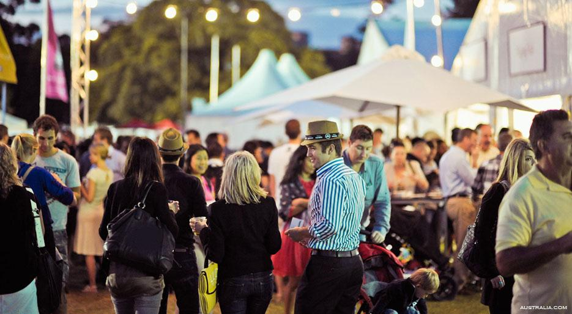
Sociocultural Issues?
Income distribution
Demographics
Lifestyle changes
Attitudes to work and leisure
Education
Fashion and Fads
Health & Welfare
Living conditions
Cultural clash

Slide 10
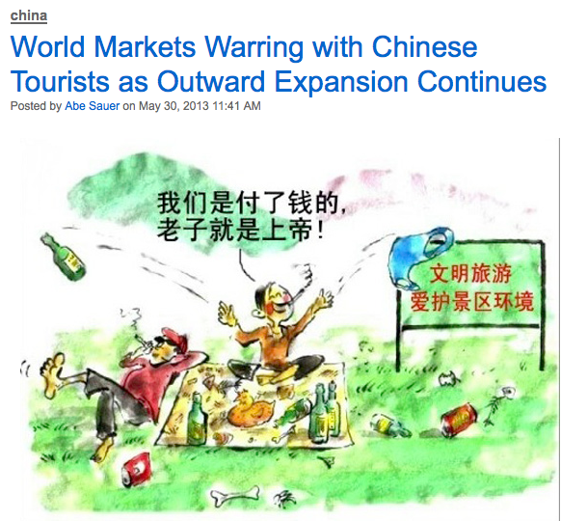
Sociocultural
Reports of UA discriminating against Chinese passengers
The Chinese are now the worlds most significant travellers, spending $102 billion overseas in 2012
Outrage over Chinese carving their names on ancient relics (Luxor, Egypt)
Chinese employee at a hotel in the Maldives revealed kettles were removed from rooms of Chinese guests to prevent making 2 minute noodles
http://www.brandchannel.com/home/post/2013/05/30/Chinese-Tourists-053013.aspx

Slide 11
Why Monitor Society?
Change = opportunities
Avoid being called a “bad corporate citizen”
A good reputation can lead to increased demand or business opportunities
Accurate assessment can sometimes help firms avoid restrictive legislation
https://vimeo.com/69110670

Slide 12
Global Economic Forces to Monitor and Predict
Economic Growth - Influences consumer demand, cost of factors of production, availability of factors of production (especially labor and scarce resources)
Interest Rates - Influences cost of capital for new projects, cost of refinancing existing debt, consumer demand (due to customer ability to finance purchases)
Inflation - Influences interest rates, cost of factors of production, optimism or pessimism of stakeholders
Bitcoin
Exchange Rates – Influences ability to remove profits from foreign ventures, government policies towards business
Trade Deficits – Influences government policies, incentives and trade barriers

Slide 13

Political/Legal Forces
Environmental legislation
Consumer protection
Government’s attitude
Competition regulation
Advertising standards
Employment law
Health and Safety
Taxation law
International trade barriers
Strength of the rule of law

Slide 14



Technological Forces
Changes in physical sciences
New discoveries (e.g. apps/social media/trip advisor, airbnb)
Technological obsolescence
Government and Industry focus on tech
Government spending on research
Trip Advisor

Slide 15
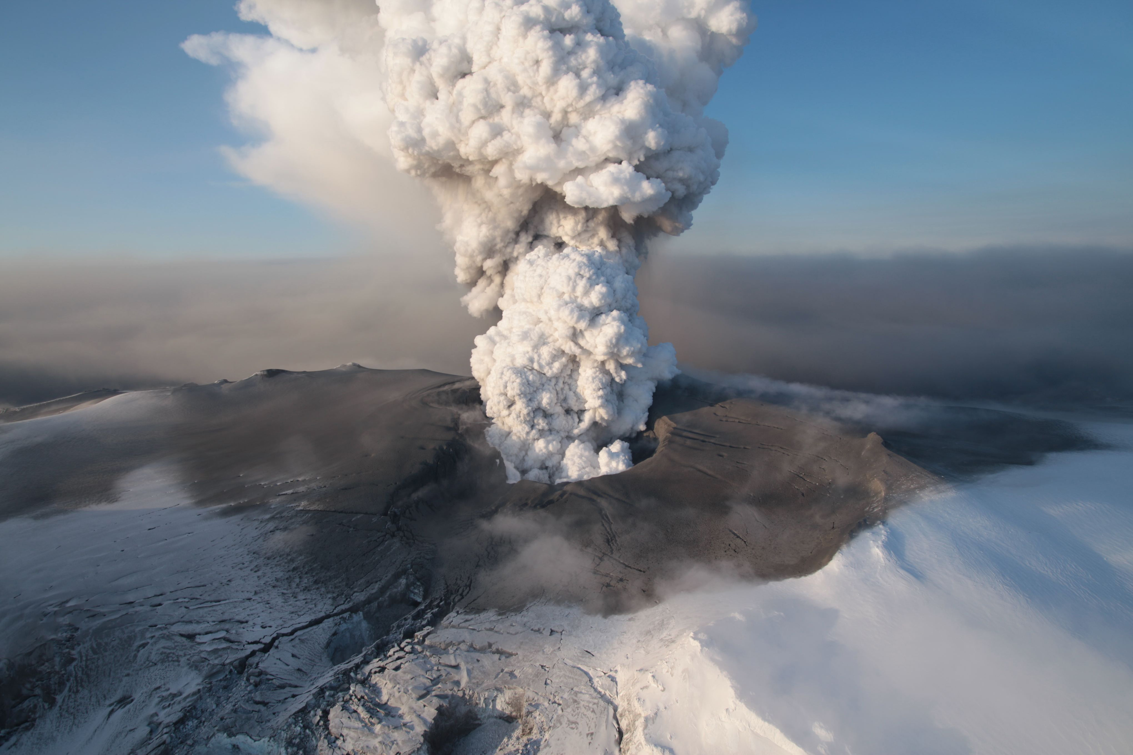
Ecological Environment
Impact of actual environmental change (e.g. weather instability)
Changing perception and reaction to environmental issues
Iceland Case Study

Slide 16
Analysis to Development of Strategies
For each key influence found during analysis of the broad environment, determine whether it is:
  An opportunity
  A threat
  Neutral
Then determine which strategies the firm might pursue in response to each influence, if action should be taken at all
This is one way to generate ideas regarding future strategies the firm might pursue

Slide 17
Environmental Analysis Exercise
Step 1: Select any hotel property or restaurant you wish. Prepare a one-paragraph description of the hotel or restaurant including things like location, size, age, product/customer mix, etc.
Step 2: Identify and describe six environmental trends (they could be positive or negative) that may affect this organisation. A trend is any emerging activity that you believe is important to the future of this business. Trends can fall into any of the various categories including sociocultural, economic, political, legal, environmental and technological (PESTLE Analysis).
Step 3: Provide a rationale for why you selected these six trends. Then indicate what you consider to be the probability of each trend occurring using a range from 0–100%. Also rate the trend on importance using a scale of 1–10 with 10 being the most important.
Step 4: Determine which two of the six trends should be addressed by the company. The trends you select should most likely be those that were the highest in probability of occurring and also highest in importance.
Notes:
Trend or fad?

Slide 18
The Firm and Its Operating Environment
The Operating Environment
Competitors
Activist
Groups
Local
Communities
The Firm
Suppliers
Customers
Unions
The Media
Financial
Intermediaries
Government Agencies
and Administrators

Slide 19
Porter’s Five Forces of Industry Competition
Potential Entrants
Threat of new entrants
Industry
Competitors
Rivalry Among
Existing Firms
Bargaining power of suppliers
Bargaining power of customers
Suppliers
Customers
Threat of substitute products or services
Substitutes

Slide 20
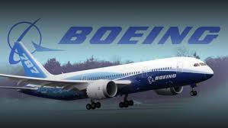
Economic Power of Customers
Customers are more powerful if:
  They are few in number
  They make high-volume purchases
  They are buying undifferentiated products
  They are highly motivated to get good deals (i.e., earn low profits or buy a lot from the industry)
  They can easily vertically integrate backward and become their own suppliers
  They are not very concerned about quality
  They have an information advantage over the suppliers
  They are well organised
Who are Boeing’s customers in Australia?

Slide 21
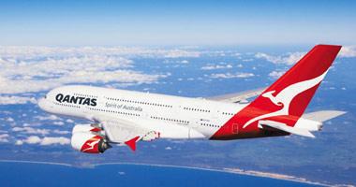
Economic Power of Suppliers
Suppliers are more powerful if:
  They are few in number
  They sell products/services that are not easily substituted
  They do not sell a large percentage of their products/services to the buying industry
  They have a dependent customer
  They sell products/services that are differentiated
  They can easily vertically integrate forward and become their own customers
  They have an information advantage relative to their buyers
  They are well organised
Who are Qantas’ aircraft suppliers?

Slide 22
Entry Barriers
  Some common entry barriers include:
  Economies of scale
  High capital requirements
  High levels of product/service differentiation
  Limited access to distribution channels
  Inimitable resources
  Government policies or regulations that discourage new entry

Slide 23
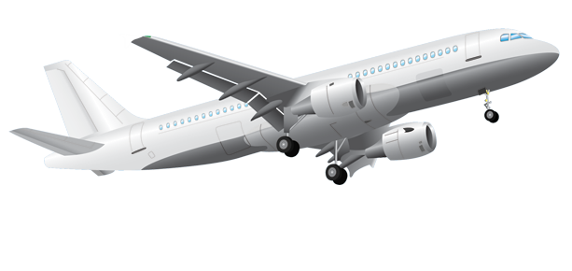
Substitute Products
  Substitutes are products or services provided by another industry that can be readily substituted for an industry’s own products or services
  Substitutes place a ceiling on the price
  that can be charged
  They can also set new performance standards
What is a substitute for an aeroplane?

Slide 24

Industry Competition
A high level of competition is expected when:
  There are many competitors and none of them is dominant
  Slow industry growth
  Hard to differentiate products
  High fixed costs exist
  High exit barriers exist (what is lost if you leave the industry)
Terms to describe industry competition:
  A monopoly is a situation in which one firm is the only significant provider of a good or service
  An oligopoly exists when an industry contains a few very large firms (very common in established industries)
  Hypercompetition is a condition of rapidly escalating competition
Who are Qantas’ competitors?

Slide 25

Managing the Operating Environment
Economic Actions
  Erect new entry barriers
  Competitive tactics such as advertising, new-product launches, cost-reduction efforts, new distribution methods or quality improvements (to name a few)
  Competitive benchmarking
Political Strategies include all firm activities that have as
one of their objectives the creation of a friendlier political climate
  Direct contact with legislators and government leaders
  Political contributions
  Lobbying
  Creation of collective institutions such as
  trade associations

Slide 26


Common Forms of Interfirm Relationships
Joint Venture
  An entity that is created when two or more firms pool a portion of their resources to create a separate jointly owned entity eg. Video streaming site Hulu combines content from News Corp, Disney & Comcast
Network
  A hub and wheel configuration with a local firm at the hub organising the interdependencies of a complex array of firms
Consortia
Specialised joint ventures encompassing many different arrangements. Consortia are often a group of firms oriented towards problem solving and technology development, such as R&D consortia. Eg. Travel agents
+
“Dining Under The Stars”

Slide 27
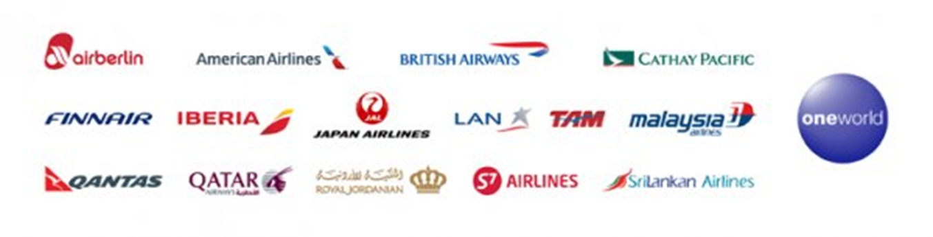
Common Forms of Interfirm Relationships
Alliance
  An arrangement between two or more firms that establishes an exchange relationship but has no joint ownership involved eg. oneworld air alliance vs Star Alliance
Trade Association
  Organisations (typically nonprofit) that are formed by firms in the same industry to collect and disseminate trade information, offer legal and technical advice, furnish industry-related training, and provide a platform for collective lobbying eg. Australian Hotel Association
Interlocking Directorate
  Occurs when a director or executive of one firm sits on the board of a second firm or when two firms have directors who also serve on the board of a third firm. Interlocking directorates serve as a mechanism for interfirm information sharing and cooperation

Slide 28
The eight questions of strategy
We can use this framework to assess the feasibility of any strategic initiative:
Company strengths and weaknesses
Customers Needs
What are we good at?
Can we do this?
What do customers want?
Will they value this?
Corporate Objectives
Market Characteristics
Where do we want to go?
Will this get us there?
What is the market like?
Will the market support this?
Not only do you determine GO/NO GO, you can identify leverage points
Prof. John Roberts, 2014

Slide 29
Group Case Analysis
Form groups of 4
Determine key problems
Note the relevant considerations for each problem area. Distinguish between symptoms and the core issue
Do appropriate analysis using the information at hand. Be aware of any assumptions you are making and note these
Develop a set of recommendations, supported by your analysis of the case data

Slide 30
Hints
You may wish to identify the questions IHG needs to ask about China and the Chinese tourism market before they enter new cities.
Examine the institutional differences across countries to help understand how IHG’s strategy might differ in the US, Europe & Asia.
Strategies for managing the stakeholders?

Slide 31
Next Week
Strategic Direction
Group Case Analysis: The Fun Ship Experience At Carnival Cruise Lines
Readings Workshop

