Slide 1

Welcome To Strategic Management in Tourism and Hospitality !!

Slide 2
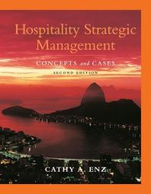
Recommended e-Text
Hospitality Strategic Management : Concepts and Cases
Cathy A. Enz, 2009

Slide 3
Learning Framework
Prescribed text readings.
Lecture PowerPoint presentations for definitions, concepts and frameworks.
Tutorials including Case Studies, Discussion Articles and Videos.
Discussions in class and Tutorials.
Individual study.
Individual Assessment.
Group Assessment and Presentation.

Slide 4
Aims Of The Course
The aim of the subject is to expose students to -
Methods of strategic thinking and a set of practical tools and concepts that will enable students to develop, evaluate and implement innovative strategies.
Theories, frameworks and examples relating to the management of critical aspects of strategic management activity in a Tourism and Hospitality context.
Develop their ability to critically analyse strategic management issues and present the results of this analysis in an engaging and informative fashion.

Slide 5
Course Learning Outcomes
Critically assess and apply highly developed strategic management concepts, tools, and techniques for the tourism and hospitality industry.
Critically evaluate the strategic management process and the relationship between strategy formulation, implementation and control.
Undertake research and analyse and interpret tourism and hospitality industry data to inform the development of strategic options.
Succinctly communicate evidence-based solutions to tourism and hospitality management problems.

Slide 6
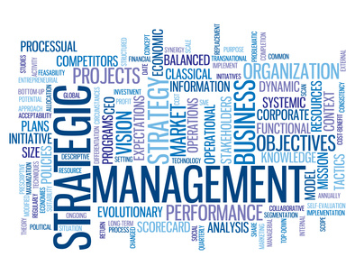
Strategic Management

Slide 7
Learning Objectives
Define Strategy, Resources, Capabilities, Core Competencies, Competitive Advantage and Above Average Returns.
Describe the competitive landscape and explain how globalisation and technological changes shape it.
Use the Industrial Organisation (IO) model to explain how firms can earn above average returns.
Use the Resource Based model to explain how firms can earn above average returns.
Describe Vision, Mission, Values and Organisational Culture - discuss their importance.
Define Stakeholders and describe their ability to influence organisations.
Describe the work of Strategic Leaders.

Slide 8
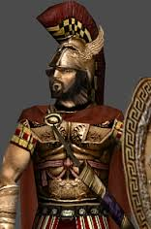
What is Strategy ?
Strategos – Greek military origin
meaning Generalship.

Slide 9
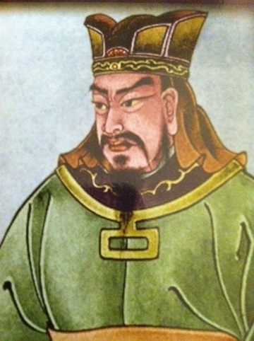
What is Strategy ?
Sun Tzu – The Art of War
“All men can see these tactics
whereby I conquer,
but what none can see is the strategy
out of which victory is evolved.”
  Tactics – win the battle.
  Strategy – wins the war.

Slide 10
What Is Strategy ?
Alfred Chandler – 1962
Strategy will determine structure.
Igor Ansoff – 1965 Corporate Strategy
Strategic planning could be derived in a controlled manner by conducting a detailed analysis of the past to predict the future.
Peter Drucker – "Strategic planning is the continuous process of making present entrepreneurial (risk-taking) decisions systematically and with the greatest knowledge of their futurity; organizing systematically the efforts needed to carry out these decisions; and measuring the results of these decisions against the expectations through organized, systematic feedback”. (Drucker, 1973)
Henry Mintzberg – describes strategy as “a pattern in a stream of decisions”. (Mintzberg, 1978)

Slide 11
What is Strategy ?
Michael Porter –
Competitive strategy “is about being different” and further, “deliberately choosing a different set of activities to deliver a unique mix of value”.
(Porter 1986)
Kim & Mauborgne –
Contend that the real strategic opportunity is, “to create blue oceans of uncontested market space”.
(Kim & Mauborgne, 2004)
Max McKeown –
Argues that “strategy is about shaping the future” and is the human attempt to get to “desirable ends with available means”.
(McKeown, 2011)

Slide 12
What Is Strategy ?
Successful strategy is all about delivering value.
Value – for the customer
and
Value – for the firm.

Slide 13
What Is Strategy ?
Michael Porter describes strategy –
https://www.youtube.com/watch?v=ibrxIP0H84M&feature=youtu.be
That unique place you want your business to be in where you have a competitive advantage that is sustainable over time.
Uniquely differentiated sustainable competitive advantage.

Slide 14
What Is Strategy ?
Strategy creates a unique and valuable position for a firm through the utilisation of a different set of activities.
Effective strategy requires a firm to make competitive trade-offs, most importantly choosing what not to do.
Successful strategy creates fit amongst a company’s key activities.
Successful strategy requires strategic flexibility.
Successful strategy requires effective leadership.

Slide 15
Operational Effectiveness is not Strategy
Operational Effectiveness means performing activities better than competitors.
Faster with better quality, utilising fewer inputs and producing less defects.
The worst thing you can do strategically is to compete on the same dimensions as your competitors.

Slide 16
Quality
Customers perceive a firm’s goods or services to perform in ways that are important to customers, meeting or exceeding their expectations.
From a strategic perspective, quality is the outcome of how a firm completes its primary and support activities.
Quality is possible only when top-level managers support it and when its importance is institutionalized throughout the entire organisation and its value chain.
Quality is a universal theme in the global economy and is a necessary, but insufficient, condition for competitive success.

Slide 17
Strategic Flexibility
Is a set of capabilities used to respond to various demands and opportunities that are a part of a dynamic and uncertain competitive environment.
To achieve strategic flexibility, many firms have to develop new organisational capabilities.
To be strategically flexible on a continuing basis, a firm has to develop the capacity to learn.

Slide 18
Technology and Technological Changes
There is an increasing rate of technological change and diffusion.
Perpetual innovation – the rapid and consistent replacement of new information-intensive technologies.
Disruptive technologies – technologies that destroy the value of existing technology and create new markets.
The information age – the ability to effectively and efficiently access and use information has become an important source of competitive advantage.
Increasing knowledge intensity – firms must be able to adapt quickly to achieve strategic competitiveness.

Slide 19
Hypercompetition
Hypercompetition is a condition of rapidly escalating competition arising from strategic maneuvering among global and innovative combatants.
Competition is based on
- price and quality positioning
- new know-how (open web)
- first-mover advantage
- protecting and invading product or geographic markets.

Slide 20
Industrial Organisation Model of Above Average Returns
This model specifies that the industry in which a firm competes has a stronger influence on performance than the choices managers make inside their organisations.
Determinants of a firm’s performance are
- economies of scale
- barriers to market entry
- diversification
- product differentiation
- degree of concentration of firms in the industry.

Slide 21
Resource Based Model of Above Average Returns
The resource-based model has four underlying assumptions
1) Differences in firms’ performances across time are due primarily to their unique resources and capabilities rather than the industry’s structural characteristics.
2) Firms acquire different resources and develop unique capabilities based on how they combine and use the resources.
3) Resources and capabilities are not highly mobile across firms.
4) The differences in resources and capabilities are the bases of competitive advantages.

Slide 22
Resources and Capabilities
Resources
capital equipment
skills of individual employees
patents
talented managers
Capabilities
should not be so simple that it is highly imitable
finances
should not be so complex that it defies internal steering and control

Slide 23
Capabilities
A capability is the capacity for a set of resources to perform a task or an activity in an integrative manner.
Capabilities evolve over time and must be managed dynamically in pursuit of above average returns.

Slide 24
Core Competencies
Are resources and capabilities that serve as a source of competitive advantage for a firm over its rivals.
When the following four criteria are met, resources and capabilities become core competencies –
1) Valuable.
2) Rare.
3) Costly to imitate.
4) Non-substitutable.

Slide 25
Core Competencies
VALUABLE
They are valuable when they allow a firm to take advantage of opportunities or neutralise threats.
NON-SUBSTITUTABLE
RARE
COSTLY TO IMITATE
Resources are costly to imitate when other firms cannot obtain them or are at a cost disadvantage.
They are rare when possessed by few, if any, current and potential competitors.
They are non-substitutable when they have no structural equivalents.

Slide 26





Core Competencies
Are resources and capabilities that serve as a source of competitive advantage for a firm over its rivals.
They are often visible in the form of organisational functions.
They underpin the vision and mission of the organisation.

Slide 27
Competitive Advantage
To gain an advantage over competitors by offering superior value to customers through either –
lower prices
or
delivering greater benefits and services at higher prices.
“If you don’t have a competitive advantage,
don’t compete.”
(Jack Welch)

Slide 28
First Mover Advantage
The advantage that a company gains by being the first to enter and occupy a market before any competitors, that may lead to heightened brand recognition and customer loyalty resulting in an advantageous and possibly insurmountable market position certainly in the short term before competition emerges.
“The first man gets the oyster,
the second man gets the shell.”
(Andrew Carnegie)

Slide 29
Competitive Advantage
Competitive Advantage is the cornerstone of strategic management
- without it you are a follower
- with it you are a market leader.
Competitive Advantage occurs when a firm implements a strategy which competitors are unable to duplicate, or find too costly to imitate.
A uniquely differentiated and sustainable competitive advantage will lead to above average returns.

Slide 30
Above Average Returns
Above average returns are in excess of what investors would expect to earn from other investments with similar risk.

Slide 31
Strategic Vision
The strategic vision is a picture of what a firm wants to be in the future and what it wants to achieve in a targeted period
- are intended to capture the hearts and minds of employees and other stakeholders
- can incorporate values – beliefs that are shared among the stakeholders of an organisation and drive culture
- tend to be enduring, while missions can change in view of changing environmental conditions
- tend to be relatively short and concise, and therefore easily remembered.

Slide 32
Vision Statements
To fill the earth with the light and warmth of hospitality – by delivering exceptional experiences – every hotel, every guest, every time.
- Hilton
To be the #1 hospitality company in the world.
- Marriott
Our ambition is to be the world’s benchmark hospitality player so we can offer our guests, employees and partners a unique experience.
- Accor
Our goals, beliefs and principles are the foundation of the work we do every day on behalf of our guests.
- Four Seasons

Slide 33
Starwood Shared Values “Promises”
At Starwood‚ we call our shared values “promises.” These promises guide our everyday actions and ensure a common understanding of what we can expect from one another.
Starwood’s values are:
Go the Extra Step by taking actions that build lasting connections and loyalty
Play as a Team by working globally and across all teams in the company
Do the Right Thing by using good judgment, respecting our communities, associates, owners, partners and the environment
We’re committed to creating a company that is a great place to work and provides wonderful guest experiences, great returns to stakeholders and is:
Growing
Strong
Stable

Slide 34
The Ritz Carlton Credo
The Ritz-Carlton Hotel is a
place where the genuine care
and comfort of our guests is
our highest mission.
We pledge to provide the finest
personal service and facilities
for our guests who will always
enjoy a warm, relaxed, yet
refined ambience.
The Ritz-Carlton experience
enlivens the senses, instils
well-being, and fulfills even
the unexpressed wishes
and needs of our guests.

Slide 35
The Ritz Carlton Motto
At The Ritz-Carlton Hotel Company, L.L.C.,
"We are ladies and gentlemen serving ladies and gentlemen."
This motto exemplifies the anticipatory service provided by all staff members.

Slide 36
Strategic Mission
The business or businesses in which a firm intends to compete and the customers it intends to serve.
An effective strategic mission defines what a firm does at present and establishes a firm’s uniqueness.

Slide 37
Organisational Culture
The complex set of ideologies, symbols and core values shared throughout the firm that influence the way it conducts its business.
Organisational culture is the social energy that drives – or fails to drive – the organisation.
Culture is critical to strategic leadership and strategic implementation.
An effective culture is a potential source of competitive advantage.

Slide 38
Stakeholders
Are individuals, groups and organisations that have a stake in the firm.
Can affect a firm’s vision and mission.
Are affected by the strategic outcomes achieved.
Have enforceable claims on a firm’s performance.
Organisations are not equally dependent on all stakeholders, so not every stakeholder has the same level of influence.
The more critical and valued a stakeholder’s participation, the greater a firm’s dependence on it, which gives the stakeholder more potential influence over the firm.
Firms effectively managing stakeholder relationships outperform those that do not – competitive advantage.

Slide 39
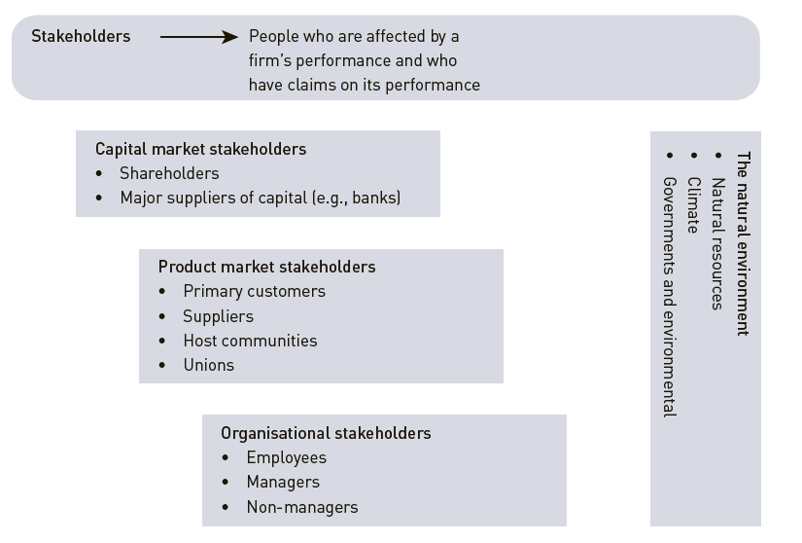
The Four Stakeholder Groups
FIGURE 1.4
THE FOUR STAKEHOLDER GROUPS

Slide 40
Stakeholder Power and Influence
Hi
Manage Closely
Power
Monitor
Lo
Lo
Influence
Hi

Slide 41
Strategic Leaders
Strategic leaders are people located in different areas and levels of a firm who use the strategic management process to select strategic actions that help the firm achieve its Vision and fulfill its Mission.
Successful strategic leaders are decisive, committed to nurturing those around them and committed to helping the firm create value for all stakeholder groups.

Slide 42
Strategic Leaders in Tourism and Hospitality
Cesar Ritz
Ritz & Savoy
Conrad Hilton
Hilton
Bill Marriott Jr.
Marriott
Kemmons Wilson
Holiday Inn
Barry Sternlicht
Starwood, Westin, Sheraton & St. Regis

Slide 43
Strategic Leaders in Tourism and Hospitality
Paul Dubrule and Gerard Pellisson
Accor
Jay Pritzker
Hyatt
PRS Biki Oberoi
Oberoi & Raj Villas
Isadore Sharp & Murray Koffler
Four Seasons
Adrian Zecha
Regent & Aman

Slide 44
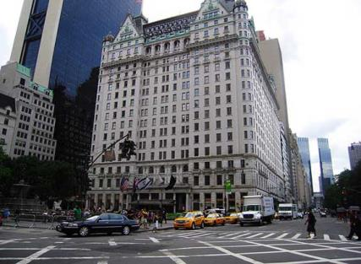
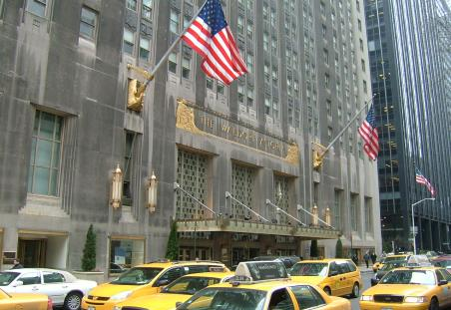
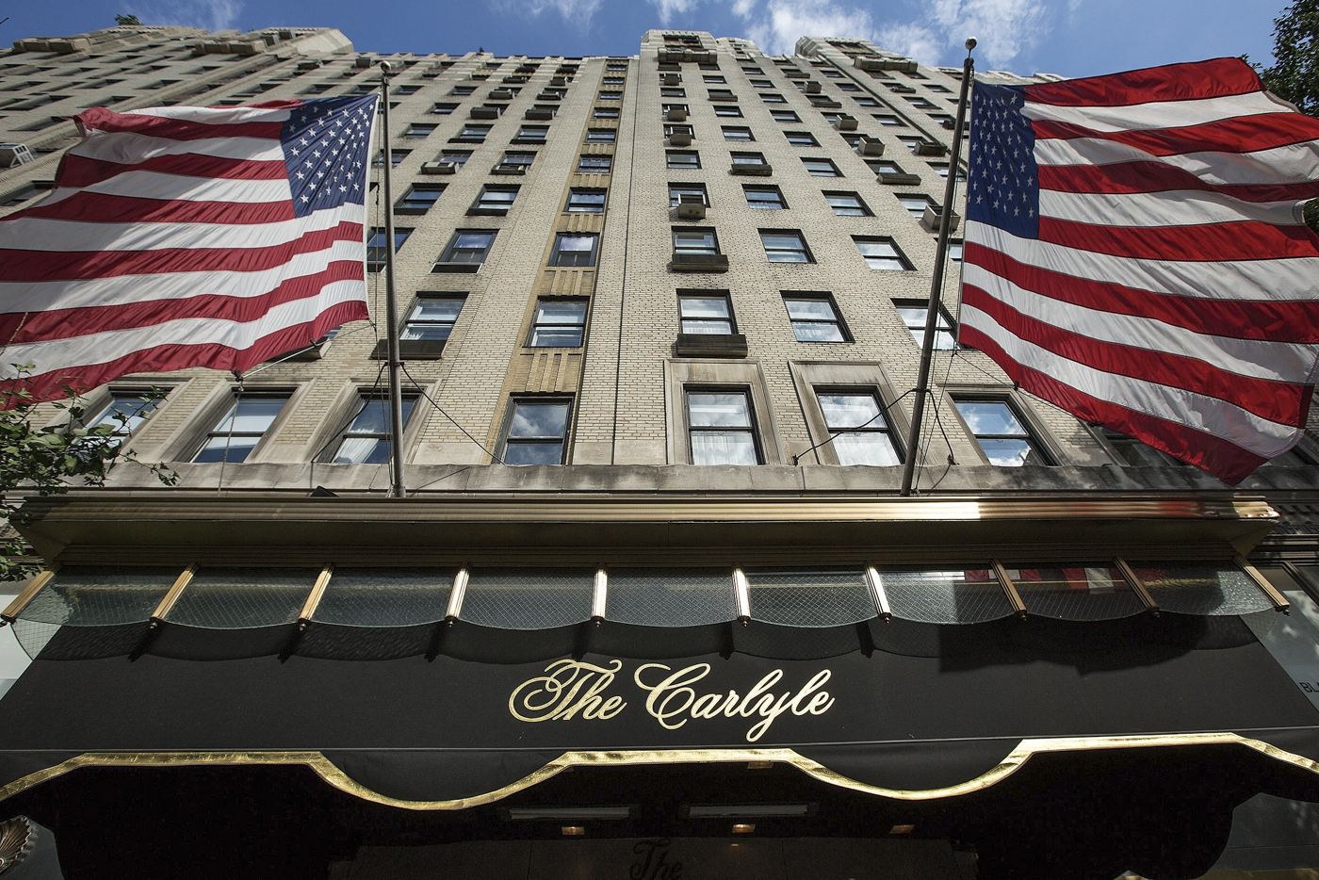
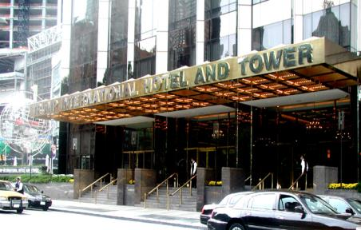
Strategic Thinking in Tourism and Hospitality

Slide 45
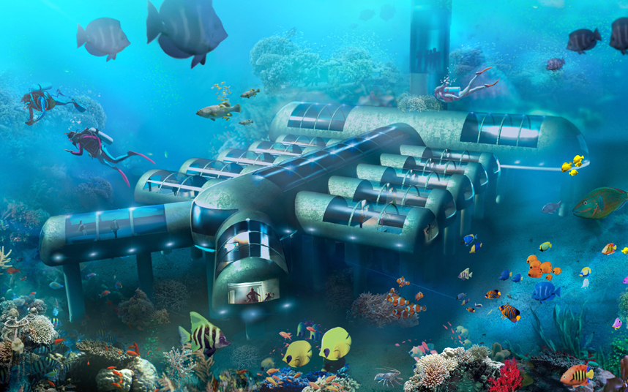
Strategic Thinking in Tourism and Hospitality
Planet Ocean Underwater Hotel, Key West, Florida will have 12 ‘aqua pods’ located some 28 ft below sea level. The hotel, which will technically be classed as a vessel, can navigate waters using electromechanical propulsion technology. It will be made of double-welded steel and thick, clear acrylic, through which guests will be able to view the surrounding marine life in crystal-clear waters. Rooms will contain luxury amenities, and could be named after seafarers such as Cousteau or Captain Nemo.
http://www.planetoceanunderwaterhotel.com/

