Slide 1
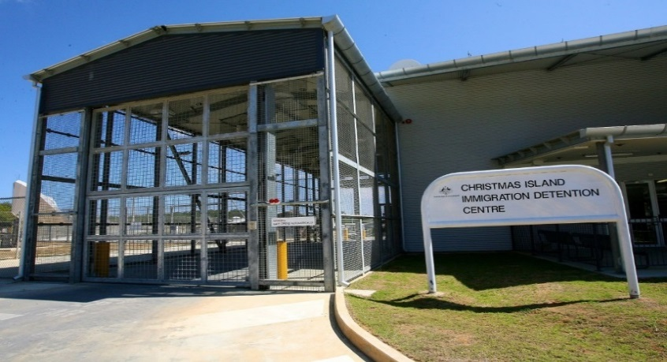
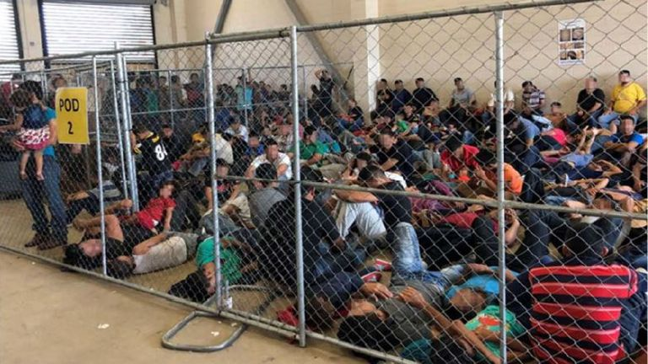
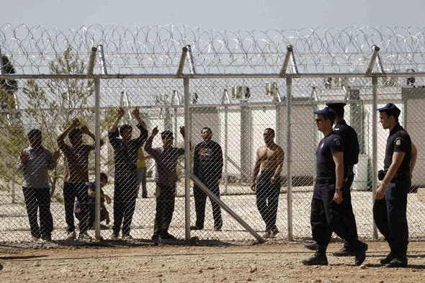
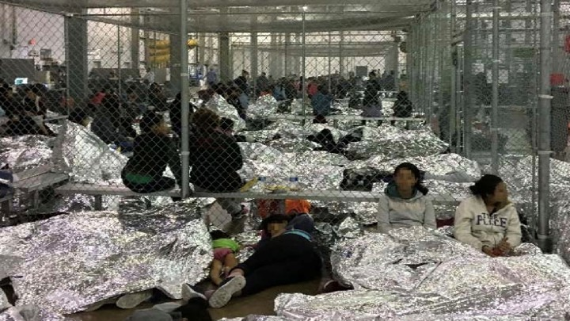
LAWS7714 Seminar four: Access to Asylum and Administrative Detention
Art 31(1) Refugees Convention: ‘The Contracting States shall not impose penalties, on account of their illegal entry or presence, on refugees who, coming directly from a territory where their life or freedom was threatened …, enter or are present in their territory without authorization, provided they present themselves without delay to the authorities and show good cause for their illegal entry or presence’.
Art 31(2). ‘Contracting States shall not apply to the movements of such refugees restrictions other than those which are necessary and such restrictions shall only be applied until their status in the country is regularized or they obtain admission into another country.’

Slide 2
Right to personal liberty and security
Art 9(1) Int Covenant Civil and Political Rights (‘ICCPR’), contains a substantive guarantee: Everyone has the right to liberty and security of person. No one shall be subjected to arbitrary arrest or detention. No one shall be deprived of his liberty except on such grounds and in accordance with such procedure as are established by law.
Art 9(4) contains a procedural guarantee. Anyone who is deprived of his liberty by arrest or detention shall be entitled to take proceedings before a court, in order that that court may decide without delay on the lawfulness of his detention and order his release if the detention is not lawful.
Liberty of person concerns freedom from confinement; and security of person concerns freedom from injury to body and mind (this overlaps with Art 7 ICCPR).
Is the personal ‘right to liberty’ an absolute right, or is deprivation of liberty sometimes justified in respect of migration control and so extend to asylum seekers and refugees?
Yes deprivation of liberty is permissible, but deprivation of liberty must not be ‘arbitrary’ and must be legally permitted (‘rule of law’). Detention must be justified as ‘reasonable, necessary and proportionate’.
Conditions of detention (treatment of detainees) are subject to constraints: ‘No one should be subjected to torture or to cruel, inhuman or degrading treatment or punishment’ (ICCPR art 7). And persons shall be treated with humanity (Art 10(1)).

Slide 3
What are the purpose(s) of administrative detention?
Administrative detention: How is it distinguishable from criminal detention?
Without judicial order or warrant: not pursuant to a conviction by a competent court or for non-compliance with a court order, but used to promote other objectives. e.g.
quarantine laws, mental health laws, anti-terrorism laws and immigration and refugee laws
Rationale for immigration detention?
Administrative efficiency: facilitate prompt health and security checks
Administrative processing: detention (for visa-less arrivals) pending refugee status determination or pending removal/deportation
Public health, safety and security: protective rationale (captures excludable protection seekers – e.g. those who fail security checks)
Non-compliance grounds: person’s deemed ‘flight risks’ (potential absconders)
Deterrence: desire to dissuade unlawful ‘irregular’ migration– a lawful purpose?
Punishment for unlawful mode of arrival in a state?
Detention in the course of controlling immigration is not, per se, arbitrary. But are all of these rationales consistent with Art 9 ICCPR?

Slide 4
The subjects of detention: who faces (prolonged and indefinite) detention?
‘Irregular’ asylum seekers pending administrative decisions about lawful entry to a state or removal: health checks, security clearance and refugee status outcomes
‘Risky’ refugees denied a visa or who have visas cancelled on adverse character grounds or who fail national security checks but who may not be simply excludable (due to human rights (non-refoulement) principles)
Stateless persons (Al-Kateb v Godwin (2004) 219 CLR 562) – removal may be impractical or impossible
Other migrants - who are overstayers or otherwise in breach of visa conditions, or illegal foreign fishers. Go here for a report on the recent arrival of an illegal fishing vessel.

Slide 5
Core human rights principles applicable to regulate administrative detention
Right to liberty - ICCPR Art 9(1) – applicable to all persons; asylum seekers, refugees and stateless persons within a State’s territory and subject to that State’s jurisdiction.
Access to justice: prompt judicial oversight – ICCPR Art 9(4) – to guard against arbitrariness and illegality; and, to facilitate release if necessary
Detention must be in accordance with (‘prescribed by’) law, be necessary and reasonable in a given case so an assessment must be made on an individualised basis.
Determining whether detention is necessary and reasonable requires restrictions on liberty to be proportionate to a State’s legitimate objective(s)
Children’s Rights Art 37(b) – UN Convention on the Rights of the Child. No child shall be deprived of his or her liberty unlawfully or arbitrarily. The arrest, detention or imprisonment of a child shall be in conformity with the law and shall be used only as a measure of last resort and for the shortest appropriate period of time;

Slide 6
When is detention of refugees not ‘in accordance with law’
No-one shall be deprived of their liberty except on such grounds and in accordance with procedures established by law (Art 9(1)).
Deprivation of liberty without legal foundation (e.g. a statutory basis) is unlawful.
There must be legally prescribed procedures governing administrative detention of refugees: determining and limiting when administrative detention is permissible; when it may continue and for what duration; the location of detention; and, provision of legal safeguards including; access to legal representation and access to courts to test the legality of detention and seek release if detention is not lawful (Art 9(4)).
Art 9(4) requires a court (or independent tribunal) must have the capacity to review and check the ‘necessity, reasonableness and proportionality’ of detention and the coercive power to order the release of a person, held unlawfully, immediately.
Administrative detention that may have been justified initially, may become unlawful over time.
Consider the position of a ‘failed’ asylum seeker (who is also stateless) where no third country is willing to accept them. That was the fate of Mr Al-Kateb (Al-Kateb v Godwin (2004) 219 CLR 562) and note also Plaintiff M47 (2012) 251 CLR 1). Both cases are discussed in the prescribed reading.

Slide 7
When is detention of refugees arbitrary (unnecessary and disproportionate)?
Asylum seekers who unlawfully enter a State may be detained briefly in order to document their entry, record their claims for protection and determine identity (A v Australia (1998) UN Human Rights Committee)
Routine and blanket detention is abitrary – i.e. detention beyond a brief period, that is not justified on an individualised basis, e.g. risk of absconding, risk of criminality (Shafiq v Australia (2006) UNHRC)
Where the state has not demonstrated that less invasive alternatives to detention are unviable (C v Australia (2002) UNHRC)
Where deprivation of liberty is unjust, unreasonable or disproportionate to the pursuance of a legitimate aim (Immigration detainees with adverse security assessments v Commonwealth of Australia [2014] Aust Human Rights Comission 92, 7 [34])
What are legitimate aims? managing health, identity and security risks; ensuring the effective operation of the migration system; protecting the community; preventing the risk of absconding to avoid deportation.
Detention must be in non-punitive environments, i.e. not in prisons
See United Nations Human Rights Committee, General Comment 35 (2014), Article 9: Liberty and security of person, UN Doc CCPR/C/GC/35 [18] and [39]-[48]. Go here.

Slide 8
Are the following practices lawful (consistent with international human rights norms)?
The Canadian President determines that henceforth all ‘irregular’ asylum seekers crossing from the US will be administratively detained in prison pending removal, in order to send a message and deter others.
Greece routinely administratively detains all adult asylum applicants from Syria for between twelve to eighteen months for health/security checks and a formal refugee status determination.
New Zealand subjects a Rohingya family of four (including two minors) to detention on a remote island, pending refugee status determination, with periodic evaluation of its ongoing necessity and proportionality performed by government officials.
Australia detains a ‘failed’ refugee (on adverse security grounds) from Sri Lanka indefinitely in solitary confinement in a detention centre, in order to promote community safety and to prevent the person absconding, pending removal to a safe third country willing to accept them.
Unlawful: deterrence is not a legitimate aim under ICCPR art 9, it is not necessary and proportionate.
Managing health, identify and security check is a legitimate aim but detention must be necessary and proportionate in each individual case if it is to be lawful.
There must be oversight by an independent court or tribunal to check the legality of detention and its necessity/proportionality. Detention of children must be a measure of last resort.
Protection of the community/prevention of flight risk are legitimate aims but states must show there are not less invasive means available (e.g. ‘reporting’ obligations or sureties) otherwise it is unlawful. Also, solitary confinement may be inhumane or degrading treatment contrary to Arts 7 and 10 ICCPR)

Slide 9
Judicial Review: an effective remedy against prolonged and indefinite detention?
Judicial Review is concerned with judicial supervision of the legality and procedural fairness (i.e. formal questions) of administrative action by government officials. Is that enough to comply with international law?
ICCPR art 9(4) requires an effective and prompt review meaning that an independent court (or independent tribunal) must have power to review the substantive merits of the decision to detain (necessity and proportionality of detention) and have power to order release.
(See A v Australia (1997) UNHRC; Torres v Finland (1990) UNHRC; and Baban v Australia (2003) UNHRC).

Slide 10
What are the costs of detention (in Australia)?
Financial costs
In April 2014, the National Commission of Audit reported that it costs:
$400,000 a year to hold an asylum seeker in offshore detention (eg Nauru);
$239,000 to hold them in detention in Australia;
less than $100,000 for an asylum seeker to live in ‘community detention’; and,
around $40,000 for an asylum seeker to live in the community on a bridging visa while their claim is processed
A 2016 report At what cost? by UNICEF/Save the Children estimated that expenditure on deterrence policies - boat turn-backs, onshore and offshore detention and other programs - amounted to more than $9.6 billion.
Strategic costs – reputational, and weakens regional commitment to international human rights law refugee protection

Slide 11
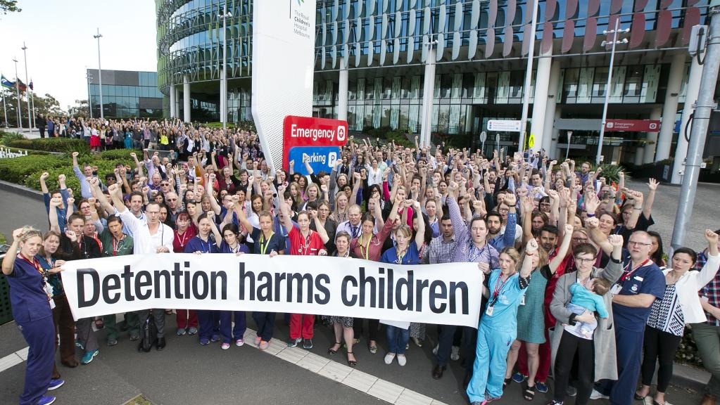
What are the human costs of detention?
Human Costs
Detention causes or exacerbates physical and mental health problems experienced by refugees, in part due to uncertainties as to duration of confinement and the future
Medical research shows health deterioration and high levels of stress, depression, suicidal ideation and self-harm among detainees (including children) - linked to length and repressive conditions of detention
Inadequate healthcare, recreation and education for children detrimental to children’s development
Health problems impede effective participation in migration processes; RSD, fitness to travel (removal) and repatriation and/or reintegration in society
See further, M Bull, “Sickness in the System of Long-term Detention” (2013) 26(1) Journal of Refugee Studies 47.; and D Marr “Australia’s Detention regime sets out to make asylum seekers suffer” The Guardian (August 5, 2014).

Slide 12
Less coercive means: law/policy alternatives to closed detention?
Non-custodial options may be compliant with international law because they are necessary and less intrusive means to achieve aims (i.e. proportionate) in the circumstances given the risks:
Payment of bond or bail;
Periodic (daily) reporting requirements to police of immigration officials;
Restrictions on freedom of movement (designated residence (‘community detention’));
Restrictions on freedom of movement (electronic tagging);
Restrictions on freedom of movement (home curfew);
Conditional release from detention pending migration outcomes (‘bridging visas’).

