Slide 1
LAWS7714: Seminar Five – Access to Asylum and Offshore Processing
“Obstructing safe travel, indefinite detention and forced removal become routine practices in pursuit of the organisational goal of denying refugees the ability to seek asylum in accordance with the 1951 Refugee Convention”
(Nethery and Holman, “Secrecy and human rights abuse in Australia’s offshore immigration detention centres” (2016) IJHR 1018,1019)

Slide 2
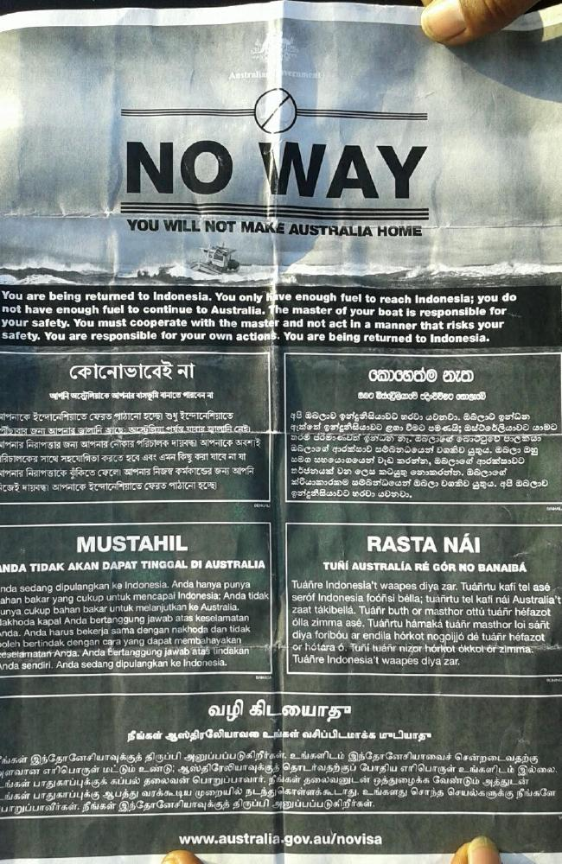
Operation Sovereign Borders: Externalising Australia’s border controls
‘If you attempt to come to Australia by illegal maritime means, you will be turned around or taken back. If you are rescued at sea, you will be safely turned around and the most that you might hope for is to be taken to Papua New Guinea or Nauru for the purposes of being assessed and processed for potential settlement outside Australia or return to your country of origin. You will never settle in Australia. To those waiting in Indonesia, Sri Lanka, Vietnam, Pakistan, Afghanistan, Iraq, Syria and elsewhere, seeking to come to Australia by illegal maritime means, and who listen very carefully to what is said by ministers and senior officials, let me be very clear: The path is shut, with no exceptions.’
Senate, Legal and Constitutional Affairs Legislation Committee, Estimates, 8 February 2016, 3 (M Pezzullo, Secretary, Department of Immigration and Border Protection).

Slide 3
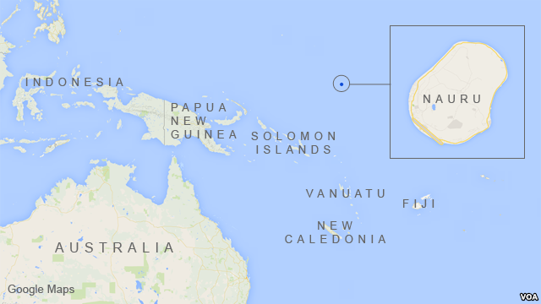
What is Operation Sovereign Borders (OSB)?
OSB entails the militarisation of the border and comprises several inter-related measures:
A. Regional processing and resettlement in Nauru, PNG (Manus Island/Port Moresby), & US;
B. Covert maritime interdiction and turn-backs of asylum seekers to: Indonesia/Sri Lanka/Vietnam;
C. Overseas disruption of people smuggling operations;
D. Communications campaign for diaspora communities in Australia, in source countries and in transit; and
E. Temporary protection visas for irregular maritime arrivals (2012-2013) granted asylum in Australia.

Slide 4
Historical Context: The MV Tampa – and the ‘Pacific Solution’ (2001-07)
22 August 2001: Tampa sets sail for Singapore from Fremantle
26 August: Tampa rescues people from sinking boat
27 August: – Australian authorities advise the Captain not to enter its territorial waters around Christmas Island
29 August: SAS board the vessel. The following day those on board petition for refugee protection pursuant to the 1951 Refugee Convention
3 September: passengers taken by HMAS Manoora to Nauru.
11 September 2001: North J finds that the Commonwealth acted illegally and ordered the release of the asylum seekers (VCCL v Minister for Immigration (2001) FCR 452.
Decision is appealed to the FCA (Full Court).

Slide 5
Ruddock v Vadarlis (2001) 110 FCR 491
What supplied the Australian government with the legal power to interdict and detain asylum seekers at sea?
Was the Commonwealth acting within non-statutory Executive power (s.61 Cth Constitution) when intercepting the Tampa?
Specifically did the asserted (executive/prerogative) power to prevent the entry of non-citizens, and to do such ancillary things necessary to effect their exclusion, exist?
If it did exist was it extinguished by virtue of the Migration Act – which regulated the entry, presence and departure of non-citizens?

Slide 6
Ruddock v Vadarlis (2001) 110 FCR 491
French and Beaumont JJ held:
The executive power of the Commonwealth did extend to a power to prevent entry of non-citizens and to to effect their exclusion;
Executive power did extend to excluding non-citizens by preventing a vessel from docking at a port and to restraining persons/or boat from landing in Australia;
Migration Act did not deprive the Government of the Executive power;
Steps taken to effect interdictees departure from Australian waters were lawful: within the non-statutory executive power of Australian government
(2001) 10 FCR 491 [176]-[191] [193]-[197], [201-204] (French J) - nature of executive power/gatekeeping function and key reasoning of the court
Black CJ (dissenting): Doubted that the asserted executive (prerogative) power to exclude ‘aliens’ continued to exist at common law: its existence was entirely uncertain, and no previous modern instances of its exercise; and the Migration Act evinced an intention to cover the field, regulating: ‘the coming into, and presence of, non-citizens in Australia’ (s.4). Accordingly, the statute displaced the asserted executive power (at common law).
(2001) 10 FCR 491 [8]-[29], [42]-[47], [60]-[64], [126]. See P Billings, ‘Refugees, the rule of law and executive power: A(nother) case of the conjuror’s rabbit?’ (2003) 54 Northern Ireland Legal Quarterly 412 (analysing the Tampa case).

Slide 7
Post Tampa: the “Pacific Solution” (2001-08)
What were the law/policy responses to boat arrivals in Australia post Tampa (2001-08)?
Regional ‘Offshore’ Processing: New arrangements for processing refugee claims (lodged by maritime arrivals) on Nauru
Excision of territory from the migration zone
Operation Relex: maritime interception and turnaround of boats bearing asylum seekers
Temporary Protection Visas (1999-2007) for ‘unauthorised’ maritime arrivals (refugees)

Slide 8
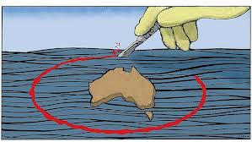
Excision Laws: Purpose and effect of a legal fiction?
Migration laws decouple Australian territory from ‘migration zone’. Physical presence on Australian soil does not equate to legal presence in Australia
Purpose is to deprive asylum seekers of substantive and procedural rights arising under the Migration Act and deter future putative refugees
Remote islands (Christmas Island, Cocos Islands) were first ‘excised’ in 2001, removed from the migration zone, meaning people were barred from making a valid protection visa application
In 2013 legislative reforms - Migration Amendment (UMA) Act - ‘excised’ the Australian mainland from the migration zone so any irregular (visa-less) arrivals reaching the mainland cannot apply for a visa on arrival: they are liable to be sent offshore for ‘regional processing’ and overseas resettlement.
See, A Vogl, “Over the Borderline: A Critical Inquiry into the Geography of Territorial Excision…” (2015) 38(1) UNSW LJ 114.

Slide 9
“No advantage principle” (2012)
What was the ‘no advantage’ principle (2012-13) and the motivation behind it, and relatedly OSB (2013-18)?
Deterrence was the central element referable to (a) the ‘illegal’ act of seeking asylum (without a visa) and (b) humanitarianism (preventing loss of life at sea).
A priority for the Houston Panel was:
‘[T]o recalibrate Australian policy settings to achieve an outcome that asylum seekers will not be advantaged if they pay people smugglers to attempt dangerous irregular entry into Australia instead of pursuing regular migration pathways and international protection arrangements as close as possible to their country of origin’
Led to passage of the Regional Processing Act (2012)
Go here for an ABC Four Corners report from April 2013 on the resuscitation of offshore processing

Slide 10
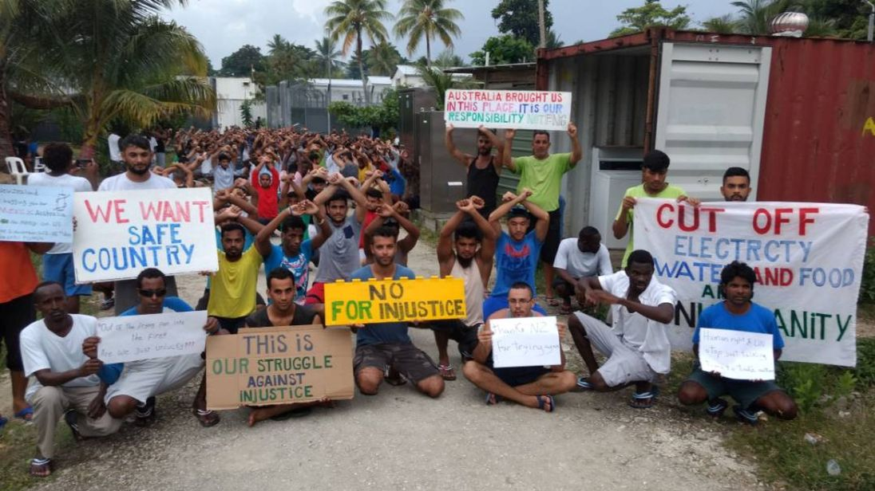
Regional Processing Act (Cth) (2012): Establishing Refugee Camps (or, Prisons)
Australian government’s statutory power to ‘designate’ regional processing countries (RPCs) was conditioned by a broad discretionary (‘national interest’) requirement & political assurances that refugee law would be complied with in RPCs.
The statutory (designation) power was unconditioned by international (refugee) law obligations or the regional processing country’s domestic laws or international obligations
Transfer of legal responsibility: Regional Processing Act (2012) made no provision for what was to happen to maritime arrivals after their transfer overseas which was a matter for the domestic law of a ‘designated’ RPC.
Neo-colonialism? Large transfers of funds/foreign aid to RPCs
Manus island centre: a “gulag within which Australian state agencies, through an opaque and complex chain of command, wield control over detainees’ basic means of survival, their daily routines and the key decisions affecting their lives.”
M Grewcock, ‘‘Our lives is in danger’: Manus Island and the end of asylum’ (2017) 59(2) Race and Class 70, 76.

Slide 11
Legality of offshore processing tested before the
Before the HCA: Plaintiff S156/2013 v Minister for Immigration and Border Protection (2014) 254 CLR 28
Australian government’s offshore regional processing arrangements with PNG were deemed to be legally valid, supported by both legislation (s 198AB 198AD Migration Act) and those laws were valid under the Australian Constitution (s 51 (xix) because they were in respect of a class of aliens.
The High Court expressed doubts as to whether the new regional processing laws were consistent with Australia’s obligations under the Refugee’s Convention:
“The plaintiff relies on what was said in Plaintiff M61/2010E v The Commonwealth (2010) … about the Migration Act more generally. It was said [in M61] that, read as a whole, the Migration Act contains an “elaborated and interconnected set of statutory provisions directed to the purpose of responding to the international obligations which Australia has undertaken in the Refugees Convention and the Refugees Protocol”. […]
There may be some doubt whether the provisions of subdiv B, which were inserted after these cases, can be said to respond to Australia’s obligations under the Refugees Convention.”
Plaintiff S156/2013 (2014) 254 CLR 28, 47 [39]-[44].

Slide 12
Legality of offshore processing tested before the
Plaintiff M68-2015 v Minister for Immigration and Border Protection (2016) 257 CLR 42, 60-65, 67-73 (French CJ, Kiefel and Nettle JJ).
A Bangladeshi asylum seeker argued that the government had acted illegally by participating in a practical sense (procuring and funding) with her detention in Nauru. HCA ruled offshore arrangements with Nauru were legal.
The HCA found that laws authorising the Australian government to secure funding for and to participate in an asylum seeker’s detention at the RPC on Nauru were valid laws under the Constitution (s 51(xix) (laws with respect to aliens) applying the principles in Plaintiff S156.
Furthermore that s 198AHA of the Migration Act (which was inserted into the Act in 2015 (i.e. well after regional processing had begun in late 2012) retrospectively authorised the Australian government’s conduct in relation to the plaintiff’s detention during 2014.
Section 198AHA(2) founded the government’s participation in the detention of an alien (and restraint over liberty) for so long as was reasonably necessary to achieve the purpose of processing by Nauru of a person’s refugee status claim.

Slide 13
Judicial consideration of offshore processing: Manus Island
Before the PNG Supreme Court: Namah v Pato (2016) SC 1497
Deciding on the constitutionality of bi-lateral arrangements entered into in Sept 2012 and later (purportedly) validated by an amendment to the PNG Constitution s 42 (personal liberty) [5]-[7].
Detention centre is enclosed and manned by security officers to prevent people leaving; all funded by Australia [20].
In an effort to pre-empt a legal challenge to the legality of the detention arrangements, constitutional amendments were introduced in 2014: per s 42(1)(ga). [22]
Prior to the 2014 amendments s 42(1) Constitution guaranteed individual liberty. Liberty could only be curtailed on specified grounds given effect through legislation [33] and [38]. Detention outside of that authorised by s 42(1) would be unconstitutional.
Relevantly s 42(1)(g) Constitution was potentially applicable here; it addressed detention to prevent unlawful entry or to facilitate removal.

Slide 14
Namah v Pato (2016) SC 1497
PNG Supreme Court held: that the forcible transfer to PNG and detention of asylum seekers was contrary to s 42(1)(g) Constitution: it was therefore unconstitutional.
Refugees had entered on a lawful basis with a permit so detention unwarranted [39].
Also, the 2014 constitutional amendments (per s 42(1)(ga) were not validly made [53]-[54].
And there was no relevant enabling domestic law to regulate asylum seekers freedom of movement even if 2014 amendments had been validly introduced [56] and [59].

Slide 15
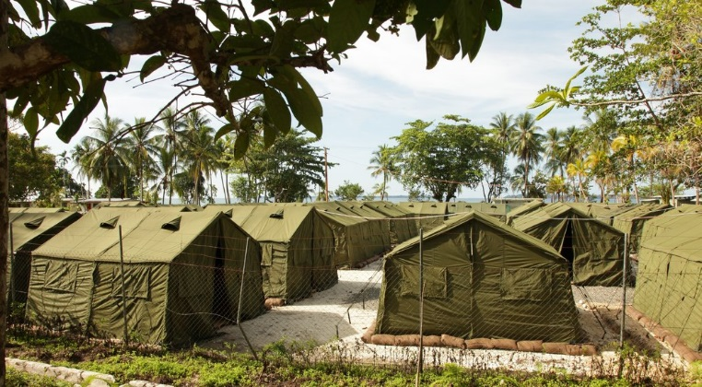
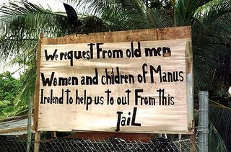
Offshore detention on Manus illegal
“I agree … that treating those required to remain in the relocation centre as prisoners irrespective of their circumstances or their status save only as asylum seekers, is to offend against their rights and freedoms as guaranteed by the various conventions on human rights at international law and under the PNG Constitution.
This position is aggravated by the lack of any Act of Parliament or a regulation promulgated under s. 23 of the Migration Act or any other law made for that purpose clearly specifying how the asylum seekers are to be treated, whilst having due regard to their rights and freedoms as guaranteed under the various international conventions and more so under the PNG Constitution.”
Namah v Pato (2016) SC 1497 [69] (Kandakasi J). On the closure of Manus Island RPC go here and on the costs of offshore processing go here

Slide 16
Consequences of unlawful detention on Manus?
Closure of detention centre (Oct 2017)
Class action for false imprisonment: Majid Kamasee v Commonwealth (2017)
Claim for negligence and false imprisonment (following PNG SC ruling) settled on 6 Sept 2017 with Supreme Court (Vic) ruling on compensation settlement agreement between the parties.
Settlement ($70M): government agrees to compensate detainees to avoid going to trial – go here.
Alternative perspectives on the payout:
Comment in the Sydney Morning Herald – go here
Australian government politicians response - go here

Slide 17
Legal responsibility for violations of international (human rights) law?
Legal responsibility under international law for human rights violations:
“Considering that this situation is purposely engineered by Australian authorities to serve as a deterrent for potential future unauthorized maritime arrivals (“we stopped the boats”), considering the incredible hardship that most of these asylum seekers and refugees have already endured in their countries of origin and in transit countries on their way to Australia, and considering that Australian authorities have been alerted to such serious issues by numerous reports from international organizations such as the United Nations and civil society organizations, Australia’s responsibility for the physical and psychological damage suffered by these asylum seekers and refugees is clear and undeniable.”
François Crépeau, Report of the Special Rapporteur on the Human Rights of Migrants on His Mission to Australia and the Regional Processing Centres in Nauru, UN Doc A/HRC/35/25/Add.3 (24 April 2017) pp 14-15.
“while Australia’s offshore detention share many characteristics with prisons and other closed institutions, offshore detention centres have unique features that further jeopardise the human rights of detainees.”
(Nethery and Holman, “Secrecy and human rights abuse in Australia’s offshore immigration detention centres” (2016) IJHR 1018,1023)

Slide 18
Violations of international human rights law?
Lack of transparency: Would-be scrutineers including various UN rapporteurs, human rights organisations, journalists, and advocates, faced a number of structural barriers to entering either Nauru or PNG
Parliamentary inquiries found that the RPC environments were unsafe generally—particularly for children—and regarded the mechanisms by which incidents were reported and investigated, to be inadequate
Damaging living environment and lack of autonomy: The ongoing use of tented accommodation in Nauru has been a source of sustained criticism over many years, particularly in relation to the lack of privacy, and the unsuitability of these facilities in such a humid climate
The allegations of abuse and neglect… are prevalent and sustained. They indicate that refugees and asylum seekers in RPCs are living in an unsafe environment. The causal nexus between this unsafe living environment, including instances of abuse and neglect, and corresponding widespread mental health problems and self-harm, is indisputable.
Inadequate health care and inadequate processes for medical transfers: as illustrated by Hamid Khazaei’s case (2014). Go here for the coroner’s report (30 July 2018).
Durable solution and effective protection? Strong evidence indicating that when the RPCs became ‘open centres’, the damaging living environment has not improved, and that refugees and asylum seekers became exposed to new risks
The Senate, Parliament of Australia, ‘Serious allegations of abuse, self harm and neglect of asylum seekers in relation to the Nauru Regional Processing Centre, and any like allegations in relation to Manus Island Processing Centre’ (21 April 2017)

Slide 19
Offshore processing, human rights abuses and the lived experience
“the overwhelming weight of evidence points to an environment that is not ‘adequate, appropriate or safe for the asylum seekers detained there’, characterised by poor facilities; neglect of medical welfare and educational needs of detainees; dehumanising treatment by staff; widespread mental illness and rates of self-harm; and pervasive physical and sexual abuse of detainees including children”
(Nethery and Holman, “Secrecy and human rights abuse in Australia’s offshore immigration detention centres” (2016) IJHR 1018,1032)
“This issue must be understood as the annihilation of human beings, the incarceration of human beings within the history of modern Australia; it is a long history, a comprehensive history, it is intertwined with its colonial history.”
Behrouz Boochani, “I write from Manus Island as a duty to history” 6 Dec 2017, The Guardian.
“Starvation, thirst and terror slowly but surely dominate the prison. Gradually these factors impose their power over the incarcerated refugees. Bodies are weak, muscles are fatigued, spirits are weary. It has been nearly five years full of anguish – anguish that has ground everyone down.”
Behrouz Boochani, “Manus is a landscape of surreal horror” (2 Nov 2017), The Guardian.

