Slide 1
Topic 5 – Planning marketing communications
Marketing Communications – MKT10723

Slide 2
Lecture outline
Understand the structure of a marketing communications plan
Identify and discuss communications objectives
Examine the different steps used in a marketing communications plan
Understand and identify the creative messages used in communication
Evaluate the effectiveness of a marketing communications plan

Slide 3
IMC Planning Starts at Zero
Zero-based planning:
A process that determines objectives and strategies based on current brand and marketplace conditions

Slide 4
Reasons for IMC Planning
Provides a Rational Process
Provides a Rational Process
Informs Everyone of Expectations
Informs Everyone of Expectations
IMC Planning Reasons
Ensures That the Program Is Integrated
Ensures That the Program Is Integrated
Helps Identify Budget
Helps Identify Budget
Creates a Benchmark for Measuring Results

Slide 5
Where it Fits in the Organisation
Corporate Level
Department Level
Mar Coms Level
Business Plan:
Focused on the profits and brand equity
Department Plan:
Marketing operations/ production, human resources
IMC plan:
Advertising, PR, sales promotion, direct marketing, digital marketing, personal selling and other strategies

Slide 6
What Are the 6 Steps in the Process?
Step 1: Identify Target Audiences
Step 1: Situation analysis
Step 2: Identify target markets
Step 2: Analyze SWOTs
Step 3: Determine Marketing Communication Objectives
Step 3: Determine MC Objectives
Step 4: Develop Strategies and Tactics
Step 4: Develop Strategies and Tactics
Step 5: Set the Budget
Step 5: Set the Budget
Step 6: Evaluate Effectiveness

Slide 7
1. Situation analysis
Company analysis
Competitor analysis
Consumer analysis
Market analysis
Product analysis
Opportunities and threats

Slide 8
2. Identify target markets
Segmentation
Targeting
Consumer markets:
Primary and secondary
Non customers, potential customers and existing customers groups
Trade markets
Retail markets (if required)

Slide 9
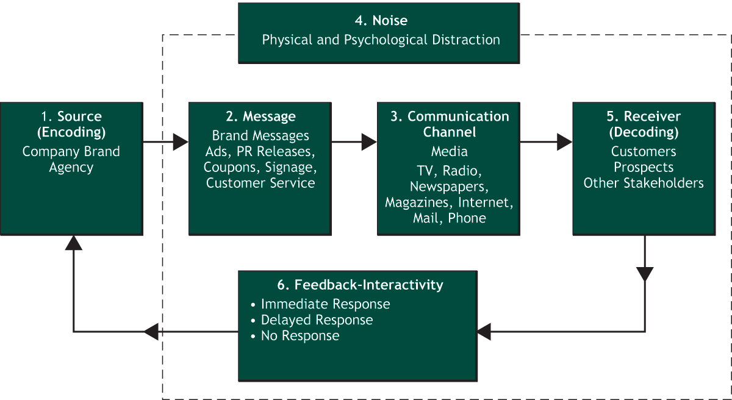
How Brand Communication Works

Slide 10
3. Determine objectives
Purchase Decision Stage vs Communication Effects

Slide 11
Purchase decision stage | Objective (or effect) | Example of use
Problem or need recognition | Need or category orientated | Need activation/reminder
Information search | Brand orientated | Brand awareness Brand attitude Brand differentiation Brand relevance
 | Socially orientated | Converse Connect Create Collaborate
Evaluation of alternatives | Pre-purchase orientated | Enquiries, retail visits, web search Purchase facilitation Form purchase intentions
Purchase | Purchase orientated | Trial Repeat purchase Amount purchased Frequency of purchase
Post purchase evaluation | Post-purchase orientated | Make recommendations (stimulate word of mouth) Ask for referrals - Encourage consumption

Slide 12
Step 4: Developing strategies and tactics
Phase 1: mediums
Phase 2: messages

Slide 13
Step 4: Developing strategies and tactics
Phase 1: mediums
Advertising
PR
Direct marketing
Personal selling
Digital marketing
Sales promotion
Others: ambush marketing, cause related marketing, sponsorship

Slide 14
Phase 2: Messages
Messages are always related to your positioning strategy.
Always keep your target market in mind
Notes:
Chapter 1
Using Advertising and Promotion to Build Brands
For use only with Duncan texts. © 2005 McGraw-Hill Companies, Inc. McGraw-Hill/Irwin

Slide 15
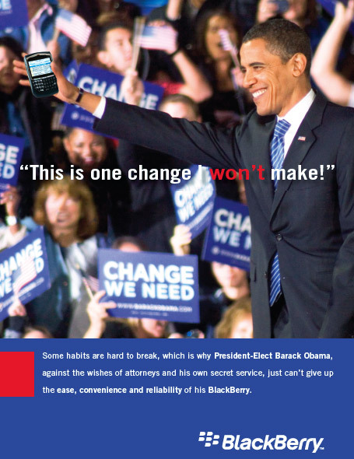
Notes:
Chapter 1
Using Advertising and Promotion to Build Brands
For use only with Duncan texts. © 2005 McGraw-Hill Companies, Inc. McGraw-Hill/Irwin

Slide 17
What messages do VB use?

Slide 18
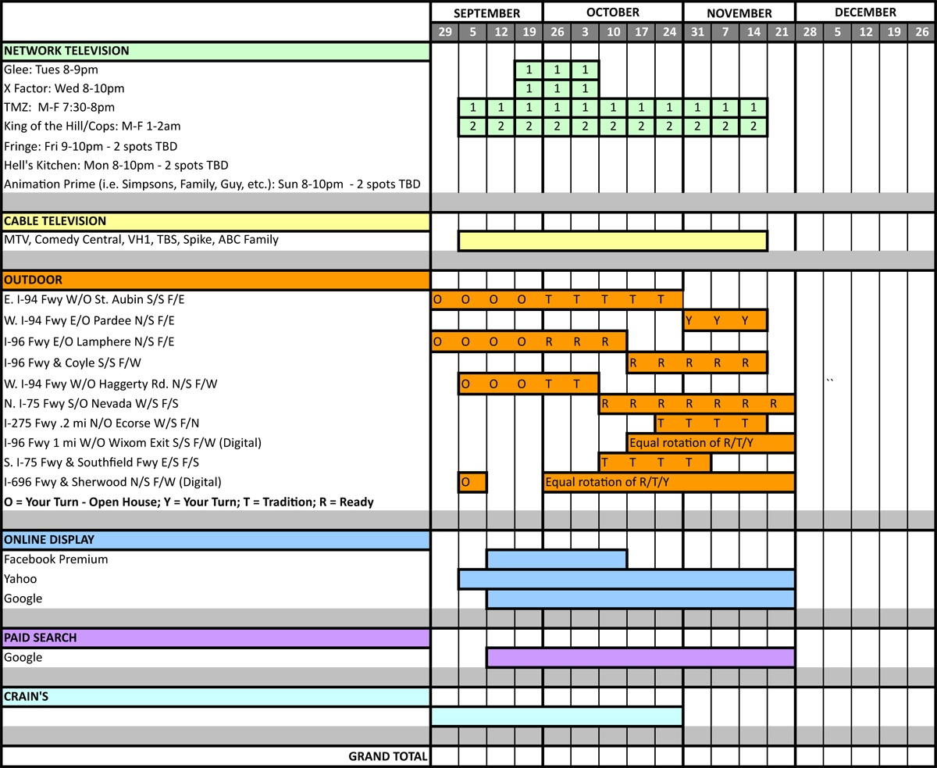

Slide 19
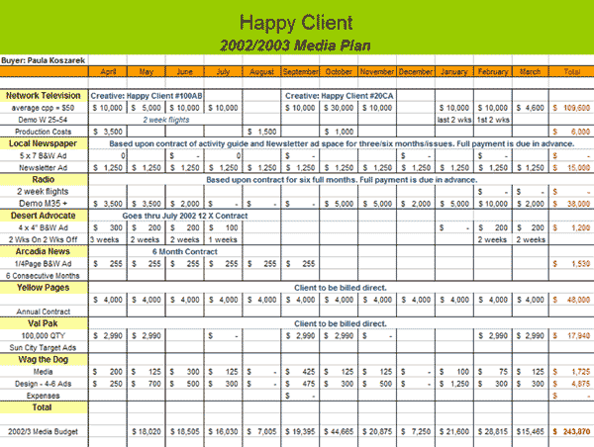

Slide 20
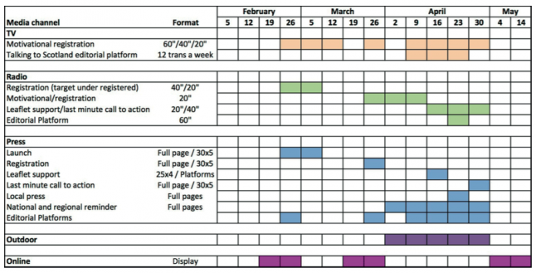

Slide 21
Step 5 measurement, evaluation, and effectiveness
Control
Evaluation

Slide 22
What Are the 6 Steps in the Process?
Step 1: Identify Target Audiences
Step 1: Situation analysis
Step 2: Identify target markets
Step 2: Analyze SWOTs
Step 3: Determine Marketing Communication Objectives
Step 3: Determine MC Objectives
Step 4: Develop Strategies and Tactics
Step 4: Develop Strategies and Tactics – 2 phases
Step 5: Set the Budget
Step 5: Set the Budget
Step 6: Evaluate Effectiveness

Slide 23
The marketing communications plan 1.0 Executive Summary 2.0 Situation analysis 2.1 Company analysis 2.2 Competitor analysis 2.3 Consumer analysis 2.4 Market and product analysis 2.5 Opportunities and threats 3.0 Target market profile 3.1 Consumer - primary, secondary 3.2 Trade (if required) 4.0 Objectives 4.1 Marketing objectives 4.2 Communication objectives 5.0 Positioning or brand strategy 6.0 Creative Strategy 6.1 Objectives 6.2 Strategy 6.3 Executions

Slide 24
7.0 Marketing communication strategy 7.1 Consumer 7.1.1 Advertising strategy 7.1.2 Sales promotion strategy 7.1.3 Public relations strategy 7.1.4 Direct marketing strategy 7.1.5 Digital strategy 7.1.6 Other strategies 7.2 Trade (IF REQUIRED) 7.2.1 Advertising strategy 7.2.2 Sales promotion strategy 7.2.3 Public relations strategy 7.2.4 Direct marketing strategy 7.2.5 Digital strategy 7.2.6 Other strategies 8.0 Action/media plan 8.1 Media selection 8.2 Reach, frequency 8.3 Human Resources 8.4 Timing 8.5 Budget 8.6 Control

