Slide 1


CHCDIV003
Manage and promote diversity
Lesson 4
Cultural dimensions and communication strategies
Notes:
1

Slide 2


Slide 3
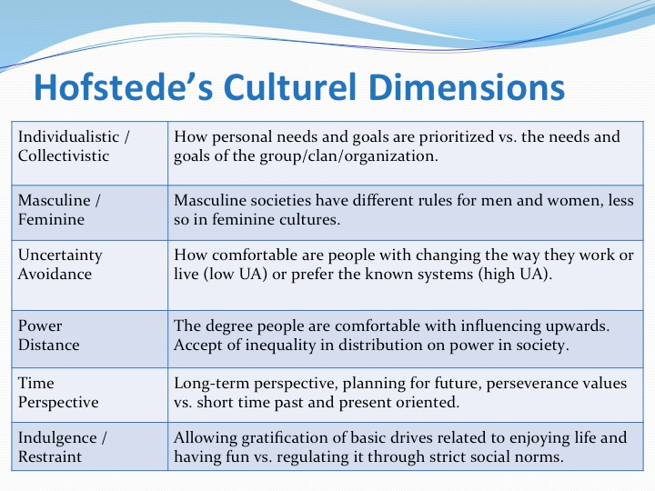

Slide 4
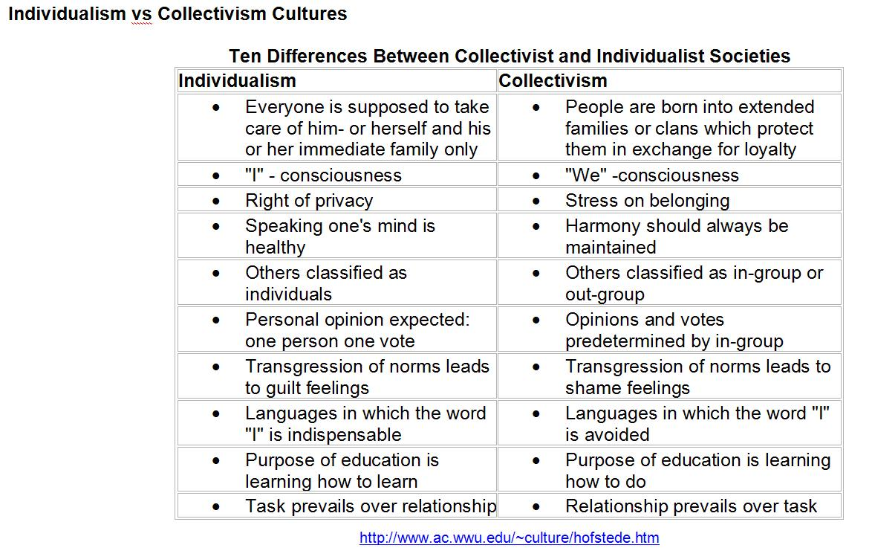

Slide 5
Give your country of birth and every other country you have lived in an estimated score between 1 - 100 for individualism

Slide 6
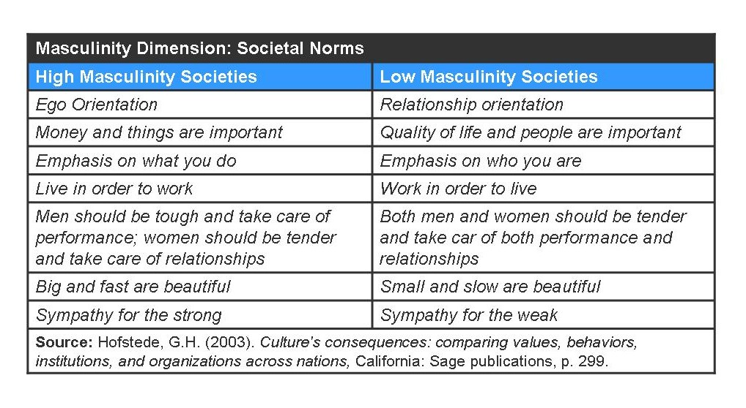

Slide 7
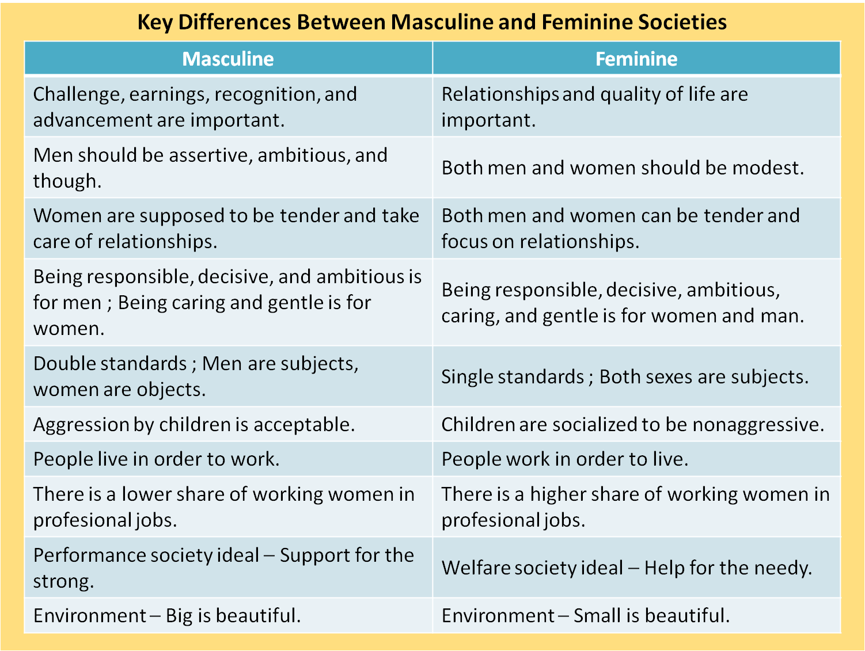

Slide 8
Give your country of birth and every other country you have lived in an estimated score between 1 - 100 for masculinity

Slide 9
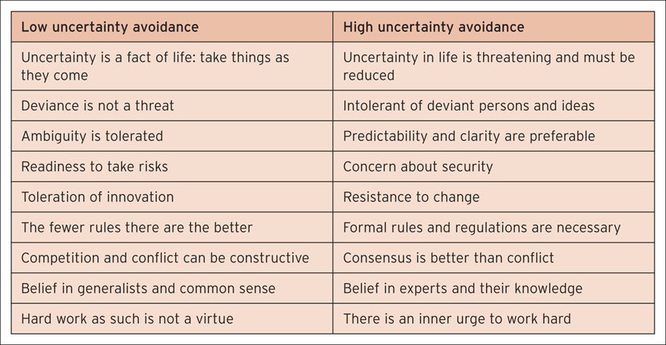

Slide 10
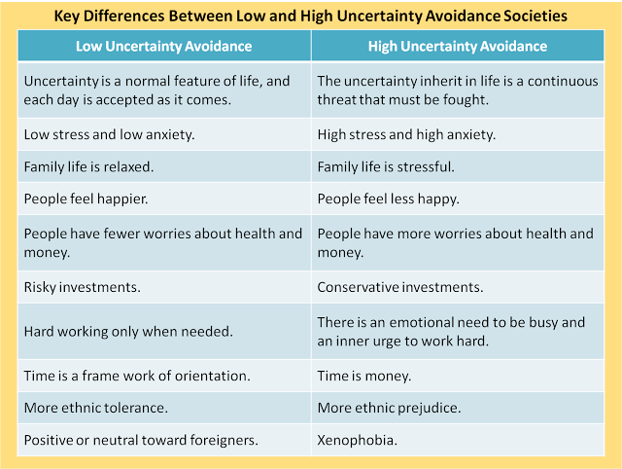

Slide 11
Give your country of birth and every other country you have lived in an estimated score between 1 - 100 for uncertainty avoidance.

Slide 12
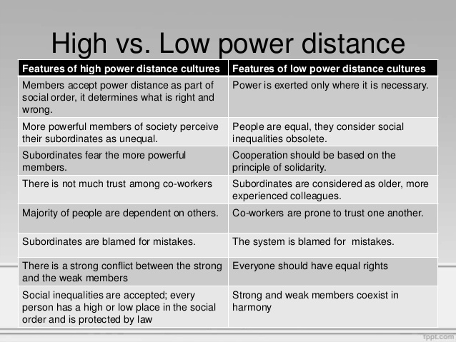

Slide 13
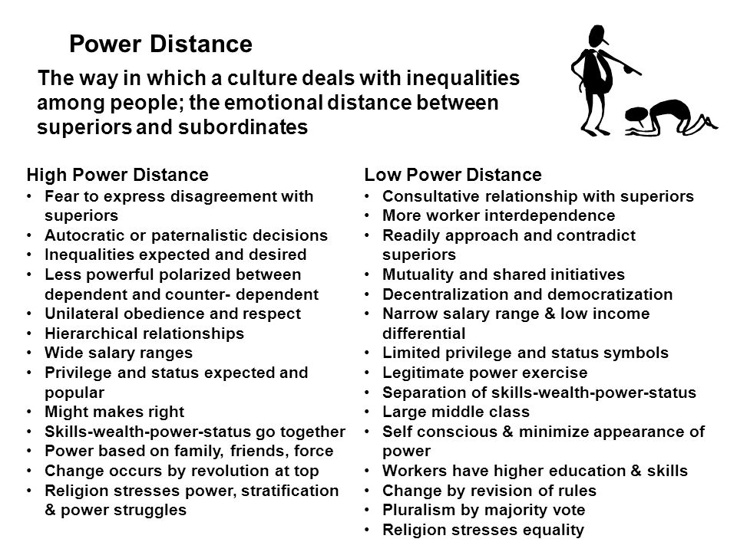

Slide 14
Give your country of birth and every other country you have lived in an estimated score between 1 - 100 for power distance

Slide 15
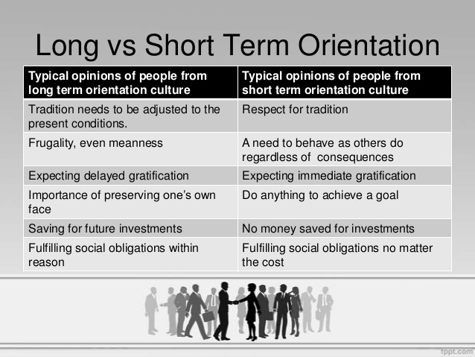

Slide 16
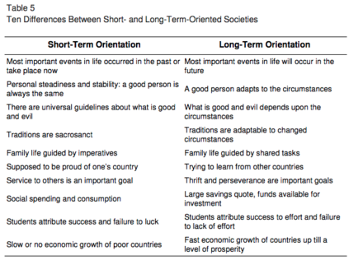

Slide 17
Give your country of birth and every other country you have lived in an estimated score between 1 - 100 for long term orientation

Slide 18
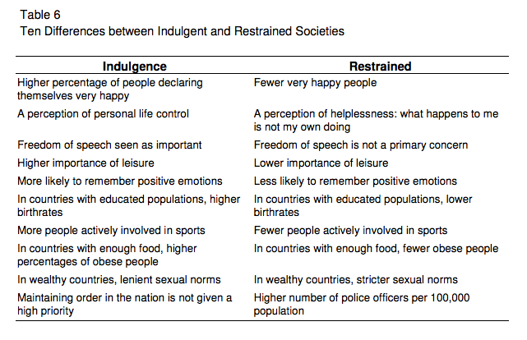

Slide 19
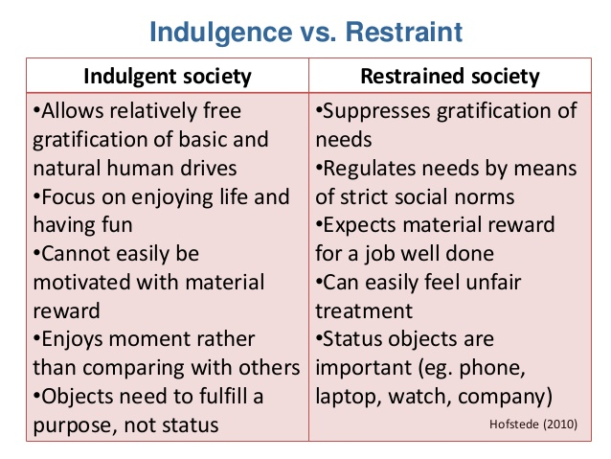

Slide 20
Give your country of birth and every other country you have lived in an estimated score between 1 - 100 for indulgence

Slide 21
Use this tool to see scores for cultural dimensions for all countries. Compares your estimates to the scores from the tool.
https://www.geert-hofstede.com/countries.html

Slide 22

Contribute to workplace diversity policies and procedures
4.1 Develop and document diversity strategies in consultation with stakeholders including people from key target groups
Notes:
22

Slide 23

Framework of legislation
The Australian Human Rights Commission Act
The Age Discrimination Act
The Sex Discrimination Act
The Racial Discrimination Act
The Racial Hatred Act
The Disability Discrimination Act
The Workplace Gender Equality Act 2012
The Fair Work Act and National Employment Standards (NES)
State-based anti-discrimination and WHS laws.

Slide 24

Establishing key result areas (KRAs)
Key result areas must possess three qualities – they must:
Be clear, specific and measurable
Be an activity important to the function of a business
Be something you have control over (in terms of outcome).

Slide 25

Stakeholders
Stakeholders may include:
Employees at all levels of the organization
Other government and non-government organizations
Union and association representatives
Boards of management
Government
Ministers
Community
Clients.

Slide 26

Consider:
Key target groups – ensure those from diverse backgrounds have their views heard when developing diversity strategy
Balancing stakeholder views with legal requirements
Taking stakeholder views into consideration.

Slide 27
Contribute to workplace diversity policies and procedures
4.2 Advocate for diversity strategies to be implemented in accordance with workplace policies and procedures
Notes:
27

Slide 28

Diversity issues and objectives
EEO issues
Different values
Resolving communication issues
Developing cultural competence
Negotiating commonalities
Resolving conflict
Negotiating difference.

Slide 29

Legislation
Workplace diversity guidelines
Policies relating to language services
Government diversity requirements
EEO requirements
Public sector ethics
Public sector management standards
Commissioner’s directions
Community guidelines
MOU
Two way flow of information and resources.

Slide 30
Contribute to workplace diversity policies and procedures
4.3 Develop measures for evaluating the outcomes of workplace strategies, policies and procedures for diversity
Notes:
30

Slide 31

Review diversity and inclusion practices
Your reviews may need to be conducted with:
Senior management/company directors
Department managers
Supervisors
Shift managers
Client/customer-facing personnel
Work teams
Employees.

Slide 32

Evaluations
Benchmarks
Impact assessment
Observation
Peer review
Well-being monitor.

Slide 33
Evaluation matrix
 | Observation | Benchmarks | Impact assessment | Well-being monitor
What was the quality of implementation? | ✓ | ✓
How far have the objectives been met? | ✓ |  | ✓
What other impacts have occurred? | ✓ |  | ✓ | ✓
What improvements could be made? | ✓ | ✓ | ✓ | ✓

Slide 34
Contribute to workplace diversity policies and procedures
4.4 Report on workplace diversity strategies within appropriate context
Notes:
34

Slide 35

Reporting on workplace diversity strategies
Reporting on workplace diversity strategies may involve:
Compiling a written report with evidence of results
Giving a presentation to the relevant personnel
Providing feedback to workgroup members.

Slide 36

Appropriate context
Context of specific interactions
Did the period of evaluation allow for all aspects of the diversity strategy to be observed?
The possibility of bias in feedback
Support for staff in implementing diversity policy.

