Slide 1


CHCDIV003
Manage and promote diversity
Lesson 3 cross-cultural communication

Slide 2

Adapt communication strategies
3.1 Use communication strategies to meet the diverse needs of individuals within the workplace

Slide 3
Introduction
https://www.youtube.com/watch?v=UTE0G9amZNk
https://www.youtube.com/watch?v=SkBXaKfxl7Y

Slide 4
Question 1
What is the ‘iceberg model’ in regards to intercultural communication?

Slide 5
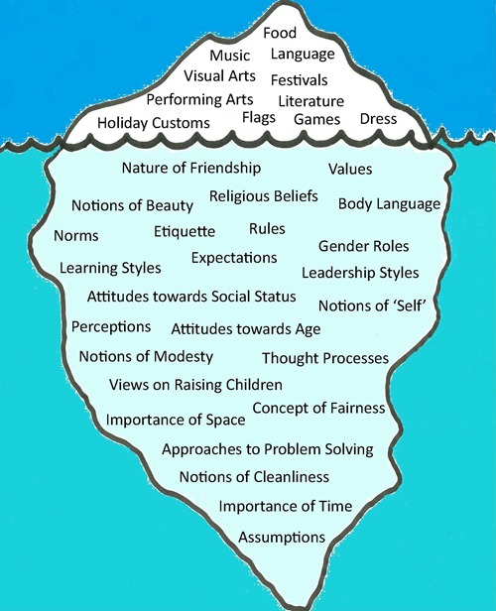

Slide 6
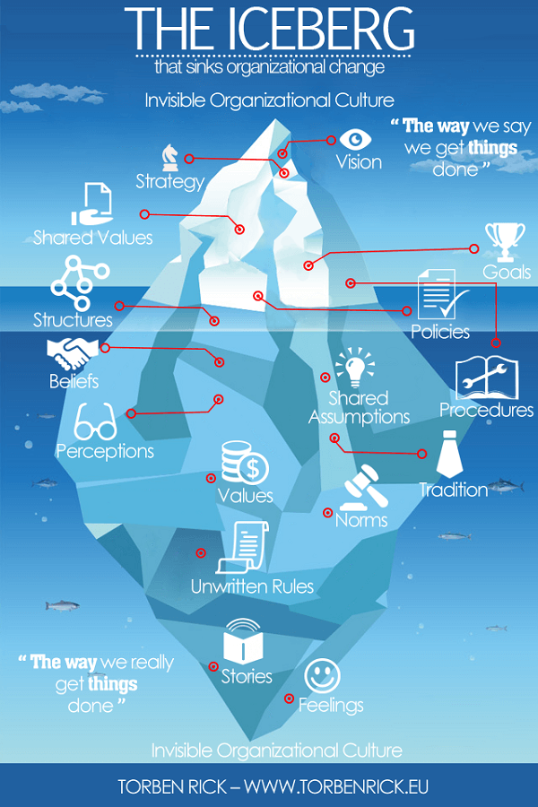

Slide 7
It is important to realize that a basic understanding of cultural diversity is the key to effective cross-cultural communications.
Without necessarily studying all individual cultures and languages in detail, we must learn how to better communicate with individuals and groups whose first language, or language of choice, is different from our own.

Slide 8
Six fundamental patterns of cultural differences
Communication styles
Attitudes towards conflict
Approaches to completing tasks
Decision making styles
Attitudes toward disclosure
Attitudes towards knowing

Slide 9
1. Communication styles
One aspect of communication style is language usage. Across cultures, some words and phrases are used in different ways.
Another major aspect of communication style is the degree of importance given to non-verbal communication. Non-verbal communication includes not only facial expressions and gestures, it also involves seating arrangements, personal distance, and sense of time.
In addition, different norms regarding the appropriate degree of assertiveness in communicating can add to cultural misunderstandings.

Slide 10
2. Attitudes to conflict
Some cultures view conflict as a positive thing, while others view it as something to be avoided.
Face-to-face meetings customarily are recommended as the way to work through whatever problems exist.
In contrast, in many Eastern countries, open conflict is experienced as embarrassing or demeaning, as a rule, differences are best worked out quietly. A written exchange might be the favoured means to address the conflict.

Slide 11
3. Completing tasks
From culture to culture, there are different ways that people move towards completing tasks. Some reasons include different access to resources, different judgments of the rewards associated with task completion, different notions of time, and varied ideas about how relationship-building and task-oriented work should go together.
When it comes to working together effectively on a task, cultures differ with respect to the importance placed on establishing relationships early on in the collaboration. This does not mean that people from any cultural backgrounds are more or less committed to accomplishing the task or value relationships more or less, it means they may pursue them differently.

Slide 12
4. Decision making
The roles individuals play in decision-making vary widely from culture to culture. Be aware that individuals' expectations about their own roles in shaping a decision may be influenced by their cultural frame of reference.
For example, in the U.S., decisions are frequently delegated. An official assigns responsibility for a particular matter to a subordinate. In many Southern European and Latin American countries, there is a strong value placed on holding decision-making responsibilities oneself.
When decisions are made by groups of people, majority rule is a common approach in the U.S.; in Japan consensus is the preferred mode.

Slide 13
5. Disclosure
In some cultures, it is not appropriate to be frank about emotions, about the reasons behind a conflict or a misunderstanding, or about personal information.
When you are dealing with a conflict, be mindful that people may differ in what they feel comfortable revealing. Questions that may seem natural to you -- What was the conflict about? What was your role in the conflict? What was the sequence of events? -- may seem intrusive to others.
The variation among cultures in attitudes toward disclosure is also something to consider before you conclude that you have an accurate reading of the views, experiences, and goals of the people with whom you are working.

Slide 14
6. Knowing
Notable differences occur among cultural groups when it comes to epistemologies -- that is, the ways people come to know things. European cultures tend to consider information acquired through cognitive means, such as counting and measuring, more valid than other ways of coming to know things.
Compare that to African cultures' preference for affective ways of knowing, including symbolic imagery and rhythm. Asian cultures tend to emphasize the validity of knowledge gained through striving toward transcendence.
Some members of your group may want to do library research to understand a shared problem better and identify possible solutions. Others may prefer to visit places and people who have experienced challenges like the ones you are facing, and get a feeling for what has worked elsewhere.

Slide 15
Question 2
Write down 3 keywords for yourself in regards to how you go about each of the 6 patterns and discuss with your classmates.
Communication style
Attitude towards conflict
Approach to completing tasks
Decision making style
Attitude toward disclosure
Attitude towards knowing

Slide 16
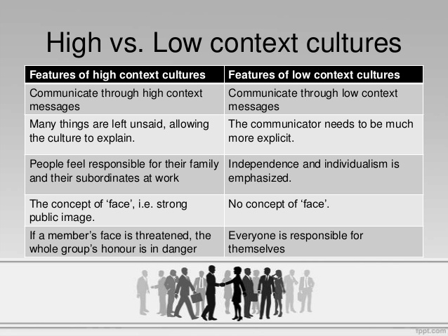

Slide 17
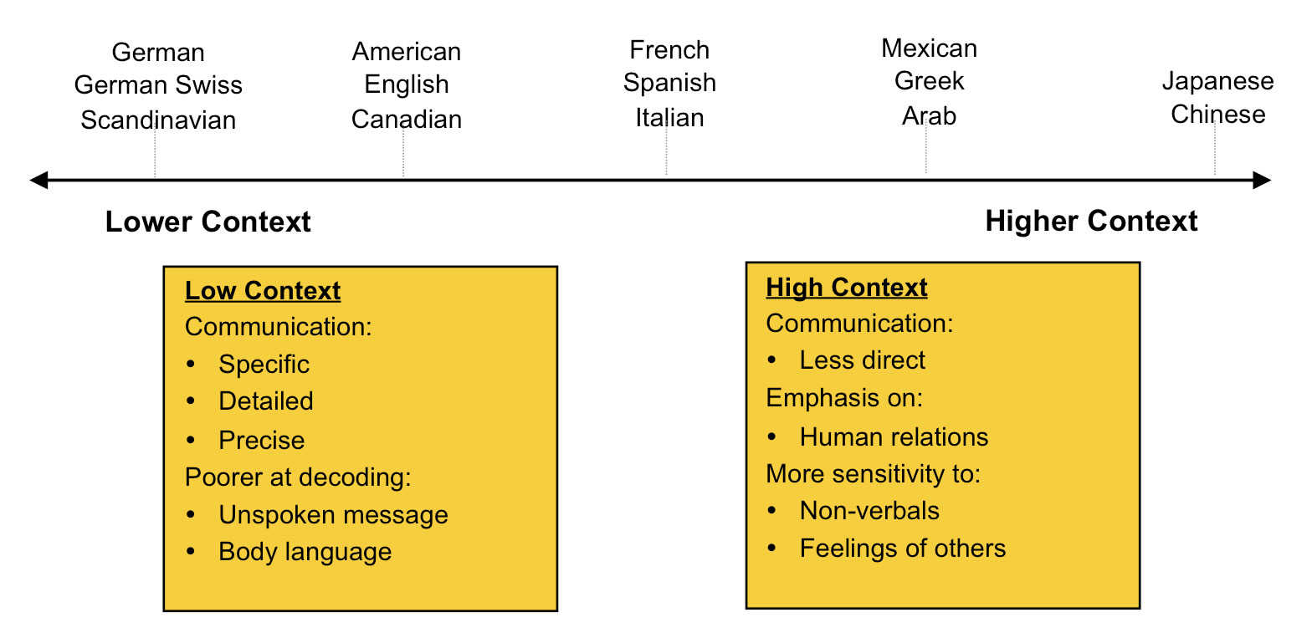

Slide 18
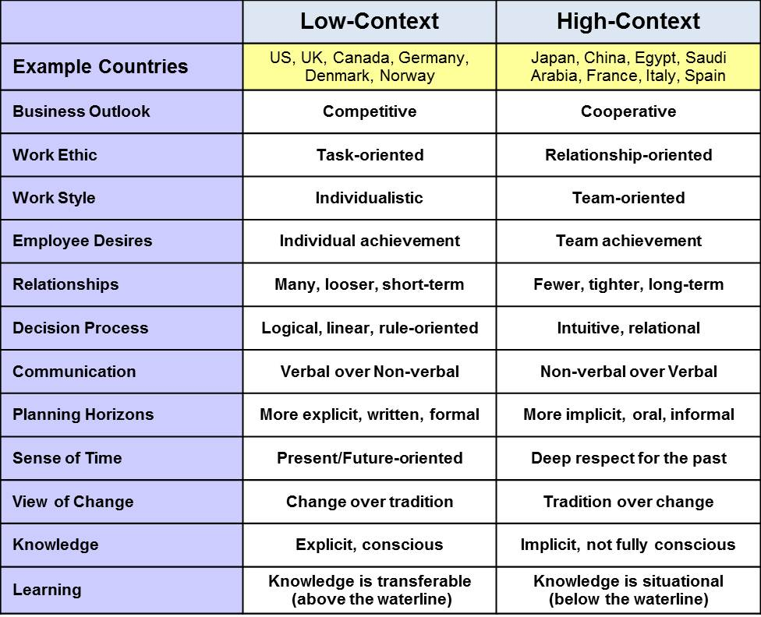

Slide 19
Question 3
Which of the low-context or high context traits do you identify with? Name 5. Did you name more high-context of low context traits?

Slide 20
High context vs low context
https://www.youtube.com/watch?v=9oYfhTC9lIQ

Slide 21
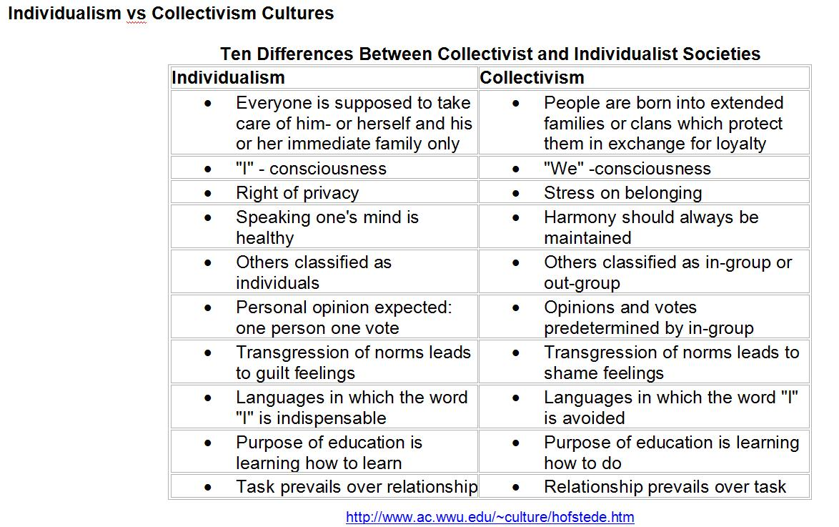

Slide 22
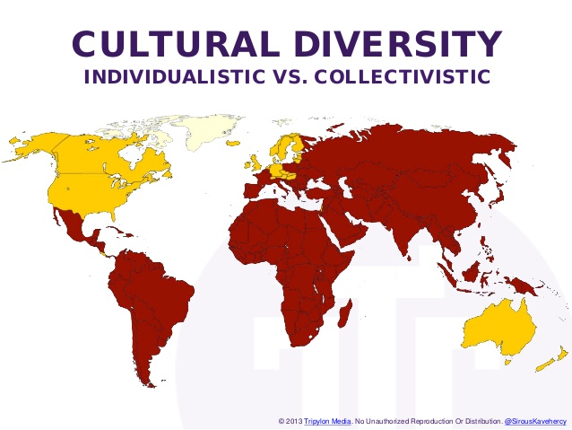

Slide 23
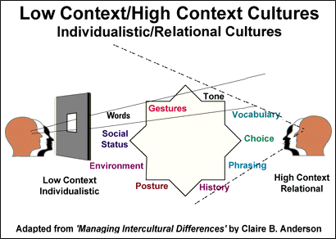

Slide 24
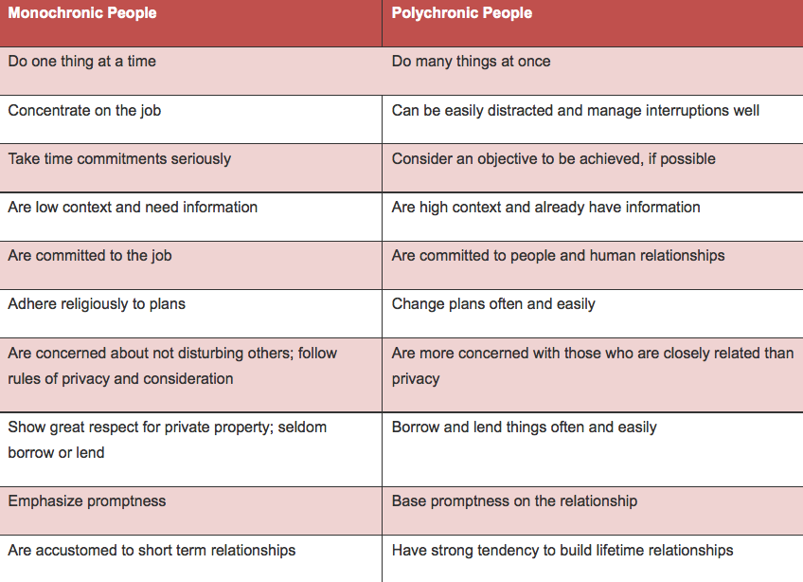
Concepts of time.

Slide 25

Contents of a communication strategy
A statement of purpose
Current situation
Objectives
Stakeholders
Information to be communicated
How to communicate information
Work plan.

Slide 26

Meeting objectives according to diverse needs
This may involve:
Making use of translation tools and/or interpreters
Providing suitable materials
Using language and behaviour that is culturally/age/gender appropriate, etc.

Slide 27
Adapt communication strategies
3.2 Implement tailored communication strategies for targeted individual and group needs

Slide 28
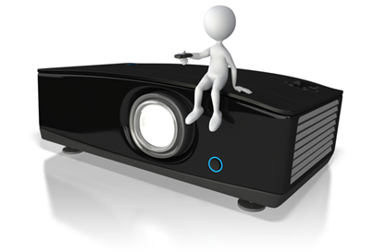
Communication styles
Visual
Auditory
Kinaesthetic.

Slide 29
Body language around the world
https://www.youtube.com/watch?v=IQuFNvkPjik

Slide 30

Communication style requirements
Use of plain English
Simple sentence structure
Lack of jargon and acronyms
Reader-friendly layout
Effective paragraphing
Catering for different language requirements
Interpreting and translating
Use of different media e.g. online, visual media.

Slide 31
Adapt communication strategies
3.3 Identify and/or develop and use resources that facilitate effective communication in the workplace

Slide 32
Question 4
How would you describe your own body language? Do you feel like it matches your culture?

Slide 33

Resources that facilitate effective communication
Newsletters
Intranet
Websites
Information sheets
Booklets
Adapted materials, e.g. large font
Translation software.

Slide 34

Interactive communication methods
Staff networks
Group meetings
Databases
Organisational IM (Instant Messenger) system
Log books, etc.

Slide 35

Developing resources
Identify issues, e.g. language barriers, physical impairment
Develop resources to overcome these barriers
Organisational and governmental materials can provide guidance on accessing resources.

Slide 36
Adapt communication strategies
3.4 Reflect on use of communication strategies with regard to workplace diversity and identify potential improvements

Slide 37
TED- survival guide to cross-communication
https://www.youtube.com/watch?v=aa2LX6l31rg

Slide 38
Question 5
After watching this lecture, what tips would you give another Community Services worker in regards to cross cultural communication?

Slide 39
Tips for cross-cultural communication

Slide 40
Learn from generalizations about other cultures, but don't use those generalizations to stereotype, "write off," or oversimplify your ideas about another person.
The best use of a generalization is to add it to your storehouse of knowledge so that you better understand and appreciate other interesting, multi-faceted human beings.

Slide 41
Practice, practice, practice.
It's in the doing that we actually get better at cross-cultural communication.

Slide 42
Don't assume that there is one right way (yours!) to communicate.
Keep questioning your assumptions about the "right way" to communicate.
For example, think about your body language; postures that indicate receptivity in one culture might indicate aggressiveness in another.

Slide 43
Don't assume that breakdowns in communication occur because other people are on the wrong track.
Search for ways to make the communication work, rather than searching for who should receive the blame for the breakdown.

Slide 44
Listen actively and empathetically. Try to put yourself in the other person's shoes.
when another person's perceptions or ideas are very different from your own, you might need to operate at the edge of your own comfort zone.

Slide 45
Respect others' choices about whether to engage in communication with you.
Honour their opinions about what is going on.

Slide 46
Stop, suspend judgment, and try to look at the situation as an outsider.

Slide 47
Remember that cultural norms may not apply to the behaviour of any particular individual.
We are all shaped by many, many factors -- our ethnic background, our family, our education, our personalities -- and are more complicated than any cultural norm could suggest.
Check your interpretations if you are uncertain what is meant.

