Slide 1


CHCDIV003
Manage and promote diversity
PPT 1
Research diversity in the workplace
Notes:
1

Slide 2
Objectives
Discover how to research diversity in the workplace
Know how to foster diversity
Learn how to adapt communication strategies
Understand how to contribute to workplace diversity policies and procedures
Gain the skills and knowledge required for this unit

Slide 3

Research diversity in the workplace
1.1 Collect and evaluate quantitative and qualitative workplace diversity data
Notes:
3

Slide 4
Question 1
Mind map
Make a mind map around ‘areas of diversity’
Southern Cross Education Institute
4

Slide 5

Key areas of diversity
Age
Educational level
Ethnicity
Culture
Gender
Marital status
Physical ability
Religious belief
Sexual orientation
Socio-economic background.
Work/ life balance.

Slide 6

Qualitative and quantitative data
Quantitative data:
Numerical
Statistical
Objective.
Qualitative data:
Emotional
Personal
Subjective.

Slide 7
Qualitative vs quantitative
https://www.youtube.com/watch?v=bCuwX35MHyE
Southern Cross Education Institute
7

Slide 8
Question 2
Match the following words with either qualitative or quantitative data:
Objective
Numerical
Case study
Survey
Opinion
Scientific experiments
Personalised interpretations
Subjective
Interviews
Measured
Descriptive
Southern Cross Education Institute
8

Slide 9

Metrics for diversity
Percentage of minorities, EEO targets
Representation of minorities at different levels within the organisation
Employee satisfaction surveys
Number of discrimination grievances and complaints
Total findings of discrimination by adjudicators and government agencies.

Slide 10
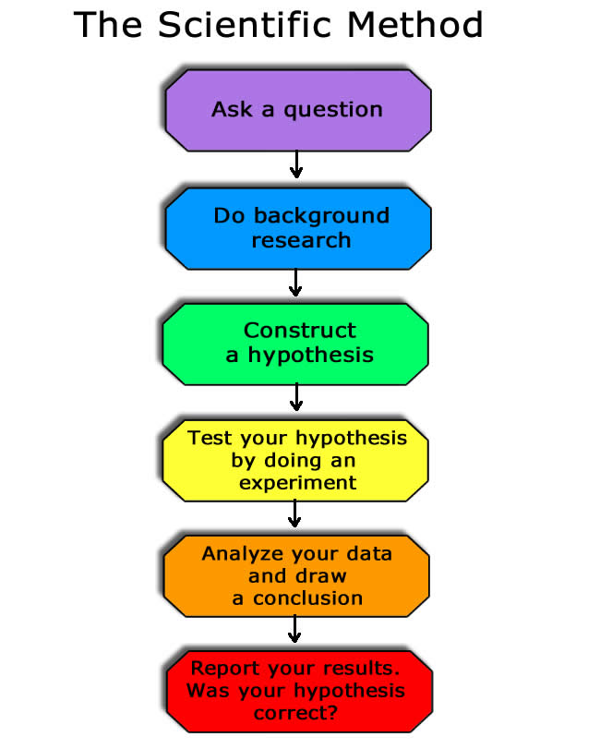
Southern Cross Education Institute
10

Slide 11
The scientific method
https://www.youtube.com/watch?v=SMGRe824kak
Southern Cross Education Institute
11

Slide 12
Question 3
Think of an example where you have recently used the scientific method in your life.
Southern Cross Education Institute
12

Slide 13
Scientific method song.
https://www.youtube.com/watch?v=KIFz_-KzURY
Southern Cross Education Institute
13

Slide 14
Question 4
In what way is the scientific method related to Community services?
Southern Cross Education Institute
14

Slide 15
Research diversity in the workplace
1.2 Identify and analyse potential benefits of diversity in relation to the workplace objectives
Notes:
15

Slide 16

Workplace objectives
Workplace objectives are your organisation’s ultimate goals and desired work outcomes
Diversity can be hugely beneficial in the realisation of workplace objectives, as a diverse workforce can offer a variety of skills and expertise that a restricted workforce might not be able to provide.

Slide 17
Question 5
Think of a situation in which diversity in the workplace can help achieving workplace objectives.
Southern Cross Education Institute
17

Slide 18

Benefits of diversity
The benefits of a diverse workforce may include:
Improved service delivery
Promotion of equity and fairness
Improved access for clients from diverse backgrounds to government services and programs
Improved relationship with the community
Wider sources of recruitment
Cultural enrichment.

Slide 19
Benefits of diversity
https://www.youtube.com/watch?v=_tGjgRwgAeo
(Australia post)
https://www.youtube.com/watch?v=05-H96tmQs0
https://www.youtube.com/watch?v=2XbeJotW16E
Southern Cross Education Institute
19

Slide 20
Question 6
Think of a benefit of having a diverse class of students.
Southern Cross Education Institute
20

Slide 21
Research diversity in the workplace
1.3 Analyse how current diversity practice matches workplace objectives
Notes:
21

Slide 22

Diversity practice
Diversity practice is how the values of diversity are applied in the workplace
Diversity practice can relate to workplace objectives in a number of ways, such as ensuring that the organisation meets the objectives set out in its Mission, Vision and Values statement.

Slide 23

Matching diversity practice and workplace objectives
Matching diversity practice and workplace objectives might involve:
Drawing links between diversity practice and organisational goals and values
Identifying any diversity plan(s) in place
Gathering information about current diversity practice.

Slide 24
Diversity in the workplace
The surprising solution to workplace diversity
https://www.youtube.com/watch?v=mtUlRYXJ0vI
Southern Cross Education Institute
24

Slide 25
Question 7
Summarize the video in your own words. Discuss with your classmates.
Southern Cross Education Institute
25

Slide 26

Analysing diversity practice
Analysing diversity practice and how it matches workplace objectives might involve:
Evaluating how well the organisation is meeting the objectives of any diversity plan(s) in place
Gathering and analysing data relating to diversity practice
  quantitative
  qualitative.

Slide 27
You can’t ask that - transgender
http://iview.abc.net.au/programs/you-cant-ask-that/LE1517H003S00
Southern Cross Education Institute
27

