Slide 1

International Commercial Litigation
Law011-6
Induction
Dr Crina Baltag

Slide 2
International Commercial Litigation
__________________________________________________________________________________________________________________________________________________________________
Dr Crina Baltag, Senior Lecturer in Law, crina.baltag@beds.ac.uk, Room H209, Mondays: 09:00-10:00 & Tuesdays: 9:00-10:00
Weeks 1&2 and 4&5: teaching/guided learning
Weeks 3&6: assignments

Slide 3
International Commercial Litigation – Course Description
__________________________________________________________________________________________________________________________________________________________________
When business is transacted across national boundaries, special kinds of legal problems are likely to arise. If a dispute arises between the parties, it cannot be assumed that English courts will decided a case which has a foreign element in the same way it would decide a case which is connected only with England. In cases with foreign connections, three questions arise: first, does the English court have jurisdiction to hear the case; second, which law should an English court apply to the dispute between the parties; and third if a dispute is resolved abroad can one of the parties have the decision of the foreign tribunal recognised and enforced in England?
The aim of this unit is to give you a thorough grounding in both traditional common law rules and rules derived from International Conventions to which the UK is a party that relate to International Commercial Ligation. On completing this unit, you will be able to identify and fully understand the factors which may justify the exercise of jurisdiction by the English court; the elements which may help determine whether the English court should apply its own law or the law of a foreign country; and the considerations which may justify an English court in giving effect to a foreign judgment in England. Through a combination of teaching, case studies and critical appraisal, you will be kept abreast of current developments in this dynamic area of law. An increasingly relevant area for International Commercial Litigation is the energy law, with the rise of contentious matters in the in the past years as a result of the increased liberalisation of markets. Large projects in the energy field usually generate disputes related to costs, warranties or performance or termination of contracts, as well as environmental related claims (see the oil pollution liability in offshore petroleum industry after the Macondo spill).
Topics to be covered: Introduction to International Commercial Litigation; Jurisdiction of English Courts: persons who can/cannot be sued; Jurisdiction of English Courts: bases of jurisdiction; Jurisdiction of the English Courts: staying proceedings; Provisional measures and anti-suit injunctions; Choice of law in tort and choice of law in contract; International Commercial Litigation and Energy Law: particularities, applicable conventions; Recognition and enforcement of foreign judgments concluding observations.

Slide 4
International Commercial Litigation – Assessments
__________________________________________________________________________________________________________________________________________________________________
Assessment 1 (40%) will be a research essay of up to 2,500 words on a topical issue relating to recent case law or to the interpretation of a new legal instrument. All formally assessed work will be checked via Turnitin.
Assessment 2 (60%) will be a 15-minute oral presentation, defending your opinion as the Advocate General of the CJEU. As part of this assessment, you will be expected to submit a “skeleton” of your opinion a week before the presentation. The skeleton will account for 10% of the total grade for Assessment 2; the presentation will account for the remaining 90%.

Slide 5
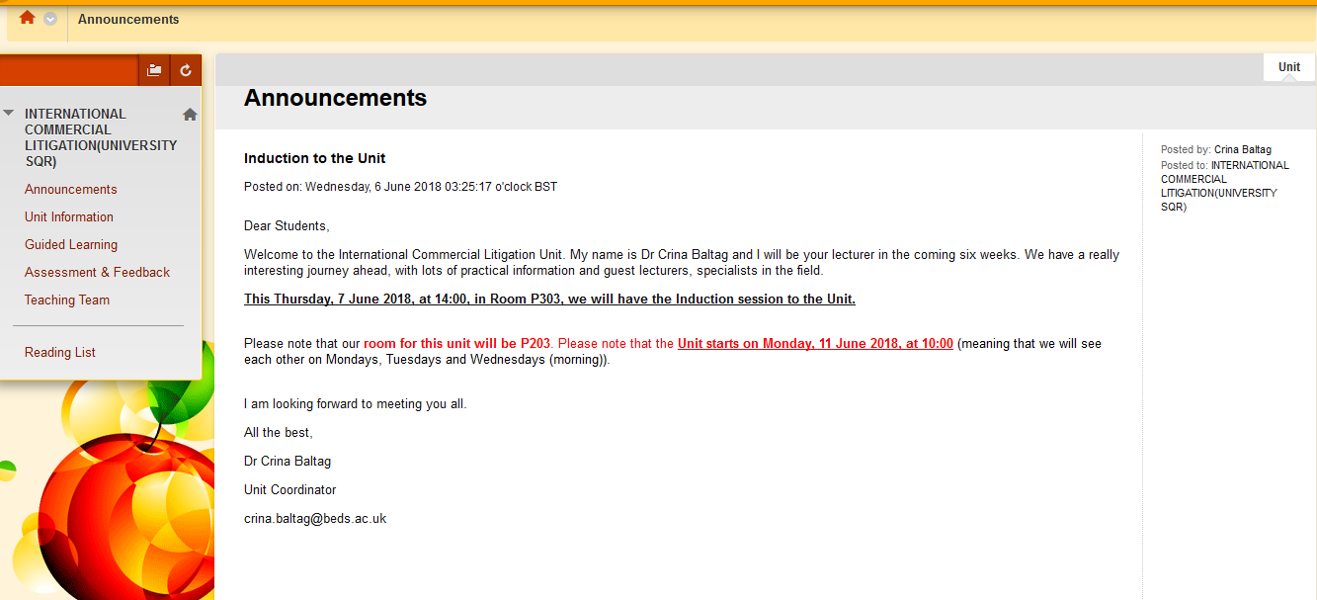
International Commercial Litigation – BREO
__________________________________________________________________________________________________________________________________________________________________

Slide 6
International Commercial Litigation – Key Contacts
__________________________________________________________________________________________________________________________________________________________________
Dr Crina Baltag
crina.baltag@beds.ac.uk
Room: H209
SID
sid@beds.ac.uk or
Luton, Campus Centre, G Block Levels 1 and 2
Level 1 open: 9.00 - 18.00 Monday to Friday
Level 2 open: 9.00 - 17.00 Monday to Friday

