Slide 1
Introduction to Industry Analysis
FINM014
Dr Xun Lei

Slide 2
Chapter 21 Macroeconomic and Industry Analysis
Chapter 22 Equity Valuation Models

Slide 3
Types and Characteristics of Equity Securities
Common Shares
Common shares represent an ownership interest in a company and are the predominant type of equity security.
Common shareholders share participate in the governance process through voting rights.
Companies may choose to pay out some or all of their net income in the form of cash dividends to common shareholders, but they are not contractually obligated to do so.
Preference Shares
Preference shares rank above common shares with respect to the payment of dividends and the distribution of the company’s net assets upon liquidation.
Generally do not have any voting rights.

Slide 4
Return Characteristics of Equity Securities
There are two main sources of equity securities’ total return: price change (or capital gain) and dividend income.
Therefore, an equity security’s total return is calculated as:

Slide 5
Risk of Equity Securities
The risk of any security is based on the uncertainty of its future cash flows.
Risk is most often measured by calculating the standard deviation of the equity’s expected total return.
The type of equity security, as well as its characteristics, affects the uncertainty of its future cash flows and therefore its risk.
In general, preference shares are less risky than common shares.
With common shares, however, a larger portion of shareholders’ total return (or all of their total return for non-dividend shares) is based on future price appreciation and future dividends are unknown.

Slide 6
Basics of Industry Analysis
Industry analysis is the analysis of a specific branch of manufacturing, service, or trade. Related to following questions:
What are the similarities and differences among industry classification systems?
How does an analyst go about choosing a peer group of companies?
What are the key factors to consider when analyzing an industry?
What advantages are enjoyed by companies in strategically well-positioned industries?
Uses of Industry Analysis:
Understanding a company’s business and business environment
Identifying active equity investment opportunities
Portfolio performance attribution

Slide 7
Approaches to Identifying Similar Companies
Industry classification attempts to place companies into groups on the basis of commonalities.
Major approaches to industry classification:
Products and/or services supplied
Business-cycle sensitivities
Statistical similarities

Slide 8
Approach 1: Products and/or services supplied
Modern classification schemes are most commonly based on grouping companies by similar products and/or services.
An industry is defined as a group of companies offering similar products and/or services. For example, some of the large players in the global automobile industry are Toyota, General Motors, Volkswagen, Ford, Honda, Nissan, PSA Peugeot Citroën, etc.
The term sector is often used to refer to a group of related industries. For example, the health care sector include the pharmaceutical, biotechnology, medical device, medical supply, hospital, and managed care industries.
These classification schemes typically place a company in an industry on the basis of a determination of its principal business activity.
Many classification systems based on this approach, like the Global Industry Classification Standard (GICS), Russell Global Sectors (RGS), and Industry Classification Benchmark.

Slide 9
Approach 2: Business-Cycle Sensitivities
Companies are sometimes grouped on the basis of their relative sensitivity to the business cycle. This method often results in two broad groupings of companies—cyclical and non-cyclical.
A cyclical company is one whose profits are strongly correlated with the strength of the overall economy. Examples of cyclical industries are autos, housing, basic materials, industrials, and technology.
A non-cyclical company is one whose performance is largely independent of the business cycle. Examples of non-cyclical industries are food and beverage, household and personal care products, health care, and utilities.

Slide 10
Approach 3: Statistical Similarities
Statistical approaches to grouping companies are typically based on the correlations of past securities’ returns. For example, companies can be separated (on the basis of historical correlations of stock returns) into groups in which correlations are relatively high but between which correlations are relatively low.
This method of aggregation often results in non-intuitive groups of companies, and the composition of the groups may vary significantly by time period and region of the world.
Moreover, statistical approaches rely on historical data, but analysts have no guarantee that past correlation values will continue in the future.

Slide 11
Industry Classification Systems
Major index providers, including Standard & Poor’s, MSCI Barra, Russell Investments, Dow Jones, and FTSE, classify companies in their equity indices into industry groupings. For example:
Global Industry Classification Standard (GICS) was jointly developed by Standard & Poor’s and MSCI Barra in 1999.
The Russell Global Sectors (RGS) classification system uses a three-tier structure to classify companies globally on the basis of the products or services a company produces.
The Industry Classification Benchmark (ICB), which was jointly developed by Dow Jones and FTSE, uses a four-tier structure to categorize companies globally on the basis of the source from which a company derives the majority of its revenue.
Other governmental industry classification systems…

Slide 12
Constructing a Peer Group
A peer group is a group of companies engaged in similar business activities whose economics and valuation are influenced by closely related factors.
Steps in constructing a preliminary list of peer companies:
Examine commercial classification systems. These systems often provide a useful starting point for identifying companies operating in the same industry.
Review the subject company’s annual report for a discussion of the competitive environment. Companies frequently cite specific competitors.
Review competitors’ annual reports to identify other potential comparable companies.
Review industry trade publications to identify comparable companies.
Confirm that each comparable company derives a significant portion of its revenue and operating profit from a business activity similar to the primary business of the subject company.

Slide 13
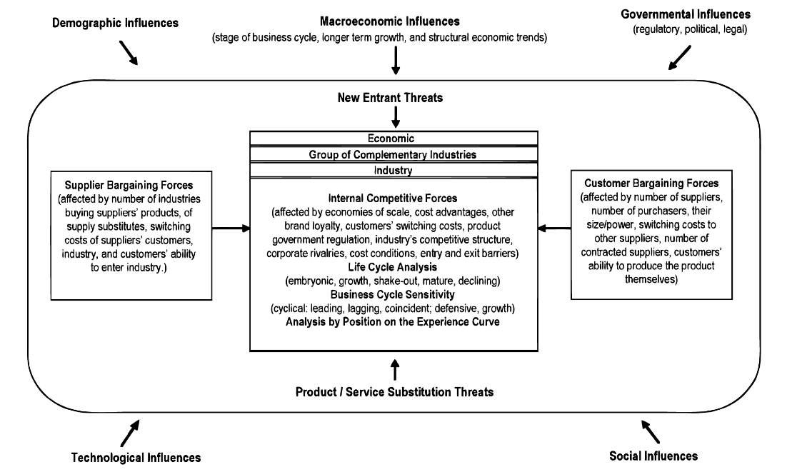
A Framework for Industry Analysis

Slide 14
Principles of Industry Analysis
Barriers to Entry
What are the barriers to entry? Is it difficult or easy for a new competitor to challenge incumbents? Relatively high (low) barriers to entry imply that the threat of new entrants is relatively low (high).
Industry Concentration
How concentrated is the industry? Do a small number of companies control a relatively large share of the market, or does the industry have many players, each with a small market share?
Industry Capacity
What are capacity levels? That is, based on existing investment, how much of the goods or services can be delivered in a given time frame? Does the industry suffer chronic over- or under-capacity, or do supply and demand tend to come into balance reasonably quickly in the industry?

Slide 15
Principles of Industry Analysis (cont’d)
Market Share Stability
How stable are market shares? Do companies tend to rapidly gain or lose share, or is the industry stable?
Industry Life Cycle
Where is the industry in its life cycle? Does it have meaningful growth prospects, or is demand stagnant/declining? (More details in next slide)
Price Competition
How important is price to the customer’s purchase decision?

Slide 16
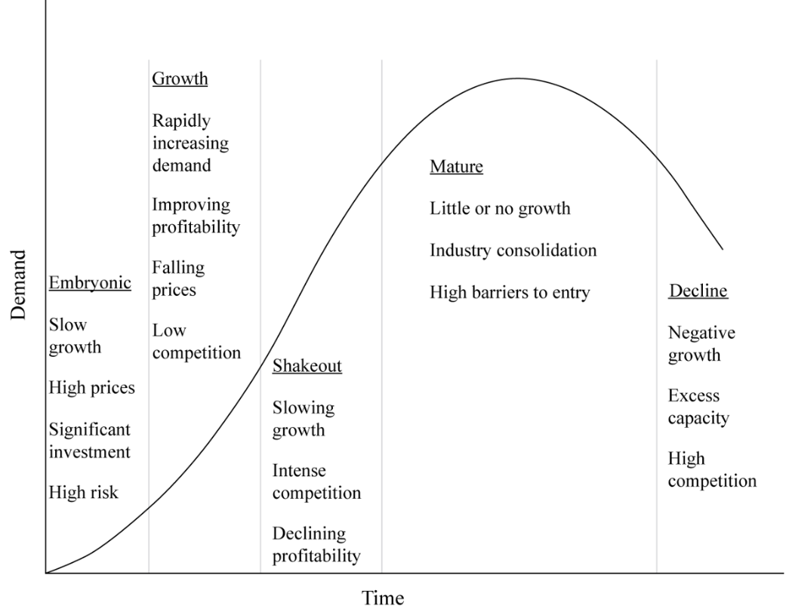
Industry Life-Cycle Model

Slide 17
Porter’s Five Forces
Porter (2008) identified the following five determinants of the intensity of competition in an industry:
The threat of entry to the industry, which depends on barriers to entry, or how difficult it would be for new competitors to enter the industry.
The power of suppliers, which may be able to raise prices or restrict the supply of key inputs to a company.
The power of buyers, which can affect the intensity of competition by exerting influence on suppliers regarding prices.
The threat of substitutes, which can negatively affect demand if customers choose other ways of satisfying their needs.
The rivalry among existing competitors, which is a function of the industry’s competitive structure.

Slide 18
External Influences on Industry Growth, Profitability, and Risk
Macroeconomic Influences
Technological Influences
Demographic Influences
Governmental Influences
Social Influences

Slide 19
Summary
The three main approaches to classifying companies are: products and/or services supplied; business-cycle sensitivities; and statistical similarities.
A limitation of current classification systems is that the narrowest classification unit assigned to a company generally cannot be assumed to constitute its peer group for the purposes of detailed fundamental comparisons or valuation.
A peer group is a group of companies engaged in similar business activities whose economics and valuation are influenced by closely related factors.
Not all industries are created equal. Some are highly competitive, with many companies struggling to earn returns in excess of their cost of capital, and other industries have attractive characteristics that enable a majority of industry participants to generate healthy profits.

Slide 20
Summary
Differing competitive environments are determined by the structural attributes of the industry. For this important reason, industry analysis is a vital complement to company analysis. The analyst needs to understand the context in which a company operates to fully understand the opportunities and threats that a company faces.
The framework for strategic analysis known as “Porter’s five forces” can provide a useful starting point.

