Slide 1
Basics of Portfolio Construction
FINM014
Dr Xun Lei

Slide 2
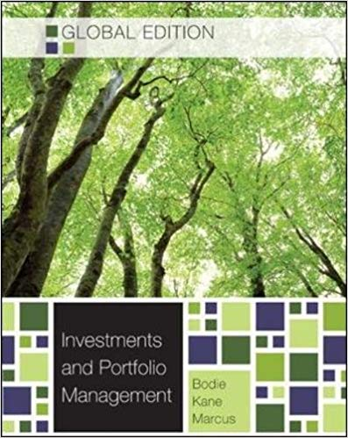
Chapter 4 Mutual Funds and Other Investment Companies
Chapter 28 Investment Policy and the Framework of the CFA Institute

Slide 3
Basics of Portfolio Construction
Capital Market Expectations
Capital market expectations are the investor’s expectations concerning the risk and return prospects of asset classes.
Capital market expectations are quantified in terms of asset class expected returns, standard deviation of returns, and correlations among pairs of asset classes.
Expected returns are in practice developed in a variety of ways, including the use of historical estimates, economic analysis, and various kinds of valuation models.
Standard deviations and correlation estimates are frequently based on historical data.

Slide 4
Basics of Portfolio Construction
The Strategic Asset Allocation
The strategic asset allocation (SAA) is the set of exposures to IPS-permissible asset classes that is expected to achieve the client’s long-term objectives given the client’s investment constraints.
As the strategic asset allocation is built up by asset classes, the decision about how to define those asset classes is an important one.
The risk–return profile of the strategic asset allocation depends on the expected returns and risks of the individual asset classes, as well as the correlation between those asset classes.

Slide 5
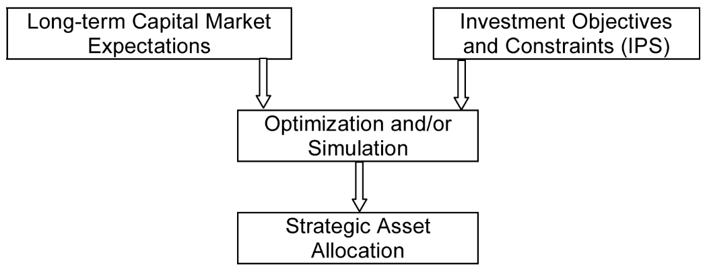
The Strategic Asset Allocation
A strategic asset allocation results from combining the constraints and objectives articulated in the IPS and long-term capital market expectations regarding the asset classes.

Slide 6
The Strategic Asset Allocation
How will capital market expectations and investment objectives and constraints eventually translate into a strategic asset allocation?
Investors’ risk and return objectives can be described as a utility function.
Capital market expectations, specified in asset classes’ expected returns, standard deviations of return, and correlations, translate into an efficient frontier of portfolios.

Slide 7
Strategic Asset Allocation Efficient Frontier

Slide 8
Steps Toward an Actual Portfolio
The strategic asset allocation is the first step in implementing an investment strategy.
The second step is risk budgeting, which is the establishment of objectives for individuals, groups, or divisions of an organization that takes into account the allocation of an acceptable level of risk.
Tactical asset allocation is the decision to deliberately deviate from the strategic asset allocation in an attempt to add value based on forecasts of the near-term relative performance of asset classes.
Security selection is an attempt to generate higher returns than the asset class benchmark by selecting securities with a higher expected return.

Slide 9
Steps in the Portfolio Management Process
The Planning Step
Understanding the client’s needs
Preparation of an investment policy statement (IPS)
The Execution Step
Asset allocation
Security analysis
Portfolio construction
The Feedback Step
Portfolio monitoring and rebalancing
Performance measurement and reporting

Slide 10
Mutual Funds and Other Investment Companies: An Introduction
Mutual Funds
A professional managed investment pool in which investors in the fund typically each have a pro-rate claim on the income and value of the fund.
Mutual funds are one of the most important investment vehicles for individuals and institutions.
At the end of the third quarter of 2008, the Investment Company Institute reported over 48,000 mutual funds in over 23 countries with a total net asset value of approximately US$20 trillion.

Slide 11
Mutual Funds: An Example
Suppose that an investment firm wishes to start a mutual fund with a target amount of US$10 million. It is able to reach this goal through investments from five individuals and two institutions. The investment of each is as follows:
The fund can be set up as an open-end fund or a closed-end fund.

Slide 12
Types of Mutual Funds
Money Market Funds
Taxable and tax-free
Bond Mutual Funds
Global, Government, Corporate, High yield, Inflation protected, National tax-free bonds
Stock Mutual Funds
Actively managed and passive management (index funds)
Hybrid/Balanced Funds
Mutual funds that invest in both bonds and shares

Slide 13
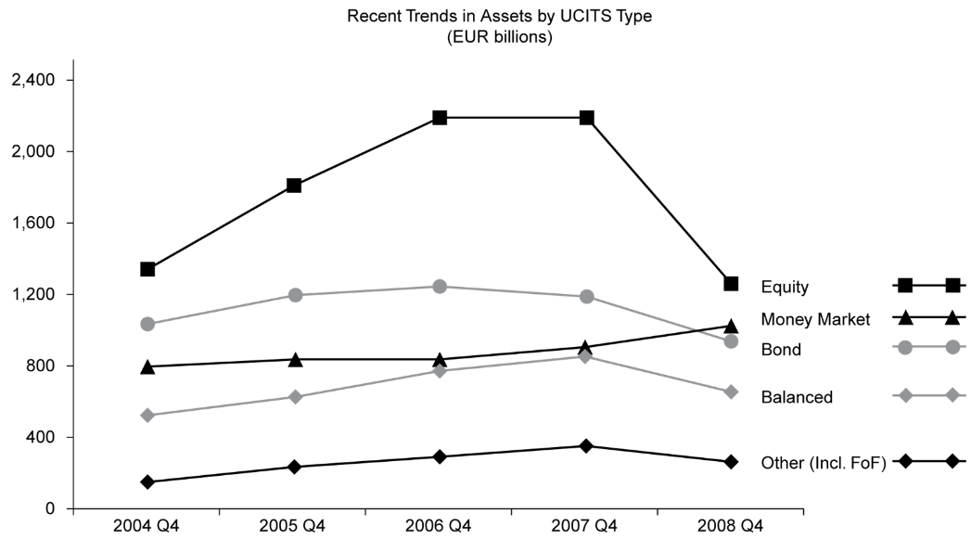
Types of Mutual Funds
A breakdown for the European mutual fund market.

Slide 14
Other Investment Products
Exchange Traded Funds (ETFs)
An ETF is an investment fund traded on stock exchanges, much like stocks. It combines features of closed-end and open-end mutual funds.
Separately Managed Accounts (SMAs)
An SMA is an investment portfolio managed exclusively for the benefit of an individual or institution.
Hedge Funds
Private investment vehicles that typically use leverage, derivatives, and long and short investment strategies.
Venture Capital Funds
A fund provides financing for companies in their start-up phase

Slide 15
Summary
The IPS is the starting point of the portfolio management process. Without a full understanding of the client’s situation and requirements, it is unlikely that successful results will be achieved.
Asset classes are the building blocks of an asset allocation. An asset class is a category of assets that have similar characteristics, attributes, and risk–return relationships. Traditionally, investors have distinguished cash, equities, bonds, and real estate as the major asset classes.
A strategic asset allocation results from combining the constraints and objectives articulated in the IPS and capital market expectations regarding the asset classes.
As time goes on, a client’s asset allocation will drift from the target allocation, and the amount of allowable drift as well as a rebalancing policy should be formalized.

Slide 16
Summary
In addition to taking systematic risk, an investment committee may choose to take tactical asset allocation risk or security selection risk. The amount of return attributable to these decisions can be measured.
Understanding the needs of investors and creating an investment policy statement represent the first steps of the portfolio management process. Those steps are followed by security analysis, portfolio construction, monitoring, and performance measurement stages.
We also discussed the different types of investment products that investors can use to create their portfolio. These range from mutual funds, to exchange traded funds, to hedge funds, to private equity funds.

