Slide 1
Introduction to Capital Market Theory and Asset Pricing Model
FINM014
Dr Xun Lei

Slide 2
Part III Equilibrium in Capital Markets
Chapter 9 The Capital Asset Pricing Model
Chapter 10 Arbitrage Pricing Theory and Multifactor Models of Risk and Return

Slide 3
Capital Market Theory: An Overview
Capital market theory extends portfolio theory and develops a model for pricing all risky assets, while capital asset pricing model (CAPM) will allow you to determine the required rate of return for any risky asset
Three Areas
Background for Capital Market Theory
Developing the Capital Market Line
Risk, Diversification, and the Market Portfolio

Slide 4
Portfolio of Risk-Free and Risky Assets
A combination of the risk-free asset and a risky asset can result in a better risk–return trade-off than an investment in only one type of asset because the risk-free asset has zero correlation with the risky asset.
Combining a Risk-Free Asset with a Portfolio of Risky Assets:

Slide 5
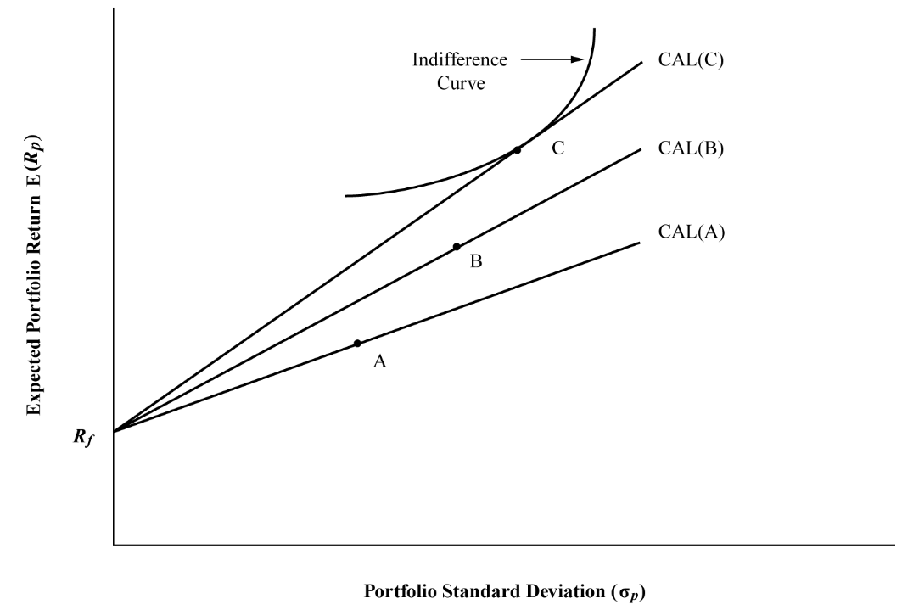
Risk-Free Asset and Portfolio of Risky Assets

Slide 6
The Capital Market Line
A capital allocation line includes all possible combinations of the risk-free asset and an investor’s optimal risky portfolio. The capital market line is a special case of the capital allocation line, where the risky portfolio is the market portfolio.
What Is the “Market”?
Theoretically, the market includes all risky assets or anything that has value, which includes stocks, bonds, real estate, and even human capital.
Practically, a local or regional stock market index is used as a proxy for the market (e.g. FTSE100, S&P500)

Slide 7
The Capital Market Line

Slide 8
The Capital Market Line
A combination of the risk-free asset and a risky portfolio is a straight line.
Risk and return characteristics of the portfolio represented by the CML can be computed by using the return and risk expressions for a two-asset portfolio:

Slide 9
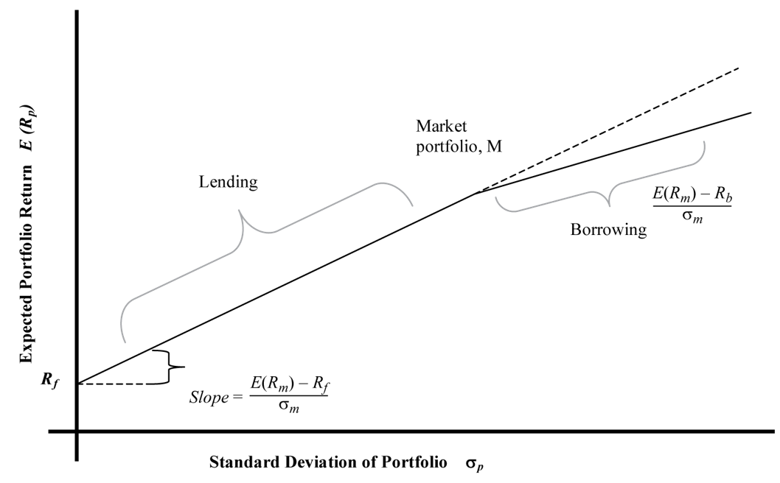
Leveraged Portfolios
Leveraged Portfolios with Different Lending and Borrowing Rates.

Slide 10
Pricing of Risk and Computation of Expected Return
Systematic Risk and Nonsystematic Risk
Systematic risk is risk that cannot be avoided and is inherent in the overall market.
Nonsystematic risk is risk that is local or limited to a particular asset or industry that need not affect assets outside of that asset class.
Total variance = Systematic variance + Nonsystematic variance

Slide 11
Calculation and Interpretation of Beta
Return-Generating Models
A model that can provide an estimate of the expected return of a security given certain parameters and estimates of the values of the independent variables in the model.
A general return-generating model is expressed in the following manner:
The simplest form of a return-generating model is a single-index model, in which only one factor is considered:

Slide 12
Calculation and Interpretation of Beta
Decomposition of total risk for a single-index model
Expected returns
Realised returns
Variance of realised returns
Total variance = Systematic variance + Nonsystematic variance
Back to CML and we can get the following single-index model:

Slide 13
Calculation and Interpretation of Beta
We rewrite single-index model using realized returns as:
Systematic risk depends on the correlation between the asset and the market:
Because the error term is uncorrelated with the market, the second term drops out. Then, we can rewrite the equation in terms of beta as follows:

Slide 14
Calculation and Interpretation of Beta
beta is a measure of how sensitive an asset’s return is to the market as a whole.
beta captures an asset’s systematic risk, or the portion of an asset’s risk that cannot be eliminated by diversification.
A positive beta indicates that the return of an asset follows the general market trend, whereas a negative beta shows that the return of an asset generally follows a trend that is opposite to that of the market.
A risk-free asset’s beta is zero.
beta of the market is 1.

Slide 15
The Capital Asset Pricing Model
CAPM provides a linear expected return–beta relationship that precisely determines the expected return given the beta of an asset. Recall the following equation:
The CAPM asserts that the expected returns of assets vary only by their systematic risk as measured by beta.

Slide 16
Assumptions of the CAPM
Investors are risk-averse, utility-maximizing, rational individuals.
Markets are frictionless, including no transaction costs and no taxes.
Investors plan for the same single holding period.
Investors have homogeneous expectations or beliefs.
All investments are infinitely divisible.
Investors are price takers.

Slide 17
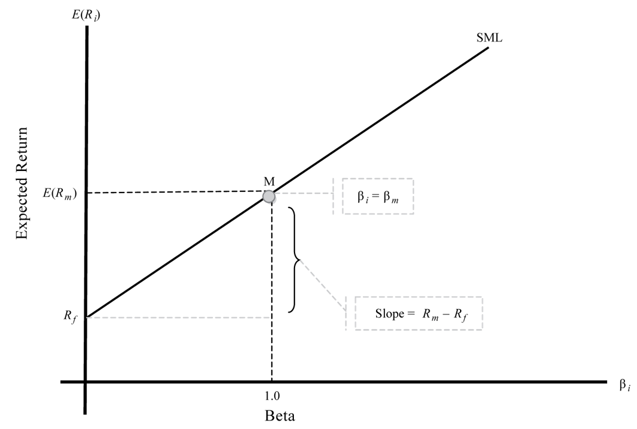
The Security Market Line
The security market line (SML) is a graphical representation of the capital asset pricing model.

Slide 18
Applications of the CAPM
Estimate of Expected Return
Portfolio Performance Evaluation (e.g. Sharpe and Treynor Ratios, M-Squared, Jensen’s Alpha)
Security Selection
Constructing a Portfolio

Slide 19
Security Selection

Slide 20
Constructing a Portfolio

Slide 21
Extensions to the CAPM
Theoretical Models
Theoretical models are based on the same principle as the CAPM but expand the number of risk factors. The best example of a theoretical model is the arbitrage pricing theory (APT), which was developed by Stephen Ross (1976).
Unlike the CAPM, however, APT allows numerous risk factors—as many as are relevant to a particular asset.

Slide 22
Extensions to the CAPM
Practical Models
If beta risk in the CAPM does not explain returns, which factors do? Practical models seek to answer this question. The best example of such a model is the three-factor model proposed by Fama and French (1992).
Based on an analysis of the relationship between past returns and a variety of different factors, Fama and French (1992) proposed that three factors seem to explain asset returns better than just systematic risk. Those three factors are relative size, relative book-to-market value, and beta of the asset.

Slide 23
Summary
The capital market line is a special case of the capital allocation line, where the efficient portfolio is the market portfolio.
Obtaining a unique optimal risky portfolio is not possible if investors are permitted to have heterogeneous beliefs because such beliefs will result in heterogeneous asset prices.
Investors can leverage their portfolios by borrowing money and investing in the market.
Systematic risk is the risk that affects the entire market or economy and is not diversifiable.
Nonsystematic risk is local and can be diversified away by combining assets with low correlations.

Slide 24
Summary
Beta risk, or systematic risk, is priced and earns a return, whereas nonsystematic risk is not priced.
The expected return of an asset depends on its beta risk and can be computed using the CAPM, which is given by E(R_{i}) = R_{f} + β_{i}[E(R_{m}) – R_{f}].
The security market line is an implementation of the CAPM and applies to all securities, whether they are efficient or not.
Expected return from the CAPM can be used for making capital budgeting decisions.
Portfolios can be evaluated by several CAPM-based measures, such as the Sharpe ratio, etc.
The SML can assist in security selection and optimal portfolio construction.

Slide 25
Appendix: Limitations of the CAPM
Theoretical Limitations of the CAPM:
Single-factor model: Only systematic risk or beta risk is priced in the CAPM. Thus, the CAPM states that no other investment characteristics should be considered in estimating returns. As a consequence, it is prescriptive and easy to understand and apply, although it is very restrictive and inflexible.
Single-period model: The CAPM is a single-period model that does not consider multi-period implications or investment objectives of future periods, which can lead to myopic and suboptimal investment decisions. For example, it may be optimal to default on interest payments in the current period to maximize current returns, but the consequences may be negative in the next period. A single-period model like the CAPM is unable to capture factors that vary over time and span several periods.

Slide 26
Appendix: Limitations of the CAPM
Practical Limitations of the CAPM:
Market portfolio: The true market portfolio according to the CAPM includes all assets, financial and nonfinancial, which means that it also includes many assets that are not investable, such as human capital and assets in closed economies.
Proxy for a market portfolio: In the absence of a true market portfolio, market participants generally use proxies. These proxies, however, vary among analysts, the country of the investor, etc. and generate different return estimates for the same asset, which is impermissible in the CAPM.
Estimation of beta risk: A long history of returns (three to five years) is required to estimate beta risk. The historical state of the company, however, may not be an accurate representation of the current or future state of the company. In addition, using different periods for estimation results in different estimates of beta.

Slide 27
Appendix: Limitations of the CAPM
Practical Limitations of the CAPM:
The CAPM is a poor predictor of returns: If the CAPM is a good model, its estimate of asset returns should be closely associated with realized returns. However, empirical support for the CAPM is weak. In other words, tests of the CAPM show that asset returns are not determined only by systematic risk. Poor predictability of returns when using the CAPM is a serious limitation because return-generating models are used to estimate future returns.
Homogeneity in investor expectations: The CAPM assumes that homogeneity exists in investor expectations for the model to generate a single optimal risky portfolio (the market) and a single security market line. Without this assumption, there will be numerous optimal risky portfolios and numerous security market lines. Clearly, investors can process the same information in a rational manner and arrive at different optimal risky portfolios.

