Slide 1
Introduction to Portfolio Management FINM014 Dr Xun Lei

Slide 2
Part II Portfolio Theory and Practice
Chapter 5 Introduction to Risk, Return, and the Historical Record
Chapter 6 Risk Aversion and Capital Allocation to Risky Assets
Chapter 7 Optimal Risky Portfolios

Slide 3
Portfolio Management Assumptions
Definition of Risk
Uncertainty: Risk means the uncertainty of future outcomes. For instance, the future value of an investment in Google’s stock is uncertain; so the investment is risky. On the other hand, the purchase of a six-month Certificate of Deposit has a certain future value; the investment is not risky.
Probability: Risk is measured by the probability of an adverse outcome. For instance, there is 40% chance you will receive a return less than 8%.

Slide 4
Investment Characteristics of Portfolio
Portfolio Return
The portfolio return is simply a weighted average of the returns of the individual investments, or assets.
For portfolio of two risky asset:
Consider Assets 1 and 2 with weights of 25 percent and 75 percent in a portfolio. If their returns are 20 percent and 5 percent, the weighted average return = (0.25 × 20%) + (0.75 × 5%) = 8.75%.

Slide 5
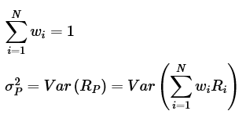
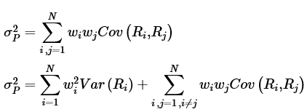
Investment Characteristics of Portfolio
Portfolio Risk
The right side of the equation is the variance of the weighted average returns of individual securities. Portfolio risk or variance measures the amount of uncertainty in portfolio returns.

Slide 6
Investment Characteristics of Portfolio
For a two asset portfolio
The standard deviation of a two asset portfolio is given by the square root of the portfolio’s variance:

Slide 7
Investment Characteristics of Portfolio
Covariance and Correlation (two asset portfolio)
Covariance is a measure of the co-movement (linear association) between two random variables (here, returns).
Correlation is a measure of the consistency or tendency for two investments to act in a similar way.
ρ₁₂ = +1: Returns of the two assets are perfectly positively correlated. Assets 1 and 2 move together 100 percent of the time.
ρ₁₂ = –1: Returns of the two assets are perfectly negatively correlated. Assets 1 and 2 move in opposite directions 100 percent of the time.
ρ₁₂ = 0: Returns of the two assets are uncorrelated. Movement of Asset 1 provides no prediction regarding the movement of Asset 2.

Slide 8
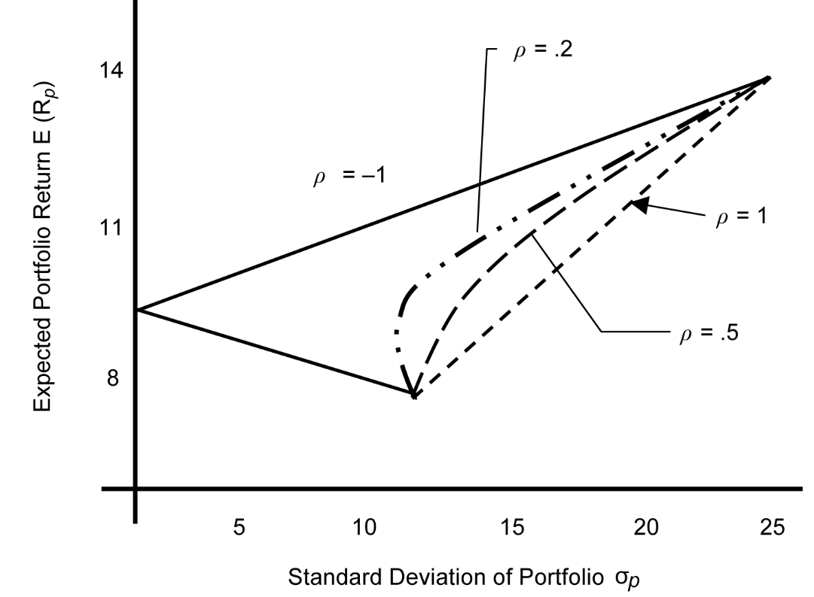
Investment Characteristics of Portfolio
Relationship between Risk and Return

Slide 9
Risk Aversion and Portfolio Selection
The Concept of Risk Aversion
The concept of risk aversion is related to the behaviour of individuals under uncertainty, that is, the degree of an investor’s inability and unwillingness to take risk.
Risk Seeking
Risk Neutral
Risk Averse
Risk tolerance refers to the amount of risk an investor is willing to tolerate to achieve an investment goal. The higher the risk tolerance, the greater is the willingness to take risk. Thus, risk tolerance is negatively related to risk aversion.

Slide 10
Utility Theory and Indifference Curves
Utility
In general terms, utility is a measure of relative satisfaction from consumption of various goods and services or in the case of investments, the satisfaction that an investor derives from different portfolios.
A simple implementation of utility theory allows us to quantify the rankings of investment choices using risk and return. An example of a utility function is
where, U is the utility of an investment, E(r) is the expected return, and σ² is the variance of the investment. A is a measure of risk aversion.

Slide 11
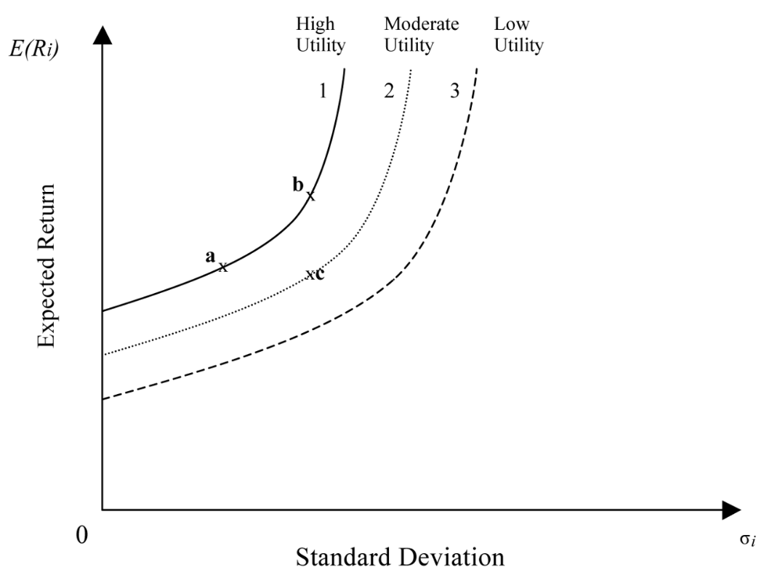
Utility Theory and Indifference Curves
Indifference Curves
An indifference curve plots the combinations of risk–return pairs that an investor would accept to maintain a given level of utility.

Slide 12
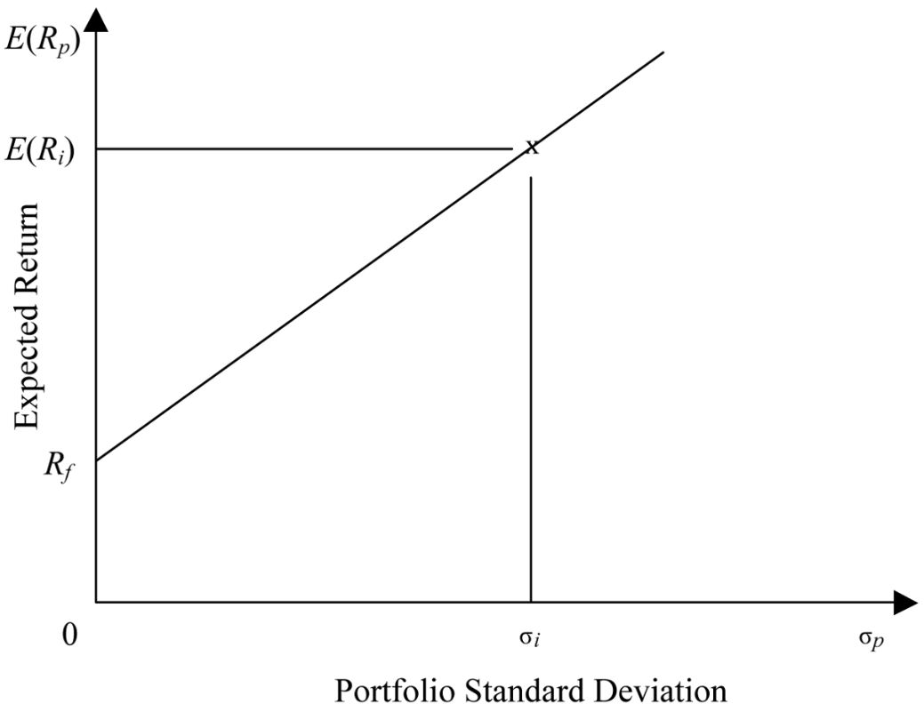
Application of Utility Theory to Portfolio Selection
The simplest application: a portfolio of two assets, a risk-free asset and a risky asset.

Slide 13
Application of Utility Theory to Portfolio Selection
Capital allocation line (CAL)
CAL represents the portfolios available to an investor. Equation:
Rewrite as
Substituting the value of w₁ in the equation for expected return
This equation can be rewritten in a more usable form:

Slide 14
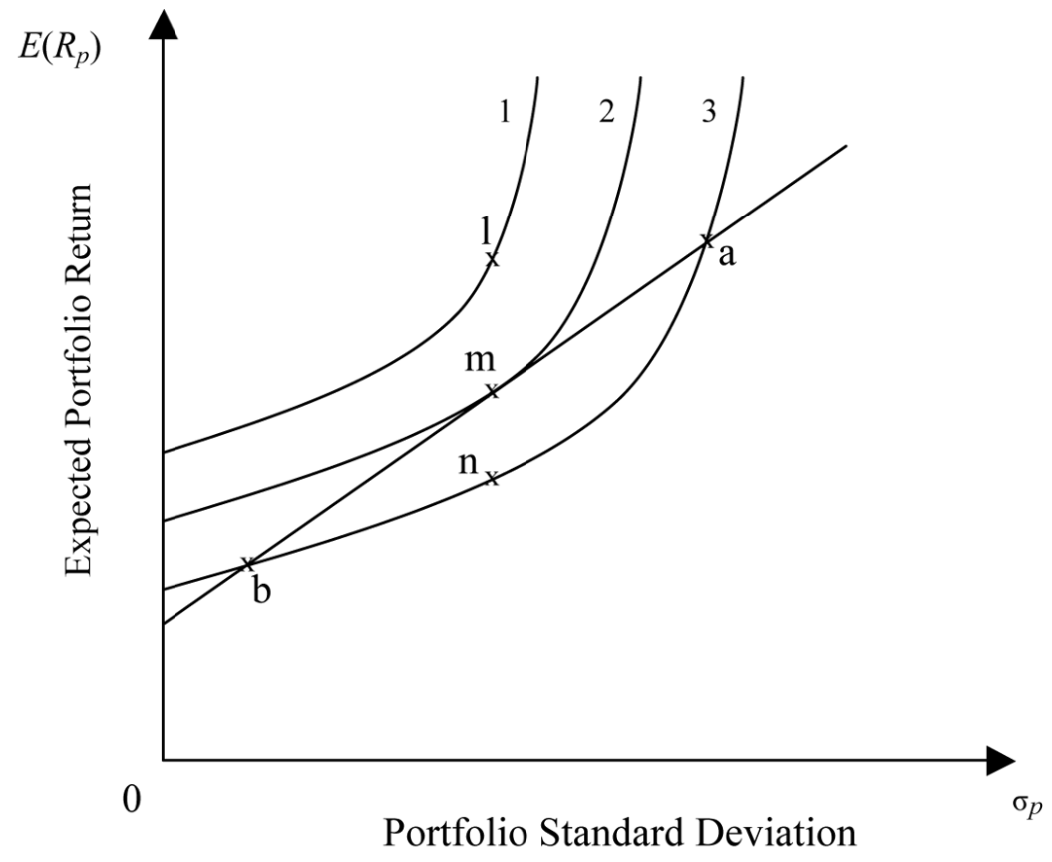
Application of Utility Theory to Portfolio Selection
Which one of these portfolios should be chosen by an investor?

Slide 15
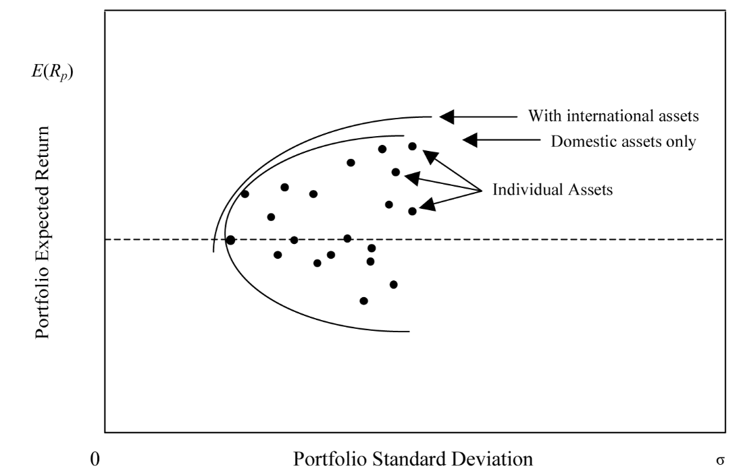
Efficient Frontier and Investor’s Optimal Portfolio
Investment Opportunity Set

Slide 16
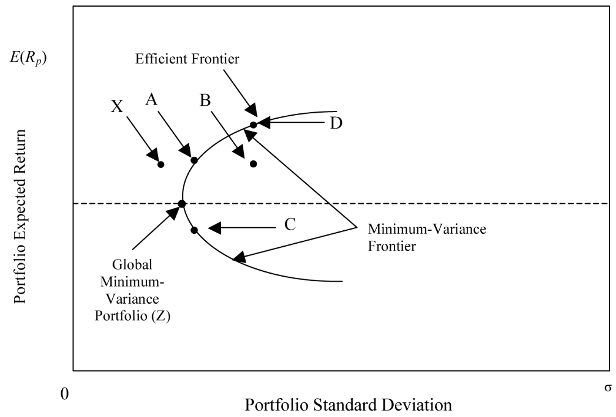
Efficient Frontier and Investor’s Optimal Portfolio
Minimum-Variance Portfolios

Slide 17
Efficient Frontier of Risky Assets
The efficient frontier represents that set of portfolios with the maximum rate of return for every given level of risk, or the minimum risk for every level of return
Efficient frontier are portfolios of investments rather than individual securities except the assets with the highest return and the asset with the lowest risk

Slide 18
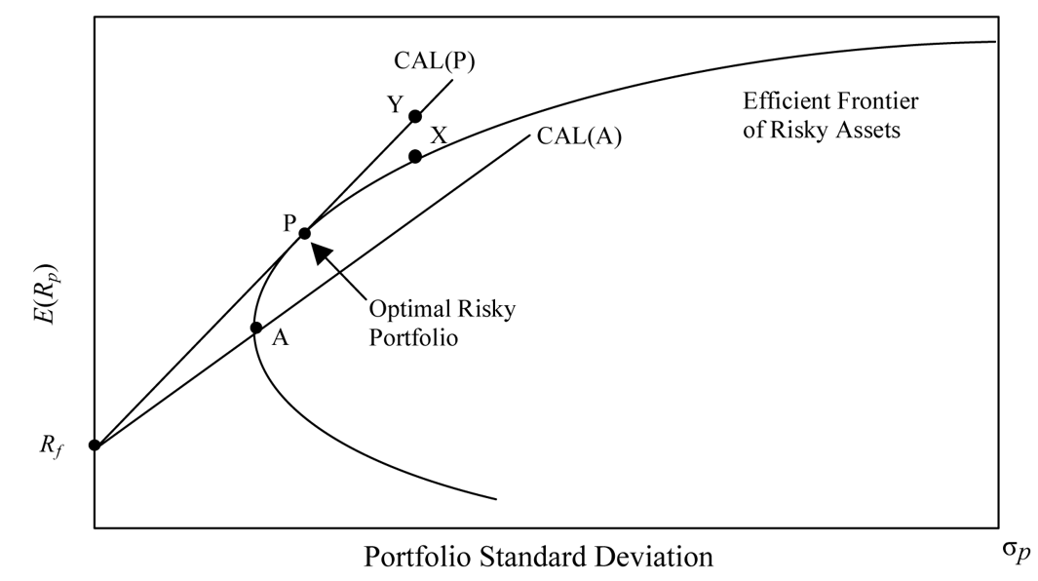
A Risk-Free Asset and Many Risky Assets
Capital Allocation Line and Optimal Risky Portfolio

Slide 19
Optimal Investor Portfolio
We understood the best possible portfolios available to investors, each of those portfolios is a linear combination of the risk-free asset and the optimal risky portfolio.
Among the available portfolios, the selection of each investor’s optimal portfolio depends on the risk preferences of an investor.
We discussed that the individual investor’s risk preferences are incorporated into their indifference curves. These can be used to select the optimal portfolio.

Slide 20
Optimal Investor Portfolio

Slide 21
Investor Preferences and Optimal Portfolios
The location of an optimal investor portfolio depends on the investor’s risk preferences.
A highly risk-averse investor may invest a large proportion, even 100 percent, of his/her assets in the risk-free asset.
A less risk-averse investor, however, may invest a large portion of his/her wealth in the optimal risky asset.
Some less risk-averse investors (i.e., with a high risk tolerance) may wish to accept even more risk because of the chance of higher return.
Thus, moving from the risk-free asset along the capital allocation line, we encounter investors who are willing to accept more risk.

Slide 22
Summary
Risk-averse investors make investment decisions based on the risk–return trade-off, maximizing return for the same risk, and minimizing risk for the same return. They may be concerned, however, by deviations from a normal return distribution and from assumptions of financial markets’ operational efficiency.
Investors are risk averse, and historical data confirm that financial markets price assets for risk-averse investors.
The risk of a two-asset portfolio is dependent on the proportions of each asset, their standard deviations and the correlation (or covariance) between the asset’s returns. As the number of assets in a portfolio increases, the correlation among asset risks becomes a more important determinate of portfolio risk.

Slide 23
Summary
Combining assets with low correlations reduces portfolio risk.
The two-fund separation theorem allows us to separate decision making into two steps. In the first step, the optimal risky portfolio and the capital allocation line are identified, which are the same for all investors. In the second step, investor risk preferences enable us to find a unique optimal investor portfolio for each investor.
The addition of a risk-free asset creates portfolios that are dominant to portfolios of risky assets in all cases except for the optimal risky portfolio.

