Slide 1
Week 2 FINM014 Dr Xun Lei
Global Market Investment Decision and Securities Markets

Slide 2
These slides have been prepared using learning support material published by Cengage Learning.
© 2012 Cengage Learning. All Rights Reserved. May not scanned, copied or duplicated, or posted to a publicly accessible website, in whole or in part.

Slide 3
Growing Investment Opportunities
More investment instruments available in the financial markets as a results of technological advances and new regulations
Ability to invest from a global perspective thanks to the globalization or integration of domestic and foreign financial markets
New investment vehicles with a variety of maturities, risk-return characteristics, and cash flow patterns being spawned due to competition and deregulations in the financial sector

Slide 4
The Case for Global Investments
Three reasons investors should think of constructing global investment portfolios
Opportunities: Ignoring foreign markets can substantially reduce the investment choices for domestic investors.
Return: The rates of return on foreign securities often have substantially exceeded those for domestic securities
The low correlation between local stock markets and many foreign markets can help to substantially reduce portfolio risk

Slide 5
The Case for Global Investments
Relative Size of U.S. Financial Markets
Overall value of the securities available in world capital market has increased from $2.3 Trillion in 1969 to $113.6 Trillion in 2010 and the U.S. portion has declined to less than half.
The US share in world stock and bond markets has dropped from about 65 percent of the total in 1969 to about 47 percent in 2010.
The growing importance of foreign securities in world capital markets is likely to continue.
Exhibit 3.1 shows the breakdown of securities in the global capital market.

Slide 6
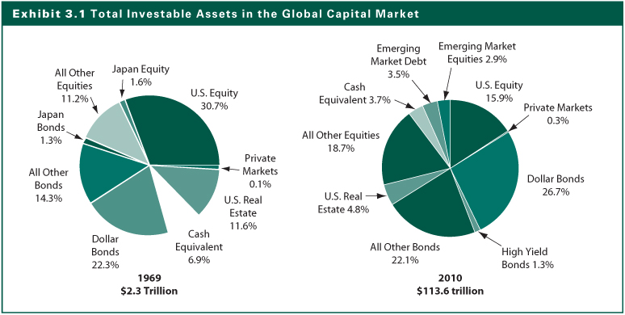
Exhibit 3.1

Slide 7
The Case for Global Investments
Rates of Return on U.S. and Foreign Securities
Global Bond-Market Return:
From 1986–2010, the return performance of the U.S. bond market ranked sixth out of the six countries when the returns are measured in U.S. dollar.
The better performance of the non-U.S. markets is partly due to the weakened dollar in this time frame
See Exhibit 3.2
Global Equity-Market Return
From 2007 through 2010, the United States’ average rank in annual return measured in U.S. dollar was 17.5 out of 34 countries.

Slide 8
Exhibit 3.2

Slide 9
The Case for Global Investments
Risk of Combined Country Investments
Diversification with foreign securities can help reduce portfolio risk because foreign markets have low correlation with U.S. capital markets.
The correlation of returns between a single pair of countries changes over time because the factors influencing the correlation change over time.
Diversified portfolios reduce variability of returns over time.
Correlation coefficients measure diversification contribution.

Slide 10
Global Bond Portfolio Risk
Low positive correlation (Exhibit 3.4)
For a U.S. investor, the average correlation between foreign bond return and U.S. bond return in U.S. dollars is about 0.58 from 1986 to 2010.
The U.S.–Canada correlation is 0.75, whereas
the U.S.–Japan correlation is only 0.34.
Opportunities for U.S. investors to reduce risk
Correlation changes over time
Adding non-correlated foreign bonds to a portfolio of U.S. bonds increases the rate of return and reduces the risk of the portfolio. (Exhibit 3.5)

Slide 11
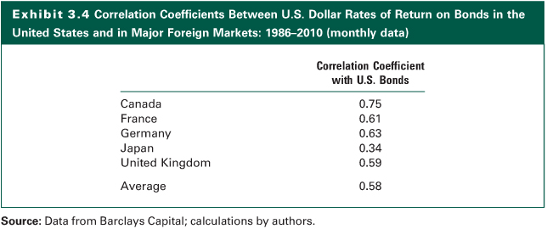
Exhibit 3.4

Slide 12
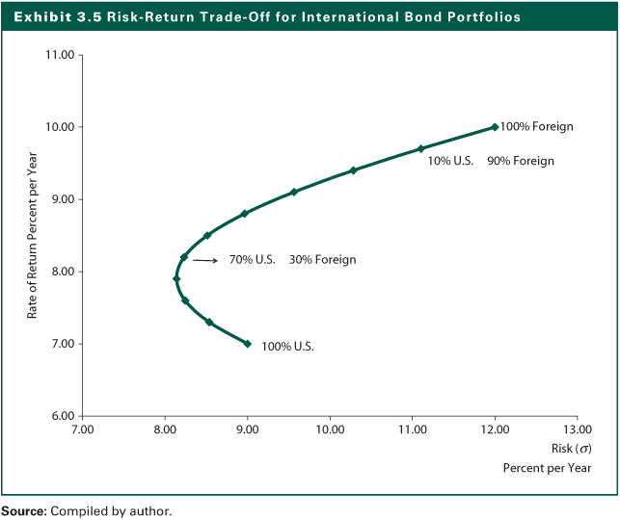
Exhibit 3.5

Slide 13
Global Equity Portfolio Risk
Low positive correlation (Exhibit 3.6)
The correlation of world equity markets resembles that for bonds; however, the average correlation between U.S. and foreign markets is about 0.65, lower than that for bonds from 1988 to 2010.
Again, the U.S.–Canada correlation is 0.76, whereas
the U.S.–Japan correlation is only 0.42.
Opportunities to reduce risk of a stock portfolio by including foreign stocks, as illustrated in Exhibit 3.7.

Slide 14
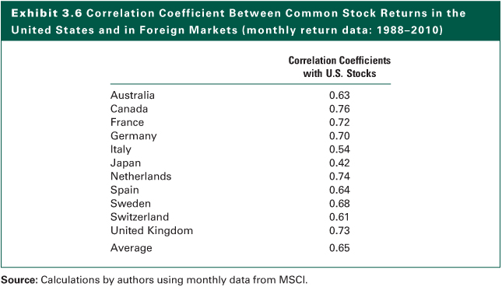
Exhibit 3.6

Slide 15
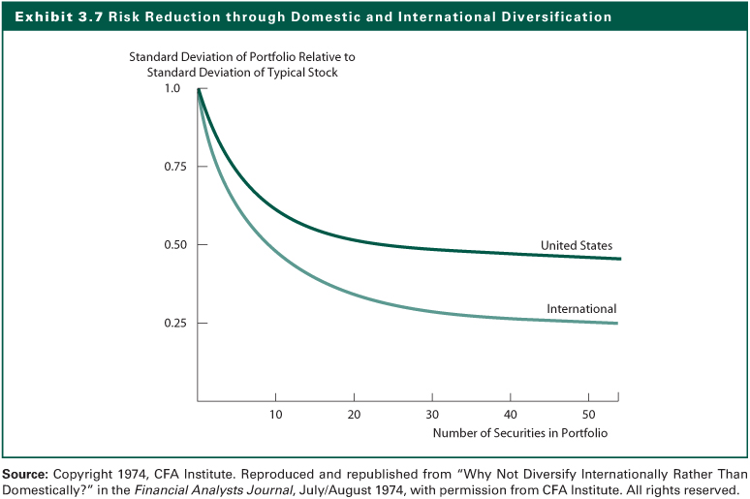
Exhibit 3.7

Slide 16
Global Investment Choices
Fixed-Income Investments
Bonds and preferred stocks
Equity Investments
Special Equity Instruments
Warrants and options
Futures Contracts
Investment Companies
Real Assets
Low Liquidity Investments

Slide 17
1) Fixed-Income Investments
Basic concepts of fixed-income investments
Contractual payment schedule
Recourse varies by instrument
(Generally) no voting rights
Bonds
Investors are lenders
Expect interest payment and return of principal
Preferred stocks
Dividends require board of directors approval

Slide 18
1) Fixed-Income Investments (examples)
Savings Accounts
Fixed earnings
Convenient
Liquid and low risk
Low rates
Certificates of Deposit (CDs)
Money Market Certificates
Compete against Treasury bills (T-bills)
Minimum $10,000
Minimum maturity of six months
Redeemable only at bank of issue
Penalty if withdrawn before maturity

Slide 19
1) Fixed-Income Investments (examples)
Fixed income obligations that trade in secondary market
U.S. Treasury securities
U.S. Government agency securities
Municipal bonds
Corporate bonds
Secured bonds
Debentures
Subordinated bonds
Income bonds
Convertible bonds

Slide 20
U.S. Treasury Securities
Issued by the U.S. Treasury
Depending on the maturity, they are:
Bills with a maturity less than 1 year
Notes with a maturity in 1 - 10 years
Bonds with a maturity over 10 years
Highly liquid
Essentially free of credit risk: They are backed by the full faith and credit of the U.S. Government

Slide 21
U.S. Government Agency Securities
Sold by government agencies
Federal National Mortgage Association (FNMA or Fannie Mae)
Federal Home Loan Bank (FHLB)
Government National Mortgage Association (GNMA or Ginnie Mae)
Federal Housing Administration (FHA)
Not direct obligations of the Treasury
Still considered almost default-free and fairly liquid

Slide 22
2) Corporate Bonds
Basic Concepts
Issued by a corporation
Fixed income
Credit quality measured by ratings
Maturity
Features
Indenture
Call provision
Sinking fund
Seniority categories

Slide 23
2) Corporate Bonds
Secured bonds
Senior secured bonds
Most senior bonds in capital structure and have the lowest risk of default
Mortgage bonds
Secured by liens on specific assets
Collateral trust bonds
Secured by financial assets
Equipment trust certificates
Secured by transportation equipment

Slide 24
2) Corporate Bonds
Debentures
Unsecured promises to pay interest and principal
In case of default, debenture owner can force bankruptcy and claim any unpledged assets to pay off the bonds
Subordinated bonds
Unsecured like debentures, but holders of these bonds may claim assets after senior secured and debenture holders claims have been satisfied

Slide 25
2) Corporate Bonds
Income bonds
Interest payment contingent upon earning sufficient income
If subsequently earned, it must be paid off
Riskier than debenture bonds
Convertible bonds
Offer the upside potential of common stock and the downside protection of a bond
Usually have lower interest rates

Slide 26
2) Corporate Bonds
Warrants
Allows bondholder to purchase the firm’s common stock at a fixed price for a given time period
Interest rates usually lower on bonds with warrants attached
Zero coupon bond
Offered at a deep discount from the face value
No interest during the life of the bond, only the principal payment at maturity

Slide 27
3) Preferred Stock
Hybrid security
Fixed dividends
Dividend obligations are not legally binding, but must be voted on by the board of directors to be paid
Most preferred stock is cumulative
Credit implications of missing dividends
Corporations may exclude 80% of dividend income from taxable income

Slide 28
International Bond Investing
Investors should be aware that there is a very substantial fixed income market outside the United States that offers additional opportunity for diversification and returns.
Bond identification characteristics
Country of origin
Location of primary trading market
Home country of the major buyers
Currency of the security denomination

Slide 29
International Bond Investing
Eurobond
An international bond denominated in a currency other than the country where it is issued
Yankee bonds
Sold in the United States and denominated in U.S. dollars, but issued by foreign corporations or governments
Eliminates exchange risk to U.S. investors
International domestic bonds
Sold by issuer within its own country in that country’s currency

Slide 30
Equity Investments
Common Stock
Represents ownership of a firm
Investor’s return tied to the performance of the company and may result in loss or gain
Common Stock Classifications
Industrial: manufacturers of automobiles, machinery, chemicals, beverages
Utilities: electrical power companies, gas suppliers, water industry
Transportation: airlines, truck lines, railroads
Financial: banks, savings and loans, credit unions

Slide 31
Acquiring Foreign Equities
American Depository Receipts (ADRs)
Easiest way to directly acquire foreign shares
Certificates of ownership issued by a U.S. bank that represents indirect ownership of a certain number of shares of a specific foreign firm on deposit in a U.S. bank in the firm’s home country
Buy and sell in U.S. dollars
Dividends in U.S. dollars
May represent multiple shares
Listed on U.S. exchanges
Very popular, 361 out of 474 foreign companies on NYSE at the end of 2010

Slide 32
Acquiring Foreign Equities
Purchase of American Shares
Issued in the US by transfer agent on behalf of a foreign firm
Higher expenses
Limited availability
Direct Purchase of Foreign Shares
In the foreign firms’ own country
Listed on a foreign stock exchange outside the home country (e.g., French firms on LSE)
Listed on a U.S. stock exchange

Slide 33
Acquiring Foreign Equities
Global Mutual Funds or ETFs
Global funds: Invest in both U.S. and foreign stocks
International funds: Invest mostly outside the U.S.
Funds can specialize
Diversification across many countries
Concentrate in a segment of the world
Concentrate in a specific country
Concentrate in types of markets
Exchange-traded funds or ETFs are a recent innovation with about 900 in earlier 2011

Slide 34
Investment Companies
Rather than buy individual securities directly from the issuer they can be acquired indirectly through shares in an investment company
Investment companies sell shares in itself and uses proceeds to buy securities
Investors own part of the portfolio of investments
Money market fund
Bond fund
Common Stock fund
Balanced fund
Index fund
Exchange traded fund

Slide 35
Investment Companies
Money Market Funds
Acquire high-quality, short-term investments
Yields are higher than normal bank CDs
Typical minimum investment is $1,000
No sales commission charges
Withdrawal is by check with no penalty
Investments usually are not insured
The total value of these funds reached almost $4 trillion in 2011

Slide 36
Investment Companies
Bond Funds
Invest in long-term government, corporate, or municipal bonds
Bond funds vary in bond quality from the risk-free government bonds to the high-yield or junk bonds
Expected returns also differ reflecting the risk level of bonds in the fund

Slide 37
Investment Companies
Common Stock Funds
Many different funds with varying stated investment objectives
Aggressive growth, income, precious metals, international stocks
Offer diversification to smaller investors
Sector funds concentrate in an industry
International funds invest outside the United States
Global funds invest in the U.S. and other countries

Slide 38
Investment Companies
Balanced Funds
Invest in a combination of stocks and bonds depending on their stated objectives
Index Funds
These are mutual funds created to track the performance of a market index like the S&P 500
Appeal to passive investors who want to simply experience returns equal to some market index
Numerous non-stock indexes including various bond indexes have been created

Slide 39
Investment Companies
Exchange-Traded Funds (ETFs)
These are depository receipts for a portfolio of securities deposited at a financial institution in a unit trust that issues a certificate of ownership for the portfolio of stocks
The stocks in a portfolio are those in an index like the S&P 500 and dozens of country or industry indexes
ETFs can be bought and sold continuously on an exchange like common stock

Slide 40
Real Estate
Real Estate Investment Trusts (REITs)
Investment fund that invests in a variety of real estate properties, similar to a stock or bond mutual fund
Construction and development trusts provide builders with construction financing
Mortgage trusts provide long-term financing for properties
Equity trusts own various income-producing properties

Slide 41
What Is A Market?
Basic Concepts
It brings buyers and sellers together to aid in the transfer of goods and services
It does not need to have a physical location
The market does not necessarily have to own the goods and services
It can deal in any variety of goods and services
Both buyers and sellers benefit from the market

Slide 42
What Is A Market?
Characteristics of a Good Market
Availability of past transaction information
must be timely and accurate
Liquidity
Marketability
Price continuity
Depth
Low transaction costs: Internal efficiency
Rapid adjustment of prices to new information: External efficiency

Slide 43
What Is A Market?
Primary markets
Market where new securities are sold and funds go to issuing unit
Secondary markets
Market where outstanding securities are bought and sold by investors. The issuing unit does not receive any funds in a secondary market transaction

Slide 44
Primary Capital Markets
Corporate Bond and Stock Issues
Corporate bond issues are almost always sold through a negotiated arrangement with an investment banking firm that maintains a relationship with the issuing firm.
New Stock Issues
Seasoned new issues: New shares offered by firms that already have stock outstanding
Initial public offerings (IPOs): A firm selling its common stock to the public for the first time
These new issues are typically underwritten by investment bankers

Slide 45
The Underwriting Function
The investment banker purchases the entire issue from the issuer and resells the security to the investing public.
The firm charges a commission for providing this service.
For municipal bonds, the underwriting function is performed by both investment banking firms and commercial banks
The underwriting organization structure (Exhibit 4.1)

Slide 46
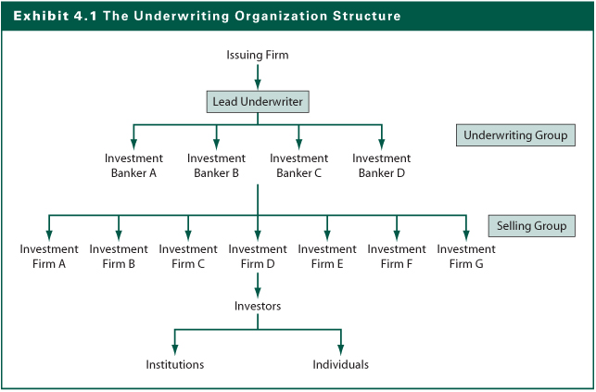
Exhibit 4.1

Slide 47
Why secondary financial markets are important?
Provides liquidity to investors who acquire securities in the primary market
Results in lower required returns than if issuers had to compensate for lower liquidity
Helps determine market pricing for new issues

Slide 48
Secondary Bond Market
Secondary market for U.S. government and municipal bonds
U.S. government bonds traded by bond dealers
Banks and investment firms make up municipal market makers
Secondary corporate bond market
Traded through an OTC market
Limited trading in corporate bonds compared to the fairly active trading in government bonds

Slide 49
Secondary Equity Markets Classification
Primary Listing Markets
NYSE, AMEX, Tokyo, and LSE
Regional Markets
Chicago, San Francisco, Boston, Osaka, Nagoya, Dublin, Cincinnati
Third Market Dealers/Brokers
Madoff Investment Securities, Knight Trading Group, Jefferies Group, ITG
Alternative Trading Systems
Electronic Communications Networks (ECNs)
Electronic Crossing Systems (ECSs)
See Exhibit 4.3

Slide 50
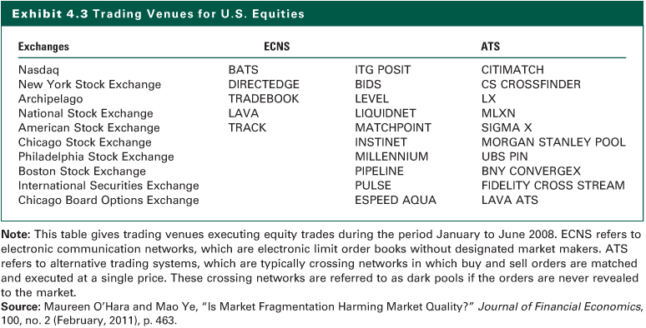
Exhibit 4.3

Slide 51
New York Stock Exchange (NYSE)
Largest organized securities market in the United States
Established in 1817, but dates back to the 1792 Buttonwood Agreement by 24 brokers
At the end of 2010, approximately 2,850 companies with securities listed on NYSE
Total market value nearly $14 trillion
2010 average daily volume of about 3.5 billion shares.

Slide 52
Global Stock Exchanges
The major markets are
Tokyo Stock Exchange,
London Stock Exchange,
Frankfurt Stock Exchange, and
Paris Bourse.
Trend toward consolidations or affiliations that will provide more liquidity and greater economies of scale to support the technology required by investors.
The existence of the strong international exchanges has made possible a global equity market wherein stocks that have a global constituency can be traded around the world continuously, creating the global 24-hour market.

Slide 53
The NASDAQ Market (NMS)
Historically known as the over-the-counter market
Largest segment of the U.S. secondary market in terms of number of issues
It is a dealer market and trades electronically
Lenient requirements for listing on the NASDAQ NMS
More than 2800 issues are actively traded on the NASDAQ NMS and almost 700 on the NASDAQ Small-Cap Market (SCM)
Any stock can be traded on the NASDAQ market as long as there are dealers willing to make a market

Slide 54
Major Types of Orders
Market Orders
Buy or sell at the best current price
Provides immediate liquidity
Limit Orders
Order specifies the buy or sell price
Time specifications for order may vary: Instantaneous “fill or kill”, part of a day, a full day, several days, a week, a month, or good until canceled (GTC)

Slide 55
Major Types of Orders
Special Orders
Stop Loss Order
A conditional market order to sell stock if it drops to a given price
Does not guarantee price you will get upon sale
Market disruptions can cancel such orders
Stop Buy Order
A conditional market order to buy stock if it increases to a specified price
Investor who sold short may want to limit loss if stock increases in price
Margin Transactions and Short Sales

Slide 56
Margin Transactions
On any type order, instead of paying 100% cash, investors can borrow a portion of the transaction and use the stock as collateral
Interest rate on the money borrowed is normally 1.50% above the bank rate, referred to as the call money rate.
Changes in stock price change the total market value of the stock bought and affect the investor’s equity position in the stock

Slide 57
Margin Transactions: Margin Requirement
The initial margin requirement is set by the Federal Reserve at 50%, although individual investment firms can require higher percentages
Maintenance Margin
Required proportion of equity to stock after purchase
Protects broker if stock price declines
Minimum requirement is 25%
Margin call on undermargined account to meet margin requirement
If margin call is not met, the stock will be sold to pay off the loan

Slide 58
Short Sales
Short sales
Sell overpriced stock that you don’t own and purchase it back later (hopefully at a lower price)
Borrow the stock from another investor (through your broker)
Must pay any dividends to lender
Margin requirements apply

Slide 59
Exchange Market Makers
They are referred to as specialist or designated market makers (DMM)
A specialist is a member of the exchange who applies to the exchange to be assigned stocks to handle (usually 10-15)
The specialist has two major functions:
As broker to match buyers and sellers
As dealer to maintain fair and orderly market

Slide 60
Exchange Merger Mania
Two Major Reasons
The trend toward portfolios that are diversified both between countries (globally) and among asset classes
The economics of high technology trading
Some Past Mergers
NYSE
Acquired Archipelago Holdings Co. and became a publicly traded entity, the NYSE Group, Inc. in 2006
In 2007, merged with Euronext NV which itself was the product of earlier mergers of several European exchanges

Slide 61
Exchange Merger Mania
NASDAQ
Acquired the Instinet Group, an ECN and became a public company
Acquired the Philadelphia Stock Exchange and OMX, an ECN
CME
The Chicago Mercantile Exchange (CME) Holding went public in 2006, and the Chicago Board of Trade (CBOT) subsequently went public.
In late 2007 these two exchanges merged to CME
London
Acquired the Borsa Italiana in 2007
Acquired the Toronto Exchange (TMX Group) in early 2011.

Slide 62
Exchange Merger Mania
Present and Future
There will be a few global holding companies that own global exchanges for stocks, bonds, and derivatives.
Examples
German Stock Exchange (Deutsche Borse) and the NYSE announced a potential merger in early 2011
The NASDAQ and the Intercontinental Exchange (ICE) came out with a competing bid for the NYSE
The potential merger between the Singapore Stock Exchange (SGX) and the Australian Stock Exchange (ASX)

