Slide 1
FINM014 Spring 2019 Week 1 Dr Xun Lei
The Investment Setting & the Asset Allocation Decision

Slide 2
Overview of the module
What do you learn?
Financial markets and instruments
Basics of valuation theory
Portfolio management
Basics of the modern financial theory
How?
14 x 3 hours lectures (including 2 x 3 hours assignment support)

Slide 3
Assessment
Individual Assignment 1 (50%). The deadline for first submission: April 24.
Individual Assignment 2 (50%) The deadline for first submission: May 22.
Your assignment must be submitted electronically (NILE: you will be able to find assignment brief and submission links in the near future).

Slide 4
Textbooks
Main textbook:
Bodie, Z., Kane, A. and Marcus, A., (2011), Investments and Portfolio Management (9th global edition.), New York: McGraw-Hill Education.
Reilly, F., Brown, K., Analysis of Investments: Management of Portfolios (2012: International Edition)
Supplementary books:
Hillier D., Ross S., Westerfield, R., Jaffe, J., and Jordan, B., (2016), Corporate Finance, 3nd Edition, New York: McGraw-Hill Education.
Hull, J., (2015), Options, Futures and other Derivatives, 9th edition, London: Prentice Hall.
Mishkin, F. S., Eakins, S. G., (2015), Financial Markets & Institutions, Global Edition, Boston: Pearson.
Lumby, S. and Jones, C., (2015), Corporate Finance: Theory and Practice, 9th edition, Andover: Cengage Learning

Slide 5
What is an investment?
The fundamental principle: You forego something today with the expectation of reaping future benefit.
Investment is current commitment of £(amount) for a period of time in order to derive future payments that will compensate for:
The time the funds are committed
The expected rate of inflation
Uncertainty of future flow of funds
Reason for Investing:
By investing (saving money now instead of spending it), individuals can tradeoff present consumption for a larger future consumption.

Slide 6
Rate of return on investment…
It is the exchange rate between future consumption (future money) and present consumption (current money).
Market forces determine this rate.
Examples:
Simple Setting: Exchange £100 today for £104 next year, this rate is 4% (104/100-1)
Compounding of return:
£10,000 invested in August 1998 in Cephalon worth $107,096 in September 2003 (and $180,000 in 2007)
Return between August 1998 to September 2003: 1070.96%
Return between September 2003 to October 2007: 168.07%

Slide 7
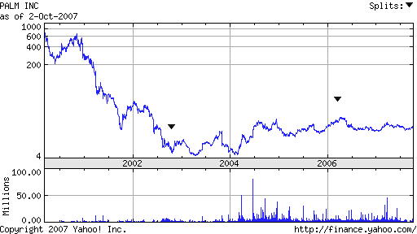
Losses in value can be even more spectacular
$10,000 invested in September 2000 in Palm Inc. would have been reduced to $91 by April 2003
A holding in July 2000 of £15 million in Exeter Equity Growth Fund would have been worth £72,463 in August 2003 (the share price fell from 103.50 to 0.50)

Slide 8
Return is a compensation for…
Time Value of Money
The fact that people are willing to pay more for the money borrowed and lenders desire to receive a surplus on their savings (money invested) gives rise to the value of time referred to as the pure time value of money.
Inflation
If the future payment will be decreased in value because of inflation, then the investor will demand an interest rate higher than the pure time value of money to also cover the expected inflation expense.
Uncertainty
If the future payment from the investment is not certain, the investor will demand an interest rate that exceeds the pure time value of money plus the inflation rate to provide a risk premium to cover the investment risk Pure Time Value of Money.

Slide 9
The notion of “Required Rate of Return”
The minimum rate of return an investor requires on an investment, including the pure rate of interest and all other risk premiums to compensate the investor for taking the investment risk.
Investors may expect to receive a rate of return different from the required rate of return, which is called expected rate of return. What would occur if these two rates of returns are not the same?

Slide 10
Return definitions
Holding Period Return (HPR)
HPR = Ending value of investment / Beginning value of investment
Holding Period Yield (HPY)
HPY=HPR-1
Annual HPR and HPY
Annual HPR=HPR^{1/n}
Annual HPY= Annual HPR -1=HPR^{1/n} – 1
where n=number of years of the investment

Slide 11
Historical Rates of Return
Example:
Assume that you invest £200 at the beginning of the year and get back £220 at the end of the year. What are the HPR and the HPY for your investment?
HPR=Ending value / Beginning value
=£220/200
=1.1
HPY = HPR-1 =1.1-1=0.1
=10%

Slide 12
Historical Rates of Return
Example:
Your investment of $250 in Stock A is worth $350 in two years while the investment of $100 in Stock B is worth $112 in six months. What are the annual HPRs and the HPYs on these two stocks?
Stock A
Annual HPR=HPR^{1/n} = ($350/$250)^{1/2} =1.1832
Annual HPY=Annual HPR-1=1.1832-1=18.32%
Stock B
Annual HPR=HPR^{1/n} = ($112/$100)^{1/0.5} =1.2544
Annual HPY=Annual HPR-1=1.2544-1=25.44%

Slide 13
Rate of return: Single period
$r_{t}=\frac{P_{1}−P_{0}+D_{1}}{P_{0}}=\frac{P_{1}−P_{0}}{P_{0}}+$ $\frac{D_{1}}{P_{0}}$
$r_{t}$ = Holding period return
P₀ = Beginning price
P₁ = Ending price
D₁ = Dividend during period one
Capital Gain
Dividend yield

Slide 14
Historical Rates of Return
Computing Mean Historical Returns
Suppose you have a set of annual rates of return (HPYs or HPRs) for an investment. How do you measure the mean annual return?
Arithmetic Mean Return (AM)
AM= Σ HPY / n
where Σ HPY=the sum of all the annual HPYs
n=number of years
Geometric Mean Return (GM)
GM= [π HPY] ^{1/n} -1
where π HPR=the product of all the annual HPRs
n=number of years

Slide 15
Historical Rates of Return
Suppose you invested $100 three years ago and it is worth $110.40 today. The information below shows the annual ending values and HPR and HPY. This example illustrates the computation of the AM and the GM over a three-year period for an investment.
Year Beginning Ending HPR HPY
Value Value
1 100 115.0 1.15 0.15
2 115 138.0 1.20 0.20
3 138 110.4 0.80 -0.20

Slide 16
Historical Rates of Return
AM=[(0.15)+(0.20)+(-0.20)] / 3
= 0.15/3=5%
GM=[(1.15) x (1.20) x (0.80)]^{1/3} – 1
=(1.104)^{1/3} -1=1.03353 -1 =3.353%
Comparison of AM and GM
When rates of return are the same for all years, the AM and the GM will be equal.
When rates of return are not the same for all years, the AM will always be higher than the GM.
While the AM is best used as an “expected value” for an individual year, while the GM is the best measure of an asset’s long-term performance.

Slide 17
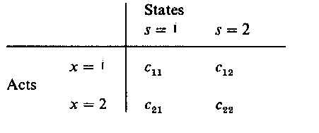
Expected Rates of Return
In previous examples, we discussed realized historical rates of return. In contrast, an investor would be more interested in the expected return on a future risky investment.
All investment returns (all future cash flows) are dependent on future states of the world.
The set of feasible actions X
The set of possible states of the world S
The set of consequences C
Payoff c = f(s,x)
Decision under certainty:
f is constant with respect to the state of the world
Decision under uncertainty:
different states lead to different consequenses

Slide 18
Expected Rates of Return
All investment returns (all future cash flows) are dependent on future events.
a probability distribution on S is defined as risk situation
for each action x ϵ X, there is a probability distribution
on C defined as follows:
prob of a particular consequence =
prob of the state of the world s which leads
to this consequence
given a particular action x
the choice of an action =
the choice of probability
distribution on consequences
Probability distribution
p1 p2

Slide 19
Expected Rates of Return
Every investment is a gamble (a lottery).
Returns are random. We model a future risky cash-flow as a random variable.
Expected value: pW1 + (1-p) W2 = (0.6 x 150,000) + (0.4 x 60,000) = £114,000
Expected profit: £114,000 - £100,000 = £14,000
p = 0.6
W₁ = £150,000
W₀ = £100,000
1 - p = 0.4
W₂ = £60,000

Slide 20
Expected Rates of Return
Computing Expected Rate of Return
where P_{i} = Probability for possible return i
R _{i} = Possible return i

Slide 21
Probability Distributions
Exhibit 1.2
Risk-free Investment

Slide 22
Probability Distributions
Exhibit 1.3
Risky Investment with 3 Possible Returns

Slide 23
Probability Distributions
Exhibit 1.4
Risky investment with ten possible returns

Slide 24
Expected Rates of Return
Scenario returns – An example:
State Prob. of State p(s) Return r(s)
Excellent .25 0.3100
Good .45 0.1400
Poor .25 -0.0675
Crash .05 -0.5200
What is the expected return?
E(r) = (.25)(.31) + (.45)(.14) + (.25)(−.0675) + (0.05)(− 0.52)
E(r) = .0976 or 9.76%

Slide 25
What is risk?
The definition of “risk” is not clear.
Risk refers to the uncertainty of an investment; therefore the measure of risk should reflect the degree of the uncertainty.
The risk of expected return reflect the degree of uncertainty that actual return will be different from the expect return.
The common measures of risk are based on the variance of rates of return distribution of an investment

Slide 26
Risk of Expected Return
The problem is: The expected return does not tell you enough!
You want to know the uncertainty of the return on an investment.
Measuring the Risk of Expected Return
Risk = volatility (measured as variance σ² and standard deviation σ)
Variance
(
σ
)
n
Possible
Expected
=
∑
−
2
(Pr
obability
)
x
(
)
Re
turn
Re
turn
i
=
1
n
=
∑
P
[
R
−
E
(
R
)]
2
i
i
i
i
=
1

Slide 27
Risk of Expected Return
Standard Deviation (σ): It is the square root of the variance and measures the total risk
Higher standard deviation - more uncertainty - the riskier the investment
Risk is the likelihood of deviation from the expected returns (dispersion of outcomes around the expected returns)
n
σ
=
∑
−
2
P
[
R
E
(
R
)]
i
i
i
i
=
1

Slide 28
Measure of risk
Expected value: p W₁ + (1-p) W₂ = (0.6 x 150,000) + (0.4 x 60,000) = £114,000.
Variance:
${ σ}^{2}$= p* [W₁ – E(W)]² + (1-p)*[W₂ – E(W)]²
= 0.6(150,000-114,000)² + 0.4(60,000 – 114,000)²
= 1,944,000,000
Standard deviation: $σ$= £44,090.82
W₁ = £150,000
p = 0.6
W₀ = £100,000
1 - p = 0.4
W₂ = £60,000

Slide 29
Measure of risk
State Prob. of State p(s) Return r(s)
Excellent .25 0.3100
Good .45 0.1400
Poor .25 -0.0675
Crash .05 -0.5200
E(r) = .0976 or 9.76%
σ² = 0.25(0.31 – 0.976) ² + 0.45(0.14 – 0.0976) ²
+ 0.25(-0.0675 – 0.0976) ² + 0.05(-0.52 – 0.0976) ²
σ² = 0.0380
σ = √0.0380 = 0.1949 = 19.49%

Slide 30
Relationship Between Risk and Return
The Security Market Line (SML)
It shows the relationship between risk and return for all risky assets in the capital market at a given time. A graphical representation of CAPM.
Investors select investments that are consistent with their risk preferences.
Expected
Return
Low
Average
High
Security
Risk
Risk
Risk
Market Line
Risk
Free
Rate
The slope indicates the
required return per unit of risk
Risk
(systematic risk-beta)

Slide 31
Relationship Between Risk and Return
Movement along the SML
When the risk changes, the expected return will also change, moving along the SML.
Risk premium: RP_{I} = E(R_{i}) – Risk Free Rate
Expected
Return
SML
Risk
Free
Rate
Movements along the curve
that reflect changes in the
risk of the asset
Risk
(systematic risk-beta)

Slide 32
Relationship Between Risk and Return
Changes in the Slope of the SML
When there is a change in the attitude of investors toward risk, the slope of the SML will also change.
If investors become more risk averse, then the SML will have a steeper slope, indicating a higher risk premium, RP_{i}, for the same risk level.
Expected Return
New SML
R _{m’}
Original SML
R _{m}
Risk
Free
Rate
Risk

Slide 33
The Asset Allocation Decision

Slide 34
What is Asset Allocation?
Asset Allocation: It is the process of deciding how to distribute an investor’s wealth among different countries and asset classes for investment purposes.
Asset Class: It refers to the group of securities that have similar characteristics, attributes, and risk/return relationships.
Investor: Depending on the type of investors, investment objectives and constraints vary
Individual investors
Institutional investors

Slide 35
The Portfolio Management Process
1. Policy Statement
Focus: Investor’s short-term and long-term needs, familiarity with capital market history, and expectations
2. Examine current and project financial, economic, political, and social conditions
Focus: Short-term and intermediate-term expected conditions to use in constructing a specific portfolio
3. Implement the plan by constructing the portfolio
Focus: Meet the investor’s needs at the minimum risk levels
4. Feedback loop: Monitor and update investor needs, environmental conditions, portfolio performance

Slide 36
The Need For A Policy Statement
Understand investor’s needs and articulate realistic investment objectives and constraints
What are the real risks of an adverse financial outcome, and what emotional reactions will I have?
How knowledgeable am I about investments and the financial markets?
What other capital or income sources do I have? How important is this particular portfolio to my overall financial position?
What, if any, legal restrictions affect me?
How would any unanticipated portfolio value change might affect my investment policy?

Slide 37
The Need For A Policy Statement
Sets standards for evaluating portfolio performance
The statement provides a comparison standard in judging the performance of the portfolio manager.
A benchmark portfolio or comparison standard is used to reflect the risk an return objectives specified in the policy statement.
It should act as a starting point for periodic portfolio review and client communication with the manager.

Slide 38
The Need For A Policy Statement
Other Benefits
It helps reduces the possibility of inappropriate or unethical behavior on the part of the portfolio manager.
A clearly written policy statement will help create seamless transition from one money manager to another without costly delays.
It also provides the framework to help resolve any potential disagreements between the client and the manager.

Slide 39
Constructing the Policy Statement
Constructing the policy statement begins with a profile analysis of the investor’s current and future financial situations and a discussion of investment objectives and constraints.
Objectives
Risk
Return
Constraints
Liquidity, time horizon, tax factors, legal and regulatory constraints, and unique needs and preferences

Slide 40
Investment Objectives
Return Objectives
The return objective may be stated in terms of an absolute or a relative percentage return.
Capital Preservation: Minimize risk of real losses
Capital Appreciation: Growth of the portfolio in real terms to meet future need
Current Income: Focus is in generating income rather than capital gains
Total Return: Increase portfolio value by capital gains and by reinvesting current income with moderate risk exposure

Slide 41
Investment Objectives
Risk Objectives
Risk objective should be based on investor’s ability to take risk and willingness to take risk.
Risk tolerance depends on an investor’s current net worth and income expectations and age.
More net worth allows more risk taking
Younger people can take more risk
A careful analysis of the client’s risk tolerance should precede any discussion of return objectives.

Slide 42
Investment Constraints
Liquidity Needs
Vary between investors depending upon age, employment, tax status, etc.
Planned vacation expenses and house down payment are some of the liquidity needs.
Time Horizons
Influences liquidity needs and risk tolerance.
Longer investment horizons generally requires less liquidity and more risk tolerance.
Two general time horizons are pre-retirement and post-retirement periods.

Slide 43
Investment Constraints
Tax Concerns
Capital gains or losses: Taxed differently from income
Unrealized capital gains: Reflect price appreciation of currently held assets that have not yet been sold
Realized capital gains: When the asset has been sold at a profit
Trade-off between taxes and diversification: Tax consequences of selling company stock for diversification purposes

Slide 44
Legal and Regulatory Factors
Limitations or penalties on withdrawals
Fiduciary responsibilities
The “Prudent Investor Rule” normally apply
Investment laws prohibit insider trading
Institutional investors deserve special attentions since legal and regulatory factors may affect them quite differently (e.g. banks vs. endowment funds).

Slide 45
Unique Needs and Preferences
Personal preferences such as socially conscious investments could influence investment choice.
Time constraints or lack of expertise for managing the portfolio may require professional management.
Large investment in employer’s stock may require consideration of diversification needs.
Institutional investors needs.

Slide 46
The Importance of Asset Allocation
An investment strategy is based on four decisions
What asset classes to consider for investment
What policy weights to assign to each eligible class
What allocation ranges are allowed based on policy weights
What specific securities to purchase for the portfolio
According to research studies, most (90%) of the overall investment return is due to the first two decisions, not the selection of individual investments (see Exhibit 2.7)

Slide 47
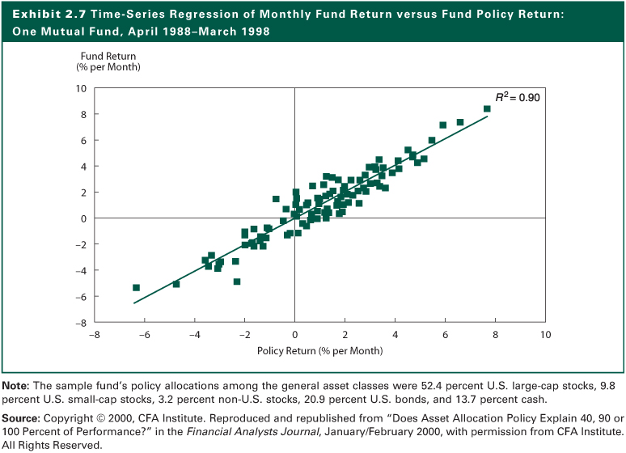
Exhibit 2.7

Slide 48
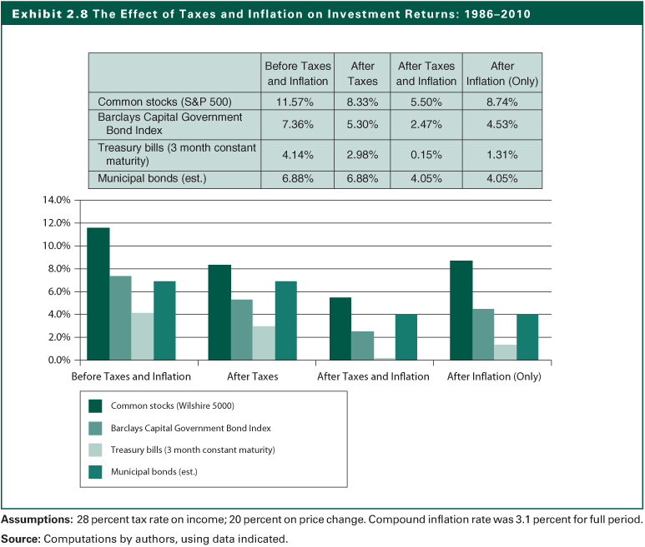
Exhibit 2.8

Slide 49
The Importance of Asset Allocation
Returns and Risks of Different Asset Classes
Historically, small company stocks have generated the highest returns, so have the volatility
Inflation and taxes have a major impact on returns
Returns on Treasury Bills have barely kept pace with inflation
Measuring risk by the probability of not meeting your investment return objective indicates risk of equities is small and that of T-bills is large because of their differences in expected returns
Focusing only on return variability as a measure of risk ignores reinvestment risk

Slide 50
Exhibit 2.9

Slide 51
Asset Allocation Summary
Policy statement determines types of assets to include in portfolio
Asset allocation determines portfolio return more than stock selection
Over long time periods, sizable allocation to equity will improve results
Risk of a strategy depends on the investor’s goals and time horizon

Slide 52
Asset Allocation Summary
Asset Allocation and Cultural Differences
Social, political, and tax environments influence the asset allocation decision
Equity allocations of U.S. pension funds average 58%
In the United Kingdom, equities make up 78% of assets
In Germany, equity allocation averages 8%
In Japan, equities are 37% of assets
See Exhibits 2.11 and 2.12
2-52

Slide 53
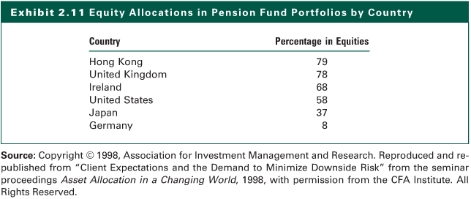
Exhibit 2.11

Slide 54
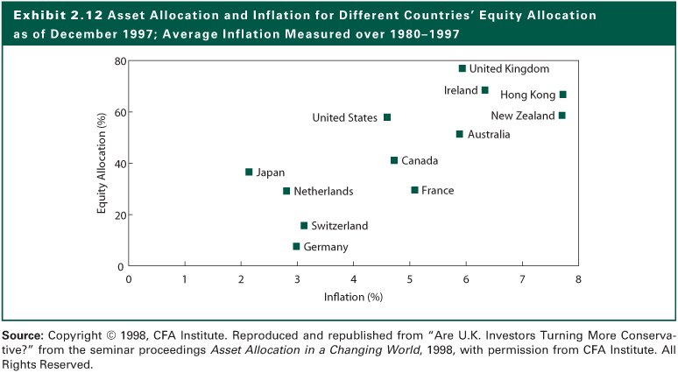
Exhibit 2.12

Slide 55
Appendix: Objectives and Constraints of Institutional Investors
Mutual Funds
Pool investors funds and invests them in financial assets as per its investment objective
Endowment Funds
They represent contributions made to charitable or educational institutions

Slide 56
Appendix: Objectives and Constraints of Institutional Investors
Pension Funds
Receive contributions from the firm, its employees, or both and invests those funds
Defined Benefit – promise to pay retirees a specific income stream after retirement
Defined Contribution – do not promise a set of benefits. Employees’ retirement income is not an obligation of the firm
Notes:
56

Slide 57
Appendix: Objectives and Constraints of Institutional Investors
Insurance Companies
Life Insurance Companies
earn rate in excess of actuarial rate
growing surplus if the spread is positive
fiduciary principles limit the risk tolerance
liquidity needs have increased
tax rule changes
Notes:
57

Slide 58
Appendix: Objectives and Constraints of Institutional Investors
Insurance Companies
Nonlife Insurance Companies
cash flows less predictable
fiduciary responsibility to claimants
Risk exposure low to moderate
liquidity concerns due to uncertain claim patterns
regulation more permissive
Notes:
58

Slide 59
Appendix: Objectives and Constraints of Institutional Investors
Banks
Must attract funds in a competitive interest rate environment
Try to maintain a positive difference between their cost of funds and their return on assets
Need substantial liquidity to meet withdrawals and loan demands
Face regulatory constraints
Notes:
59

