Slide 1
Marketing Communications MKT10723 Topic 4 Understanding customers
Topic 3 – Understanding customers

Slide 2
Lecture outline
Who are our target markets?
What influences consumers to make a decision?
How do consumers respond?
How does marketing communication affect decisions?

Slide 3
Consumer Behavior
Consumer behavior: How people think about, buy, and use products as a response to MC messages

Slide 4
Understanding marketing segmentation
Six steps in the segmentation process:
Step 1: select a market or product category for study
Step 2: choose a basis or bases for segmenting the market
Step 3: select segmentation descriptors and variables
Step 4: profile and analyse segments
This is where this unit starts:
Step 5: select target markets – Topic 4
Step 6: design, implement and maintain appropriate marketing communications – Topics 5 to 12

Slide 5
Potential vs. Current Customers
Potential customers: Those who have not bought the brand but who might be interested in it
Customers: Those who have purchased the brand at least once within a designated period.

Slide 6
Who to target
Individual consumers or business customers
Behaviourial:
Potential customers
Existing customers
Brand loyal customers or brand switchers
Psychographic
Attitudes, lifestyle
Demographic
Age, gender, lifestage and so on
Geographic
Metro, regional, country, region

Slide 7
Different types of customers: Individual consumer and business customers
Consumers (B2C)
Business (B2B)
Buy for their own personal or household use
Typically use more of an emotional approach
Trade or business as a customer
Typically consult others in the organization
Typically buy larger quantities
Often use a bidding process
Buy for their own personal or household use
Typically use more of an emotional approach

Slide 8
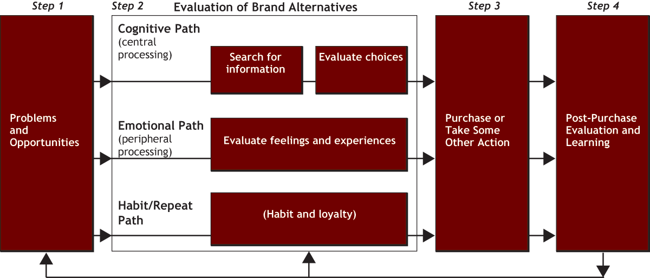
Decision making process for brands
Choose from a set of brands

Slide 9
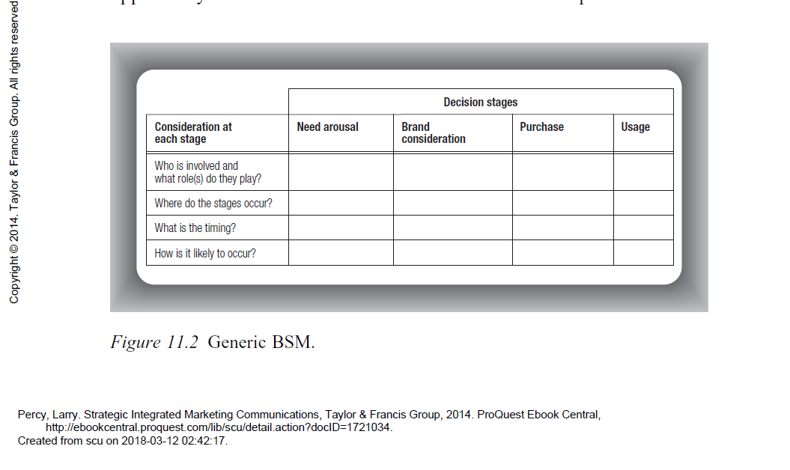

Slide 10
Marketing communications can influence consumer decisions
Influencing the way they think
Influencing the way they feel (beliefs and attitudes)
Influencing the way they behave

Slide 11
Decision making process for brands
Choose from a set of brands

Slide 12
Different paths to making a decision
Habit/ repeat path = Drives retention
(impulse, habitual)
Do/feel/think or Do/think/feel
Cognitive path = AIDA model
Think/ feel/ do
Emotional path
Feel/do/ think

Slide 13
Which path or sequence?
Level of involvement
Relatively cheap, relatively low risk = low involvement
Perceived differences, higher risk = high involvement
Two factors drive the degree of involvement:
Relevance is where is connects with the customer’s personal interest
Risk can be social, financial, psychological, performance, physical

Slide 14
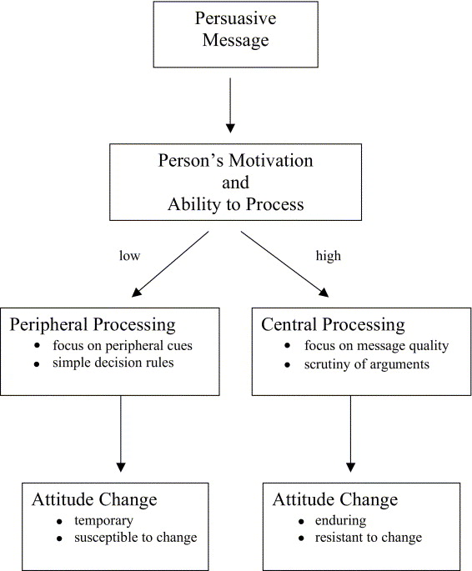
Elaboration Likelihood model (Simple version)

Slide 15
How marketing communications can influence the decision making process for brands
Choose from a set of brands

Slide 16
Final Note on ethics
Communication that aids customers and communicates with them in a personal way is much more persuasive than communication that tries to manipulate them

